Slide 1
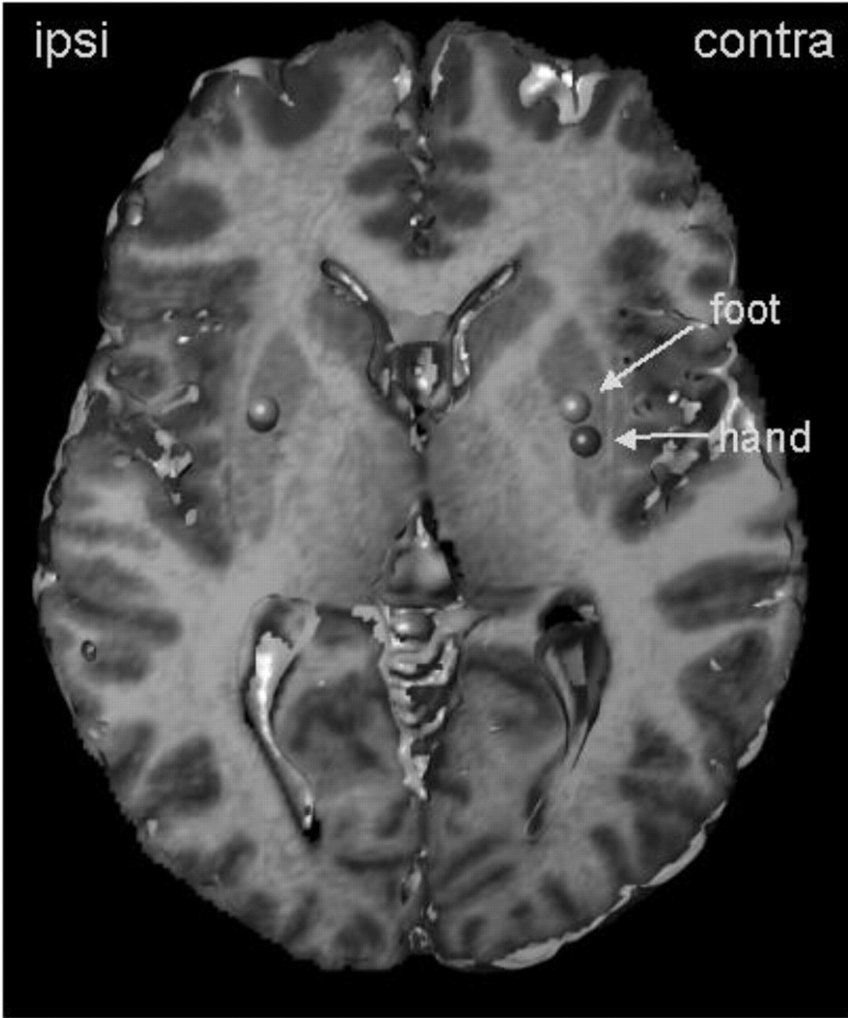
Figure 1. Differential representation sites of the hand- and foot-related laser-evoked pain in the ...
Notes:
Figure 1. Differential representation sites of the hand- and foot-related laser-evoked pain in the contralateral putamen. Hand and foot representation of laser-evoked fMRI responses in ipsilateral and contralateral putamen overlaid on a normalized T1-weighted image. Mean distributions of peak activation are illustrated by a sphere centred around the mean coordinate. Foot-related distribution is depicted in green, hand-related responses in red. Data from left- and right-sided stimulation were pooled for this illustration. To spatially overlay results for both sides of stimulus application, the results of the right-sided stimulation were mirrored along the z-plane (R–L flipped). Accordingly, responses contralateral to noxious stimulation (independent of the side of stimulation) are shown on the right, while responses in the putamen ipsilateral to nociceptive stimulation are shown on the left side. See online Supplementary Material for a colour version of this figure.
Unless provided in the caption above, the following copyright applies to the content of this slide:

Slide 2
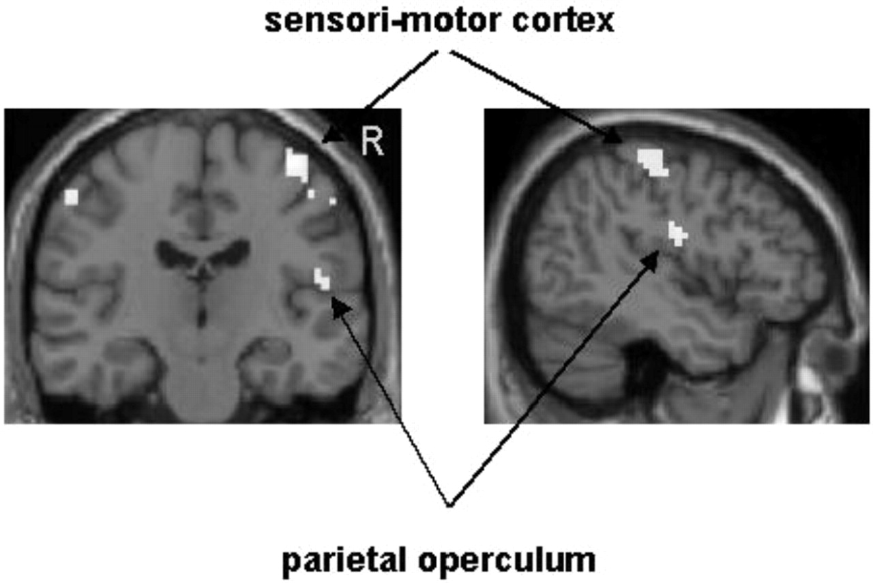
Figure 2. Areas showing a significant covariation with putamen activity during noxious stimulation of the ...
Notes:
Figure 2. Areas showing a significant covariation with putamen activity during noxious stimulation of the hand. The results from the psycho-physiological interaction analysis overlaid on a normalized T1-weighted image. Covariation of activity in the sensori-motor cortex and the parietal operculum with activity in the putamen are stronger during noxious stimulation of the hand. To spatially overlay results for both sides of stimulus application, the results of the right-sided stimulation were mirrored along the z-plane (R–L flipped). Accordingly, responses contralateral to noxious stimulation (independent of the side of stimulation) are shown on the right, while responses in the putamen ipsilateral to nociceptive stimulation are shown on the left side. See online Supplementary Material for a colour version of this figure.
Unless provided in the caption above, the following copyright applies to the content of this slide:

