Slide 1
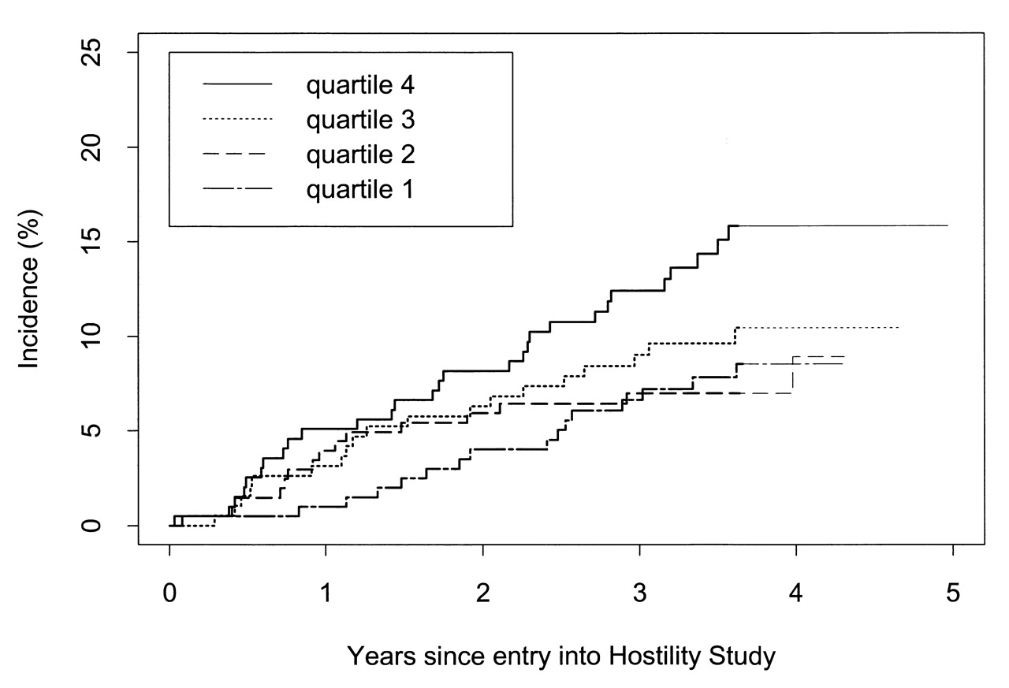
FIGURE 1. Kaplan-Meier estimates of the cumulative incidence of coronary heart disease events (nonfatal ...
Notes:
FIGURE 1. Kaplan-Meier estimates of the cumulative incidence of coronary heart disease events (nonfatal myocardial infarction and coronary heart disease death) by hostility score quartile, Hostility Ancillary Study, Heart and Estrogen/progestin Replacement Study, United States, 1993–1998.
Unless provided in the caption above, the following copyright applies to the content of this slide:

