Slide 1
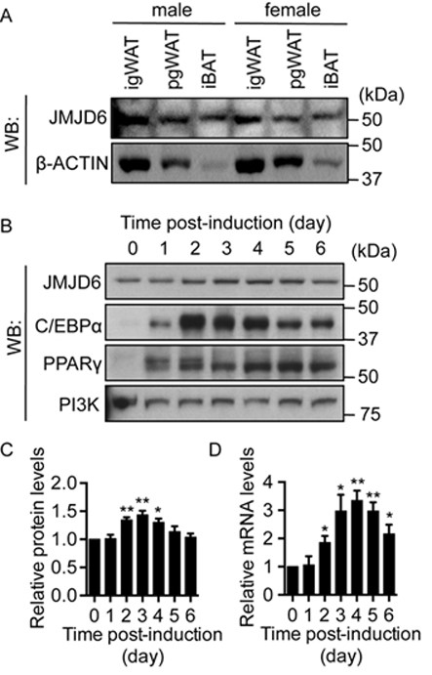
Figure 1. JMJD6 is expressed in adult adipose tissues and in differentiating C3H10T1/2 adipocytes. (A) Representative ...
Notes:
Figure 1. JMJD6 is expressed in adult adipose tissues and in differentiating C3H10T1/2 adipocytes. (A) Representative western blots for JMJD6 and β-ACTIN protein levels in adipose tissues from 6-week-old male and female C57BL/6 mice. igWAT: inguinal white adipose tissue; pgWAT: perigonadal white adipose tissue; iBAT: interscapular brown adipose tissue. (B) Representative western blots for JMJD6, C/EBPα and PPARγ protein levels in undifferentiated (day 0) and in differentiating (day 1 to 6) C3H10T1/2 cells. PI3K levels were probed as a loading control. (C) Quantification of JMJD6 protein levels from three independent western blots. The levels of JMJD6 were normalized to PI3K loading control and are presented as the relative expression levels to the day 0 sample (SEM, n = 3, *P < 0.05; **P < 0.01). (D)Jmjd6 mRNA levels in the differentiating C3H10T1/2 cells were determined by real-time qPCR. The mRNA levels were normalized to 5s rRNA levels and the sample at day 0 was set as 1 (SEM, n = 3, *P < 0.05; **P < 0.01).
Unless provided in the caption above, the following copyright applies to the content of this slide: © The Author(s) 2015. Published by Oxford University Press on behalf of Nucleic Acids Research.This is an Open Access article distributed under the terms of the Creative Commons Attribution License (http://creativecommons.org/licenses/by-nc/4.0/), which permits non-commercial re-use, distribution, and reproduction in any medium, provided the original work is properly cited. For commercial re-use, please contact journals.permissions@oup.com

Slide 2
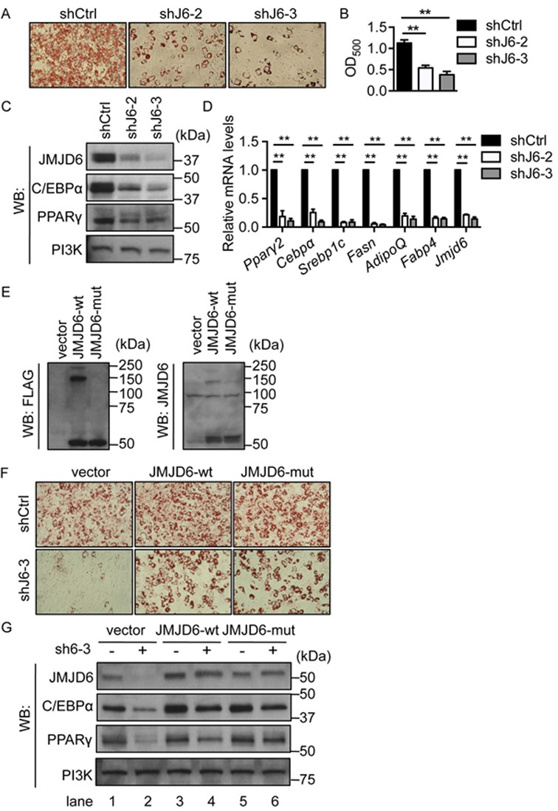
Figure 2. JMJD6 is required for the terminal differentiation of C3H10T1/2 cells independent of JmjC domain activity. ...
Notes:
Figure 2. JMJD6 is required for the terminal differentiation of C3H10T1/2 cells independent of JmjC domain activity. (A) Representative Oil-Red O staining images of day 6 post-induced C3H10T1/2 cells. Endogenous JMJD6 was knocked down by either of two shRNAs (shJ6–2 or shJ6–3). A scramble shRNA construct (shCtrl) was used a control. (B) Quantification of Oil Red O staining. The values are presented as the average of optical density at 500 nm (OD500) from three independent experiments (SEM, n = 3, **P < 0.01). (C) Representative western blots for JMJD6, C/EBPα and PPARγ protein levels in the day 6 post-induced cells as indicated. PI3K levels were probed as a loading control. (D) The mRNA levels of adipocyte-associated genes in the day 6 post-differentiated cells. The individual mRNA levels were normalized to 5s rRNA levels. The normalized expression levels of the control cells were set as 1 (SEM, n = 3, *P < 0.05; **P < 0.01). (E) Representative western blots of the ectopically expressed wild type JMJD6 (JMJD6-wt) and catalytic-inactive mutant JMJD6 (JMJD6-mut) in C3H10T1/2 cells prior to differentiation. The blots were probed with either anti-FLAG antiserum or a JMJD6-specific antibody. (F) Representative Oil Red O staining images of day 6 post-differentiated cells as indicated. The C3H10T1/2 cells expressing either wild type JMJD6 (JMJD6-wt) or catalytic-inactive mutant (JMJD6-mut) or empty vector were subsequently transduced with lentiviral constructs containing either a scramble shRNA control (shCtrl) or a shRNA targeting the 3′ UTR of Jmjd6 mRNA (shJ6–3). (G) Representative western blots for JMJD6, C/EBPα and PPARγ protein levels in day 6 post-induced cells as indicated.
Unless provided in the caption above, the following copyright applies to the content of this slide: © The Author(s) 2015. Published by Oxford University Press on behalf of Nucleic Acids Research.This is an Open Access article distributed under the terms of the Creative Commons Attribution License (http://creativecommons.org/licenses/by-nc/4.0/), which permits non-commercial re-use, distribution, and reproduction in any medium, provided the original work is properly cited. For commercial re-use, please contact journals.permissions@oup.com

Slide 3
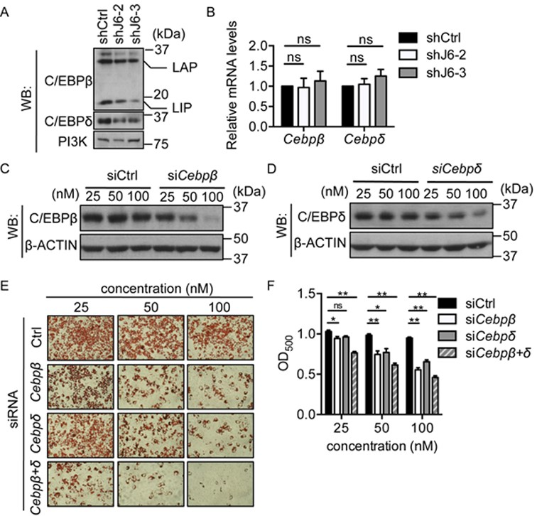
Figure 3. Down-regulation of C/EBPβ and C/EBPδ was associated with the differentiation deficiency in the JMJD6 ...
Notes:
Figure 3. Down-regulation of C/EBPβ and C/EBPδ was associated with the differentiation deficiency in the JMJD6 knockdown cells. (A) Representative western blots for C/EBPβ and C/EBPδ protein levels in the 3 h post-induced control cells (shCtrl) and the JMJD6 knockdown cells (shJ6–2 and shJ6–3). PI3K levels were probed as a loading control. LAP and LIP represent different isoforms of C/EBPβ (B)Cebpβ and Cebpδ mRNA levels in the 3 h post-induced cells. The normalized expression levels of the control cells were set as 1. The values are presented as the average of relative expression levels with standard error (SEM, n = 3, ns: not significant). (C, D) Representative western blots for C/EBPβ and C/EBPδ protein levels in 3 h post-induced cells that were pre-treated with the indicated siRNAs for 24 h prior to adipogenic induction. β-ACTIN levels were probed as a loading control. (E) Representative Oil Red O staining images of day 6 post-induced C3H10T1/2 cells with siRNA treatment as indicated. (F) Quantification of Oil Red O staining. The values are presented as the average of optical density at 500 nm (OD500) from three independent experiments (SEM, n = 3, *P < 0.05, **P < 0.01).
Unless provided in the caption above, the following copyright applies to the content of this slide: © The Author(s) 2015. Published by Oxford University Press on behalf of Nucleic Acids Research.This is an Open Access article distributed under the terms of the Creative Commons Attribution License (http://creativecommons.org/licenses/by-nc/4.0/), which permits non-commercial re-use, distribution, and reproduction in any medium, provided the original work is properly cited. For commercial re-use, please contact journals.permissions@oup.com

Slide 4
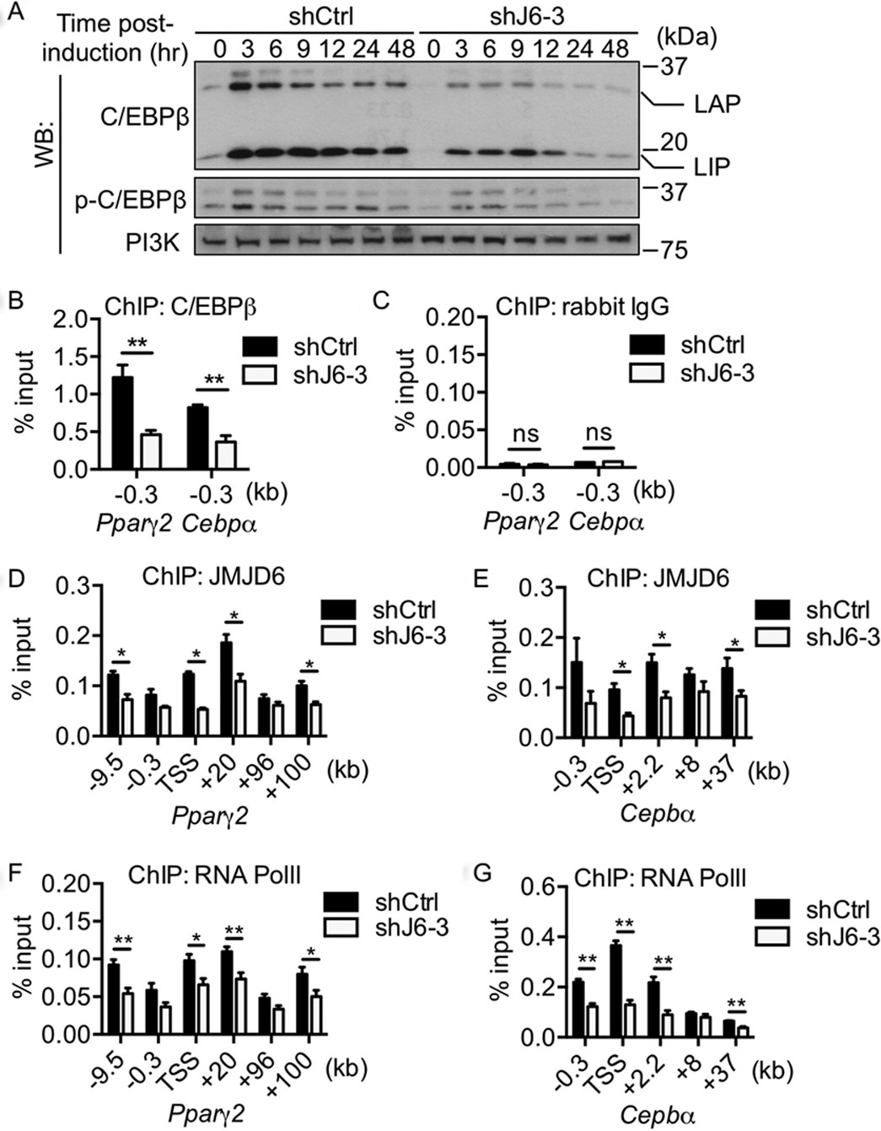
Figure 4. Reduced C/EBPβ protein levels correlated with the decrease in RNA polymerase II occupancy at the Pparγ2 and ...
Notes:
Figure 4. Reduced C/EBPβ protein levels correlated with the decrease in RNA polymerase II occupancy at the Pparγ2 and Cebpα loci and putative enhancers. (A) Representative western blots for the levels of C/EBPβ and phosphorylated C/EBPβ at threonine 188 in the control cells (shCtrl) and in the JMJD6 knockdown cells (shJ6–3) throughout the early phase of differentiation. PI3K levels were probed as a loading control. (B) ChIP of C/EBPβ at the Pparγ2 and Cebpα proximal promoters. (C) ChIP of rabbit IgG for negative control. (D, E) ChIP of JMJD6 and (F, G) ChIP of RNA polymerase II at the Pparγ2 and Cebpα loci and nearby putative enhancers. The values are presented as the average% input from at least three independent experiments (SEM, n≥3, *P < 0.05, **P < 0.01).
Unless provided in the caption above, the following copyright applies to the content of this slide: © The Author(s) 2015. Published by Oxford University Press on behalf of Nucleic Acids Research.This is an Open Access article distributed under the terms of the Creative Commons Attribution License (http://creativecommons.org/licenses/by-nc/4.0/), which permits non-commercial re-use, distribution, and reproduction in any medium, provided the original work is properly cited. For commercial re-use, please contact journals.permissions@oup.com

Slide 5
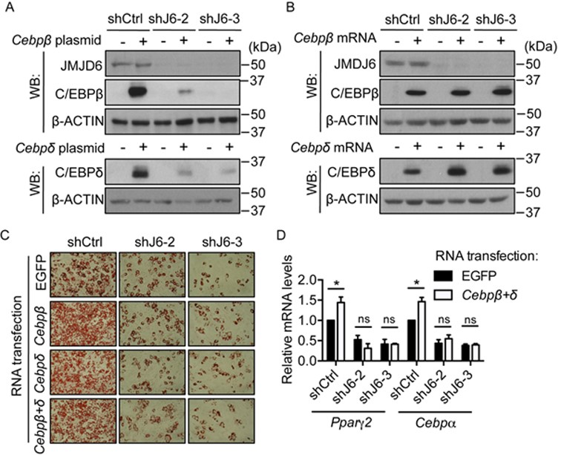
Figure 5. Ectopic expression of C/EBPβ and C/EBPδ was not sufficient to rescue the differentiation deficiency caused by ...
Notes:
Figure 5. Ectopic expression of C/EBPβ and C/EBPδ was not sufficient to rescue the differentiation deficiency caused by JMJD6 knockdown. (A) Representative western blots for the levels of C/EBPβ, C/EBPδ and JMJD6 protein expression in the control cells (shCtrl) and in the JMJD6 knockdown cells (shJ6–2 and shJ6–3) 24 h after transfection with the plasmids encoding C/EBPβ(LAP) and C/EBPδ protein. An empty vector was used as a transfection control. (B) C/EBPβ, C/EBPδ and JMJD6 protein expression in the cells 24 h after transfection with in vitro synthesized Cebpβ and Cebpδ mRNA. In vitro synthesized EGFP mRNA was used as a transfection control. (C) Representative Oil Red O staining images of the day 6 post-induced cells as indicated. (D)Pparγ2 and Cebpα mRNA levels in the day 6 post-induced cells that were transfected with EGFP mRNA or a combination of Cebpβ and Cebpδ mRNA (Cebpβ+δ) as indicated. The values are presented as the average of relative expression levels with standard error (SEM, n = 3, *P < 0.05; **P < 0.01, ns: not significant).
Unless provided in the caption above, the following copyright applies to the content of this slide: © The Author(s) 2015. Published by Oxford University Press on behalf of Nucleic Acids Research.This is an Open Access article distributed under the terms of the Creative Commons Attribution License (http://creativecommons.org/licenses/by-nc/4.0/), which permits non-commercial re-use, distribution, and reproduction in any medium, provided the original work is properly cited. For commercial re-use, please contact journals.permissions@oup.com

Slide 6
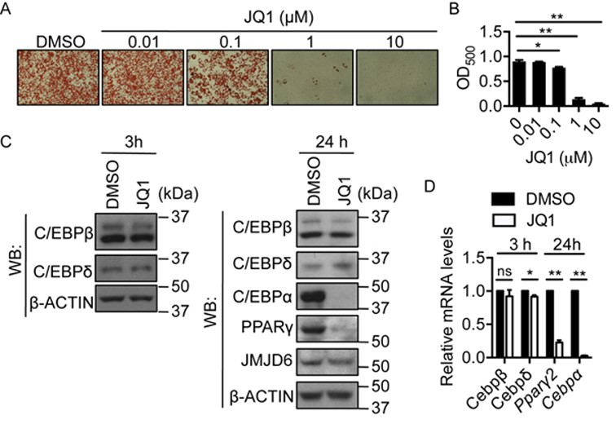
Figure 6. Targeting the chromatin reader for JMJD6 impaired adipogenic differentiation. (A) Representative Oil Red O ...
Notes:
Figure 6. Targeting the chromatin reader for JMJD6 impaired adipogenic differentiation. (A) Representative Oil Red O staining images of day 6 post-induced C3H10T1/2 cells treated with JQ1 or DMSO. The treatment was performed in the first 48 h during the adipogenic induction. (B) Quantification of Oil Red O staining. The values are presented as the average of optical density at 500 nm (OD500) from three independent experiments (SEM, n = 3, *P < 0.05, **P < 0.01). (C) Representative western blots for the indicated proteins in the 3 h and 24 h post-induced cells in the presence of 1 μM JQ1 or DMSO as a vehicle control. (D) The mRNA levels of the indicated genes in the 3 h and 24 h post-induced cells in the presence of 1 μM JQ1 or DMSO. The values are presented as the average of relative expression levels from three independent experiments with standard error (SEM, n = 3, *P < 0.05; **P < 0.01, ns: not significant).
Unless provided in the caption above, the following copyright applies to the content of this slide: © The Author(s) 2015. Published by Oxford University Press on behalf of Nucleic Acids Research.This is an Open Access article distributed under the terms of the Creative Commons Attribution License (http://creativecommons.org/licenses/by-nc/4.0/), which permits non-commercial re-use, distribution, and reproduction in any medium, provided the original work is properly cited. For commercial re-use, please contact journals.permissions@oup.com

Slide 7
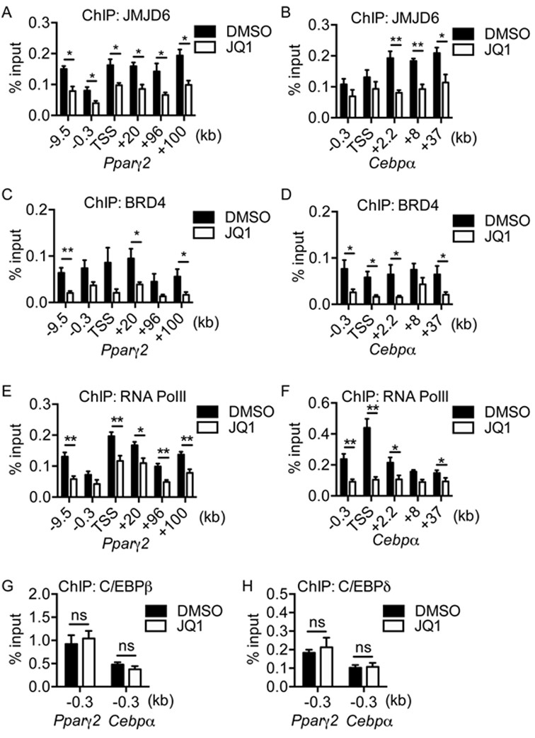
Figure 7. JQ1 treatment perturbed the binding of JMJD6 and RNA polymerase II at the Pparγ2 and Cebpα loci and putative ...
Notes:
Figure 7. JQ1 treatment perturbed the binding of JMJD6 and RNA polymerase II at the Pparγ2 and Cebpα loci and putative enhancers. (A, B) ChIP of JMJD6, (C, D) ChIP of BRD4, and (E, F) ChIP of RNA polymerase II at the Pparγ2 and Cebpα loci and nearby putative enhancers in 24 h post-induced C3H10T1/2 cells in the presence of 1μM JQ1 or DMSO. (G) ChIP of C/EBPβ and (H) ChIP of C/EBPδ at the Pparγ2 and Cebpα proximal promoters in 24 h post-induced C3H10T1/2 cells. The values are presented as the average% input from four independent experiments (SEM, n = 4, *P < 0.05, **P < 0.01, ns: not significant). For negative control, ChIP of rabbit IgG was performed under the same conditions. The average % input from rabbit IgG ChIPs was below 0.05% in all cases (data not shown).
Unless provided in the caption above, the following copyright applies to the content of this slide: © The Author(s) 2015. Published by Oxford University Press on behalf of Nucleic Acids Research.This is an Open Access article distributed under the terms of the Creative Commons Attribution License (http://creativecommons.org/licenses/by-nc/4.0/), which permits non-commercial re-use, distribution, and reproduction in any medium, provided the original work is properly cited. For commercial re-use, please contact journals.permissions@oup.com

Slide 8
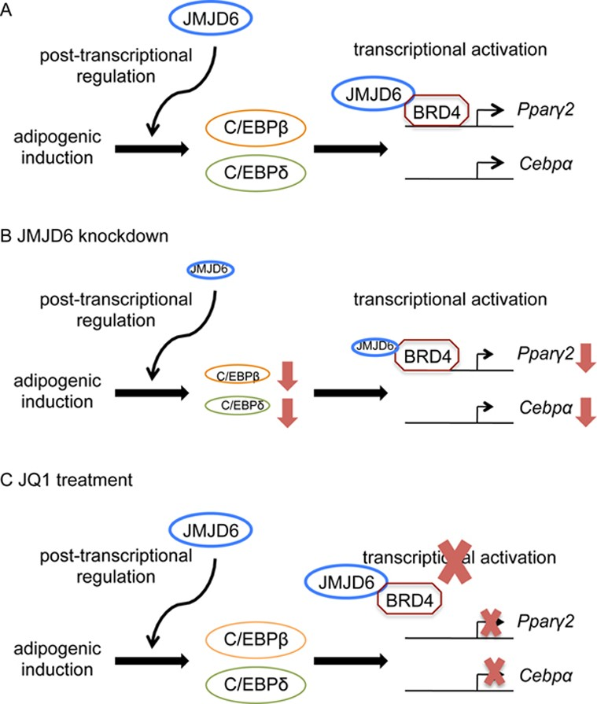
Figure 8. Schematic diagram of the dual functions of JMJD6 in the control of adipogenic regulator expression. (A) JMJD6 ...
Notes:
Figure 8. Schematic diagram of the dual functions of JMJD6 in the control of adipogenic regulator expression. (A) JMJD6 participates in the post-transcriptional regulation of C/EBPβ and C/EBPδ and transcriptional activation of Ppaγ2 and Cebpα genes. (B) Upon JMJD6 knockdown, dual functions of JMJD6 are compromised, and that results in a reduction of C/EBPβ and C/EBPδ protein levels and the mRNA levels from the Ppaγ2 and Cebpα genes. (C) Treatment of JQ1 blocks the transcriptional activation function of JMJD6 without an effect on C/EBPβ and C/EBPδ protein levels.
Unless provided in the caption above, the following copyright applies to the content of this slide: © The Author(s) 2015. Published by Oxford University Press on behalf of Nucleic Acids Research.This is an Open Access article distributed under the terms of the Creative Commons Attribution License (http://creativecommons.org/licenses/by-nc/4.0/), which permits non-commercial re-use, distribution, and reproduction in any medium, provided the original work is properly cited. For commercial re-use, please contact journals.permissions@oup.com

