Slide 1
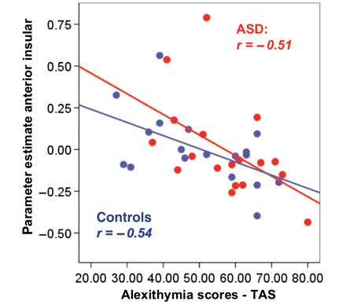
Figure 1 Mean activation levels (parameter estimates) of the voxels lying in the left anterior insula [–36 33 3] ...
Notes:
Figure 1 Mean activation levels (parameter estimates) of the voxels lying in the left anterior insula [–36 33 3] defined by the independent mask (see ‘Materials and methods’ section for details about ROI analyses) during empathy-related conditions (Pain–No pain in other) are significantly correlated with individual differences in alexithymia as measured by the TAS in both autism spectrum condition (ASD) (red dots) and control (blue dots) participants. The line represents the linear best fit. All correlations are significant at the P < 0.05 level.
Unless provided in the caption above, the following copyright applies to the content of this slide: © The Author(s) 2010. Published by Oxford University Press on behalf of Brain.This is an Open Access article distributed under the terms of the Creative Commons Attribution Non-Commercial License (http://creativecommons.org/licenses/by-nc/2.5), which permits unrestricted non-commercial use, distribution, and reproduction in any medium, provided the original work is properly cited.

