Slide 1
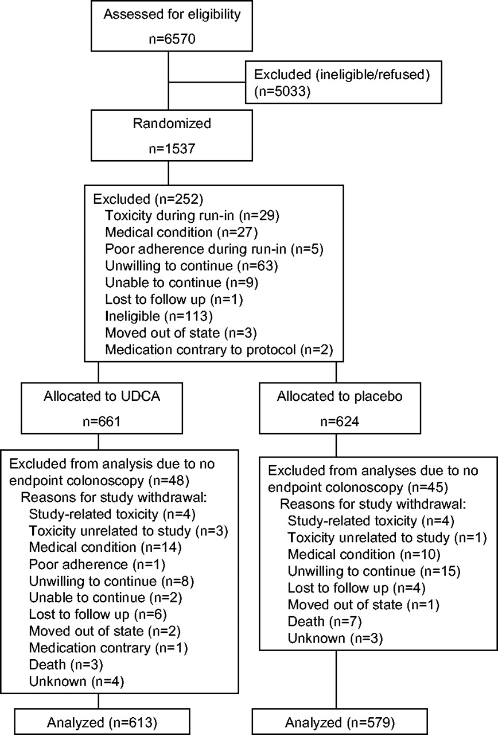
Fig. 1. CONSORT trial flow diagram.
Notes:
Fig. 1. CONSORT trial flow diagram.
Unless provided in the caption above, the following copyright applies to the content of this slide: Journal of the National Cancer Institute, Vol. 97, No. 11, © Oxford University Press 2005, all rights reserved.

