Slide 1
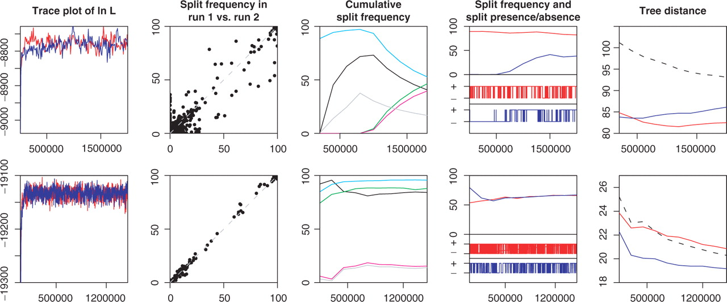
Fig. 1. Examples of output from AWTY. The figure shows the graphical exploration of the output from two different DNA ...
Notes:
Fig. 1. Examples of output from AWTY. The figure shows the graphical exploration of the output from two different DNA data sets (upper row: 86 sequences, lower row: 62 sequences) analyzed in MrBayes v.3.1.2 (Ronquist and Huelsenbeck, 2002). Two separate simulations (indicated by red and blue colors) were run for each data set using the GTR+I+Γ model. The first graph shows the trace plot of the log likelihood and the sampled values reach apparent stationarity for both simulations in both data sets. The second graph is a bivariate plot of the split frequencies for the first and second run of the simulations. A low correlation (upper row) diagnoses lack of convergence. The third graph shows the cumulative split frequency for a number of selected splits for one of the individual simulations. A trend in frequencies (upper row) diagnoses lack of convergence. The fourth graph shows the cumulative split frequency (upper part) and the corresponding presence (+) and absence (−) for a single split (lower part) over the two simulations. A slow mixing—where the chain moves slowly in parameter space—resulting in a trend in the cumulative split frequency is apparent in the upper row. The last graph compares the symmetric tree-difference score (Penny and Hendy, 1985) within and between (dashed line) simulations. A between-run distance well separated from the within-run distance (upper row) diagnoses lack of convergence.
Unless provided in the caption above, the following copyright applies to the content of this slide: © 2007 The Author(s)This is an Open Access article distributed under the terms of the Creative Commons Attribution Non-Commercial License (http://creativecommons.org/licenses/by-nc/2.0/uk/) which permits unrestricted non-commercial use, distribution, and reproduction in any medium, provided the original work is properly cited.

