Slide 1
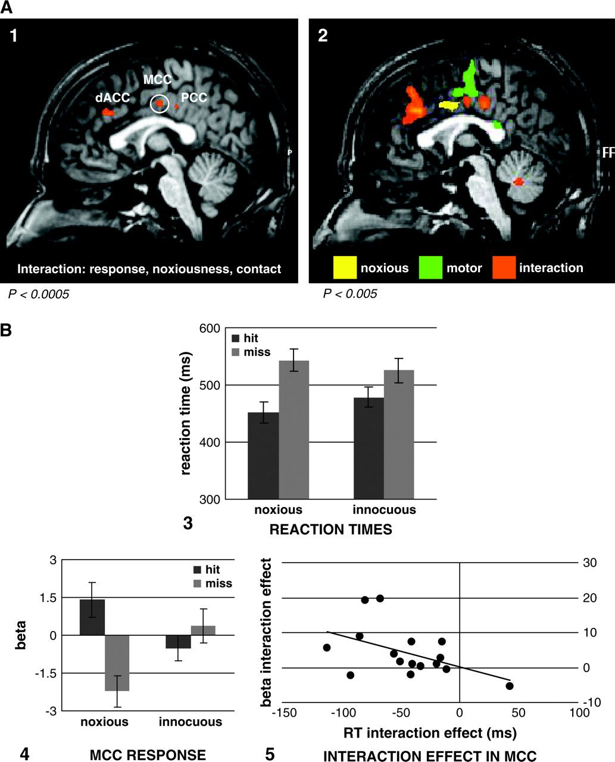
Figure 2. Panel (A1) cingulate ROIs activated by the 3-way interaction contrast between response (button ...
Notes:
Figure 2. Panel (A1) cingulate ROIs activated by the 3-way interaction contrast between response (button press/non–button press), noxiousness (noxious/innocuous), and contact (hit/miss), at P < 0.0005 uncorrected; slice shown x = 3. (2) shows the location of activations (at P < 0.005 uncorrected; slice shown x = 0) for the main effect of noxiousness (yellow), the main effect of motor response (green), and the interaction between response, noxiousness, and contact (orange). Panel (B3) shows the reaction time interaction between noxiousness and contact, F1,15 = 22.09, P = 0.0002. (4) shows the BOLD responses mirroring the behavioral interaction pattern in button-press trials, in the MCC activation (x, y, z = 3, −12, 38; white circle in (A1). (5) shows the relation in the MCC ROI between the 2-way interaction effects (noxiousness × contact) of beta values and reaction times across subjects. The interaction effect values were based on the behavioral interaction pattern and thus included only the button-press trials. These were calculated as (noxious − innocuous hits) − (noxious − innocuous misses) for both reaction times and beta values. Subjects with more negative RT interaction effects tended to have a more positive beta interaction effect (r = −0.48).
Unless provided in the caption above, the following copyright applies to the content of this slide: © The Author 2006. Published by Oxford University Press. All rights reserved. For permissions, please e-mail: journals.permissions@oxfordjournals.org

Slide 2
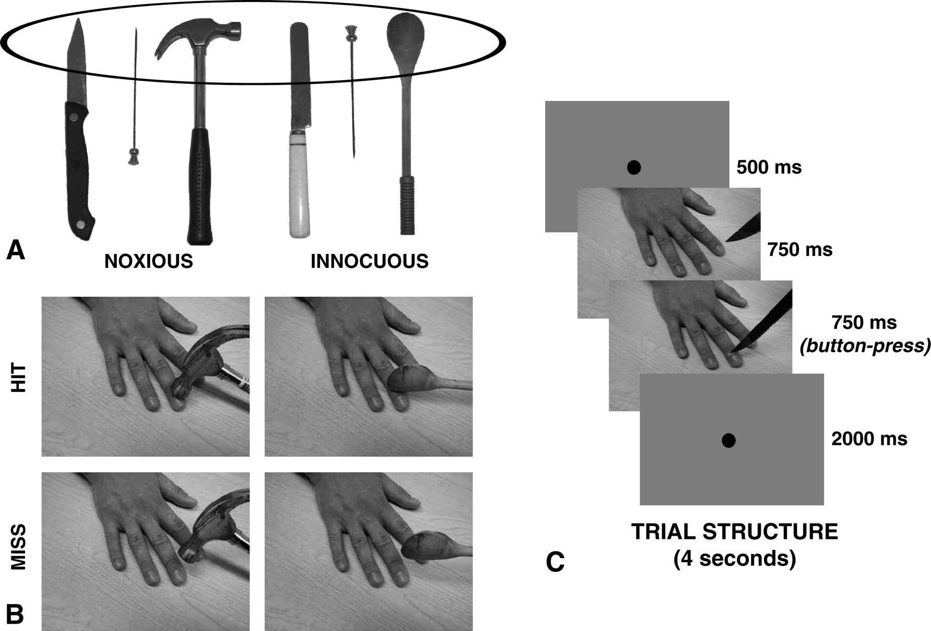
Figure 1. Stimuli and trial structure. (A) depicts the noxious and innocuous sharp knife/butter knife, hatpin ...
Notes:
Figure 1. Stimuli and trial structure. (A) depicts the noxious and innocuous sharp knife/butter knife, hatpin point/hatpin head, and hammer/spoon stimuli; oval encircles the part of the implement shown contacting the hand. (B) shows the photographs used in the second frame in the 2 × 2 design between the factors noxiousness (noxious/innocuous) and contact (hit/miss). (C) shows the sequence of events in a 4-s trial: 500-ms fixation, followed by the 1500-ms 2-frame sequence (button presses occurred at the onset of the second frame) and a further 2000-ms fixation.
Unless provided in the caption above, the following copyright applies to the content of this slide: © The Author 2006. Published by Oxford University Press. All rights reserved. For permissions, please e-mail: journals.permissions@oxfordjournals.org

Slide 3
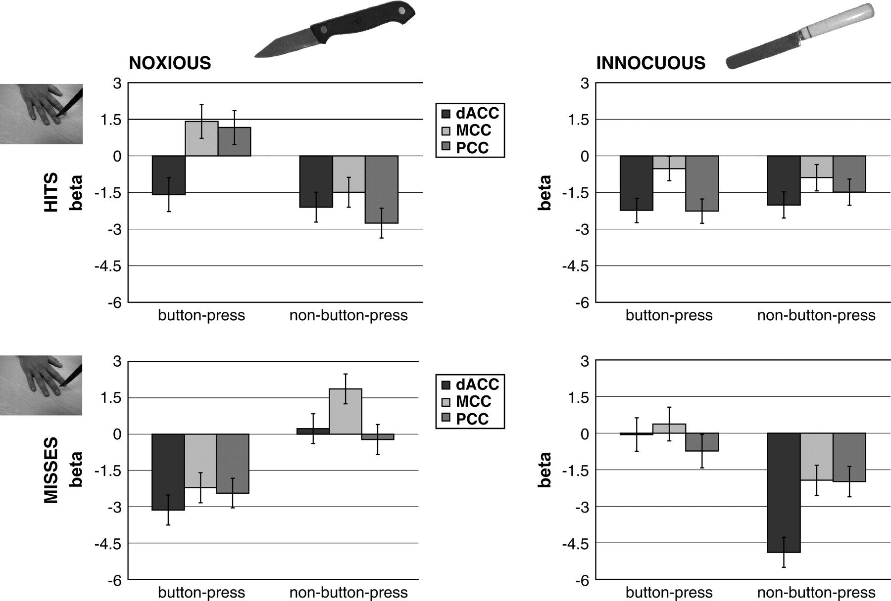
Figure 3. Hemodynamic responses to all conditions for the 3 cingulate ROIs. The upper 2 graphs show parameter estimates ...
Notes:
Figure 3. Hemodynamic responses to all conditions for the 3 cingulate ROIs. The upper 2 graphs show parameter estimates (beta values) for trials in which the implement hit the hand and the lower 2 for when it missed; the left 2 graphs are for conditions in which the implement was noxious and the right 2 for when it was innocuous. In each graph, the left bar cluster shows BOLD responses for those trials in which the participants pressed the button and the right bar cluster for those in which no button press was required. The fixation baseline is plotted as zero in these graphs.
Unless provided in the caption above, the following copyright applies to the content of this slide: © The Author 2006. Published by Oxford University Press. All rights reserved. For permissions, please e-mail: journals.permissions@oxfordjournals.org

