Slide 1
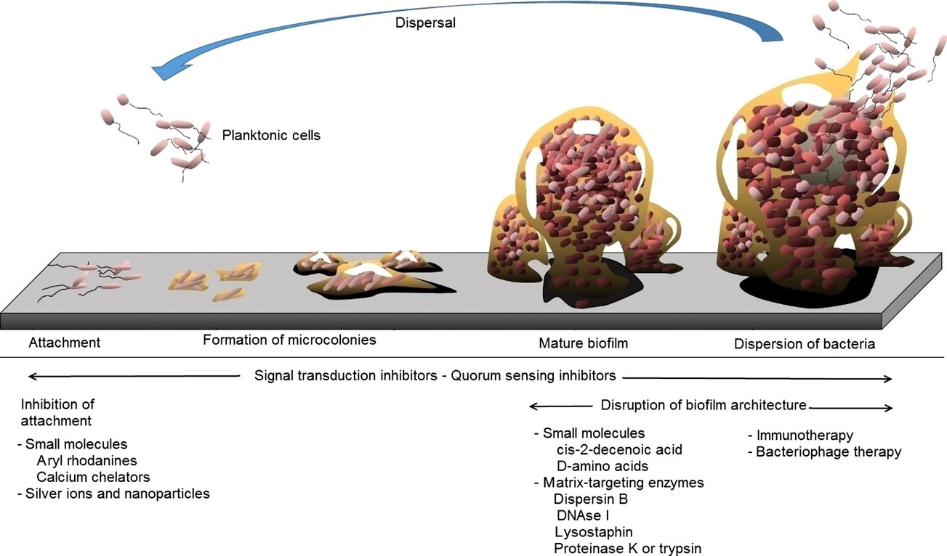
New approaches that target each important phases of biofilm formation in Staphylococcus aureus have been ...
Notes:
New approaches that target each important phases of biofilm formation in Staphylococcus aureus have been developed, and with clinical validation, these approaches will eventually lead to anti-biofilm therapies that could replace and complement current antibiotic treatment.
Unless provided in the caption above, the following copyright applies to the content of this slide: © 2014 Federation of European Microbiological Societies. Published by John Wiley & Sons Ltd. All rights reserved

Slide 2
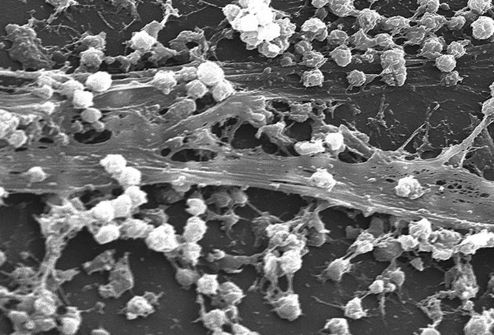
Fig. 1 Biofilm formed by Staphylococcus aureus on the surface of a catheter [CDC/Rodney M. Donlan, PhD: Janice Carr ...
Notes:
Fig. 1 Biofilm formed by Staphylococcus aureus on the surface of a catheter [CDC/Rodney M. Donlan, PhD: Janice Carr (PHIL #7488, 2005)].
Unless provided in the caption above, the following copyright applies to the content of this slide: © 2014 Federation of European Microbiological Societies. Published by John Wiley & Sons Ltd. All rights reserved

Slide 3
Fig. 2 Strategies in the management of biofilms (adapted from wikipedia.org/wiki/File:Biofilm.jpg).
Notes:
Fig. 2 Strategies in the management of biofilms (adapted from wikipedia.org/wiki/File:Biofilm.jpg).
Unless provided in the caption above, the following copyright applies to the content of this slide: © 2014 Federation of European Microbiological Societies. Published by John Wiley & Sons Ltd. All rights reserved

Slide 4
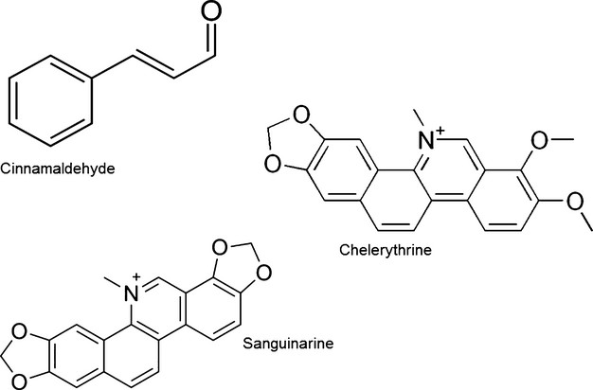
Fig. 3 Plant-derived natural compounds against biofilm formation in Staphylococcus aureus.
Notes:
Fig. 3 Plant-derived natural compounds against biofilm formation in Staphylococcus aureus.
Unless provided in the caption above, the following copyright applies to the content of this slide: © 2014 Federation of European Microbiological Societies. Published by John Wiley & Sons Ltd. All rights reserved

