Slide 1
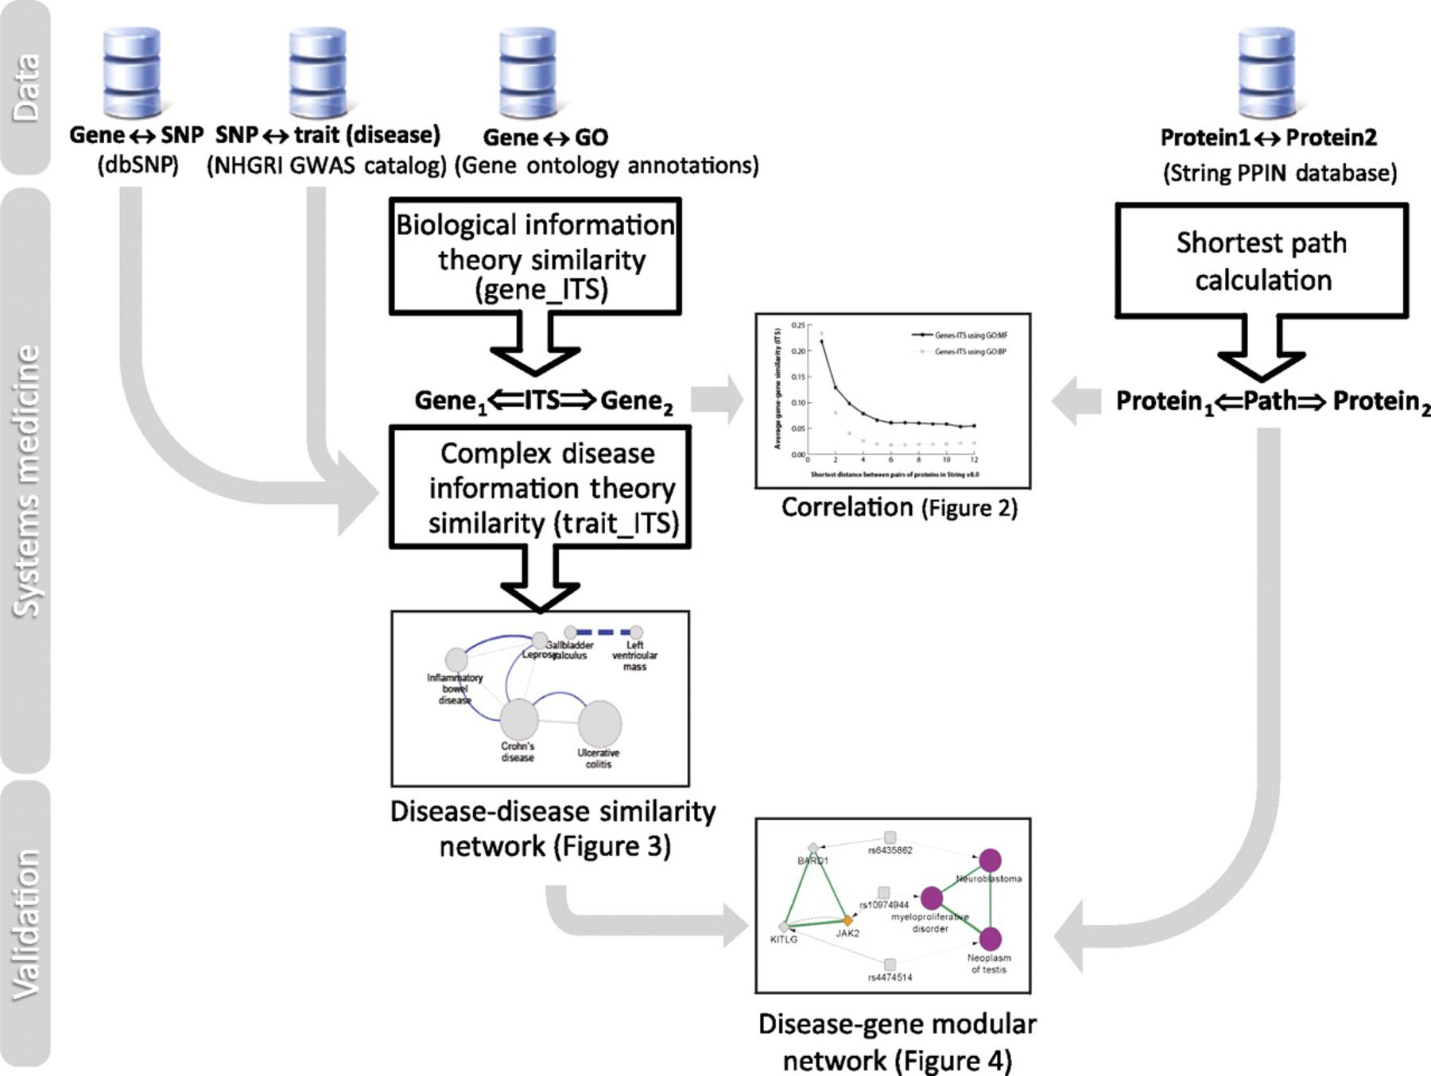
Figure 1 Workflow of our methodology. This study demonstrates the non-trivial modularity of biological mechanisms ...
Notes:
Figure 1 Workflow of our methodology. This study demonstrates the non-trivial modularity of biological mechanisms shared by some complex diseases. Specifically, complex diseases are connected using biological similarity computations between single-nucleotide polymorphisms (SNPs) associated by genome-wide association studies (GWAS) with complex traits. First, gene–gene similarity in Gene Ontology (GO) was calculated at a genome scale using an information theory similarity (ITS) measure validated previously. For a pair of genes in the STRING database, the shortest protein interaction distance is shown correlated with their biological similarity obtained by Gene_ITS using GO annotations (figure 2). Second, host genes were mapped to complex traits using the NHGRI GWAS Catalog and dbSNP database, and the trait–trait ITS of their associated traits was derived from results calculated in step 1. A disease similarity network was constructed by choosing the significant trait–trait similarity (figure 3). Metatrait modules were extended by their shortest paths between host genes with significant information similarities, due to the validated reverse correlation between them (figure 4).
Unless provided in the caption above, the following copyright applies to the content of this slide: © 2012, Published by the BMJ Publishing Group Limited. For permission to use (where not already granted under a licence) please go to http://group.bmj.com/group/rights-licensing/permissions.This is an Open Access article distributed under the terms of the Creative Commons Attribution-NonCommercial-NoDerivs licence (http://creativecommons.org/licenses/by-nc-nd/3.0/) which permits non-commercial reproduction and distribution of the work, in any medium, provided the original work is not altered or transformed in any way, and that the work is properly cited. For commercial re-use, please contact journals.permissions@oup.com.

Slide 2
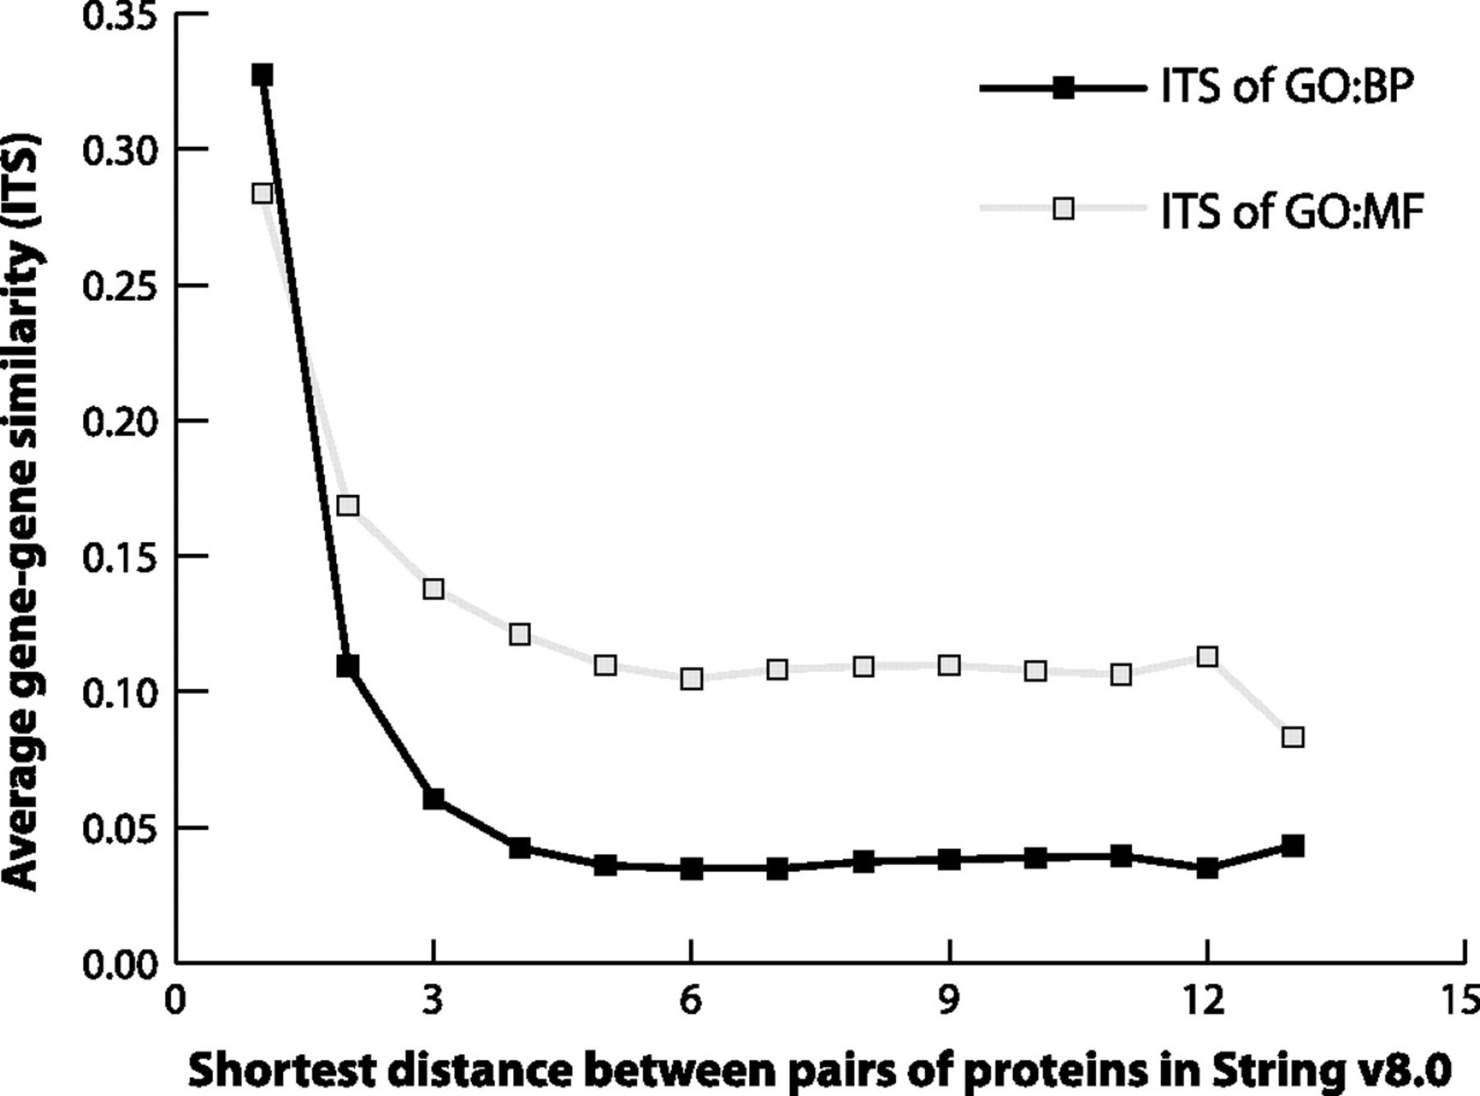
Figure 2 Higher Gene Ontology (GO) similarity between proteins is associated with smaller shortest distance in protein ...
Notes:
Figure 2 Higher Gene Ontology (GO) similarity between proteins is associated with smaller shortest distance in protein interaction networks. Relationships are seen between average Gene_ITS values and the shortest distance between pairs of proteins in the protein–protein interaction network. An average information theory similarity value was calculated for groups of protein–protein pairs in STRING v8.0 with the same shortest distances (length value of shortest paths). As hypothesized, higher biological similarity in GO was associated with shorter distances in the protein interaction network (p<10−16, Spearman correlation, using the entire set of protein combinations with GO annotations and protein interactions, which were 5753 and 5955 for GO biological processes (GO:BP) and GO molecular functions (GO:MF), respectively). These results are reproducible in the subset of genes hosting the single-nucleotide polymorphisms associated with disease traits in the National Human Genome Research Institute Catalog of Published Genome-Wide Association Studies (data not shown).
Unless provided in the caption above, the following copyright applies to the content of this slide: © 2012, Published by the BMJ Publishing Group Limited. For permission to use (where not already granted under a licence) please go to http://group.bmj.com/group/rights-licensing/permissions.This is an Open Access article distributed under the terms of the Creative Commons Attribution-NonCommercial-NoDerivs licence (http://creativecommons.org/licenses/by-nc-nd/3.0/) which permits non-commercial reproduction and distribution of the work, in any medium, provided the original work is not altered or transformed in any way, and that the work is properly cited. For commercial re-use, please contact journals.permissions@oup.com.

Slide 3
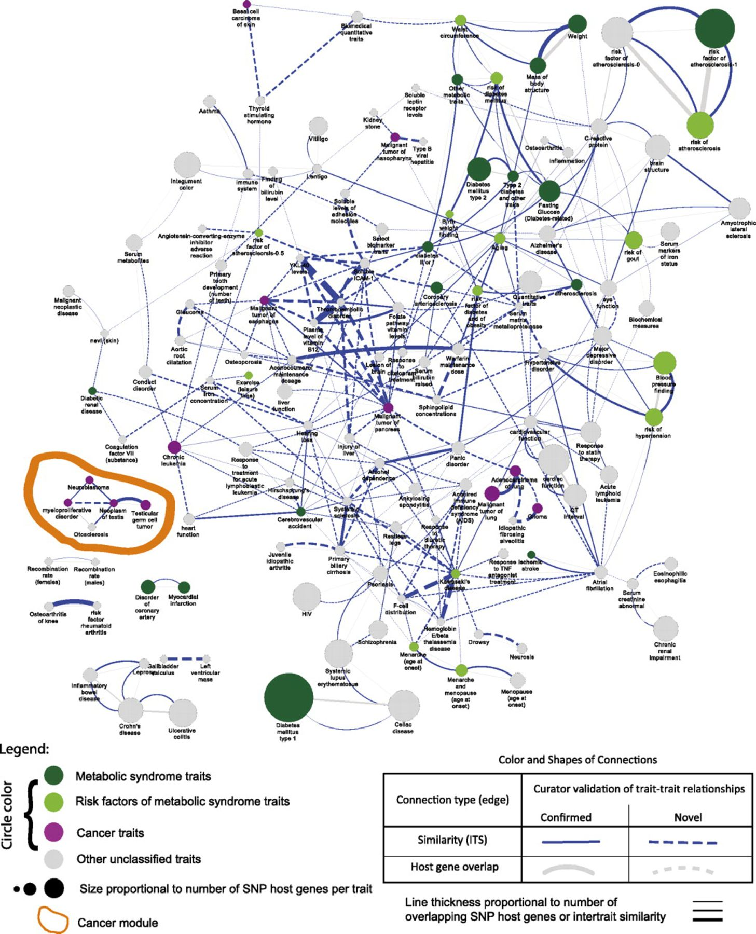
Figure 3 Network of biological similarity between complex-disease traits calculated from genome-wide association study ...
Notes:
Figure 3 Network of biological similarity between complex-disease traits calculated from genome-wide association study single-nucleotide polymorphisms (SNPs). The disease similarity network was calculated using Genome Ontology biological process similarity of the host genes of trait-associated intragenic SNPs with similarities ≥0.2 and an empirical p value <0.05. As shown, among 280 intertrait similarity connections (blue lines), 186 (66.4%) cannot be explained simply by shared host genes between the traits (gray lines) and are reported here for the first time. Therefore, this figure illustrates that our information theoretic similarity (ITS) method has found non-trivial relationships that would not have been found by conventional methods. As hypothesized, metabolic syndrome traits (green) and cancer traits (purple) are significantly enriched in connections with other traits in the same metatrait (p=3.5×10−7 and 0.001 respectively, Fisher's exact test). A significant module of cancer traits (circled in orange) is shown in greater detail in figure 4. Circles represent diseases or traits whose sizes are proportional to their number of associated intragenic SNP host genes. Green circles represent metabolic syndrome-related traits curated a priori (dark green for metabolic syndrome traits and light green for their risk factors), purple circles represent cancer traits, and gray circles represent other traits. Blue lines represent biological process similarities that are ≥0.2 and have a p value <0.05. Gray lines represent shared SNP host genes between diseases if their Trait_ITS is ≥0.2 (in other words overlapping connections between our information theoretic method and conventional gene overlapping method). Line thicknesses are proportional to Trait_ITS similarity values or number of shared genes. Solid lines have been validated as clinically meaningful by clinicians, while dotted lines have not.
Unless provided in the caption above, the following copyright applies to the content of this slide: © 2012, Published by the BMJ Publishing Group Limited. For permission to use (where not already granted under a licence) please go to http://group.bmj.com/group/rights-licensing/permissions.This is an Open Access article distributed under the terms of the Creative Commons Attribution-NonCommercial-NoDerivs licence (http://creativecommons.org/licenses/by-nc-nd/3.0/) which permits non-commercial reproduction and distribution of the work, in any medium, provided the original work is not altered or transformed in any way, and that the work is properly cited. For commercial re-use, please contact journals.permissions@oup.com.

Slide 4
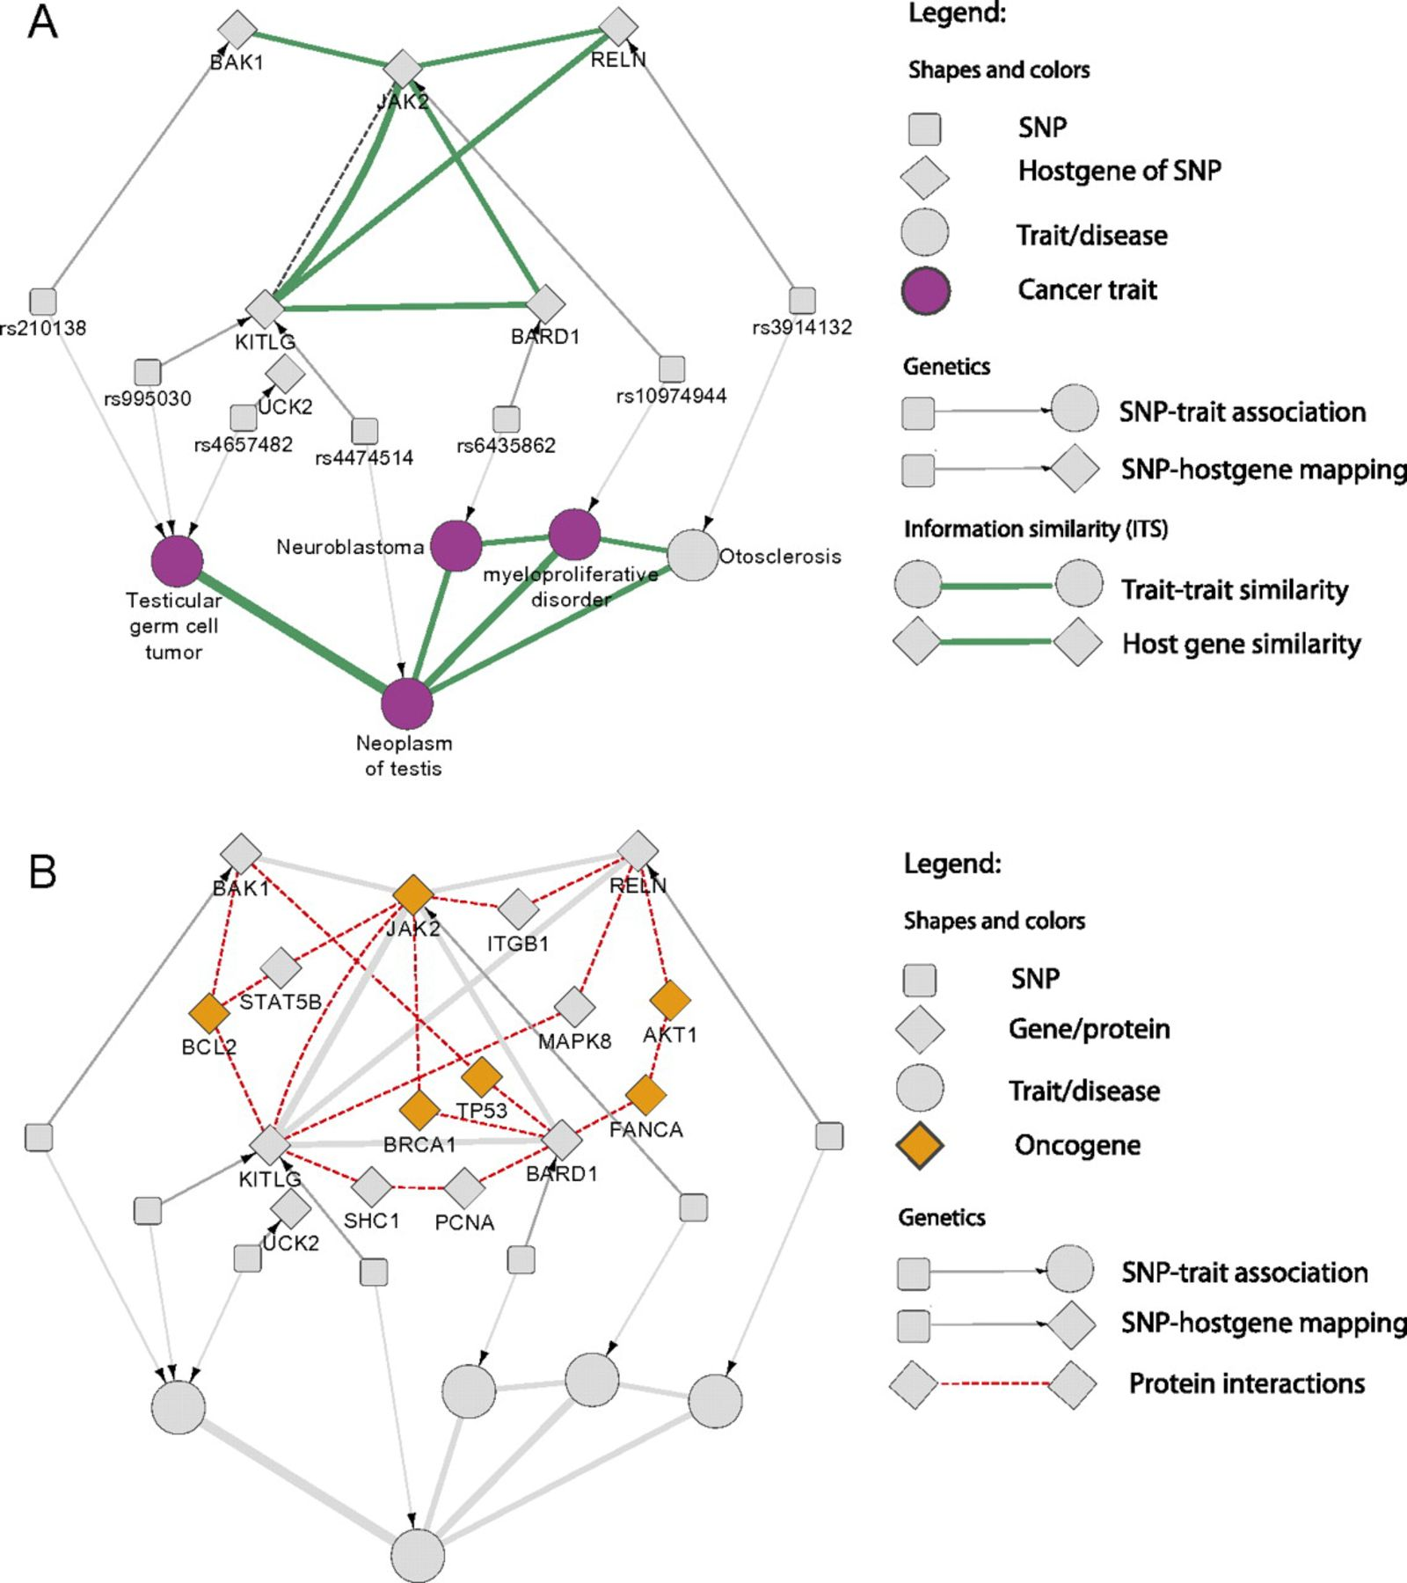
Figure 4 Biological similarity between cancer traits annotated by shortest protein interaction path between host genes ...
Notes:
Figure 4 Biological similarity between cancer traits annotated by shortest protein interaction path between host genes is enriched in oncogenes. The subset of figure 3 circled in orange corresponds to a biomodule of cancer traits. (A) provides the detailed view of their genome-wide association study-associated single-nucleotide polymorphisms (SNPs), their corresponding host genes, and their dense biological similarities (Gene_ITS ≥0.2; Trait_ITS ≥0.2; green lines; based on Gene Ontology biological processes). (B) provides an additional annotation of shortest protein interaction paths (red dotted lines) between host genes. Oncogenes (gold color) are statistically enriched in the shortest protein-interaction paths among pairs of SNP host genes associated with distinct traits that were paired by similarity measures (p=0.0001, Fisher's exact test). In addition, five out of six host genes associated with these cancer traits are either oncogenes or directly interact with oncogenes in the cancer-related modules in the disease network. Taken together, our metric produces multi-scale connections, as it contains protein interactions as well as biological similarities that both underlie the disease network connections and utilize different knowledge bases, thus validating one another.
Unless provided in the caption above, the following copyright applies to the content of this slide: © 2012, Published by the BMJ Publishing Group Limited. For permission to use (where not already granted under a licence) please go to http://group.bmj.com/group/rights-licensing/permissions.This is an Open Access article distributed under the terms of the Creative Commons Attribution-NonCommercial-NoDerivs licence (http://creativecommons.org/licenses/by-nc-nd/3.0/) which permits non-commercial reproduction and distribution of the work, in any medium, provided the original work is not altered or transformed in any way, and that the work is properly cited. For commercial re-use, please contact journals.permissions@oup.com.

