Slide 1
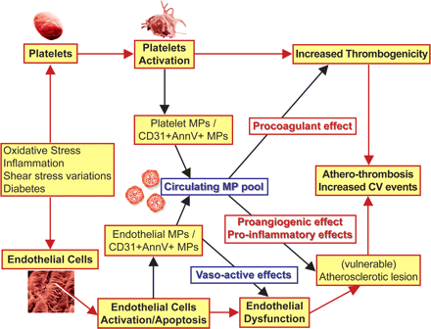
Figure 1 Release of microparticles (MPs) into the blood stream following cell activation or apoptosis. MPs released ...
Notes:
Figure 1 Release of microparticles (MPs) into the blood stream following cell activation or apoptosis. MPs released from endothelial cells and/or platelets, characterized by phosphatidylserine exposure and presence of CD31 (CD31+ AnnV+ MPs) may serve as a pronostic marker for major adverse cardiovascular events. In addition, circulating MPs may contribute to the development of athero-thrombosis by promoting endothelial dysfunction, favouring intraplaque angiogenesis and thrombus formation.
Unless provided in the caption above, the following copyright applies to the content of this slide: Published on behalf of the European Society of Cardiology. All rights reserved. © The Author 2011. For permissions please email: journals.permissions@oup.com

