Slide 1
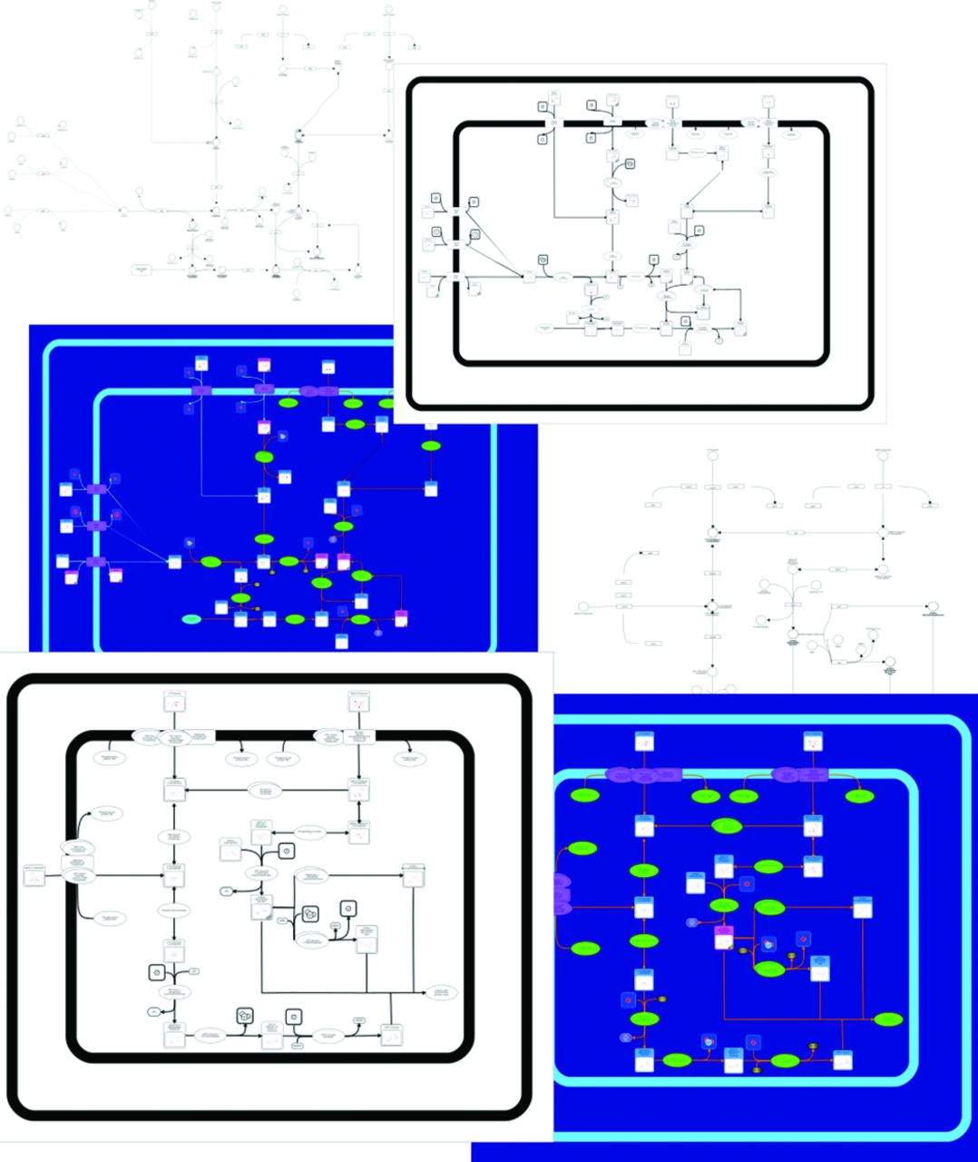
Figure 1. A screenshot montage of the Escherichia coli Metabolome Database (ECMDB) showing several of its pathways. The ...
Notes:
Figure 1. A screenshot montage of the Escherichia coli Metabolome Database (ECMDB) showing several of its pathways. The top three pathways correspond to Colanic Acid Biosynthesis pathway and the bottom three pathways refer to Galactose Metabolism pathway.
Unless provided in the caption above, the following copyright applies to the content of this slide: © The Author(s) 2015. Published by Oxford University Press on behalf of Nucleic Acids Research.This is an Open Access article distributed under the terms of the Creative Commons Attribution License (http://creativecommons.org/licenses/by/4.0/), which permits unrestricted reuse, distribution, and reproduction in any medium, provided the original work is properly cited.

