Slide 1
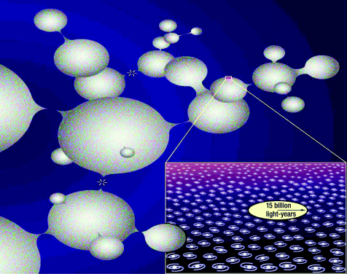
1: In inflation our universe may be a minuscule part of one of many bubbles. (E Mallove)
Notes:
1: In inflation our universe may be a minuscule part of one of many bubbles. (E Mallove)
Unless provided in the caption above, the following copyright applies to the content of this slide:

Slide 2
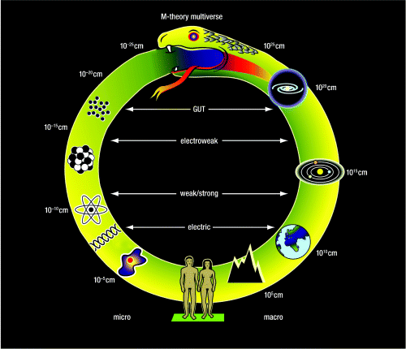
2: The Cosmic Uroborus, a summary of the different types of structure in the universe. Near the bottom is Homo ...
Notes:
2: The Cosmic Uroborus, a summary of the different types of structure in the universe. Near the bottom is Homo sapiens. As we move to the right, we encounter successively larger objects: a mountain, a planet, the solar system, a galaxy and finally the entire observable universe. As we move to the left, we encounter successively smaller objects: a cell, a DNA molecule, an atom, a nucleus, various types of fundamental particles and finally the scale at which quantum gravity effects become important. As one moves anticlockwise from the tail to the head, the scale of structure increases through 60 decades, so the Uroborus provides a “clock” in which each “minute” corresponds to a factor of 10 in scale. The horizontal lines correspond to the forces that link the microphysical and macrophysical domains. The “electric” line connects an atom to a planet because the structure of a solid object is determined by intermolecular forces which are electrical in origin. The “weak/strong” line connects a nucleus to a star because these forces are involved in the nuclear reactions which power a star. The “GUT” line connects the grand unification scale with galaxies because the density fluctuations which lead to galaxies arise when the universe has the GUT temperature.
Unless provided in the caption above, the following copyright applies to the content of this slide:

Slide 3
1 Possible anthropic fine-tunings
Notes:
1 Possible anthropic fine-tunings
Unless provided in the caption above, the following copyright applies to the content of this slide:

Slide 4
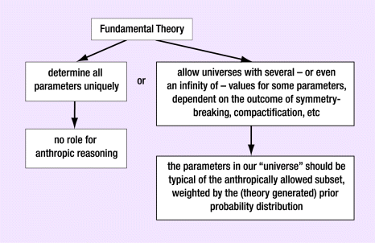
3: The “decision tree” which determines whether anthropic explanations are irrelevant or the best we can ever ...
Notes:
3: The “decision tree” which determines whether anthropic explanations are irrelevant or the best we can ever hope for. (M Rees)
Unless provided in the caption above, the following copyright applies to the content of this slide:

Slide 5
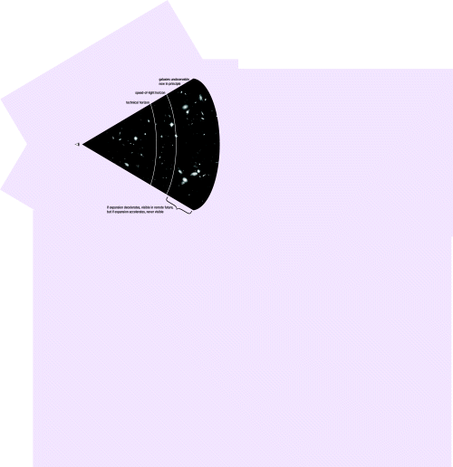
4: This shows the transition between the observable and unobservable as a succession of horizons. There is the ...
Notes:
4: This shows the transition between the observable and unobservable as a succession of horizons. There is the limit to how far our present-day telescopes can probe; the limit set by the distance light could have travelled since the Big Bang; there are galaxies which emerged from the same Big Bang as ours but which we will never see in an accelerating universe; finally there are galaxies emerging from separate Big Bangs. (M Rees)
Unless provided in the caption above, the following copyright applies to the content of this slide:

