Slide 1
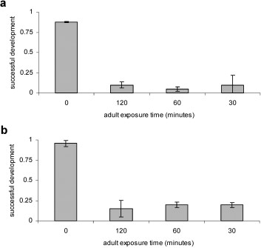
Fig. 1 (a) Adult females as vehicles for insecticide transfer: effects of 20 exposed adults on the successful ...
Notes:
Fig. 1 (a) Adult females as vehicles for insecticide transfer: effects of 20 exposed adults on the successful development of larvae in previously untreated water (mean fraction developing and 95% CL). (b) Adult females as vehicles for insecticide transfer: effects of five exposed adults on the successful development of larvae in previously untreated water (mean fraction developing and 95% CL).
Unless provided in the caption above, the following copyright applies to the content of this slide: © 2005 Entomological Society of AmericaThis is an Open Access article distributed under the terms of the Creative Commons Attribution Non-Commercial License (http://creativecommons.org/licenses/by-nc/3.0/), which permits non-commercial reuse, distribution, and reproduction in any medium, provided the original work is properly cited. For commercial re-use, please contact journals.permissions@oup.com

Slide 2
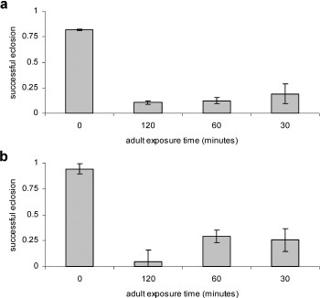
Fig. 2 (a) Effect of adult exposure on fraction of eggs eclosing: effects on groups of 20 adults (mean fraction ...
Notes:
Fig. 2 (a) Effect of adult exposure on fraction of eggs eclosing: effects on groups of 20 adults (mean fraction eclosing and 95% CL). (b) Effect of adult exposure on fraction of eggs eclosing: effects on groups of five adults (mean fraction eclosing and 95% CL).
Unless provided in the caption above, the following copyright applies to the content of this slide: © 2005 Entomological Society of AmericaThis is an Open Access article distributed under the terms of the Creative Commons Attribution Non-Commercial License (http://creativecommons.org/licenses/by-nc/3.0/), which permits non-commercial reuse, distribution, and reproduction in any medium, provided the original work is properly cited. For commercial re-use, please contact journals.permissions@oup.com

Slide 3
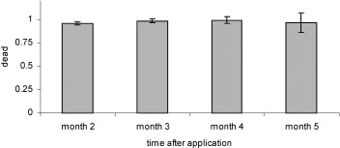
Fig. 3 Larval/pupal mortality in water samples taken from pyriproxyfen-treated tanks (mean fraction dying and 95% ...
Notes:
Fig. 3 Larval/pupal mortality in water samples taken from pyriproxyfen-treated tanks (mean fraction dying and 95% CL).
Unless provided in the caption above, the following copyright applies to the content of this slide: © 2005 Entomological Society of AmericaThis is an Open Access article distributed under the terms of the Creative Commons Attribution Non-Commercial License (http://creativecommons.org/licenses/by-nc/3.0/), which permits non-commercial reuse, distribution, and reproduction in any medium, provided the original work is properly cited. For commercial re-use, please contact journals.permissions@oup.com

