Slide 1
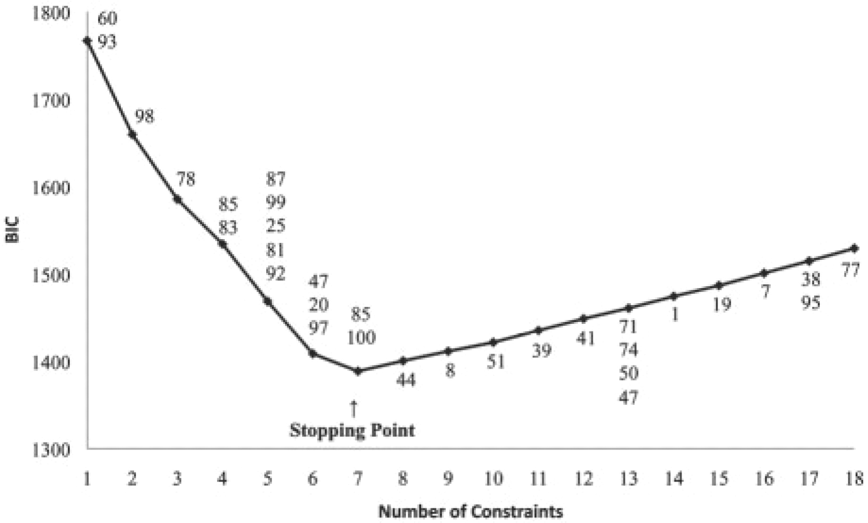
Fig. 1. BIC versus number of constraints for 100 SNPs. The SNPs in each added constraint are labeled above the curve. ...
Notes:
Fig. 1. BIC versus number of constraints for 100 SNPs. The SNPs in each added constraint are labeled above the curve. The first interaction involved SNPs 60 and 93 and the last, at the stopping point, involved SNPs 85 and 100. The method detected seven out of eight true interactions, including the five-way.
Unless provided in the caption above, the following copyright applies to the content of this slide: © The Author 2009. Published by Oxford University Press. All rights reserved. For Permissions, please email: journals.permissions@oxfordjournals.org

