Slide 1
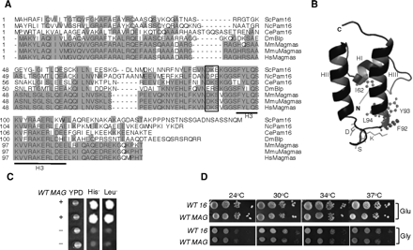
Figure 1. Sequence similarity and growth complementation analysis. (A) Magmas Sequence alignment. Predicted orthologous ...
Notes:
Figure 1. Sequence similarity and growth complementation analysis. (A) Magmas Sequence alignment. Predicted orthologous Magmas sequences from different species; S. cerevisiae (Sc), N. crassa (Nc), C. elegans (Ce), D. melanogaster (Dm), M. musculus (Mm), M. mulata (Mmu) and H. sapiens (Hs) are aligned using ClustalW program. Identical residues are shaded gray and the sequence corresponding to the histidine, proline, aspartic acid (HPD) motif of J-proteins is boxed. (B) Structure of Magmas J-like domain. Magmas J-like domain (47–125 aa) was modeled using yeast Pam16 structure co-ordinates (2GUZ). The N- and C-terminal of the domain is highlighted by N and C, respectively. The helices I, II and III are indicated by HI, HII and HIII, respectively. The amino acid alternations analyzed in this report are highlighted either in stick or ball and stick models. (C and D) In vivo growth phenotype analysis. Diploid Dpam16 cells were transformed with pRS415-MAGMAS construct and subjected to sporulation followed by tetrad dissection analysis. The spores from a single ascus were replica plated on His and Leu drop-out media for selection. Spores carrying the plasmid expressing WTMAGMAS allele (+) or WTPAM16 allele (−) are indicated. To further asses the growth complementation, a serially diluted PAM16ΔHIS/pRS315-WTPAM16 (WT 16) and PAM16ΔHIS/pRS415-WTMAGMAS (WT MAG) cells were spotted on yeast extract peptone dextrose (YPD) (Glu) and YP glycerol (Gly) media followed by incubation at the indicated temperatures for 3 days.
Unless provided in the caption above, the following copyright applies to the content of this slide: © The Author 2010. Published by Oxford University PressThis is an Open Access article distributed under the terms of the Creative Commons Attribution Non-Commercial License (http://creativecommons.org/licenses/by-nc/2.5/uk) which permits unrestricted non-commercial use, distribution, and reproduction in any medium, provided the original work is properly cited.

Slide 2
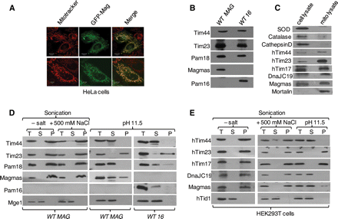
Figure 2. Magmas localization analysis. (A) Magmas localizes to the human mitochondria. Confocal fluorescence images of ...
Notes:
Figure 2. Magmas localization analysis. (A) Magmas localizes to the human mitochondria. Confocal fluorescence images of HeLa cells showing GFP-Magmas fusion protein (green fluorescence) and mitochondria (red) labeled with MitoTracker. (B and C) Subcellular fractionation of Magmas. Purified mitochondria from indicated yeast strains (B) and HEK293T cells (C) were resolved by SDS–PAGE followed by western blotting. The mitochondrial fractions were immunodecorated with respective yeast and human-specific antibodies as indicated. The purity and enrichment of mitochondria obtained from HEK293T cells were analyzed by probing with other organellar-specific antibodies as negative controls. For a comparison, equimolar concentration of total cell lysate and mitochondrial lysate was loaded. (D and E) Mitochondrial membrane association analysis of Magmas. Mitochondria from yeast cells (D) and HEK293T cell lines (E) were sonicated in the presence or absence of high salt (left panel) and carbonate extracted at pH 11.5 (right panel) was subjected to fractionation by ultra centrifugation. The equivalent samples of supernatant (S) and pellet (P) fractions, and unfractionated extract (T) were analyzed by SDS–PAGE and immunoblotted with yeast- and human-specific antibodies as indicated.
Unless provided in the caption above, the following copyright applies to the content of this slide: © The Author 2010. Published by Oxford University PressThis is an Open Access article distributed under the terms of the Creative Commons Attribution Non-Commercial License (http://creativecommons.org/licenses/by-nc/2.5/uk) which permits unrestricted non-commercial use, distribution, and reproduction in any medium, provided the original work is properly cited.

Slide 3
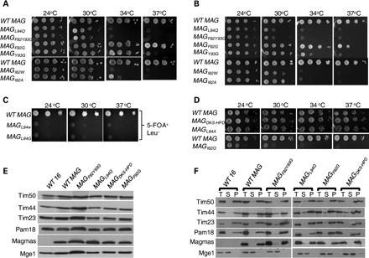
Figure 3. Analysis of mutations affecting Magmas functions. (A–D) In vivo growth phenotypes. Ten-fold serial dilutions ...
Notes:
Figure 3. Analysis of mutations affecting Magmas functions. (A–D) In vivo growth phenotypes. Ten-fold serial dilutions of wild-type and mutant cells were spotted onto YPD (A and D) and leucine drop-out media (B) or 5-FOA (C), followed by incubation at the indicated temperatures for 3 days. (E) Expression analysis of TIM23 translocon members in mutants. Equivalent amount mitochondria from wild-type and mutants were separated on SDS–PAGE and subjected to immunoblotting using indicated yeast TIM23 translocon components. (F) Membrane association analysis of Magmas mutants. Sonicated mitochondria from Magmas mutant yeast cells were subjected to ultracentrifugation. The equivalent samples of supernatant (S) and pellet (P), and unfractionated extract (T) were analyzed by SDS–PAGE and immunoblotted with yeast- and human-specific antibodies as indicated.
Unless provided in the caption above, the following copyright applies to the content of this slide: © The Author 2010. Published by Oxford University PressThis is an Open Access article distributed under the terms of the Creative Commons Attribution Non-Commercial License (http://creativecommons.org/licenses/by-nc/2.5/uk) which permits unrestricted non-commercial use, distribution, and reproduction in any medium, provided the original work is properly cited.

Slide 4
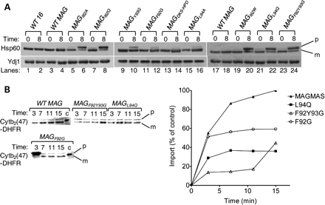
Figure 4. Analysis of protein translocation in Magmas mutants. (A) In vivo precursor accumulation: wild-type and Magmas ...
Notes:
Figure 4. Analysis of protein translocation in Magmas mutants. (A) In vivo precursor accumulation: wild-type and Magmas mutant yeast strains were grown at permissive temperatures in rich media to early log phase. The culture was shifted to 37°C for 8 h. After inducing phenotype, the whole cell lysates were resolved by SDS–PAGE followed by immunoblotting using Hsp60-specific antibodies; (p), precursor form of Hsp60; (m), mature form of Hsp60. (B) In vitro mitochondrial import of Cytb2(47)-DHFR; 100 mg of WT and mutant Magmas (MAGL94Q, MAGF92G and MAGF92GY93G) mitochondria were preincubated in import buffer and reactions were initiated by adding saturated amounts of purified Cytb2(47)-DHFR. Import reaction mixtures were separated on SDS–PAGE and analyzed by immunoblotting using anti-DHFR antibodies. One hundred percentage of the precursor protein offered to the mitochondria was loaded as a control (c). The amount of imported protein (m-Cytb2(47)-DHFR) was quantified using densitometry and plotted against the function of time of import reaction. The amount of m-Cytb2(47)-DHFR in WT mitochondria after the longest import time was set to 100%.
Unless provided in the caption above, the following copyright applies to the content of this slide: © The Author 2010. Published by Oxford University PressThis is an Open Access article distributed under the terms of the Creative Commons Attribution Non-Commercial License (http://creativecommons.org/licenses/by-nc/2.5/uk) which permits unrestricted non-commercial use, distribution, and reproduction in any medium, provided the original work is properly cited.

Slide 5
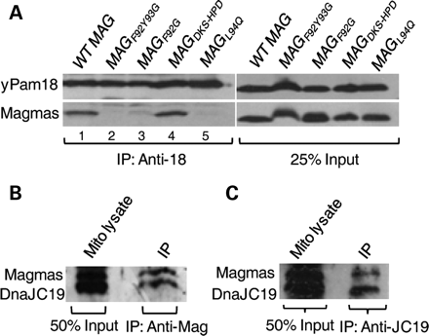
Figure 5. Analysis of mutations affecting stability of the Magmas:Pam18/DnaJC19 subcomplex. (A) Co-immunoprecipitation ...
Notes:
Figure 5. Analysis of mutations affecting stability of the Magmas:Pam18/DnaJC19 subcomplex. (A) Co-immunoprecipitation of Magmas:yPam18 subcomplex from yeast mitochondria. Wild-type and mutant Magmas yeast mitochondrial lysate were prepared using 1% Triton X-100. The lysate was subjected to immunoprecipitation using Pam18-specific antibodies, as indicated by bracket, followed by SDS–PAGE and immunoblotting using Pam18- and Magmas-specific antibodies. Twenty-five percentage of soluble material after lysis was used as loading control (25% input). (B and C) Analysis of Magmas:DnaJC19 subcomplex formation in human mitochondria. Human mitochondrial lysate was prepared with 1% Triton X-100 then subjected to immunoprecipitation using Magmas-antibodies (B) or DnaJC19-antibodies (C), followed by SDS–PAGE and immunoblotting using DnaJC19- and Magmas-specific antibodies. Fifty percentage of total soluble material after lysis was used as a loading control (50% input).
Unless provided in the caption above, the following copyright applies to the content of this slide: © The Author 2010. Published by Oxford University PressThis is an Open Access article distributed under the terms of the Creative Commons Attribution Non-Commercial License (http://creativecommons.org/licenses/by-nc/2.5/uk) which permits unrestricted non-commercial use, distribution, and reproduction in any medium, provided the original work is properly cited.

Slide 6
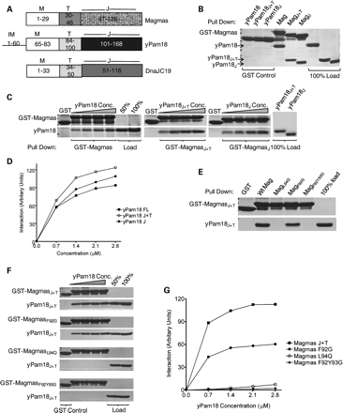
Figure 6. In vitro interaction analysis of Magmas with yPam18. (A) Domain organization of Magmas, Pam18 and DnaJC19. On ...
Notes:
Figure 6. In vitro interaction analysis of Magmas with yPam18. (A) Domain organization of Magmas, Pam18 and DnaJC19. On the basis of sequence alignment, the amino acids corresponding to the predicted regions are indicated; intermembrane space (IM), membrane association (M), predicted mitochondria targeting (T) and J-domains/J-like domains (J). (B–D) Magmas interacts with the J-domain of yPam18. Immobilized GST-Magmas, GST-MagmasJ+T and GST-MagmasJ were incubated with equimolar concentration (B) or increasing concentrations (C) of his6-tagged full-length Pam18, Pam18J+T and Pam18J, respectively. The bound proteins were washed and analyzed by SDS–PAGE followed by Coomassie dye staining, and quantified by densitometry (D). GST alone was used as a negative control, and 100% input of Pam18, Pam18J+T, PAM18J used as a loading control. (E–G) Magmas mutants are defective in forming subcomplex with yPam18. Equimolar concentration (E) or increasing concentrations (F) of yPam18 was incubated with GST-Magmas, GST-MagmasL94Q, GST-MagmasF92G and GST-MagmasF92Y93G beads for 30 min for complex formation. The beads were washed and separated on SDS–PAGE gel, followed by Coomassie dye staining and quantified by densitometric analysis (G).
Unless provided in the caption above, the following copyright applies to the content of this slide: © The Author 2010. Published by Oxford University PressThis is an Open Access article distributed under the terms of the Creative Commons Attribution Non-Commercial License (http://creativecommons.org/licenses/by-nc/2.5/uk) which permits unrestricted non-commercial use, distribution, and reproduction in any medium, provided the original work is properly cited.

Slide 7
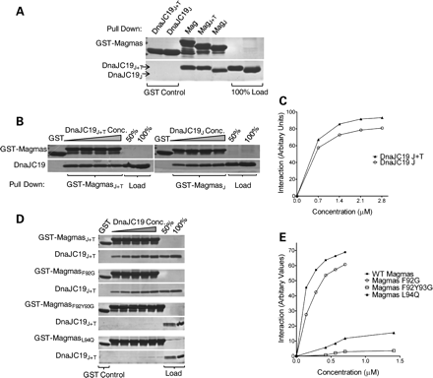
Figure 7. In vitro interaction analysis of Magmas with DnaJC19. (A–C) Magmas interact with the J-domain of DnaJC19 ...
Notes:
Figure 7. In vitro interaction analysis of Magmas with DnaJC19. (A–C) Magmas interact with the J-domain of DnaJC19 protein. The interaction analysis between GST-Magmas and DnaJC19 was carried out essentially as described in Figure 6B–D. (D and E) Magmas mutants are defective in forming subcomplex with DnaJC19. GST-Magmas, GST-MagmasL94Q, GST-MagmasF92G and GST-MagmasF92Y93G were incubated with increasing concentrations of DnaJC19 for 30 min to form the subcomplex. The samples were analyzed as mentioned in Figure 6F and G.
Unless provided in the caption above, the following copyright applies to the content of this slide: © The Author 2010. Published by Oxford University PressThis is an Open Access article distributed under the terms of the Creative Commons Attribution Non-Commercial License (http://creativecommons.org/licenses/by-nc/2.5/uk) which permits unrestricted non-commercial use, distribution, and reproduction in any medium, provided the original work is properly cited.

Slide 8
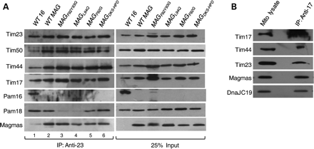
Figure 8. Magmas association with TIM23 translocase. (A) Magmas interaction with yeast Tim23-core complex. Equivalent ...
Notes:
Figure 8. Magmas association with TIM23 translocase. (A) Magmas interaction with yeast Tim23-core complex. Equivalent amounts of mitochondria from yeast cells expressing wt Magmas or mutants were solubilized by incubating in buffer containing 1% digitonin. The soluble supernatant was subjected to co-immunoprecipitation using Tim23 specific antibodies. Samples were resolved on SDS–PAGE and immunodecorated with antibodies specific to Magmas-, yPam16-, yPam18-, yTim17-, yTim23-, yTim44- and yTim50. (B) Magmas association with human Tim23-core complex. Mitochondria obtained from HEK293T cells were lysed in 1% digitonin, and the supernatant was subjected to immunoprecipitation using anti-Tim17 antibodies. Samples were analyzed on SDS–PAGE, followed by immunoblotting with antibodies against Magmas-, DnaJC19-, hTim17-, hTim23- and hTim44. Twenty-five percentage of the total soluble supernatant after lysis was used as loading control (25% input).
Unless provided in the caption above, the following copyright applies to the content of this slide: © The Author 2010. Published by Oxford University PressThis is an Open Access article distributed under the terms of the Creative Commons Attribution Non-Commercial License (http://creativecommons.org/licenses/by-nc/2.5/uk) which permits unrestricted non-commercial use, distribution, and reproduction in any medium, provided the original work is properly cited.

Slide 9
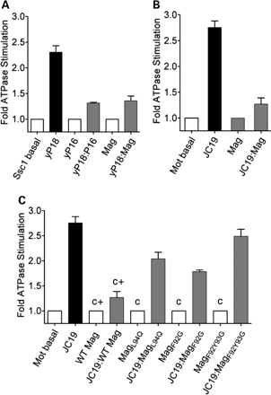
Figure 9. Inhibition of mtHsp70's ATPase activity. (A) Effect of yPam18:Magmas subcomplex: Ssc1:ATP(a-³²P) ...
Notes:
Figure 9. Inhibition of mtHsp70's ATPase activity. (A) Effect of yPam18:Magmas subcomplex: Ssc1:ATP(a-32P) complex was incubated with 2-fold excess of either yPam18 (yP18) alone, Magmas alone or yPam18:Magmas subcomplex and the rate of hydrolysis was measured as a function of time at 23°C. The experiment was repeated using yPam16 (P16) as a positive control. (B) Effect of DnaJC19:Magmas subcomplex: 2-fold excess of DnaJC19 (JC19) alone, Magmas alone or DnaJC19:Magmas subcomplex was incubated with the human Mortalin:ATP(a-32P) complex and the rate of ATP hydrolysis was monitored at identical conditions as mentioned earlier. The basal rate of ATP hydrolysis by Mortalin alone was set to 1. The rate of conversion to ADP was measured and represented as fold stimulation over the basal rate. (C) Effect of DnaJC19:Magmas mutant subcomplex: Human Mortalin:ATP(α-32P) complex was incubated with 2-fold excess of DnaJC19 alone, Magmas mutants alone (negative control; c) or DnaJC19:Magmas mutant subcomplexes as indicated. Magmas alone and Magmas:DnaJC19 subcomplex were used as a positive controls (c+); as mentioned in B. The assay was carried out and represented as described above. The assays were carried out in duplicates and the standard deviation was represented as standard error bars.
Unless provided in the caption above, the following copyright applies to the content of this slide: © The Author 2010. Published by Oxford University PressThis is an Open Access article distributed under the terms of the Creative Commons Attribution Non-Commercial License (http://creativecommons.org/licenses/by-nc/2.5/uk) which permits unrestricted non-commercial use, distribution, and reproduction in any medium, provided the original work is properly cited.

