Slide 1
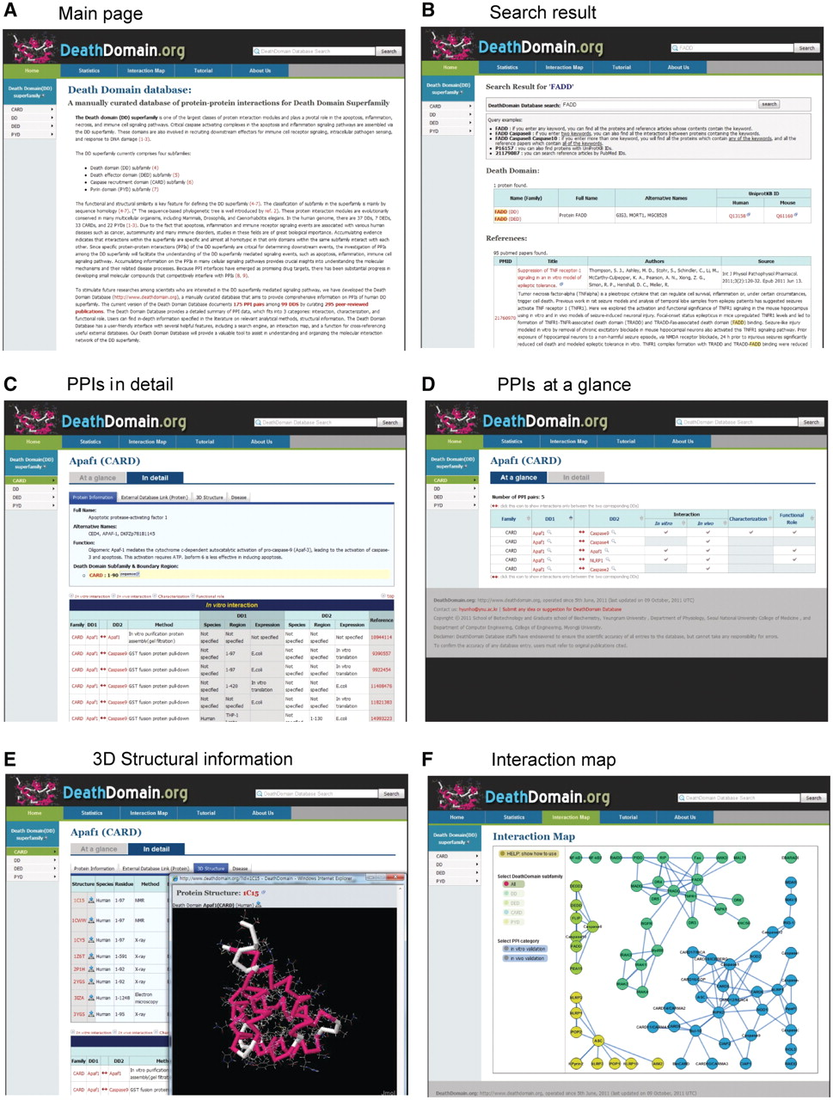
Figure 1. Overview of the DD database web interfaces, with a reconstituted illustration. (A) Main page (B) Search ...
Notes:
Figure 1. Overview of the DD database web interfaces, with a reconstituted illustration. (A) Main page (B) Search result (C) PPI in detail (D) PPIs at a glance (E) 3D structure information (F) Interaction map.
Unless provided in the caption above, the following copyright applies to the content of this slide: © The Author(s) 2011. Published by Oxford University Press.This is an Open Access article distributed under the terms of the Creative Commons Attribution Non-Commercial License (http://creativecommons.org/licenses/by-nc/3.0), which permits unrestricted non-commercial use, distribution, and reproduction in any medium, provided the original work is properly cited.

