Slide 1
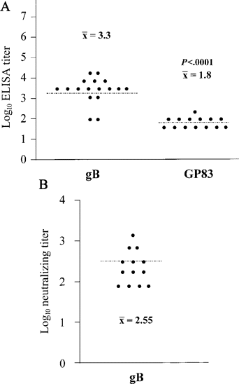
Figure 1 A ELISA antibody responses in guinea pigs vaccinated with gB or GP83 DNA vaccines. ELISA was performed ...
Notes:
Figure 1 A ELISA antibody responses in guinea pigs vaccinated with gB or GP83 DNA vaccines. ELISA was performed against guinea pig cytomegalovirus (GPCMV) antigen, as described elsewhere [31]. Animals were bled after the fourth dose of DNA vaccine. Mean log10 titer for gB-vaccine recipients was 3.3; for GP83-vaccine recipients, mean log10 titer was 1.8, which is significantly lower than that for gB-vaccine recipients (P<.0001). B Neutralizing antibody titers in 13 dams that received gB vaccine and became pregnant. Mean complement-dependent neutralizing titer was 2.55 log10
Unless provided in the caption above, the following copyright applies to the content of this slide: © 2003 by the Infectious Diseases Society of America

Slide 2
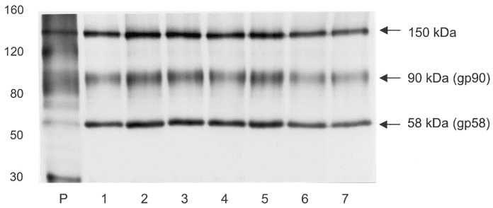
Figure 2 Immunoprecipitation analysis of serum from gB–vaccinated animals. Serum (volume, 20 μL) from vaccinated ...
Notes:
Figure 2 Immunoprecipitation analysis of serum from gB–vaccinated animals. Serum (volume, 20 μL) from vaccinated guinea pigs and Staphylococcus aureus protein A were used to immunoprecipitate 35S-labeled lysates from guinea pig cytomegalovirus (GPCMV)–infected guinea pig fibroblast lung cells. Representative results observed using serum samples from 7 gB-vaccinated animals (including serum samples from dams with both high-mortality and low-mortality litters) are indicated (lanes 1–7). All animals engendered antibody capable of immunoprecipitating the ∼90 and ∼58 kDa subunits of the gB complex. In addition, an ∼150 kDa polypeptide representing the intracellular gB precursor was identified (arrows). Immunopreciptation with preimmune serum samples did not demonstrate any GPCMV polypeptides (data not shown). Position of molecular weight markers is indicated. Immunoprecipitation profile of polypeptides immunoreactive with polyclonal anti-GPCMV antisera is also indicated (lane P)
Unless provided in the caption above, the following copyright applies to the content of this slide: © 2003 by the Infectious Diseases Society of America

Slide 3
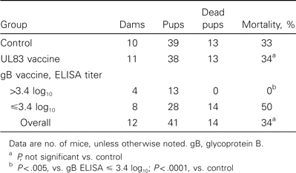
Table 1 Pup mortality after maternal inoculation with guinea pig cytomegalovirus
Notes:
Table 1 Pup mortality after maternal inoculation with guinea pig cytomegalovirus
Unless provided in the caption above, the following copyright applies to the content of this slide: © 2003 by the Infectious Diseases Society of America

Slide 4
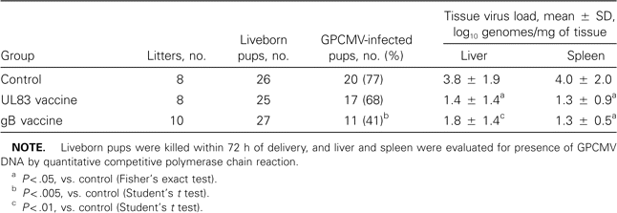
Table 2 Vertical transmission rates of guinea pig cytomegalovirus (GPCMV) and virus load analyses of infected pups, ...
Notes:
Table 2 Vertical transmission rates of guinea pig cytomegalovirus (GPCMV) and virus load analyses of infected pups, after third-trimester maternal GPCMV challenge
Unless provided in the caption above, the following copyright applies to the content of this slide: © 2003 by the Infectious Diseases Society of America

