Slide 1
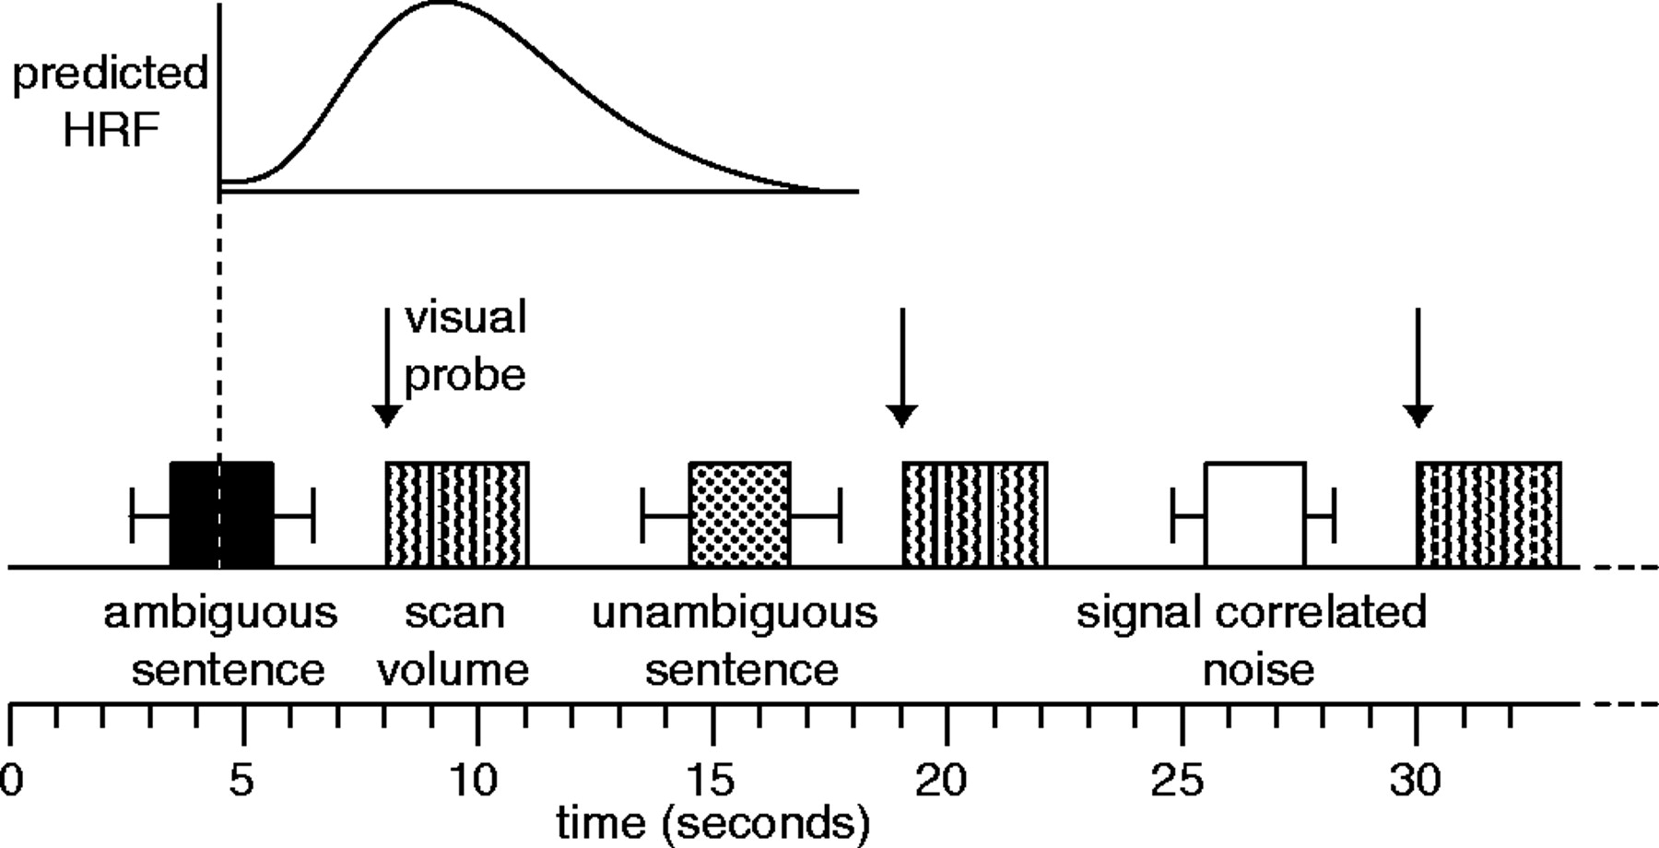
Figure 1. Details of the sparse imaging procedure (see Materials and Methods) in which a single stimulus item was ...
Notes:
Figure 1. Details of the sparse imaging procedure (see Materials and Methods) in which a single stimulus item was presented in the silent periods between scans. The mid-point of the sentence was timed such that the predicted BOLD response to each sentence (based on the canonical haemodynamic response function in the SPM software) would be maximal at the time of the scan. Error bars show the range of sentence durations used. Visual probes (in experiment 1) occurred at the onset of the scan, minimizing sensitivity to the BOLD effect of these events.
Unless provided in the caption above, the following copyright applies to the content of this slide: © Oxford University Press 2005; all rights reserved

Slide 2
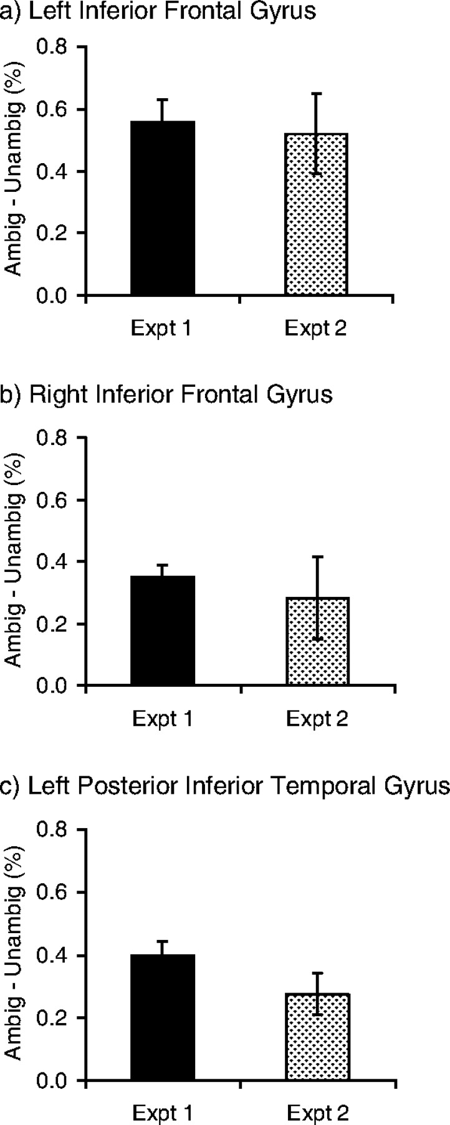
Figure 2. Percent signal change for high-ambiguity versus low-ambiguity sentences in experiments 1 and 2 for peak ...
Notes:
Figure 2. Percent signal change for high-ambiguity versus low-ambiguity sentences in experiments 1 and 2 for peak voxels from experiment 1.
Unless provided in the caption above, the following copyright applies to the content of this slide: © Oxford University Press 2005; all rights reserved

Slide 3
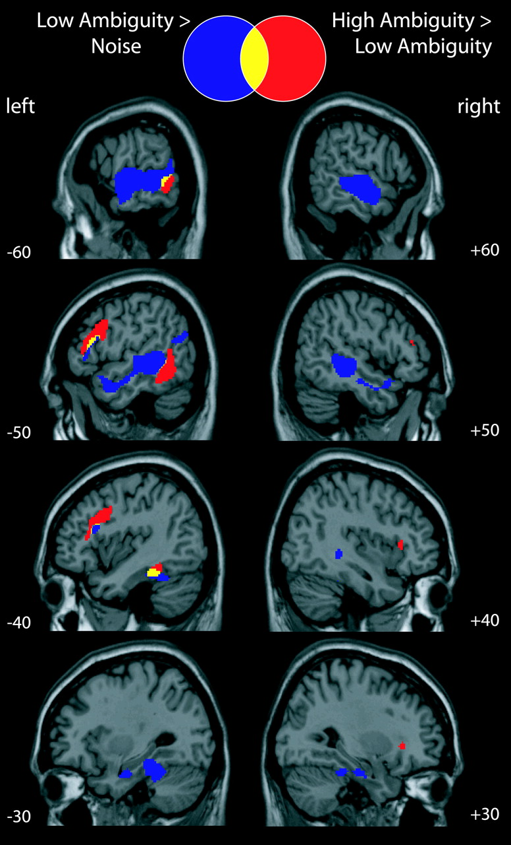
Figure 3. Combined analysis of experiments 1 and 2. Activations shown at P < 0.05 corrected for multiple comparisons.
Notes:
Figure 3. Combined analysis of experiments 1 and 2. Activations shown at P < 0.05 corrected for multiple comparisons.
Unless provided in the caption above, the following copyright applies to the content of this slide: © Oxford University Press 2005; all rights reserved

