Slide 1
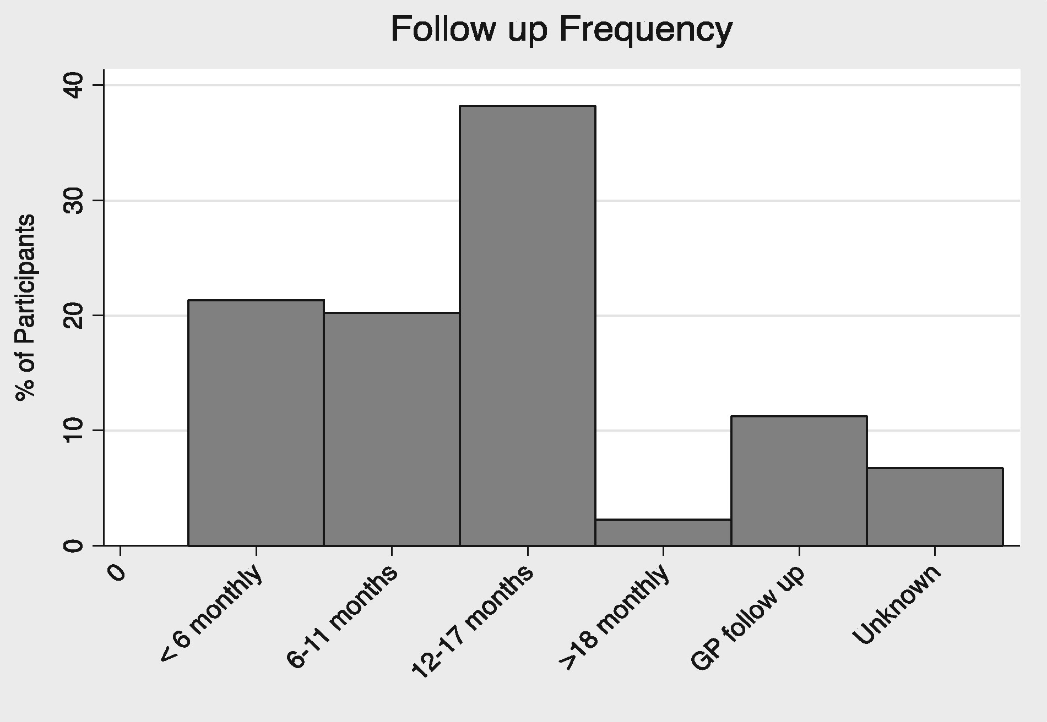
Fig. 1 Follow-up site and frequency of respondents. The majority of respondents received follow-up at least every 18 ...
Notes:
Fig. 1 Follow-up site and frequency of respondents. The majority of respondents received follow-up at least every 18 months, 21% had follow-up more frequently than every 6 months. Only 11% received follow-up in primary care.
Unless provided in the caption above, the following copyright applies to the content of this slide: © The Author 2017. Published by Oxford University Press on behalf of ERA-EDTA.This is an Open Access article distributed under the terms of the Creative Commons Attribution License (http://creativecommons.org/licenses/by/4.0/), which permits unrestricted reuse, distribution, and reproduction in any medium, provided the original work is properly cited.

Slide 2
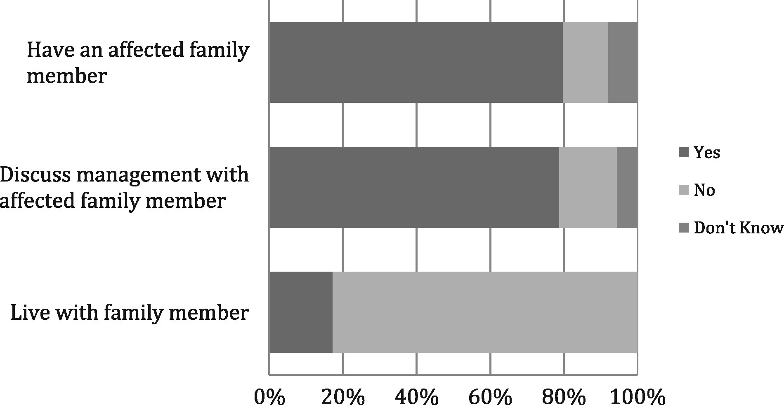
Fig. 2 Responses to family relationship survey questions. The majority (80%) knew an affected family member and ...
Notes:
Fig. 2 Responses to family relationship survey questions. The majority (80%) knew an affected family member and discussed the management of the condition with them (79%), despite most (83%) living in different households.
Unless provided in the caption above, the following copyright applies to the content of this slide: © The Author 2017. Published by Oxford University Press on behalf of ERA-EDTA.This is an Open Access article distributed under the terms of the Creative Commons Attribution License (http://creativecommons.org/licenses/by/4.0/), which permits unrestricted reuse, distribution, and reproduction in any medium, provided the original work is properly cited.

Slide 3
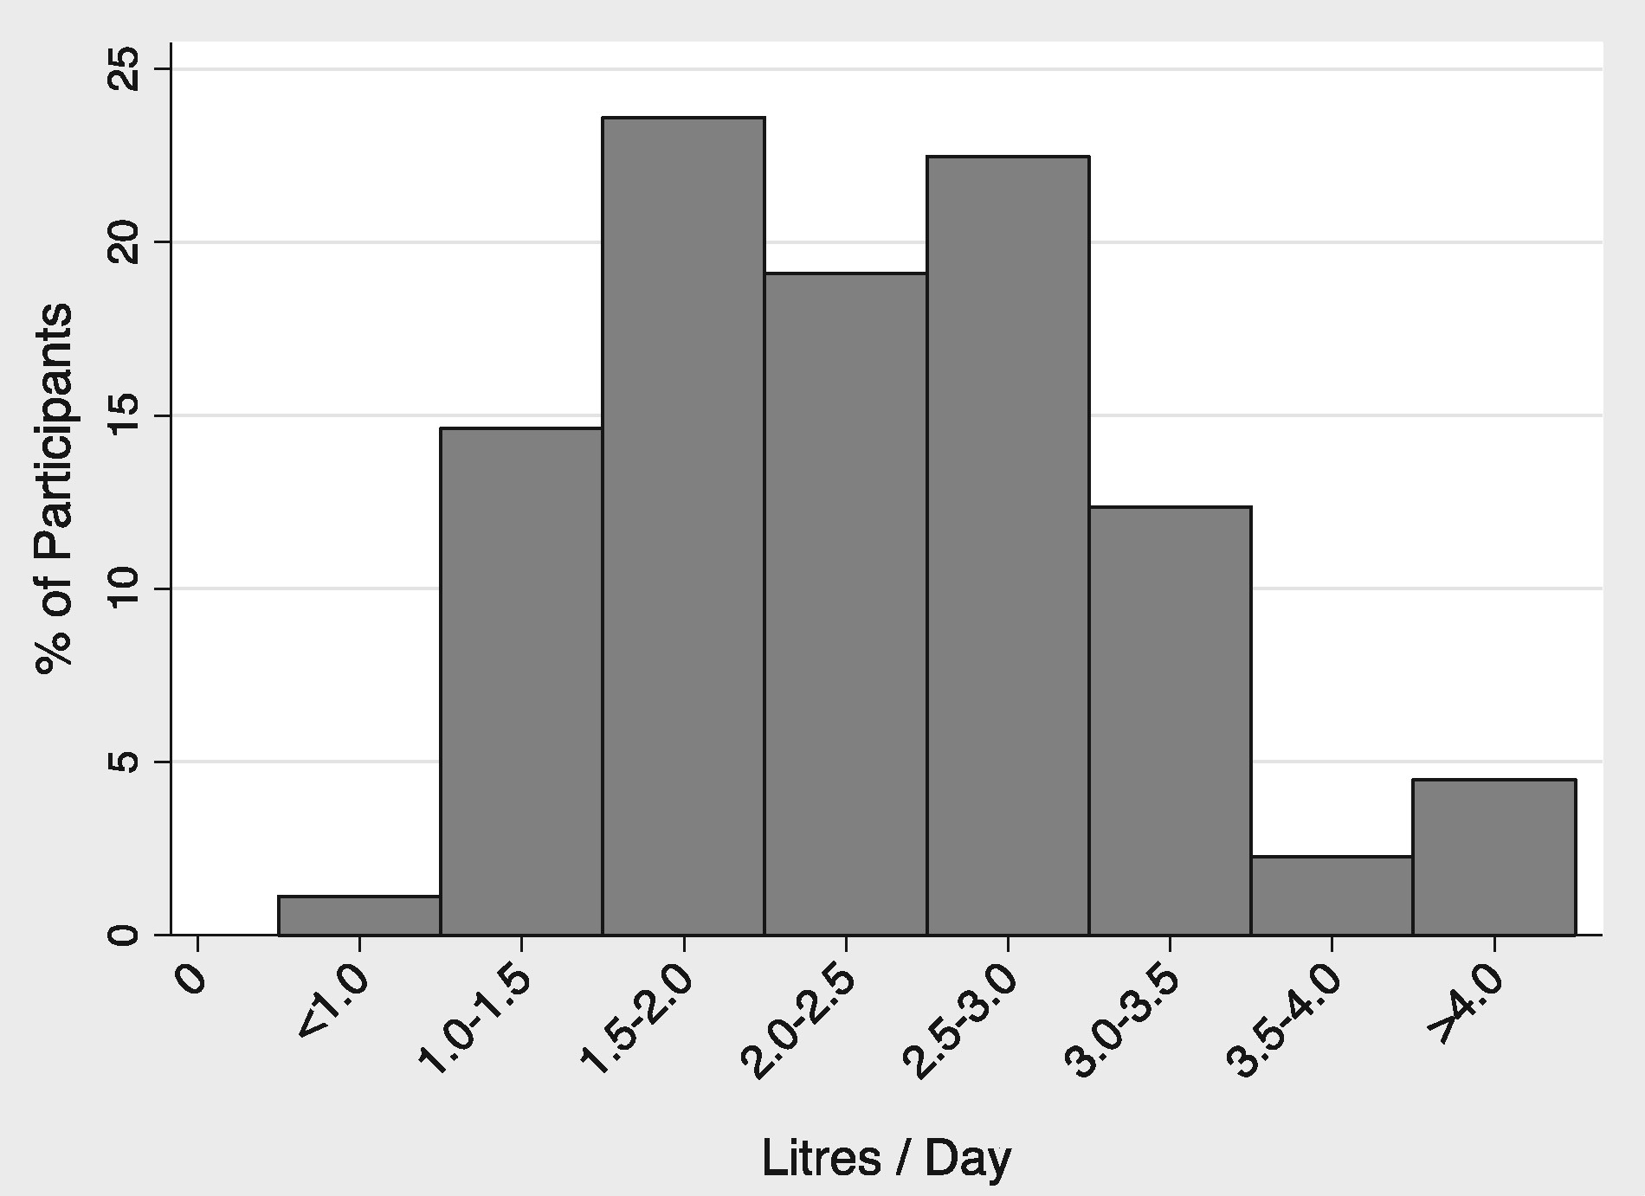
Fig. 3 Estimated current daily fluid intake (L/day).There was a wide variation in daily fluid intake; however, the ...
Notes:
Fig. 3 Estimated current daily fluid intake (L/day).There was a wide variation in daily fluid intake; however, the majority (61%) reported an intake of ≥2 L/day with only 4% drinking > 4 L/day. The rest (39%) drank < 2 L/day.
Unless provided in the caption above, the following copyright applies to the content of this slide: © The Author 2017. Published by Oxford University Press on behalf of ERA-EDTA.This is an Open Access article distributed under the terms of the Creative Commons Attribution License (http://creativecommons.org/licenses/by/4.0/), which permits unrestricted reuse, distribution, and reproduction in any medium, provided the original work is properly cited.

Slide 4
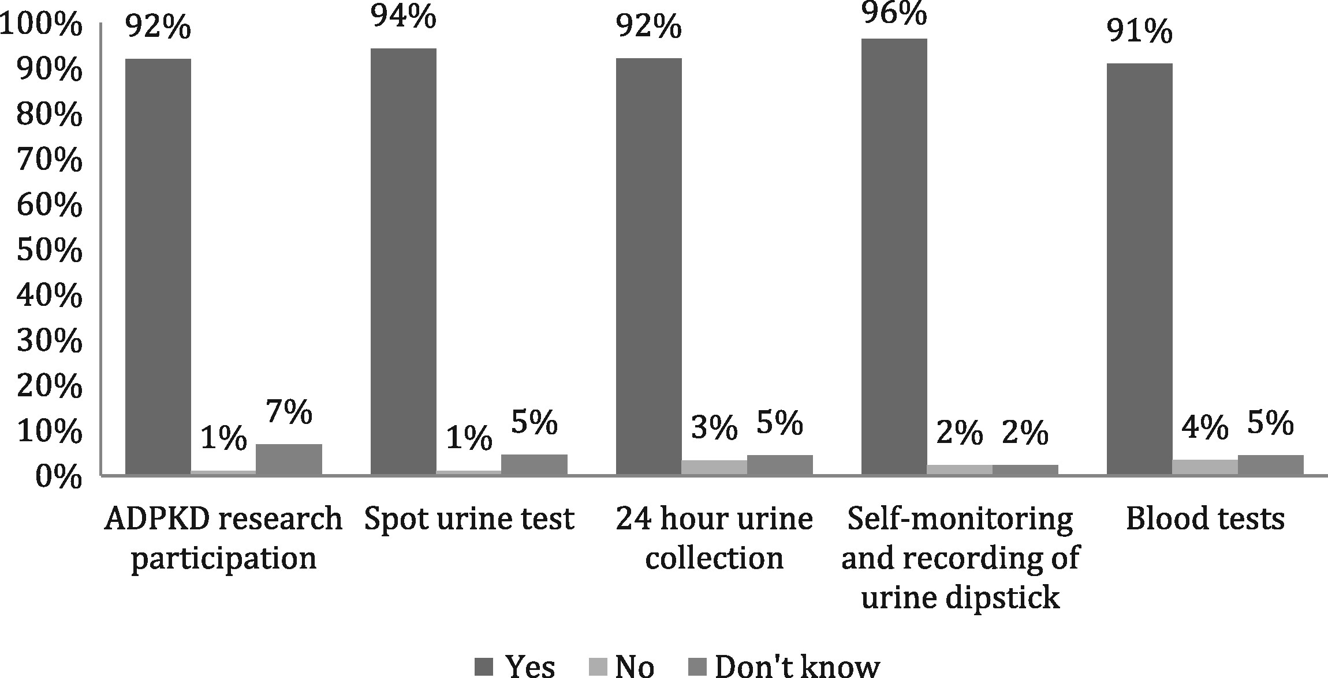
Fig. 4 Respondents willingness to participate in various aspects of research. A total of 92% indicated they were ...
Notes:
Fig. 4 Respondents willingness to participate in various aspects of research. A total of 92% indicated they were willing to participate in research, while the majority agreed to different methods of urine testing and blood tests for the purposes of research; 96% were happy to perform self-monitoring and recording of urine results.
Unless provided in the caption above, the following copyright applies to the content of this slide: © The Author 2017. Published by Oxford University Press on behalf of ERA-EDTA.This is an Open Access article distributed under the terms of the Creative Commons Attribution License (http://creativecommons.org/licenses/by/4.0/), which permits unrestricted reuse, distribution, and reproduction in any medium, provided the original work is properly cited.

