Slide 1
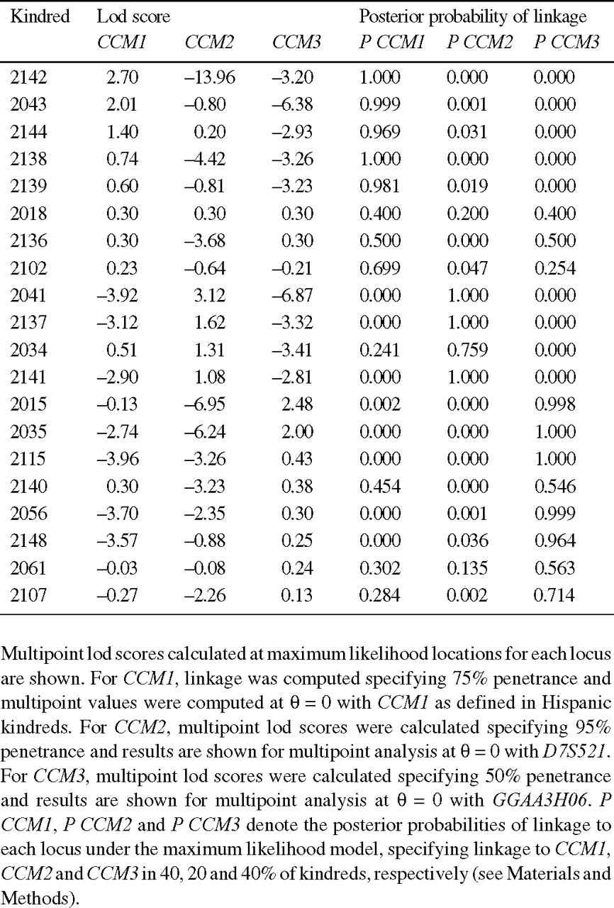
Table 1 Multipoint lod scores for linkage of cerebral cavernous malformation to CCM1, CCM2 and CCM3 in 20 ...
Notes:
Table 1 Multipoint lod scores for linkage of cerebral cavernous malformation to CCM1, CCM2 and CCM3 in 20 non-Hispanic kindreds
Unless provided in the caption above, the following copyright applies to the content of this slide: © 1998 Oxford University Press

Slide 2
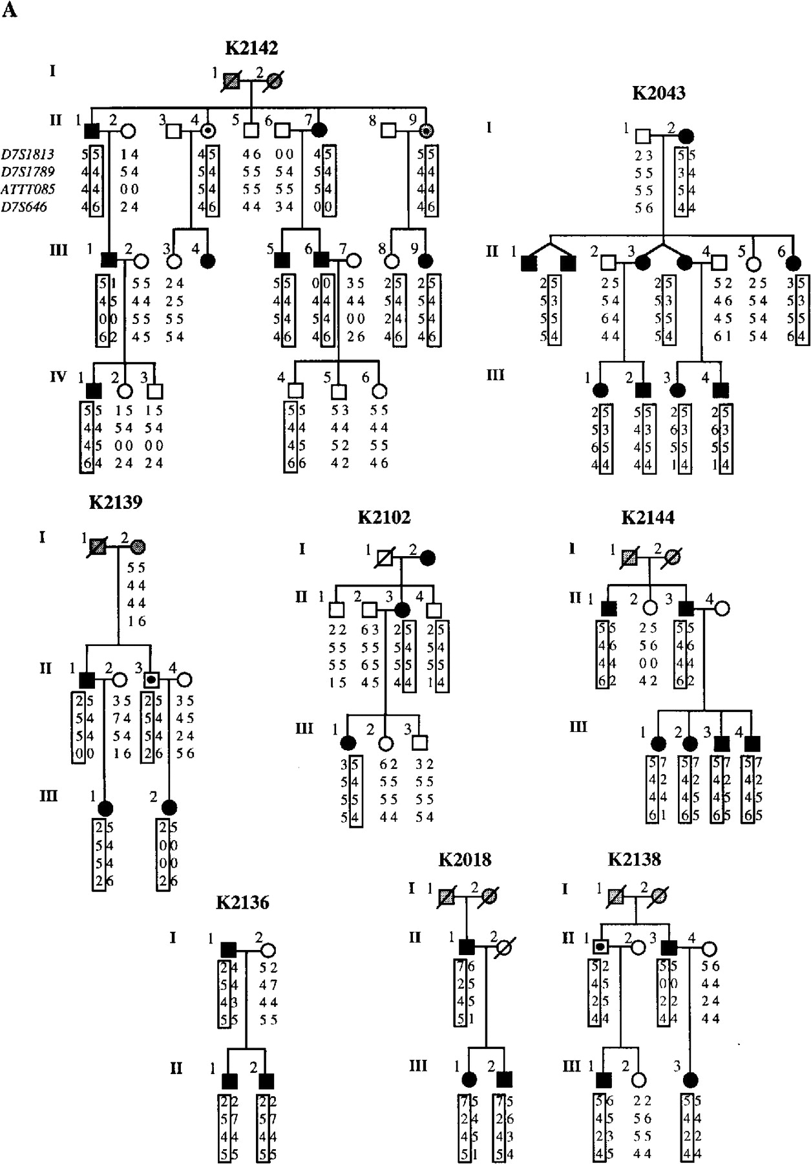
Figure 1 CCM kindreds showing evidence of linkage to CCM1, CCM2 and CCM3. Closed symbols, individuals with CCM; open ...
Notes:
Figure 1 CCM kindreds showing evidence of linkage to CCM1, CCM2 and CCM3. Closed symbols, individuals with CCM; open symbols, unaffected individuals; dots, obligate carriers assuming autosomal dominant transmission; gray symbols, phenotype unknown. Below each symbol, genotypes at indicated marker loci are shown. Loci are shown in their respective chromosomal orders and the distances between adjacent loci are indicated in Figure 2. (A) Kindreds supporting linkage to CCM1 on chromosome 7p. It is important to point out that while all kindreds have been genotyped at each locus, for each family we have only presented the genotypes at the locus with the highest lod score. Some kindreds, in particular smaller kindreds, have positive lod scores at more than one locus and in these cases the choice of which set of genotypes to show is relatively arbitrary. The results of multipoint linkage at each locus in each kindred are shown in Table 1.
Unless provided in the caption above, the following copyright applies to the content of this slide: © 1998 Oxford University Press

Slide 3
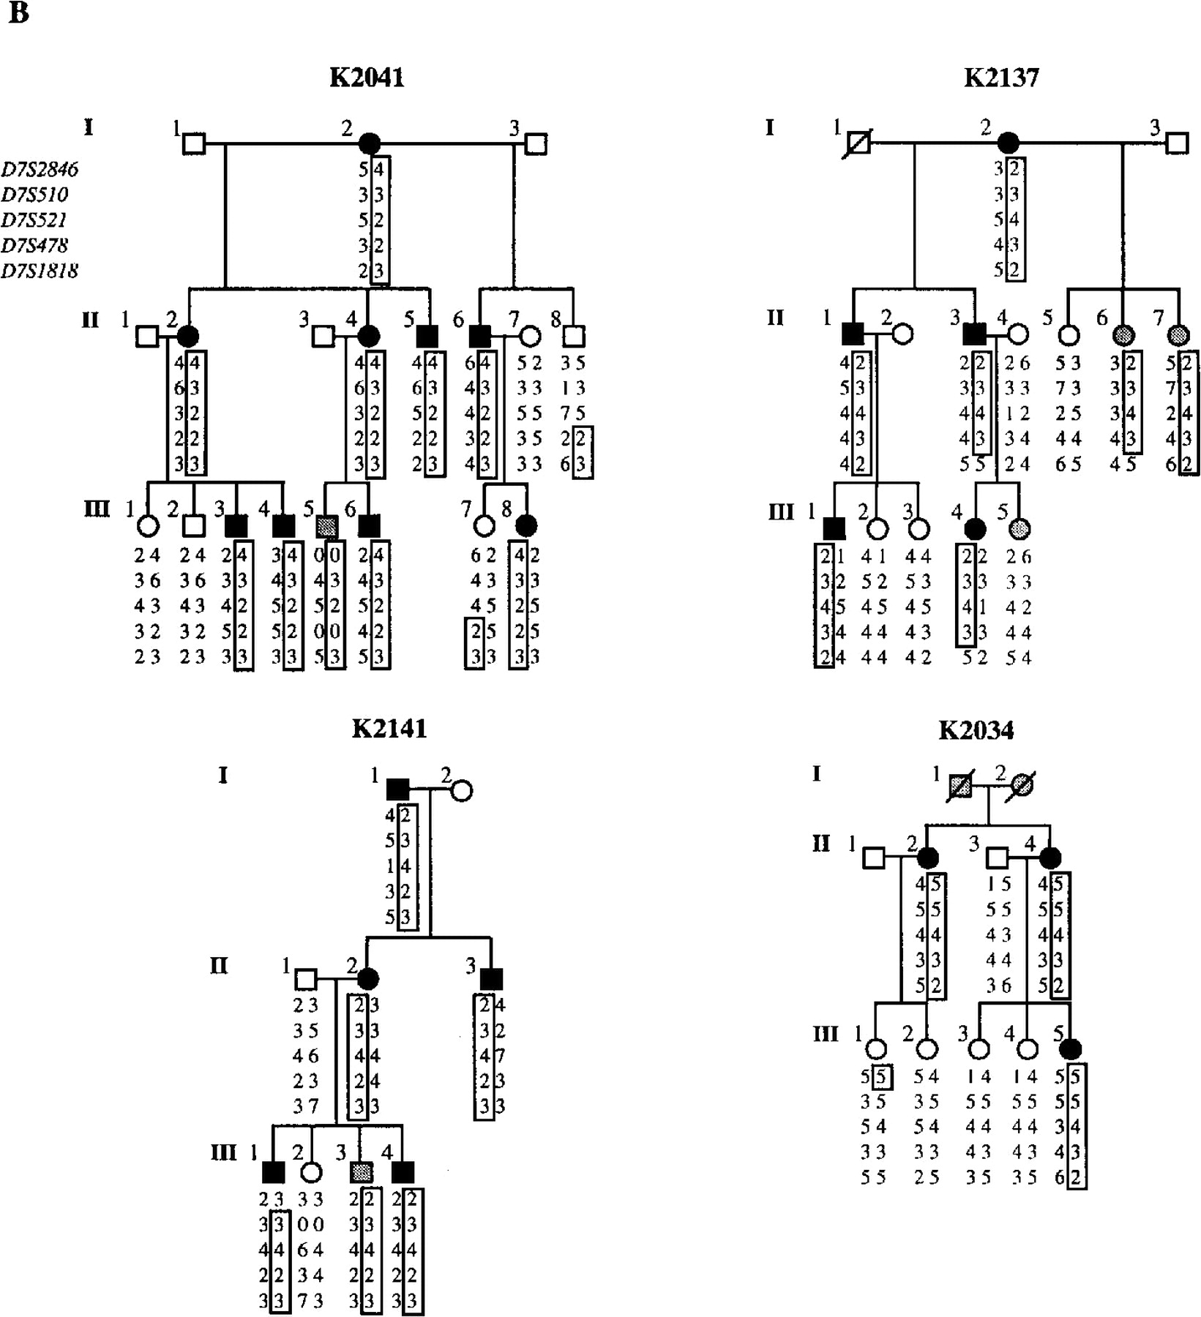
Figure 1 CCM kindreds showing evidence of linkage to CCM1, CCM2 and CCM3. Closed symbols, individuals with CCM; open ...
Notes:
Figure 1 CCM kindreds showing evidence of linkage to CCM1, CCM2 and CCM3. Closed symbols, individuals with CCM; open symbols, unaffected individuals; dots, obligate carriers assuming autosomal dominant transmission; gray symbols, phenotype unknown. Below each symbol, genotypes at indicated marker loci are shown. Loci are shown in their respective chromosomal orders and the distances between adjacent loci are indicated in Figure 2. (B) Kindreds supporting linkage to CCM2 on chromosome 7q. It is important to point out that while all kindreds have been genotyped at each locus, for each family we have only presented the genotypes at the locus with the highest lod score. Some kindreds, in particular smaller kindreds, have positive lod scores at more than one locus and in these cases the choice of which set of genotypes to show is relatively arbitrary. The results of multipoint linkage at each locus in each kindred are shown in Table 1.
Unless provided in the caption above, the following copyright applies to the content of this slide: © 1998 Oxford University Press

Slide 4
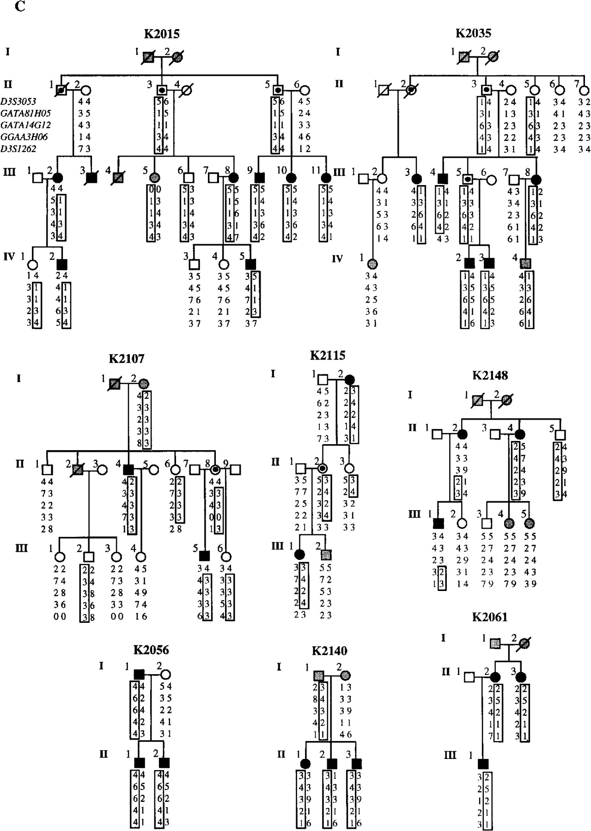
Figure 1 CCM kindreds showing evidence of linkage to CCM1, CCM2 and CCM3. Closed symbols, individuals with CCM; open ...
Notes:
Figure 1 CCM kindreds showing evidence of linkage to CCM1, CCM2 and CCM3. Closed symbols, individuals with CCM; open symbols, unaffected individuals; dots, obligate carriers assuming autosomal dominant transmission; gray symbols, phenotype unknown. Below each symbol, genotypes at indicated marker loci are shown. Loci are shown in their respective chromosomal orders and the distances between adjacent loci are indicated in Figure 2. (C) Kindreds supporting linkage to CCM3 on chromosome 3q. It is important to point out that while all kindreds have been genotyped at each locus, for each family we have only presented the genotypes at the locus with the highest lod score. Some kindreds, in particular smaller kindreds, have positive lod scores at more than one locus and in these cases the choice of which set of genotypes to show is relatively arbitrary. The results of multipoint linkage at each locus in each kindred are shown in Table 1.
Unless provided in the caption above, the following copyright applies to the content of this slide: © 1998 Oxford University Press

Slide 5
Figure 2 Refined location of CCM1, CCM2 and CCM3. Multipoint analysis of linkage comparing segregation of CCM and ...
Notes:
Figure 2 Refined location of CCM1, CCM2 and CCM3. Multipoint analysis of linkage comparing segregation of CCM and marker loci was performed; in each case only kindreds showing high posterior probabilities of linkage to indicated loci and lod scores >1.0 are included in the analysis. The location of marker loci used and the distance between adjacent loci in cM is indicated at the top of each diagram. In (B) and (C) the thick and thin bars below the marker loci indicate the lod-1 and lod-3 support intervals, respectively, for the location of each locus. (A) Multipoint analysis of linkage to CCM1 on chromosome 7q in families K2142, K2043 and K2144. The location of CCM1, as defined in Hispanic American kindreds, is shown at the top of the panel. (B) Multipoint analysis of linkage to CCM2 on chromosome 7p in families K2041, K2137 and K2141. (C) Multipoint analysis of linkage to CCM3 on chromosome 3q in families K2015 and K2035.
Unless provided in the caption above, the following copyright applies to the content of this slide: © 1998 Oxford University Press

