Slide 1
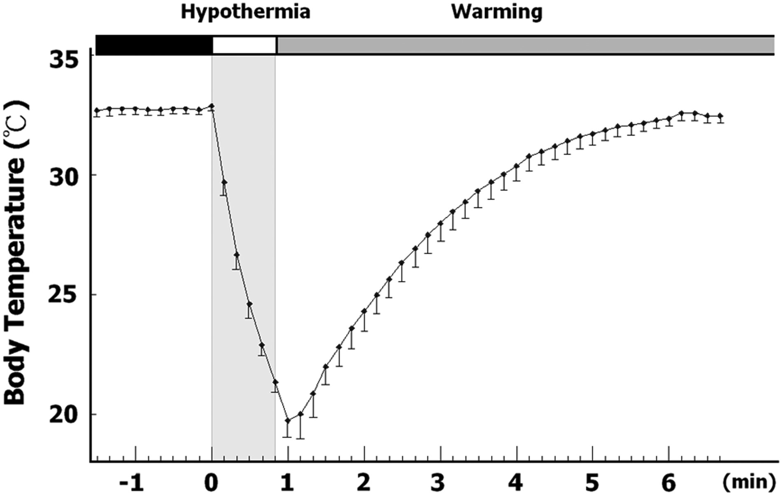
Figure 1. Body temperature of neonatal SMA mice with transient hypothermia treatment. The core body temperature ...
Notes:
Figure 1. Body temperature of neonatal SMA mice with transient hypothermia treatment. The core body temperature recorded from the intraperitoneal space of neonatal mice (postnatal day 2, n = 10) is shown.
Unless provided in the caption above, the following copyright applies to the content of this slide: © The Author 2015. Published by Oxford University Press. All rights reserved. For Permissions, please email: journals.permissions@oup.com

Slide 2
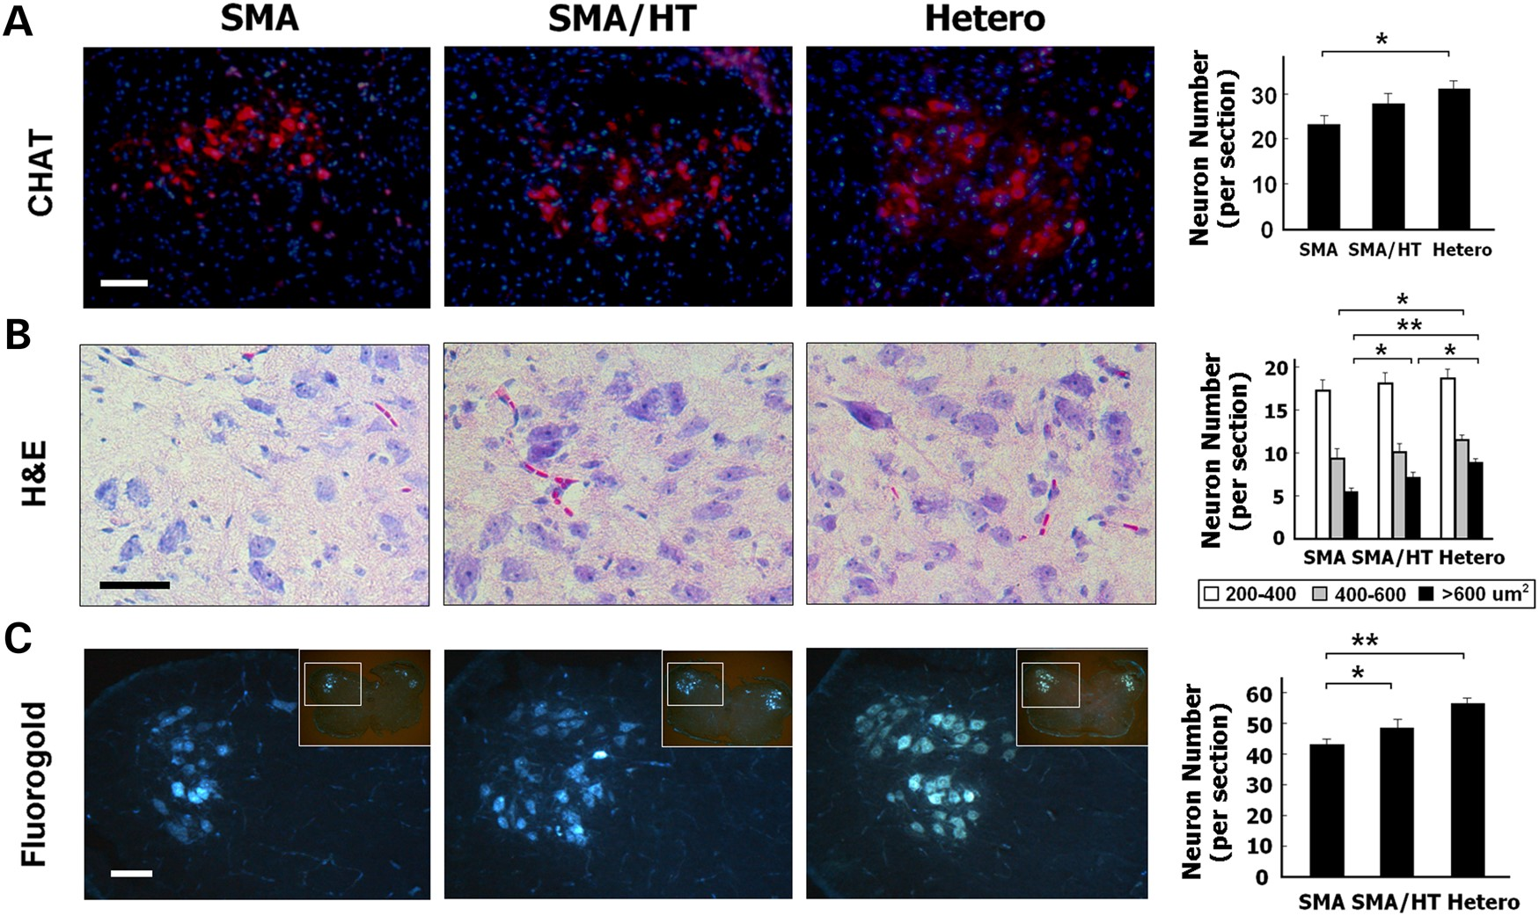
Figure 2. The effects of daily transient hypothermia (HT) treatment on spinal cord motor neurons in SMA mice. (A) ...
Notes:
Figure 2. The effects of daily transient hypothermia (HT) treatment on spinal cord motor neurons in SMA mice. (A) Immunostaining with the motor neuron marker CHAT (red), and counter-staining with the nuclear marker DAPI (blue) of motor neurons in the anterior (ventral) horn of lumbar spinal cord in untreated heterozygous, untreated SMA and HT-treated SMA mice on postnatal day 8. (B) H&E staining of neurons according to their cell size: 200–400, 400–600 and >600 μm2, respectively. (C) Results from retrograde tracing experiments using intra-gastrocnemius and intra-quadriceps injections of fluorogold. The number of fluorescent-labeled motor neurons is presented. Scale bars, 100 μm; n = 5 in each group (*P < 0.05; **P ≤ 0.01; Kruskal–Wallis test and Wilcoxon rank-sum test).
Unless provided in the caption above, the following copyright applies to the content of this slide: © The Author 2015. Published by Oxford University Press. All rights reserved. For Permissions, please email: journals.permissions@oup.com

Slide 3
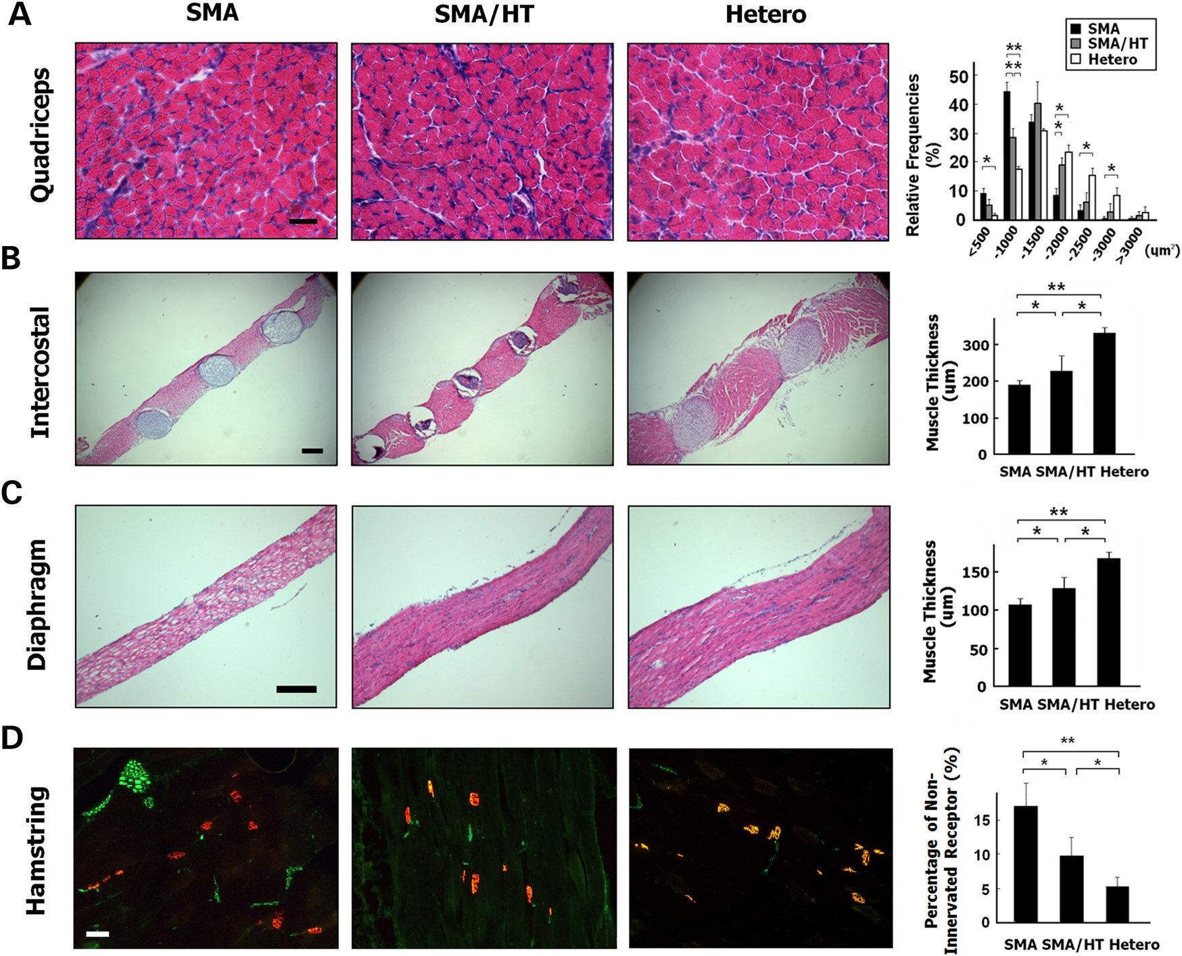
Figure 3. The effects of daily transient hypothermia treatment on quadriceps muscle, intercostal muscle, diaphragm and ...
Notes:
Figure 3. The effects of daily transient hypothermia treatment on quadriceps muscle, intercostal muscle, diaphragm and hamstring muscle in SMA mice. (A) The frequency distribution of muscle fiber size in quadriceps muscles using H&E stain in untreated heterozygous, untreated SMA and hypothermia (HT)-treated SMA mice on postnatal day 8. (B) H&E staining of the intercostal muscles for assessment of muscle thickness. (C) H&E staining of the diaphragm for assessment of muscle thickness. (D) Immunostaining with the axonal marker neurofilament H (green) and counter-staining with the NMJ marker α-bungarotoxin (red) in the hamstring muscles of SMA mice. Scale bars, 100 μm; n = 5 in each group. (*P < 0.05; **P ≤ 0.01; Kruskal–Wallis test and Wilcoxon rank-sum test).
Unless provided in the caption above, the following copyright applies to the content of this slide: © The Author 2015. Published by Oxford University Press. All rights reserved. For Permissions, please email: journals.permissions@oup.com

Slide 4
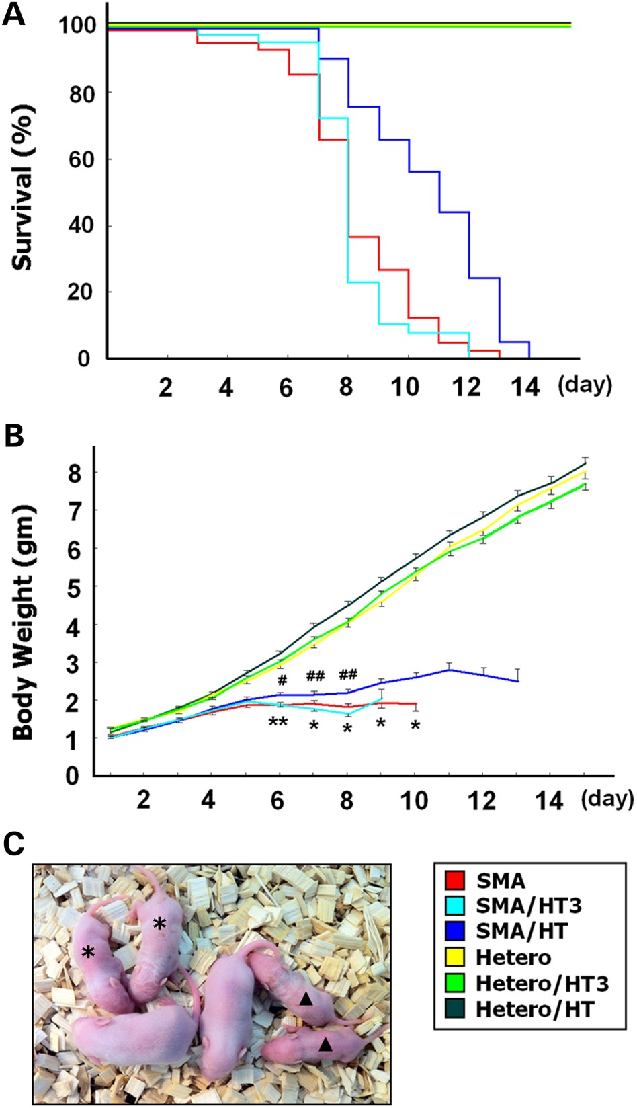
Figure 4. The effects of daily transient hypothermia treatment on the survival and health of SMA mice. (A) Lifespan, ...
Notes:
Figure 4. The effects of daily transient hypothermia treatment on the survival and health of SMA mice. (A) Lifespan, (B) body weight and (C) size of mice on postnatal day 8 in untreated SMA mice (n = 43), SMA mice receiving transient hypothermia treatment every 3 days beginning on postnatal day 1 (SMA/HT3, n = 40), SMA mice receiving daily transient hypothermia treatment (SMA/HT, n = 41), untreated heterozygous mice (n = 57), heterozygous mice receiving transient hypothermia treatment every 3 days beginning on postnatal day 1 (Hetero/HT3, n = 57) and heterozygous mice receiving daily transient hypothermia treatment (Hetero/HT, n = 63). Asterisk and arrowhead in (C) indicate daily hypothermia-treated SMA mice and untreated SMA mice, respectively. (A) P < 0.001, SMA/HT mice versus untreated SMA mice; log-rank test. (B) *P < 0.05 and **P ≤ 0.01, SMA/HT mice versus untreated SMA mice; #P < 0.05 and ##P ≤ 0.01, SMA/HT mice versus SMA/HT3 mice; one-way ANOVA with LSD post-hoc comparisons.
Unless provided in the caption above, the following copyright applies to the content of this slide: © The Author 2015. Published by Oxford University Press. All rights reserved. For Permissions, please email: journals.permissions@oup.com

Slide 5
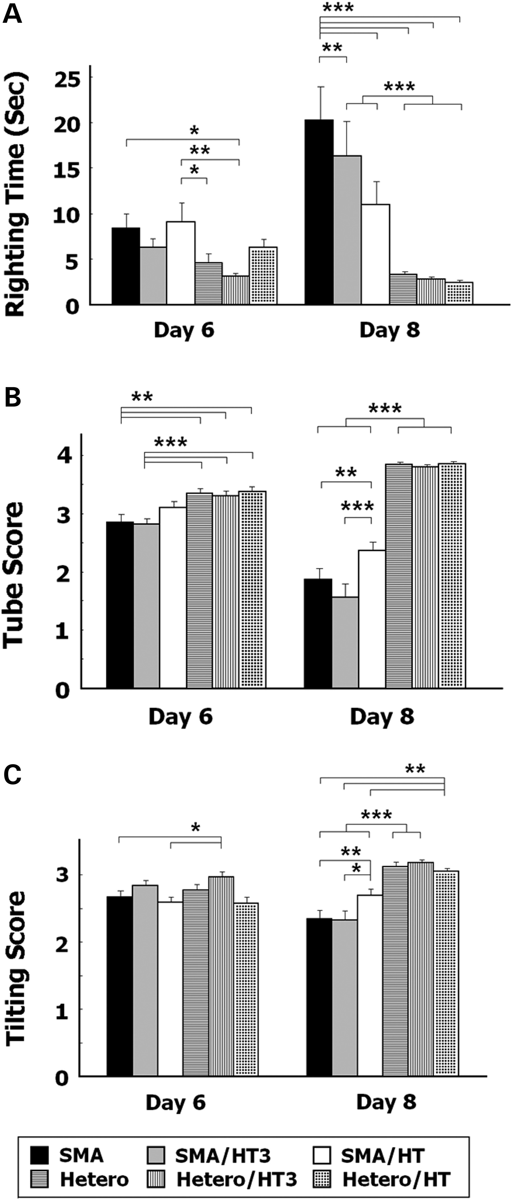
Figure 5. The effects of daily transient hypothermia treatment on motor function in SMA mice. (A) Turnover time, (B) ...
Notes:
Figure 5. The effects of daily transient hypothermia treatment on motor function in SMA mice. (A) Turnover time, (B) tube test scores and (C) the tilting scores in untreated SMA mice (n = 39), SMA mice treated with transient hypothermia treatment every 3 days beginning on postnatal day 1 (SMA/HT3, n = 32), SMA mice treated with daily transient hypothermia (SMA/HT, n = 39), untreated heterozygous mice (n = 61), heterozygous mice receiving transient hypothermia treatment every 3 days beginning on postnatal day 1 (Hetero/HT3, n = 61) and heterozygous mice receiving daily transient hypothermia treatment (Hetero/HT, n = 76). *P < 0.05; **P ≤ 0.01; ***P ≤ 0.001; one-way ANOVA with LSD post-hoc comparisons.
Unless provided in the caption above, the following copyright applies to the content of this slide: © The Author 2015. Published by Oxford University Press. All rights reserved. For Permissions, please email: journals.permissions@oup.com

Slide 6
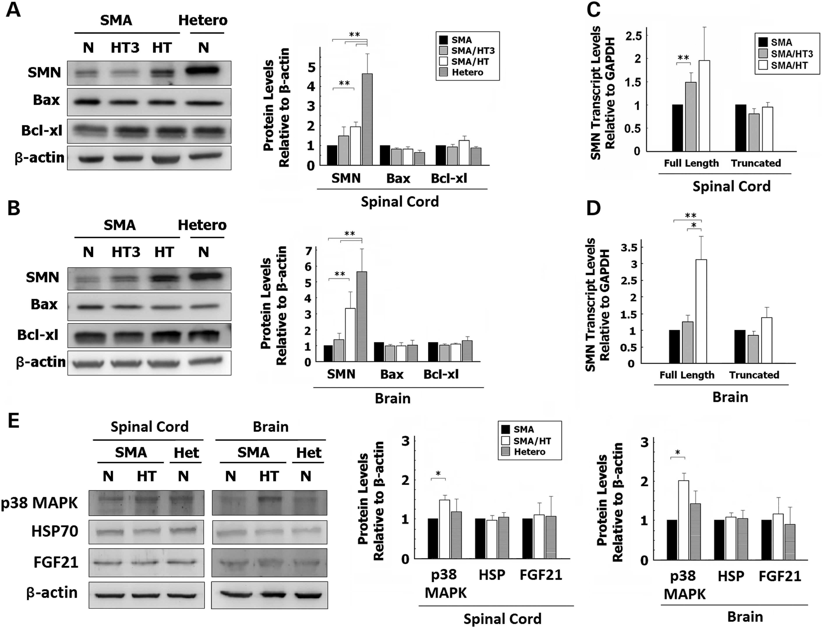
Figure 6. Analysis of protein and transcript expression in untreated SMA mice, SMA mice receiving transient hypothermia ...
Notes:
Figure 6. Analysis of protein and transcript expression in untreated SMA mice, SMA mice receiving transient hypothermia treatment every 3 days beginning on postnatal day 1 (HT3), SMA mice receiving daily transient hypothermia treatment (HT) and untreated heterozygous mice on postnatal day 8. (A) Western blots of homogenized spinal cords for SMN, Bax, Bcl-xl and β-actin. Analysis of the ratio of SMN, Bax and Bcl-xl protein levels to β-actin is shown. (B) Western blots of homogenized brain for SMN, Bax, Bcl-xl and β-actin. Analysis of the ratio of SMN, Bax and Bcl-xl protein levels to β-actin is shown. (C and D) Quantitative PCR of homogenized spinal cord (C) and brain (D) with primer pairs for full-length SMN, truncated SMN and GAPDH. Analysis of the ratio of full-length SMN levels to GAPDH and truncated SMN levels to GAPDH is shown. N = no treatment; n = 5 for each group. (E) Western blots of homogenized spinal cords and brain for p38 MAPK, HSP70, FGF21 and β-actin. Analysis of the ratio of p38 MAPK, HSP70 and FGF21 protein levels to β-actin is shown. n = 4 for each group (*P < 0.05; **P ≤ 0.01; Kruskal–Wallis test and Wilcoxon rank-sum test).
Unless provided in the caption above, the following copyright applies to the content of this slide: © The Author 2015. Published by Oxford University Press. All rights reserved. For Permissions, please email: journals.permissions@oup.com

Slide 7
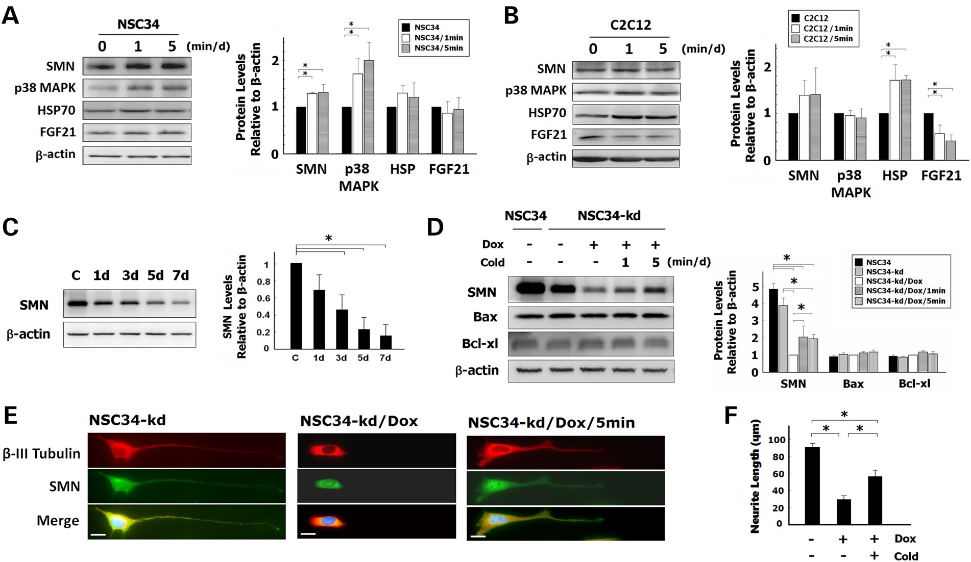
Figure 7. The effects of transient cold exposure on protein expression and neurite length in a motor neuron cell-line ...
Notes:
Figure 7. The effects of transient cold exposure on protein expression and neurite length in a motor neuron cell-line and a muscle cell-line. (A and B) Western blots of a motor neuron cell-line (NSC34, A) and a muscle cell-line (C2C12, B) with or without daily 1-min or 5-min cold exposure for 7 days. Analysis of the ratio of SMN, p38 MAPK, HSP70 and FGF21 protein levels to β-actin is shown. (C) Western blots of an SMA-like motor neuron cell-line (NSC34-kd) for SMN and β-actin with different periods of Dox treatment. Analysis of the ratio of SMN protein levels to β-actin is shown. (D) Western blots for SMN, Bax, Bcl-xl and β-actin in the cultured motor neuron cell-lines, including naïve NSC34 without treatment (NSC34), NSC34-kd without treatment (NSC34-kd), NSC34-kd with Dox treatment (NSC34-kd/Dox), NSC34-kd with Dox treatment and daily 1-min cold exposure for 7 days (NSC34-kd/Dox/1 min), NSC34-kd with Dox treatment and daily 5-min cold exposure for 7 days (NSC34-kd/Dox/5 min). Analysis of the ratio of SMN, Bax and Bcl-xl protein levels to β-actin is shown. (E) Immunostaining for SMN (green) and β-III tubulin (red), and counter-stained with DAPI (blue) in NSC34-kd cells, NSC34-kd/Dox cells and NSC34-kd/Dox/5 min cells. Scale bars, 20 μm. (F) The length of neurites was measured and compared. n = 3 in each group (*P < 0.05; Kruskal–Wallis test and Wilcoxon rank-sum test).
Unless provided in the caption above, the following copyright applies to the content of this slide: © The Author 2015. Published by Oxford University Press. All rights reserved. For Permissions, please email: journals.permissions@oup.com

Slide 8
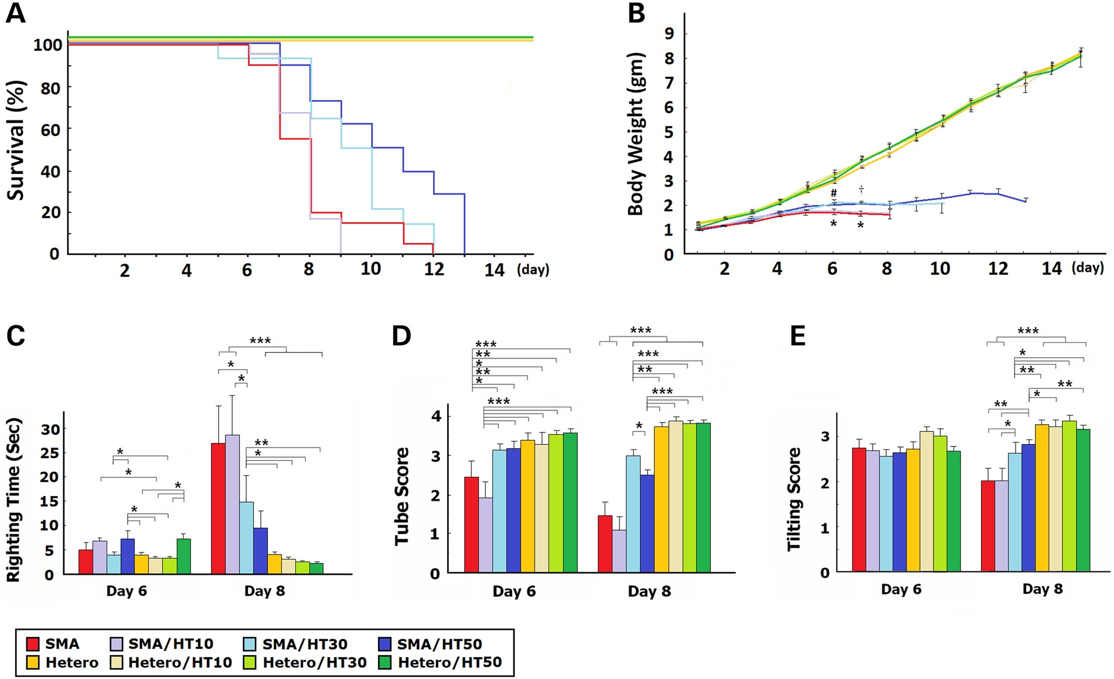
Figure 8. The effects of different intensity of daily transient hypothermia treatment on the survival and motor ...
Notes:
Figure 8. The effects of different intensity of daily transient hypothermia treatment on the survival and motor function of SMA mice. (A) Lifespan, and (B) body weight in untreated SMA mice (n = 20), SMA mice receiving hypothermia treatment for 10 s (SMA/HT10, n = 18), 30 s (SMA/HT30, n = 14) and 50 s (SMA/HT50, n = 18) per day beginning on postnatal day 1, untreated heterozygous mice (n = 27) and heterozygous mice receiving hypothermia treatment for 10 s (Hetero/HT10, n = 10), 30 s (Hetero/HT30, n = 18) and 50 s (Hetero/HT50, n = 31) per day beginning on postnatal day 1. (C) Turnover time, (D) tube test scores and (E) the tilting scores in untreated SMA mice (n = 11), SMA mice receiving hypothermia treatment for 10 s (n = 12), 30 s (n = 13) and 50 s (n = 16) per day beginning on postnatal day 1, untreated heterozygous mice (n = 20) and heterozygous mice receiving hypothermia treatment for 10 s (n = 10), 30 s (n = 22) and 50 s (n = 27) per day beginning on postnatal day 1. (A) P < 0.001, SMA/HT50 mice versus untreated SMA mice, SMA/HT10 mice versus SMA/HT30 and SMA/HT50 mice; P < 0.05, SMA/HT30 mice versus untreated SMA mice; log-rank test. (B) *P < 0.05, SMA/HT30 and SMA/HT50 mice versus untreated mice; #P < 0.05, SMA/HT30 mice versus SMA/H10 mice; †P < 0.05, SMA/HT5 P < 0.05, SMA/HT30 mice versus SMA/H10 mice 0 mice versus SMA/H10 mice. (C–E) *P < 0.05; **P ≤ 0.01; ***P ≤ 0.001; one-way ANOVA with LSD post-hoc comparisons.
Unless provided in the caption above, the following copyright applies to the content of this slide: © The Author 2015. Published by Oxford University Press. All rights reserved. For Permissions, please email: journals.permissions@oup.com

