Slide 1
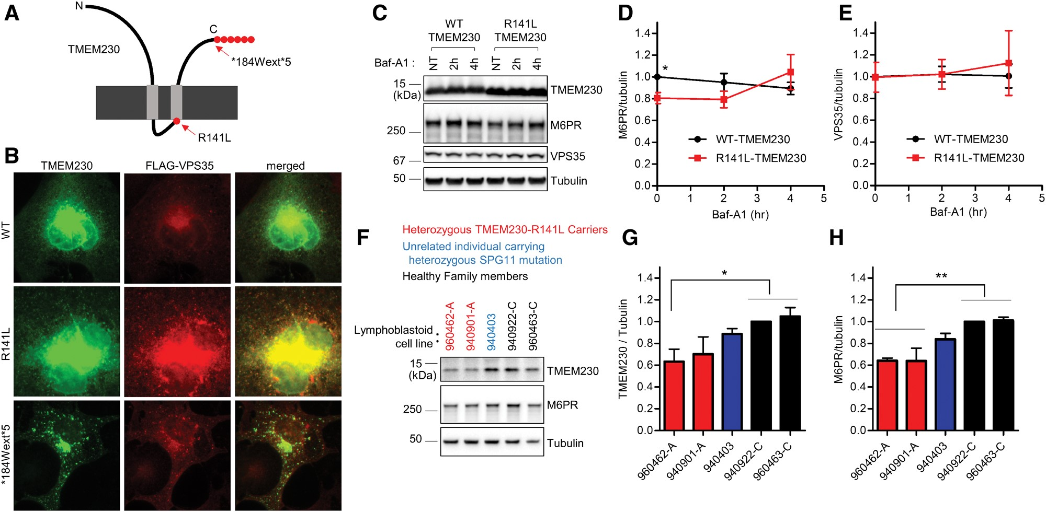
Figure 1. PD-linked TMEM230 variants disrupt VPS35 distribution and retromer cargo CI-M6PR trafficking. (A) Schematic ...
Notes:
Figure 1. PD-linked TMEM230 variants disrupt VPS35 distribution and retromer cargo CI-M6PR trafficking. (A) Schematic diagram of TMEM230 mutations from Parkinson’s patients. (B) Pathogenic PD-linked TMEM230 mutants show more punctate distribution, and alter intracellular distribution of the VPS35 retromer complex. COS-7 cells were transfected with indicated tag-free TMEM230 expression vector together with FLAG-tagged VPS35 expression vector. One day after transfection, COS-7 cells were fixed with 4%formaldehyde in PBS and immunostained with mouse anti-TMEM230 antibody and rabbit anti-FLAG-antibody. Representative images are shown. (C-E) PD-linked R141L-TMEM230 mutant reduces steady state levels of CI-M6PR retromer cargo compared to WT-TMEM230. HEK293-FT cells were transfected either with tag-free WT-TMEM230 or R141L-TMEM230. One day after transfection, transfected cells were treated with 300 nM Baf-A1 for indicated times. Cells were then lysed with 2x SDS sample buffer, and analysed with immunoblot analysis using antibodies against TMEM230, CI-M6PR, VPS35, and tubulin. (C) Representative immunoblot data from cell lysates. Immunoblot band intensities of CI-M6PR (D) and VPS35 (E) were normalized to tubulin, and then compared to wild type TMEM230. Data represent mean ± SEM; N = 3, two-tailed paired t-test, *=P < 0.05 compared with WT-TMEM230. (F–H) Human lymphoblastoid cell lines harboring the PD-linked R141L TMEM230 mutation have decreased TMEM230 and CI-M6PR levels. Total cell lysate from human lymphoblastoid cell lines derived from two affected PD patients carrying heterozygous R141L mutations, one unrelated individual carrying an ALS-linked heterozygous SPG11 mutation, and two healthy family members were analysed with immunoblotting using indicated antibodies. Band intensities of TMEM230 (G) and CI-M6PR (H) were normalized to tubulin, and then compared to a lymphoblastoid cell line from healthy family member (lymphoblastoid cell line-940922-C). Data represent mean ± SEM; N = 4, one-way ANOVA with Tukey’s multiple comparison test, *=P < 0.05; **=P < 0.01.
Unless provided in the caption above, the following copyright applies to the content of this slide: © The Author 2017. Published by Oxford University Press. All rights reserved. For Permissions, please email: journals.permissions@oup.com

Slide 2
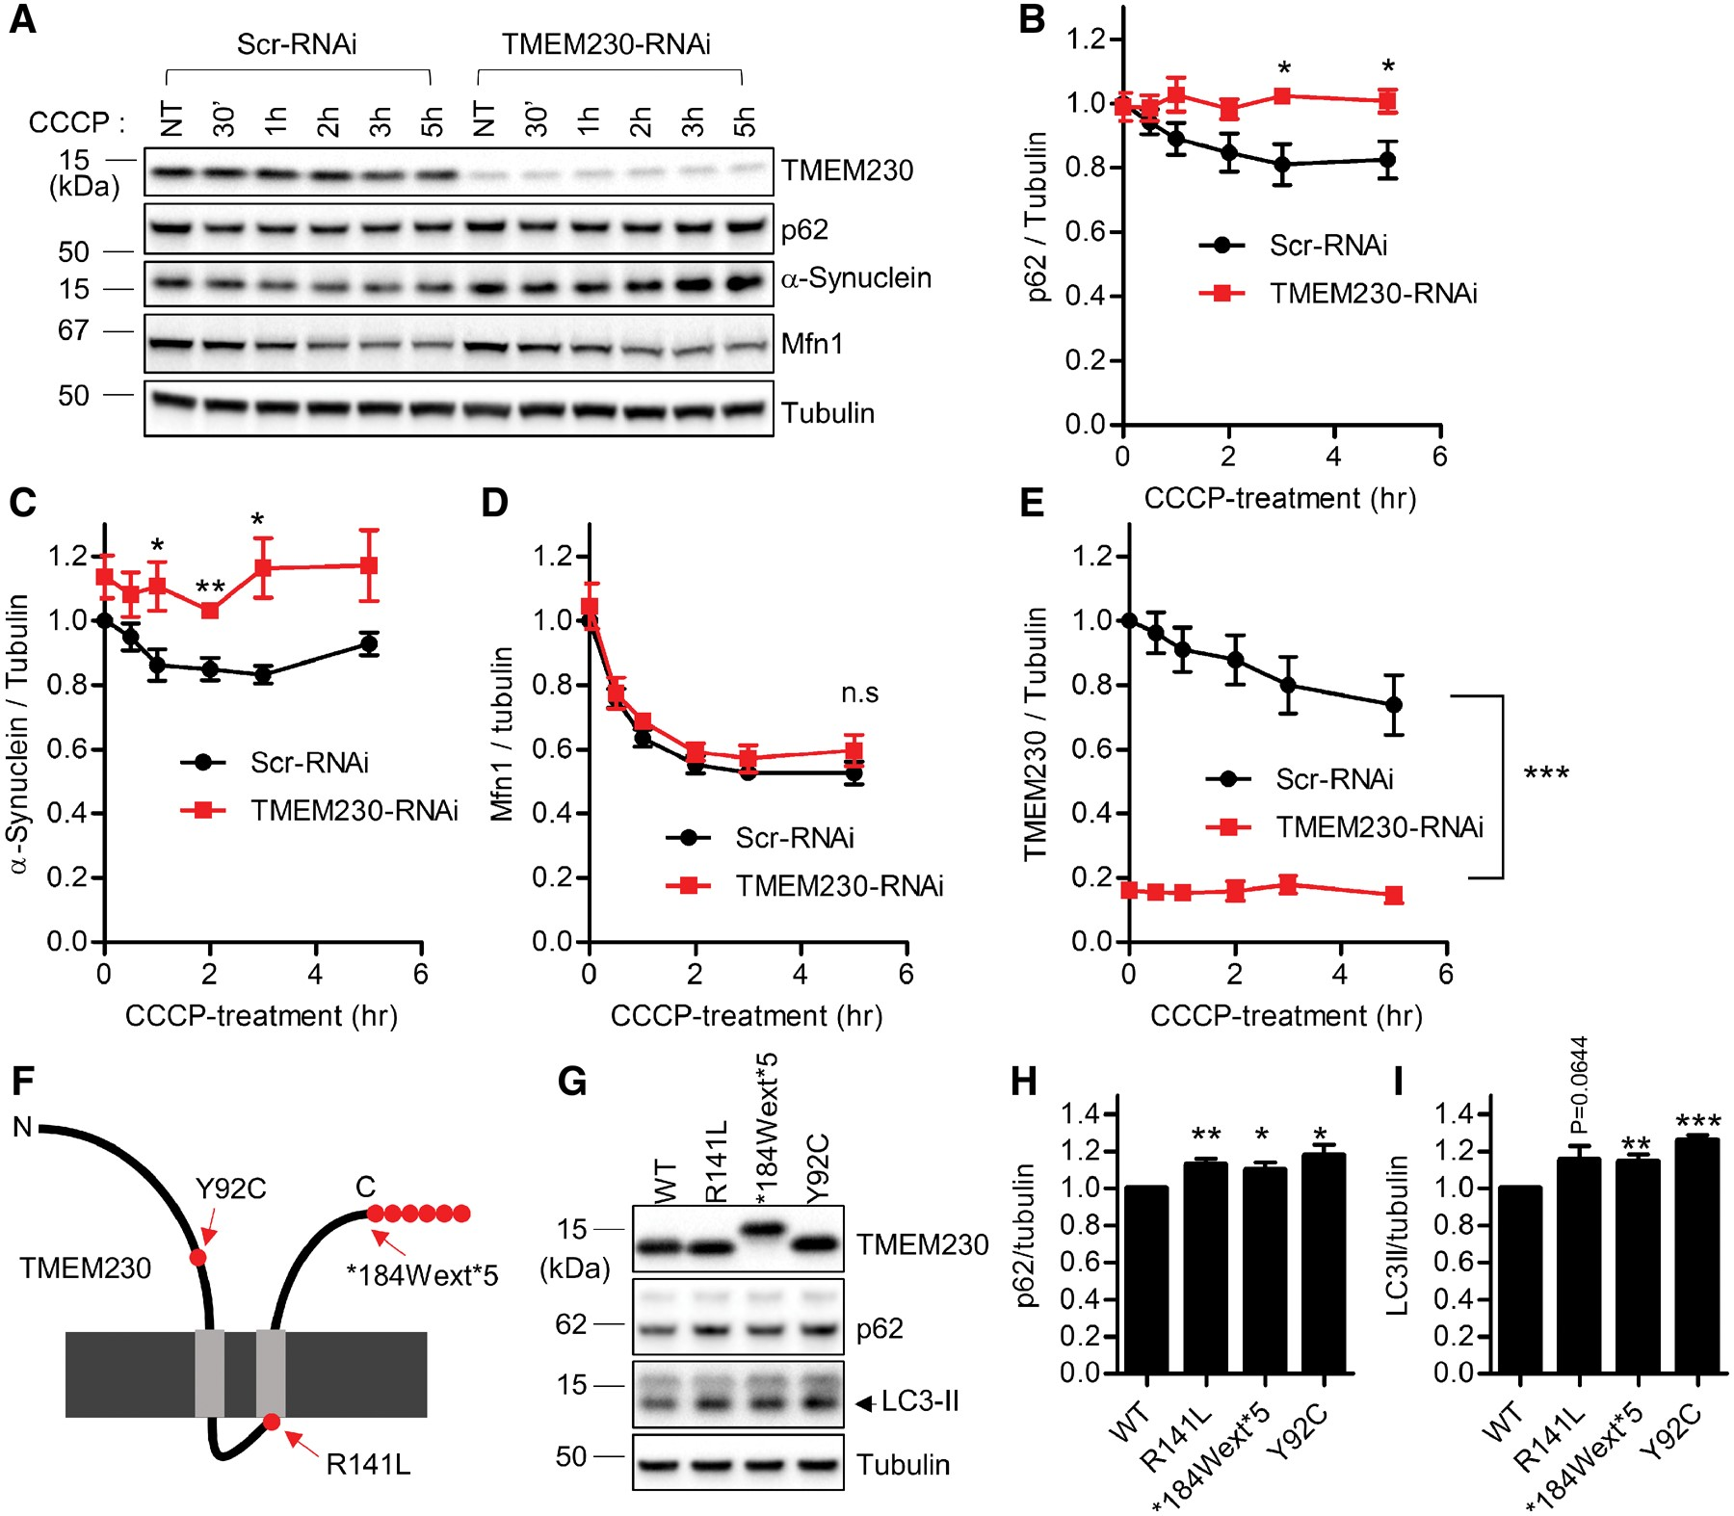
Figure 2. PD-linked TMEM230 variants and TMEM230 knockdown disrupt autophagic clearance of p62 and α-synuclein. (A–E) ...
Notes:
Figure 2. PD-linked TMEM230 variants and TMEM230 knockdown disrupt autophagic clearance of p62 and α-synuclein. (A–E) Knockdown of endogenous TMEM230 impairs CCCP-induced autophagic clearance of p62 and α-synuclein. (A) Stable HEK293-FT cell lines expressing either control Scr-RNAi or TMEM230-RNAi were treated with 5 μM CCCP for the indicated time. Cells were then lysed with 2X SDS sample buffer, and analysed with immunoblotting using indicated antibodies. Immunoblot band intensities were normalized to tubulin, and compared to control Scr-RNAi cells. Graphs show normalized immunoblot band intensities of p62 (B), α-synuclein(C), Mfn1 (D) and TMEM230 (E). Data represent mean ± SEM; N = 5, two-tailed paired t-test; *=P < 0.05; **=P < 0.01; ***=P 5, two-tailed paired t-test, *=P < 0.05; **=P < 0.01; ***=P < 0.001 compared with WT-TMEM230.
Unless provided in the caption above, the following copyright applies to the content of this slide: © The Author 2017. Published by Oxford University Press. All rights reserved. For Permissions, please email: journals.permissions@oup.com

Slide 3
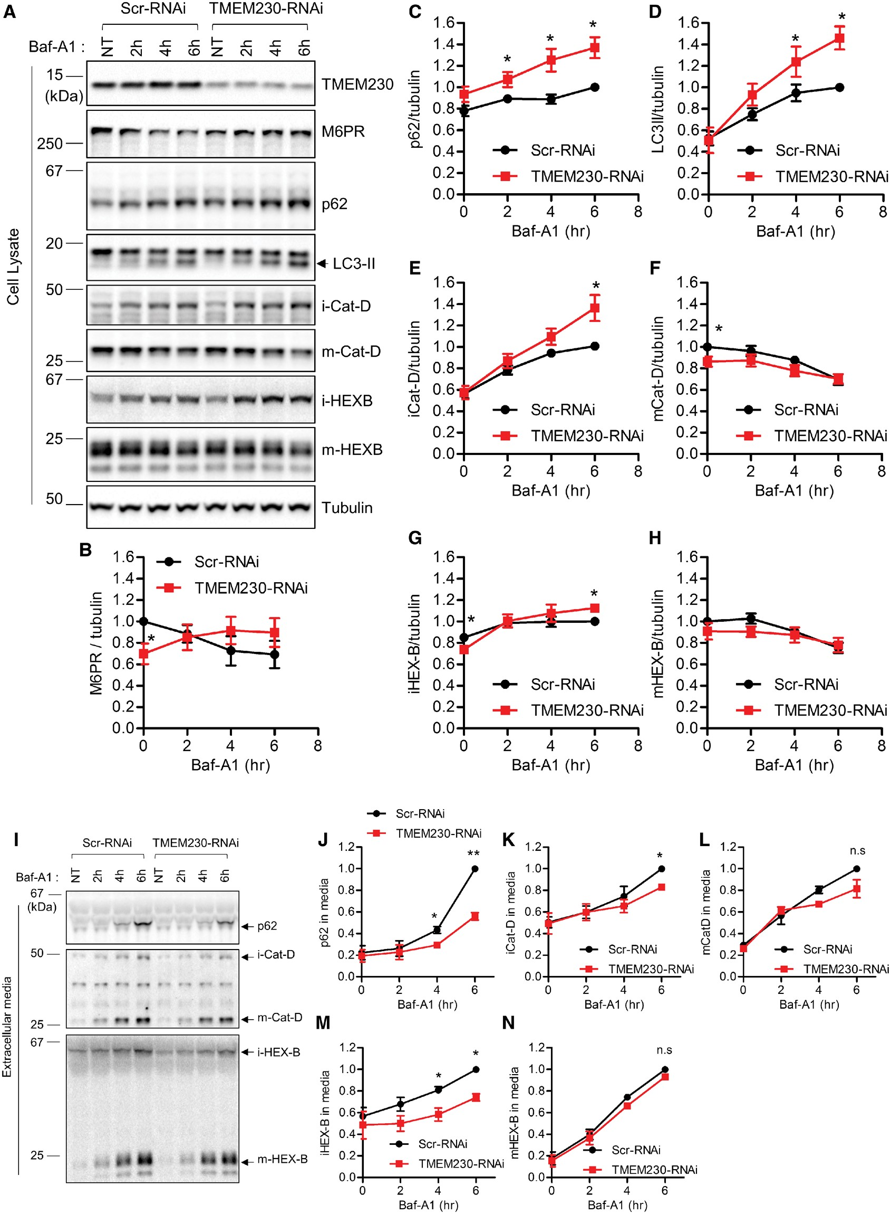
Figure 3. TMEM230 knockdown disrupts retromer cargo CI-M6PR trafficking and impairs secretory autophagy and ...
Notes:
Figure 3. TMEM230 knockdown disrupts retromer cargo CI-M6PR trafficking and impairs secretory autophagy and Golgi-derived vesicle secretion. (A–H) TMEM230 depletion reduces steady state levels of CI-M6PR retromer cargo levels and increases BafA1-induced intracellular accumulation of autophagic cargo (p62 and LC3-II) and Golgi-derived vesicle cargo (immature lysosomal hydrolases iCat-D and iHEX-B) but not lysosomal cargo (mature lysosomal hydrolases mCat-D and mHEX-B). HEK293-FT cells were transfected with either control Scr-RNAi or TMEM230-RNAi. Two days later, cells were treated with 300 nM Baf-A1 for the indicated time. Cell lysates fractions and extracellular media fraction were prepared as described in Experimental Procedures. Protein samples from cell lysate were analysed with immunoblotting with indicated antibodies. (A) Representative immunoblot data from cell lysates. Band intensities were normalized to tubulin, and compared to control Scr-RNAi. Graphs show normalized band intensities of intracellular CI-M6PR (N = 4) (B), intracellular p62 (N = 5) (C), intracellular LC3-II (N = 5) (D), intracellular immature cathepsin-D (N = 5) (E), intracellular mature cathepsin-D (N = 5) (F), intracellular immature HEX-B (N = 5) (G) and intracellular mature HEX-B (N = 5) (H). Data represent mean ± SEM; two tailed paired t-test, *=P < 0.05 compared with Scr-RNAi. (I-N) TMEM230 depletion inhibits BafA1-induced extracellular secretion of autophagic cargo (p62) and Golgi-derived vesicle cargo (immature lysosomal hydrolases iCat-D and iHEX-B) but not lysosomal cargo (mature lysosomal hydrolases mCat-D and mHEX-B). After Baf-A1 treatment for indicated times, harvested extracellular media fractions were analysed with immunoblotting using indicated antibodies. Band intensities from immunoblotting using conditioned media were normalized to total tubulin in cell lysate fractions, and compared to Scr-RNAi. (I) Representative immunoblot data from extracellular media fractions. Graphs show normalized immunoblot band intensities of p62 from extracellular media (J), immature cathepsin-D from extracellular media (K), mature cathepsin-D from extracellular media (L), immature HEX-B from extracellular media (M) and mature HEX-B from extracellular media (N). Data represent mean ± SEM; N = 3, two-tailed paired t-test, *=P < 0.05; **=P < 0.01, compared with Scr-RNAi.
Unless provided in the caption above, the following copyright applies to the content of this slide: © The Author 2017. Published by Oxford University Press. All rights reserved. For Permissions, please email: journals.permissions@oup.com

Slide 4
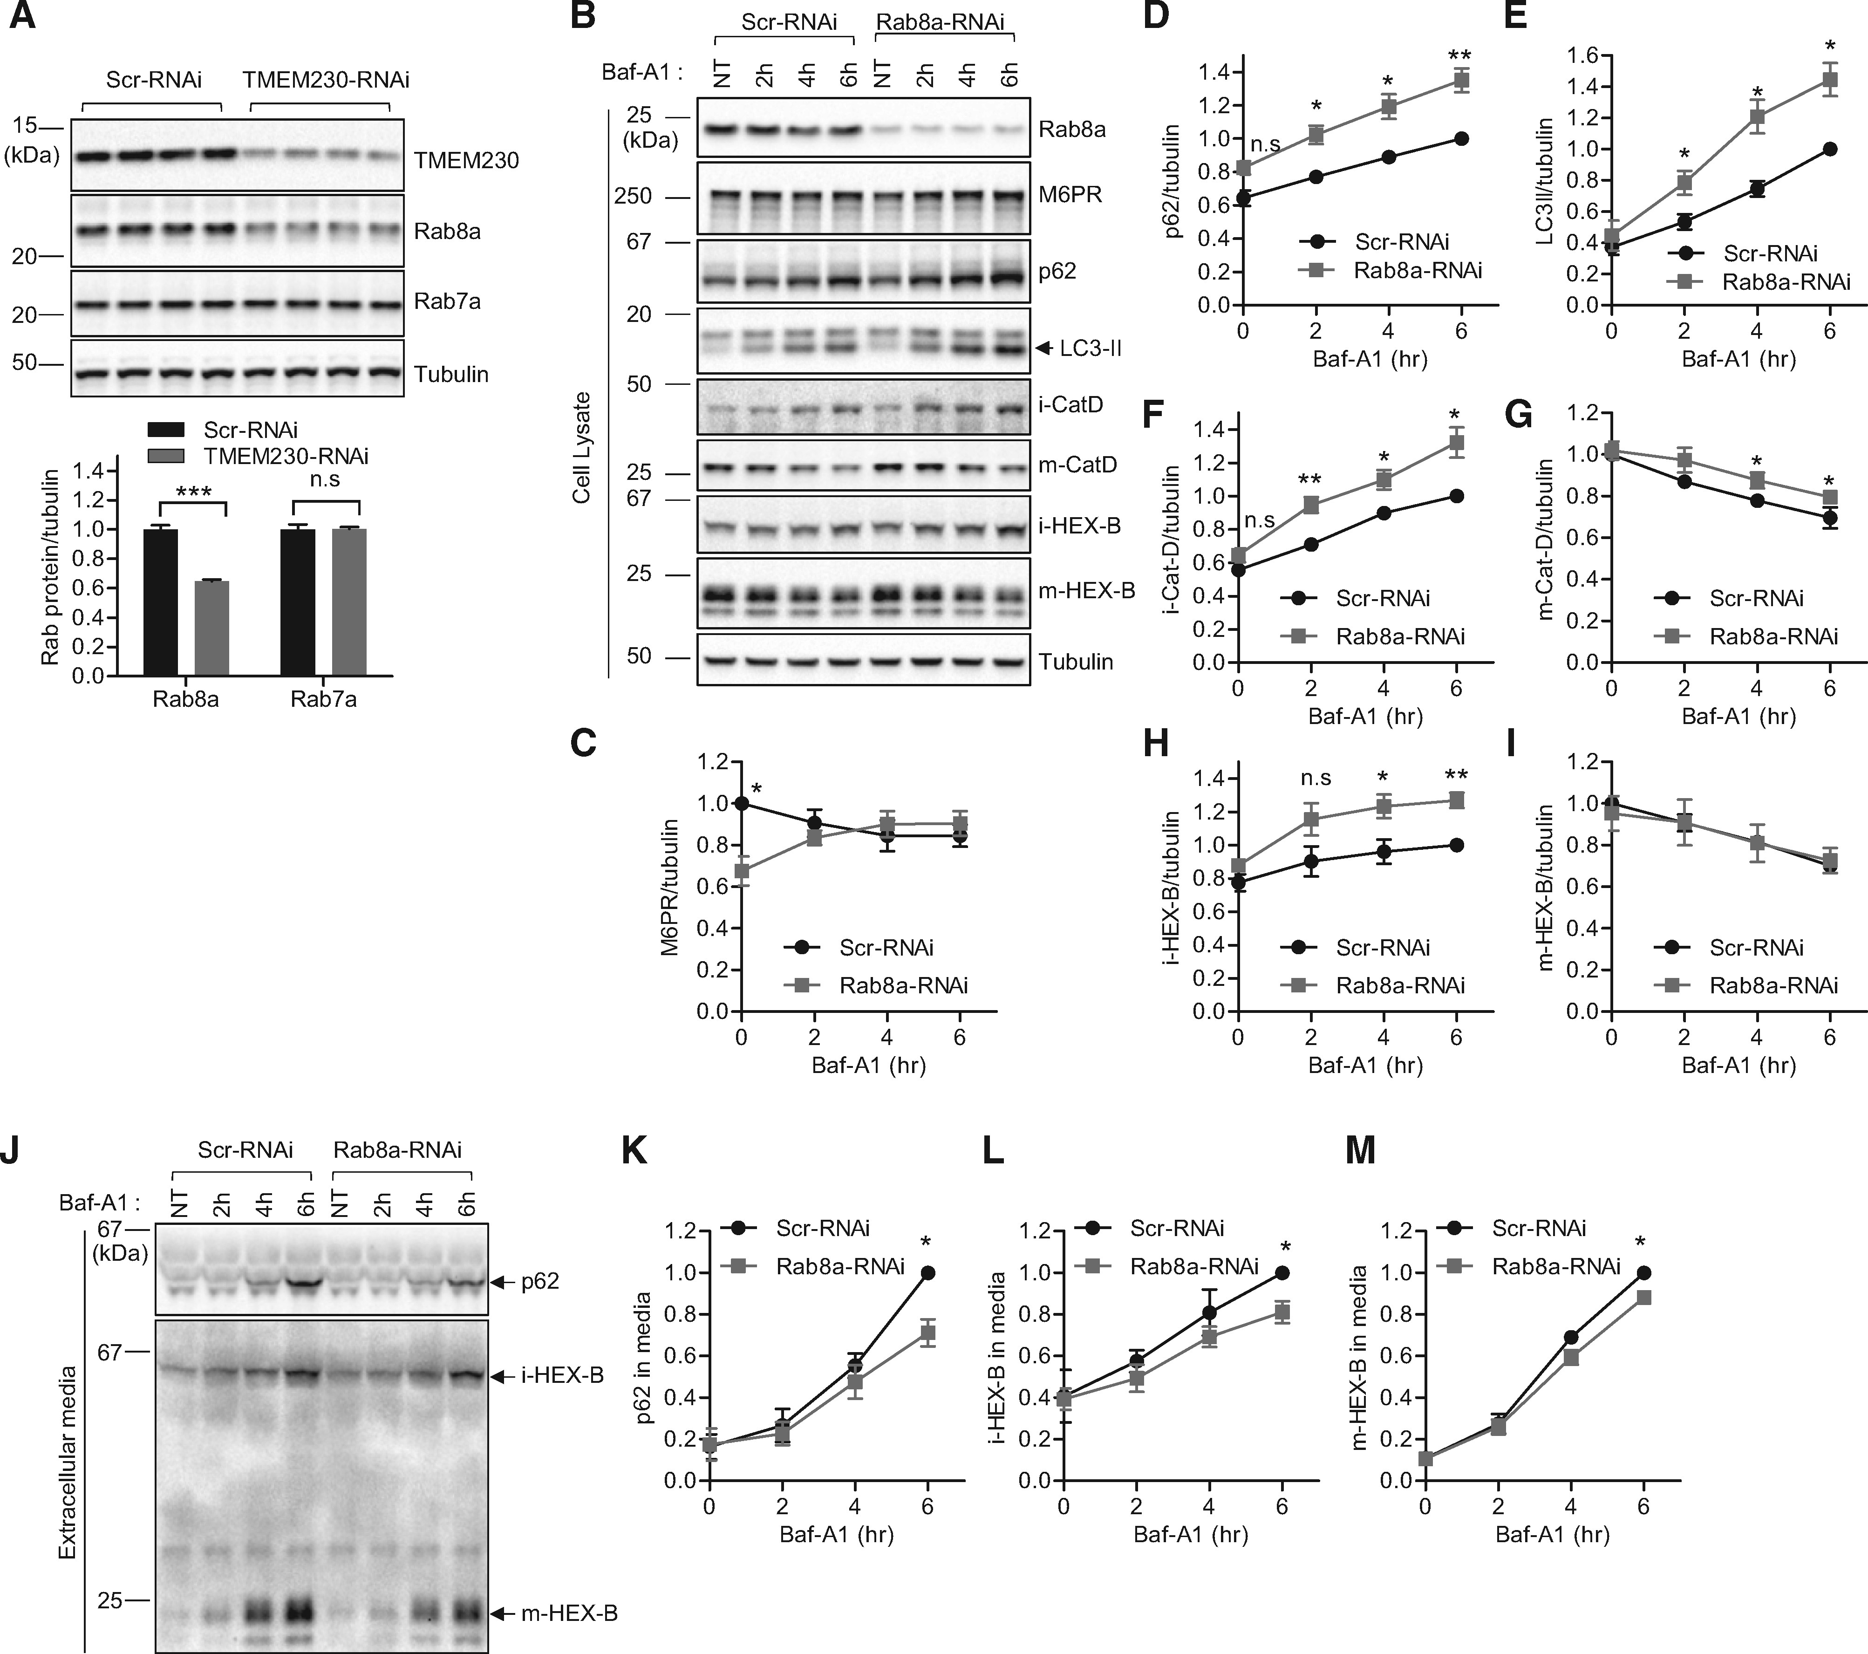
Figure 4. Rab8a mediates retromer cargo CI-M6PR trafficking, secretory autophagy and Golgi-derived vesicle secretion ...
Notes:
Figure 4. Rab8a mediates retromer cargo CI-M6PR trafficking, secretory autophagy and Golgi-derived vesicle secretion defects upon TMEM230 knockdown. (A) TMEM230 depletion reduces Rab8a but not Rab7a protein levels. HEK293-FT cells were transfected either with control Scr-RNAi or TMEM230-RNAi. Two days later, transfected cells were analysed with immunoblotting using TMEM230, Rab8a, Rab7a and tubulin antibodies. Immunoblot band intensities were normalized to tubulin, and compared to Scr-RNAi. Graphs show normalized Rab8a immunoblot intensity in cell lysates. Data represent mean ± SEM; N = 4, two-tailed t-test, ***=P < 0.001 compared to Scr-RNAi. (B-I) Rab8a depletion reduces steady state levels of CI-M6PR retromer cargo levels and increases BafA1-induced intracellular accumulation of autophagic cargo (p62 and LC3-II) and Golgi-derived vesicle cargo (immature lysosomal hydrolases iCat-D and iHEX-B), and partially affects lysosomal cargo levels (mature lysosomal hydrolases mCat-D and mHEX-B). HEK293-FT cells were transfected with either Scr-RNAi or Rab8a-RNAi. Two days later, cells were treated with 300 nM Baf-A1 for the indicated time. Extracellular media fractions were prepared as described in Experimental Procedures. Cells were lysed with 2X SDS-sample buffer and cell lysates were analysed by immunoblotting with indicated antibodies. (B) Representative immunoblot data from cell lysates. Band intensities were normalized to total tubulin, and compared to Scr-RNAi. Graphs show normalized band intensities of intracellular CI-M6PR (N = 5) (C), intracellular p62 (N = 5) (D), intracellular LC3-II (N = 5) (E), intracellular immature cathepsin-D (N = 5) (F), intracellular mature cathepsin-D (N = 5) (G), intracellular immature HEX-B (N = 5) (H) and intracellular mature HEX-B (N = 5) (I). Data represent mean ± SEM; two-tailed paired t-test, *=P < 0.05; **=P < 0.01 compared with Scr-RNAi. (J-M) Rab8a depletion inhibits Baf-A1-induced extracellular secretion of autophagic cargo (p62), Golgi-derived vesicle cargo (immature lysosomal hydrolase iHEX-B) and lysosomal cargo (mature lysosomal hydrolase mHEX-B). After Baf-A1 treatment for indicated times, harvested extracellular media fractions were analysed with immunoblotting using indicated antibodies. (J) Representative immunoblot data from extracellular media fractions. Blot band intensities were normalized to total tubulin, and compared to Scr-RNAi. Graphs show normalized immunoblot band intensities of p62 from extracellular media (N = 3) (K), immature HEX-B from extracellular media (N = 4) (L), and mature HEX-B from extracellular media (N = 4) (M). Data represent mean ± SEM; two-tailed paired t-test, *=P < 0.05, compared with control Scr-RNAi.
Unless provided in the caption above, the following copyright applies to the content of this slide: © The Author 2017. Published by Oxford University Press. All rights reserved. For Permissions, please email: journals.permissions@oup.com

Slide 5
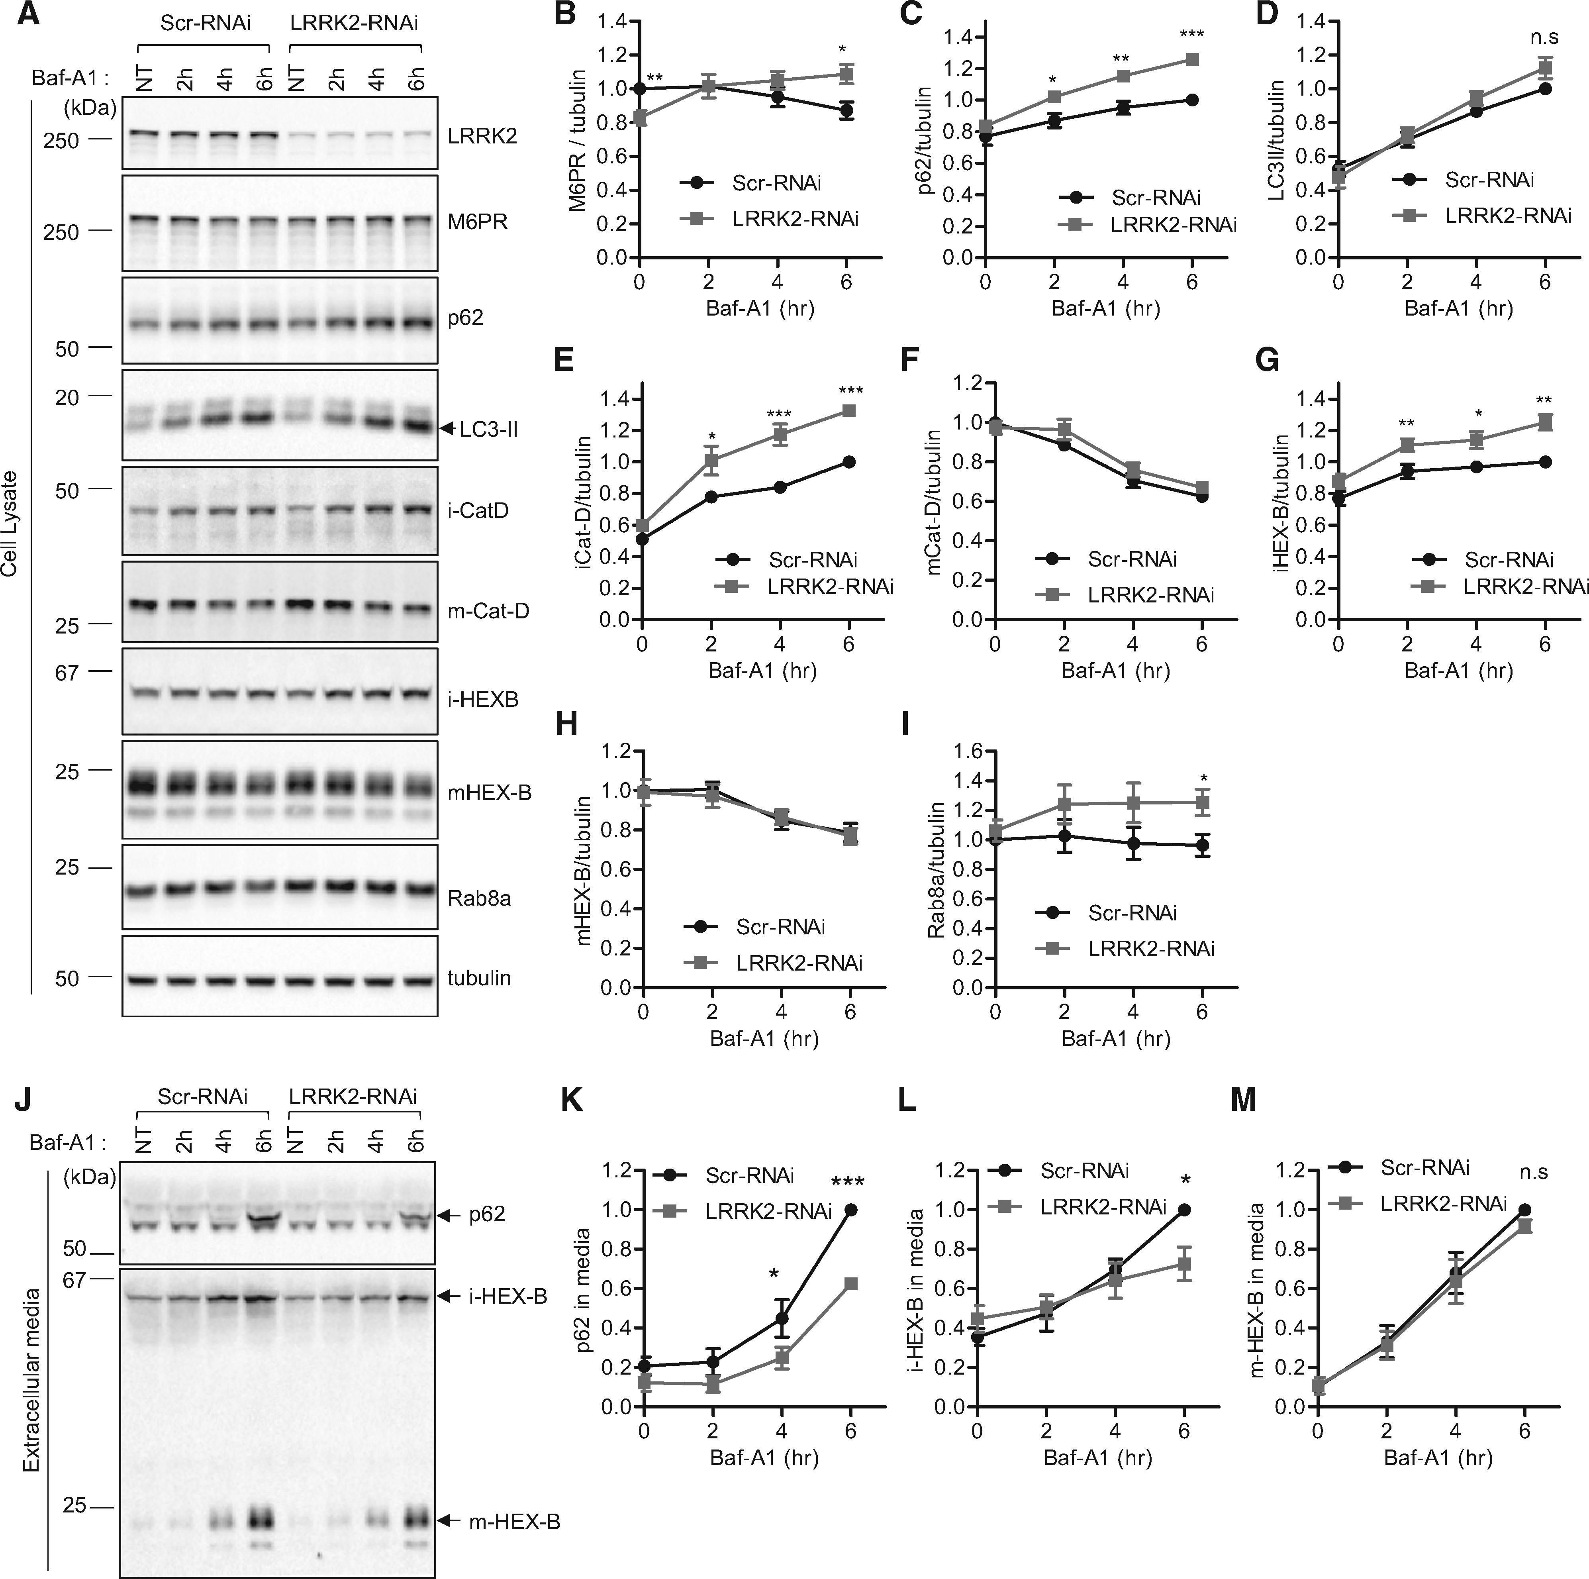
Figure 5. Knockdown of LRRK2 disrupts retromer cargo CI-M6PR trafficking and impairs secretory autophagy and ...
Notes:
Figure 5. Knockdown of LRRK2 disrupts retromer cargo CI-M6PR trafficking and impairs secretory autophagy and Golgi-derived vesicle secretion. (A–I) LRRK2 depletion reduces steady state levels of CI-M6PR retromer cargo levels and increases Baf-A1-induced intracellular accumulation of autophagic cargo (p62) and Golgi-derived vesicle cargo (immature lysosomal hydrolases iCat-D and iHEX-B) but not lysosomal cargo (mature lysosomal hydrolases mCat-D and mHEX-B). LRRK2 depletion also increases Baf-A1 induced Rab8a intracellular accumulation. HEK293-FT cells were transfected with either Scr-RNAi or LRRK2-RNAi. Two days after transfection, cells were untreated or treated with Baf-A1 for the indicated times. Extracellular media fractions from each time point were collected, and cells were lysed with 2X SDS sample buffer. Cell lysate samples were analysed with immunoblot analysis using indicated antibodies. Blot band intensities were normalized to tubulin, and compared to control Scr-RNAi. (A) Representative immunoblot data from cell lysates. Graphs show normalized band intensities of intracellular CI-M6PR (N = 7) (B), p62 (N = 7) (C), LC3-II (N = 8) (D), immature cathepsin-D (N = 8) (E), mature cathepsin-D (N = 8) (F), immature HEX-B (N = 6) (G), mature HEX-B (N = 6) (H) or Rab8a (N = 3) (I). Data represent mean ± SEM; two-tailed paired t-test, *=P < 0.05; **=P < 0.01; ***=P < 0.001 compared with control Scr-RNAi. (J-M) LRRK2 depletion inhibits Baf-A1-induced extracellular secretion of autophagic cargo (p62) and Golgi-derived vesicle cargo (immature lysosomal hydrolase iHEX-B) but not lysosomal cargo (mature lysosomal hydrolase mHEX-B). After Baf-A1 treatment for indicated times, harvested extracellular media fractions were analysed with immunoblotting using indicated antibodies. (J) Representative immunoblot data from extracellular media fractions. Blot band intensities were normalized to total tubulin, and compared to control Scr-RNAi. Graphs show normalized immunoblot band intensities of p62 from extracellular media (N = 3) (K), immature HEX-B from extracellular media (N = 4) (L), and mature HEX-B from extracellular media (N = 4) (M). Data represent mean ± SEM; two-tailed paired t-test, *=P < 0.05; ***=P < 0.001 compared with control Scr-RNAi.
Unless provided in the caption above, the following copyright applies to the content of this slide: © The Author 2017. Published by Oxford University Press. All rights reserved. For Permissions, please email: journals.permissions@oup.com

