Slide 1
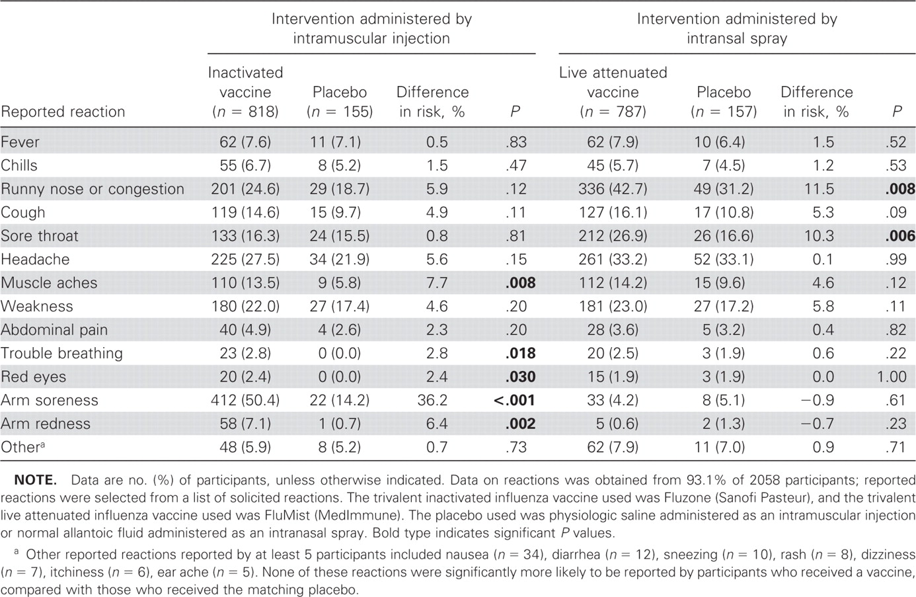
Table 1 Local and systemic reactions reported by 1917 participants in the 2005–2006 study within 7 days after receipt ...
Notes:
Table 1 Local and systemic reactions reported by 1917 participants in the 2005–2006 study within 7 days after receipt of study interventions.
Unless provided in the caption above, the following copyright applies to the content of this slide: © 2008 by the Infectious Diseases Society of America

Slide 2
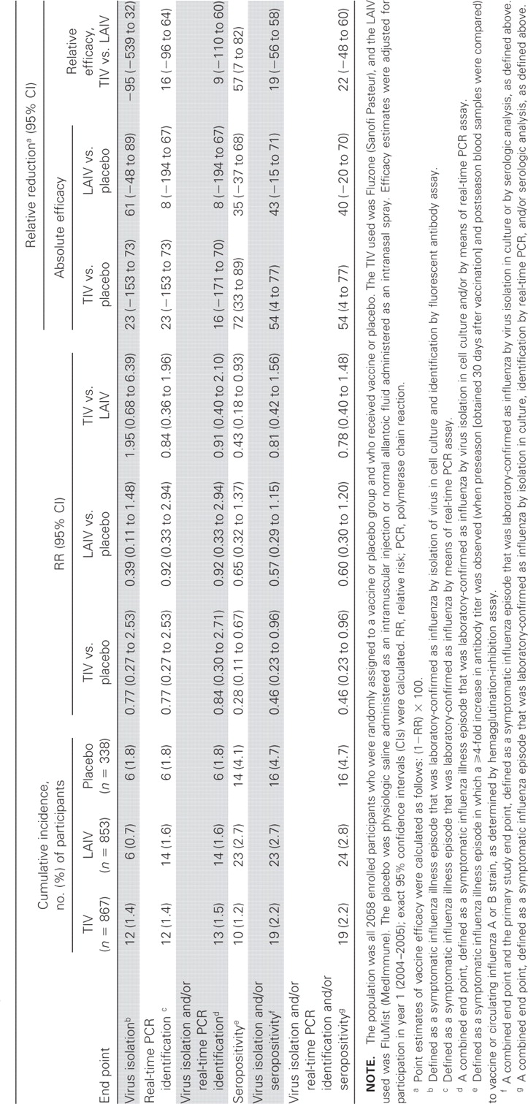
Table 2 Estimated absolute and relative efficacies of the trivalent inactivated influenza vaccine (TIV) and the live ...
Notes:
Table 2 Estimated absolute and relative efficacies of the trivalent inactivated influenza vaccine (TIV) and the live attenuated influenza vaccine (LAIV) during the 2005–2006 influenza season in Michigan.
Unless provided in the caption above, the following copyright applies to the content of this slide: © 2008 by the Infectious Diseases Society of America

