Slide 1
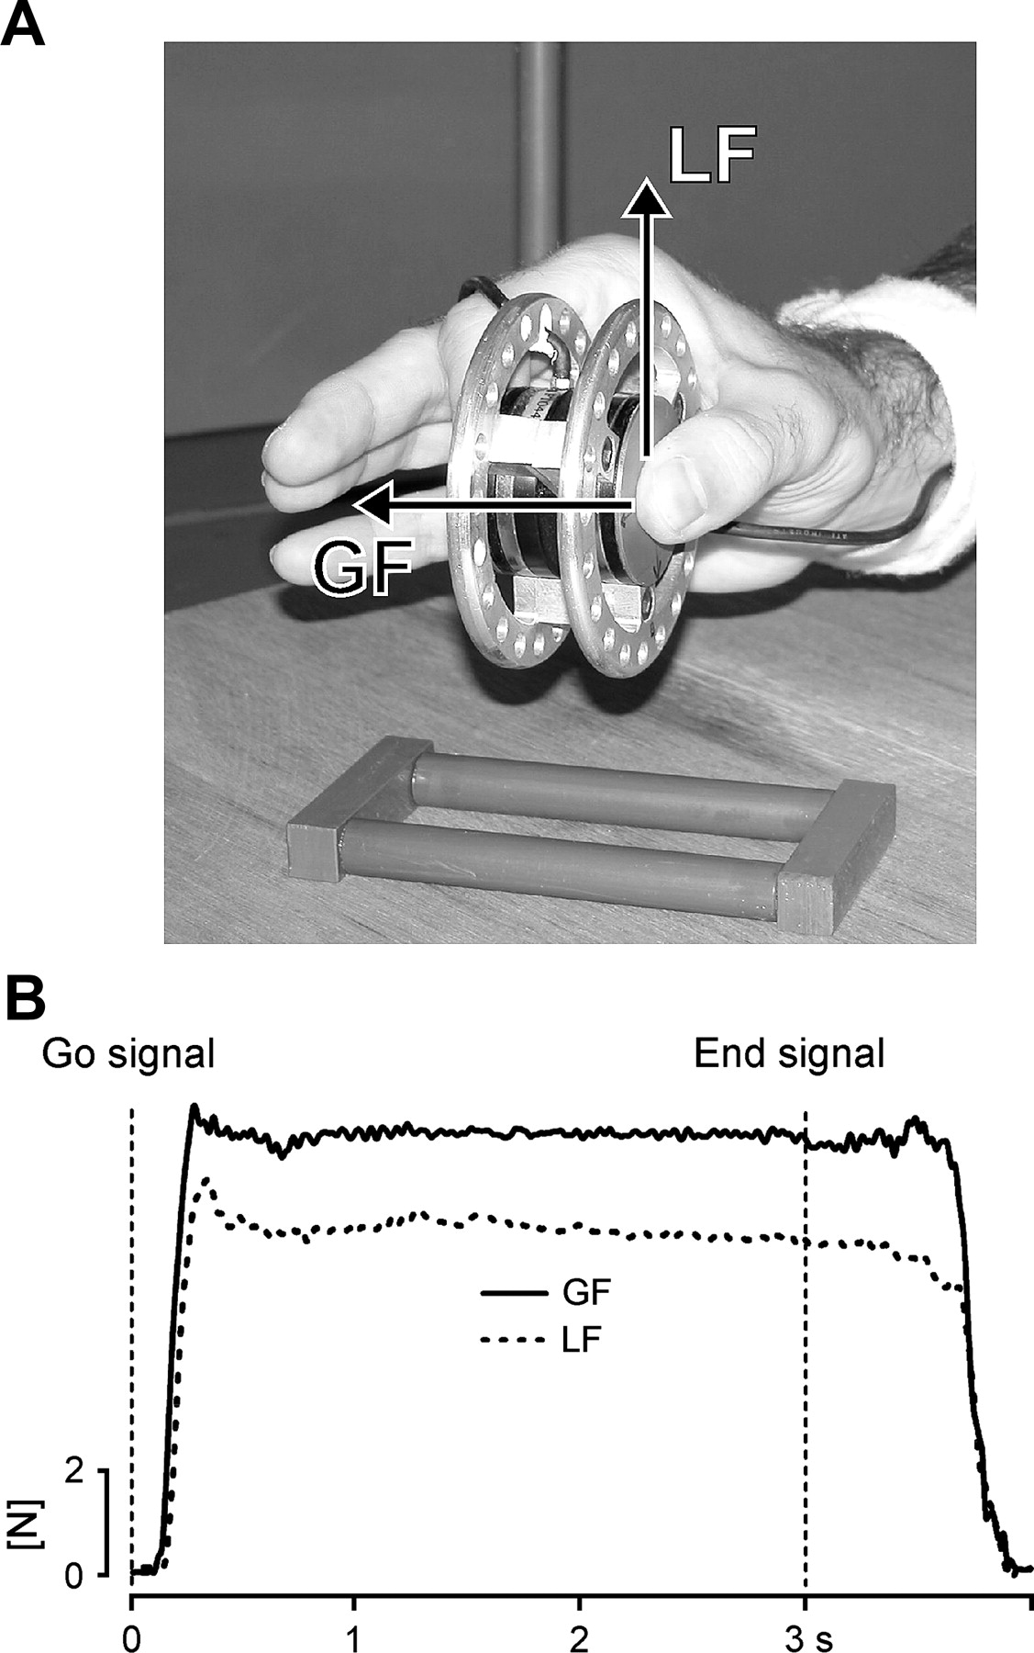
Figure 1 (A) Apparatus used to measure forces during the grip-lift task. Only the thumb and index fingertips were in ...
Notes:
Figure 1 (A) Apparatus used to measure forces during the grip-lift task. Only the thumb and index fingertips were in contact with the lateral surface of the apparatus. The GF and LF are illustrated for the thumb by horizontal and vertical vectors, respectively. (B) Representative control GF and LF traces. Following an auditory GO signal, the subject had to grasp and lift the apparatus. After about 3 s, another auditory signal indicated the end of the task.
Unless provided in the caption above, the following copyright applies to the content of this slide: © The Author 2006. Published by Oxford University Press. All rights reserved. For permissions, please e-mail: journals.permissions@oxfordjournals.org

Slide 2
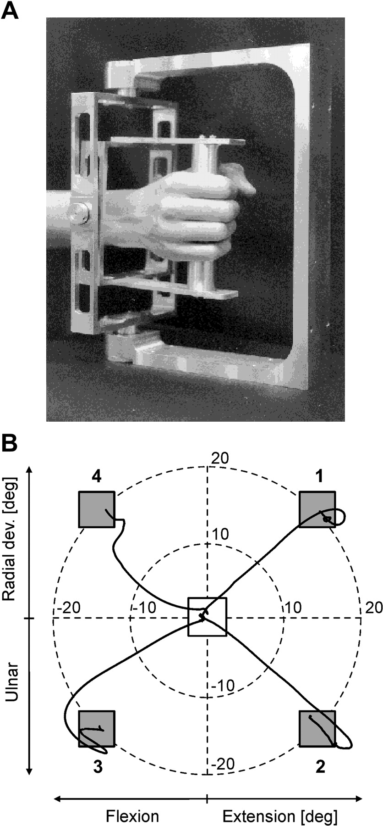
Figure 2 (A) Manipulandum used to study step-tracking wrist movements. Two potentiometers were coupled to this device ...
Notes:
Figure 2 (A) Manipulandum used to study step-tracking wrist movements. Two potentiometers were coupled to this device to measure the wrist displacements in the horizontal (FE) and vertical (RU) axes. The subject's wrist was positioned carefully so that the rotation center of the handle matched that of the wrist. (B) Schematic view of the computer display, as viewed by the subject, showing the central square, the 4 peripheral targets (light gray), and 4 illustrative trajectories of control step-tracking movements. Only one peripheral target was presented at once. The path length of the wrist necessary to reach the target was 20 degrees. Flexion/extension movements of the wrist are represented along the x axis and radial/ulnar displacements along the y axis. Positive values on the x and y axes represent, respectively, an extension and a radial displacement.
Unless provided in the caption above, the following copyright applies to the content of this slide: © The Author 2006. Published by Oxford University Press. All rights reserved. For permissions, please e-mail: journals.permissions@oxfordjournals.org

Slide 3
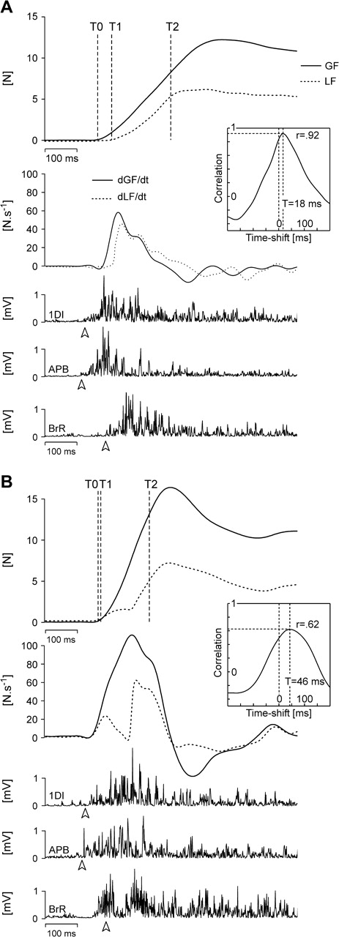
Figure 3 (A) Control recordings of different grip-lift task parameters, namely (from top to bottom), GF and LF, their ...
Notes:
Figure 3 (A) Control recordings of different grip-lift task parameters, namely (from top to bottom), GF and LF, their first derivatives (dGF/dt and dLF/dt) and the EMG activity of the 1DI, the APB, and the BrR. T0–T1 and T1–T2 cursors delimit the preloading and loading phases, respectively. The white arrowheads indicate the EMG onset for each muscle in this particular trial. All traces were aligned on the GO signal. The inset shows the cross-correlation function computed between dGF/dt and dLF/dt (see Methods); T is the timeshift and r the cross-correlation coefficient. (B) Effect of TMS applied over iM1 on a grip-lift movement. Same conventions as in (A). White arrowheads show the EMG onset times of the above control trial. TMS of iM1 yielded a decrease of the preloading and loading phase durations together with a reduced 1DI–BrR recruitment delay, whereas the time to peak dLF/dt and the timeshift increased. This resulted in a smaller cross-correlation coefficient.
Unless provided in the caption above, the following copyright applies to the content of this slide: © The Author 2006. Published by Oxford University Press. All rights reserved. For permissions, please e-mail: journals.permissions@oxfordjournals.org

Slide 4
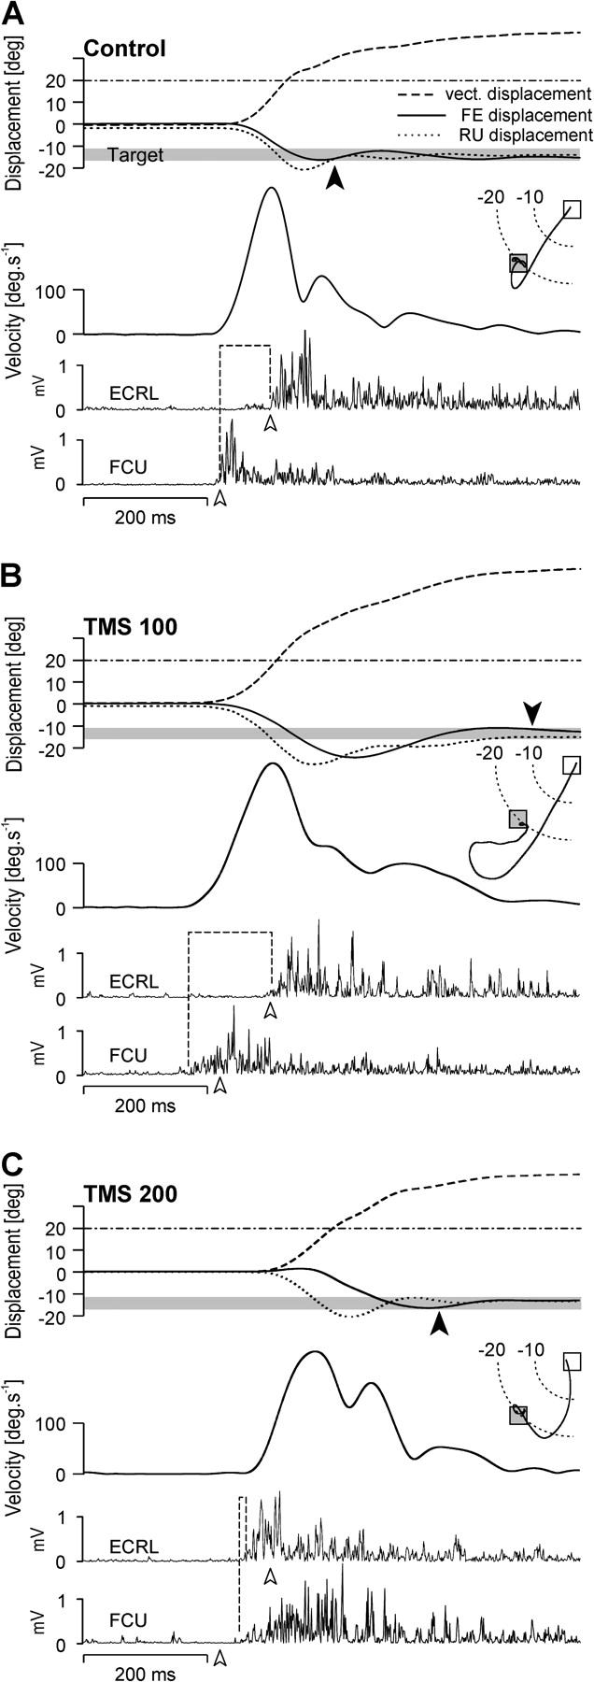
Figure 4 (A) Control recordings of the different step-tracking task parameters for a movement directed toward the ...
Notes:
Figure 4 (A) Control recordings of the different step-tracking task parameters for a movement directed toward the bottom-left target (see inset). This figure shows, from top to bottom, the wrist displacement (FE, RU, and the path length), its vectorial velocity, and the EMG activity of the agonist (FCU) and antagonist (ECRL) muscles. All traces were aligned on target presentation. The shaded gray area in the displacement traces symbolizes the target location and its size (5 degrees); the black arrowhead indicates the end of the movement (see Methods). The dash-dotted line shows the smallest path length (20 degrees) necessary to reach the target without any overshoot. White arrowheads show the EMG onset times, and the dotted lines indicate the agonist–antagonist delay in this particular trial. (B, C) Effect of TMS applied over iM1 either 100 ms (B) or 200 ms (C) after target presentation. White arrowheads show the EMG onset times of the above control trial. Same conventions as in (A). TMS of iM1 yielded either an increase (B) or a decrease (C) in the agonist–antagonist delay; both resulting in an increased DR and MT.
Unless provided in the caption above, the following copyright applies to the content of this slide: © The Author 2006. Published by Oxford University Press. All rights reserved. For permissions, please e-mail: journals.permissions@oxfordjournals.org

Slide 5
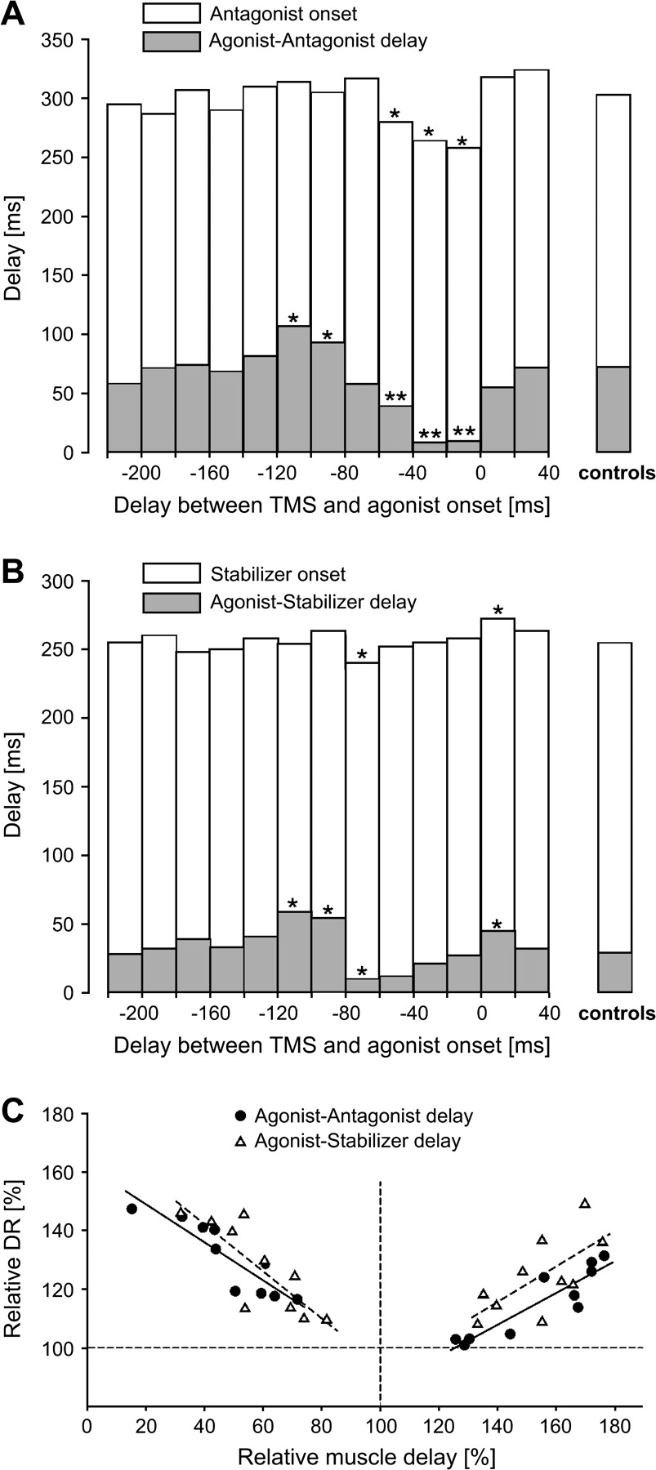
Figure 5 (A) Time course of the consequences of TMS of iM1 on the antagonist onset (white histograms) and on the ...
Notes:
Figure 5 (A) Time course of the consequences of TMS of iM1 on the antagonist onset (white histograms) and on the agonist–antagonist muscle delay (gray histogram) with respect to the onset of the agonist muscle contraction. When TMS was applied 120–80 ms before the agonist onset, it increased the agonist–antagonist delay without affecting the antagonist contraction time. TMS applied in a 60- to 0-ms time window before movement onset, decreased both the agonist–antagonist delay and the antagonist contraction time. Controls are the mean values gathered in the sham condition: **P < 0.001 and *P < 0.05 obtained after Bonferroni t-tests. Bin width 20 ms. (B) Time course of the consequences of TMS of iM1 on the stabilizer onset (white histograms) and on the agonist–stabilizer delay (gray histogram) with respect to the onset of the agonist muscle contraction. When TMS was applied 120–80 ms before the agonist onset, it increased the agonist–stabilizer delay without affecting the stabilizer contraction time. TMS applied in an 80- to 60-ms time window decreased both the agonist–stabilizer delay and the stabilizer recruitment time and, finally, when applied in a 0- to 20-ms time window, it increased both the agonist–stabilizer delay and the stabilizer recruitment time. Same conventions as in (A). (C) Correlations between TMS-induced changes in DR and in muscle delays (agonist–antagonist and agonist–stabilizer) computed using the Pearson correlation procedure. Changes in both DR and muscle delays are expressed as a percentage of control values (TMS/Sham × 100); control values are therefore at the intersection of the 2 dotted lines. Both a decrease and an increase in muscle delays led to a longer trajectory of step-tracking movements. Correlations were computed only for the muscle delays significantly different from control values (see Fig. A,B). Solid lines indicate the regression computed between the agonist–antagonist delays and DR (left: r = −0.89, P < 0.001; right: r = 0.9, P < 0.001); dashed lines show the regression calculated between the agonist–stabilizer delays and DR (left: r = −0.82, P = 0.003; right: r = 0.68, P = 0.03). Black dots: agonist–antagonist delay, open triangles: agonist–stabilizer delays.
Unless provided in the caption above, the following copyright applies to the content of this slide: © The Author 2006. Published by Oxford University Press. All rights reserved. For permissions, please e-mail: journals.permissions@oxfordjournals.org

Slide 6
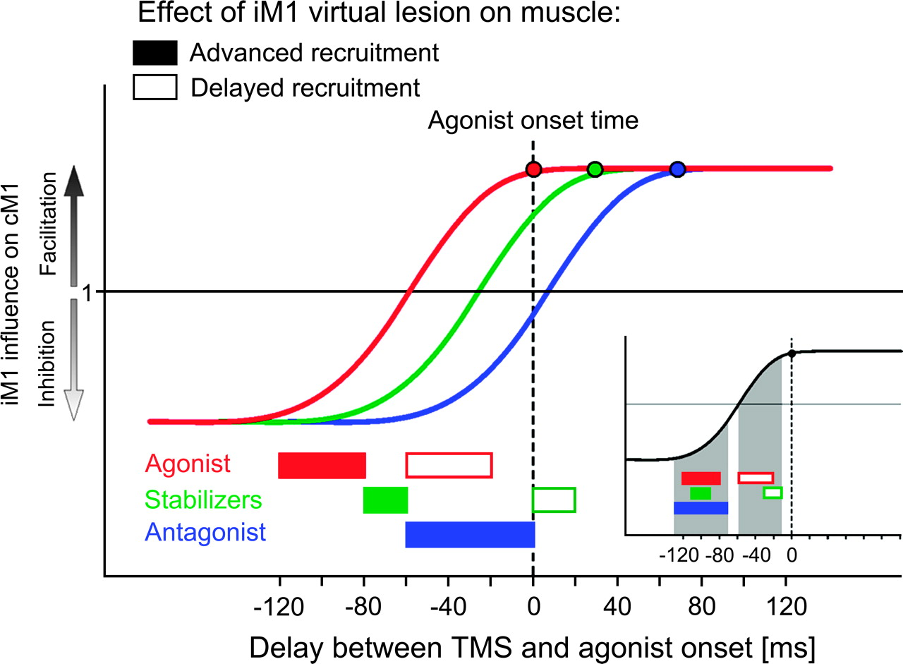
Figure 6 Schematic view of our hypothesis about the differential effects of iM1 virtual lesions on muscle contraction ...
Notes:
Figure 6 Schematic view of our hypothesis about the differential effects of iM1 virtual lesions on muscle contraction times. Our hypothesis is based on the results of a study by Murase and others (2004) showing that, at an early stage of movement preparation, the inhibition influence from iM1 to cM1 is maximal about 100 ms before the muscle recruitment; then it diminishes progressively and converts to facilitation just before the muscle becomes active. The time course of the transcallosal influence during movement preparation is represented by one sigmoid for each muscle group recruited sequentially in the step-tracking task (red: agonist, green: stabilizers, blue: antagonist); the 3 sigmoids were aligned with respect to the contraction time of the agonist (0 ms on the x axis). The color dots on each sigmoid indicate the approximate contraction time for each muscle as measured in control trials. The time windows during which TMS led either to an advanced or to a delayed recruitment of these 3 muscles are indicated by horizontal rectangles (see Fig. 5A,B for details). Filled rectangles indicate time windows when TMS advanced the muscle contraction and open rectangles when it delayed it. Color codes are the same as before: red, agonist; green, stabilizers; blue, antagonist. Because, in the present study, TMS was delivered a long way from the antagonist recruitment time, iM1 virtual lesions failed to delay its recruitment. The inset illustrates the same differential effects of TMS on muscle recruitment times but after shifting the 3 sigmoids in such a way that the contraction time of each muscle was realigned. This shows more clearly that the effects of iM1 virtual lesion on the muscle recruitment are the same for each muscle and only depend on the timing of TMS application. By inducing a virtual lesion of iM1 around 120–80 ms before the contraction of a given muscle, TMS advanced its recruitment, probably by impeding the transcallosal inhibitory influence normally exerted by iM1 on the opposite hemisphere. In contrast, by disrupting iM1 activity later, about 30 ms before the muscle contraction, when the transcallosal influence is facilitatory, we delayed the muscle recruitment, possibly by interfering with this facilitatory transcallosal influence.
Unless provided in the caption above, the following copyright applies to the content of this slide: © The Author 2006. Published by Oxford University Press. All rights reserved. For permissions, please e-mail: journals.permissions@oxfordjournals.org

