Slide 1
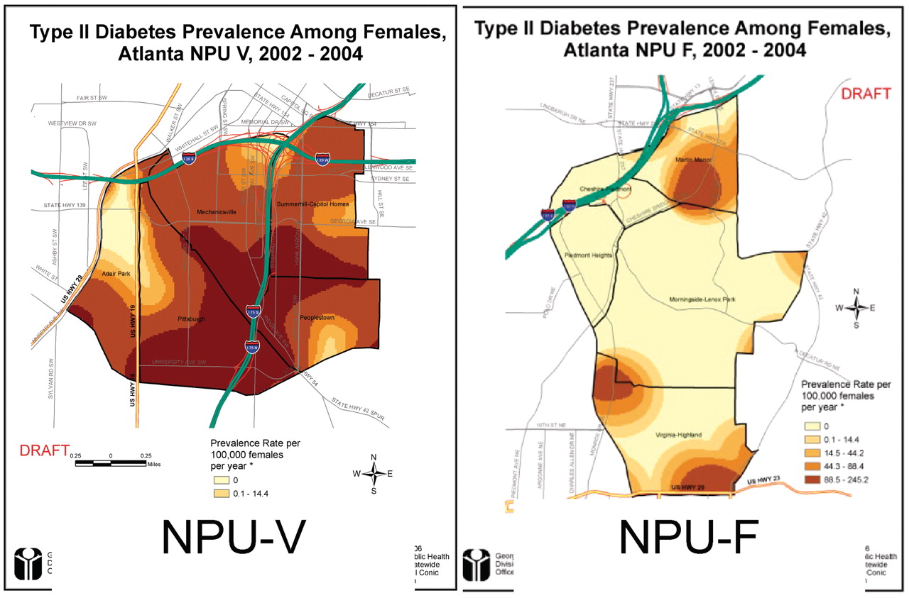
Fig. 1. Example of comparative GIS data presented during ‘Listening Sessions:’ Type II diabetes prevalence among ...
Notes:
Fig. 1. Example of comparative GIS data presented during ‘Listening Sessions:’ Type II diabetes prevalence among females, in NPU-V and NPU F 2002-2004 (the darker the shading, the higher the prevalence).
Unless provided in the caption above, the following copyright applies to the content of this slide: © The Author 2012. Published by Oxford University Press. All rights reserved. For permissions, please email: journals.permissions@oup.com

Slide 2
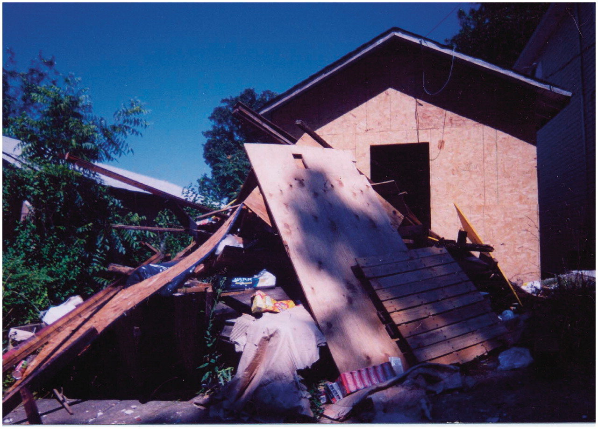
Fig. 2. Example of ‘Photovoice’ reflecting a resident’s concern.
Notes:
Fig. 2. Example of ‘Photovoice’ reflecting a resident’s concern.
Unless provided in the caption above, the following copyright applies to the content of this slide: © The Author 2012. Published by Oxford University Press. All rights reserved. For permissions, please email: journals.permissions@oup.com

Slide 3
Fig. 3. ‘Dirty Truth’ postcard. How Photovoice was used to call policy-makers’ attention to environmental problems ...
Notes:
Fig. 3. ‘Dirty Truth’ postcard. How Photovoice was used to call policy-makers’ attention to environmental problems associated in NPU-V.
Unless provided in the caption above, the following copyright applies to the content of this slide: © The Author 2012. Published by Oxford University Press. All rights reserved. For permissions, please email: journals.permissions@oup.com

