Slide 1
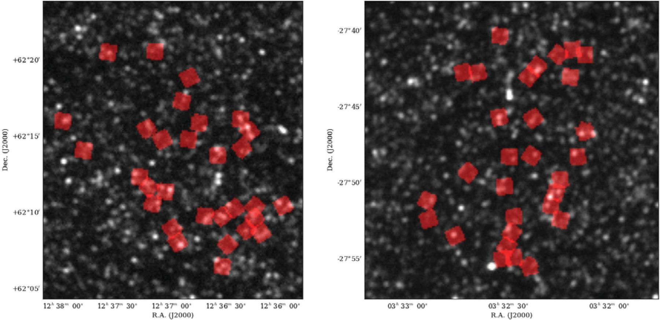
Figure 1. Footprint of the GNS (red) overlaid on the HerMES 250?µm maps of the GOODS-North (left) and GOODS-South ...
Notes:
Figure 1. Footprint of the GNS (red) overlaid on the HerMES 250?µm maps of the GOODS-North (left) and GOODS-South (right) fields. Each GNS pointing is in the direction of one or more M* > 1011?M? galaxies at 1.7 < z < 2.9, and is about 50?arcsec on a side.
Unless provided in the caption above, the following copyright applies to the content of this slide: © 2012 The Authors Monthly Notices of the Royal Astronomical Society © 2012 RAS

Slide 2
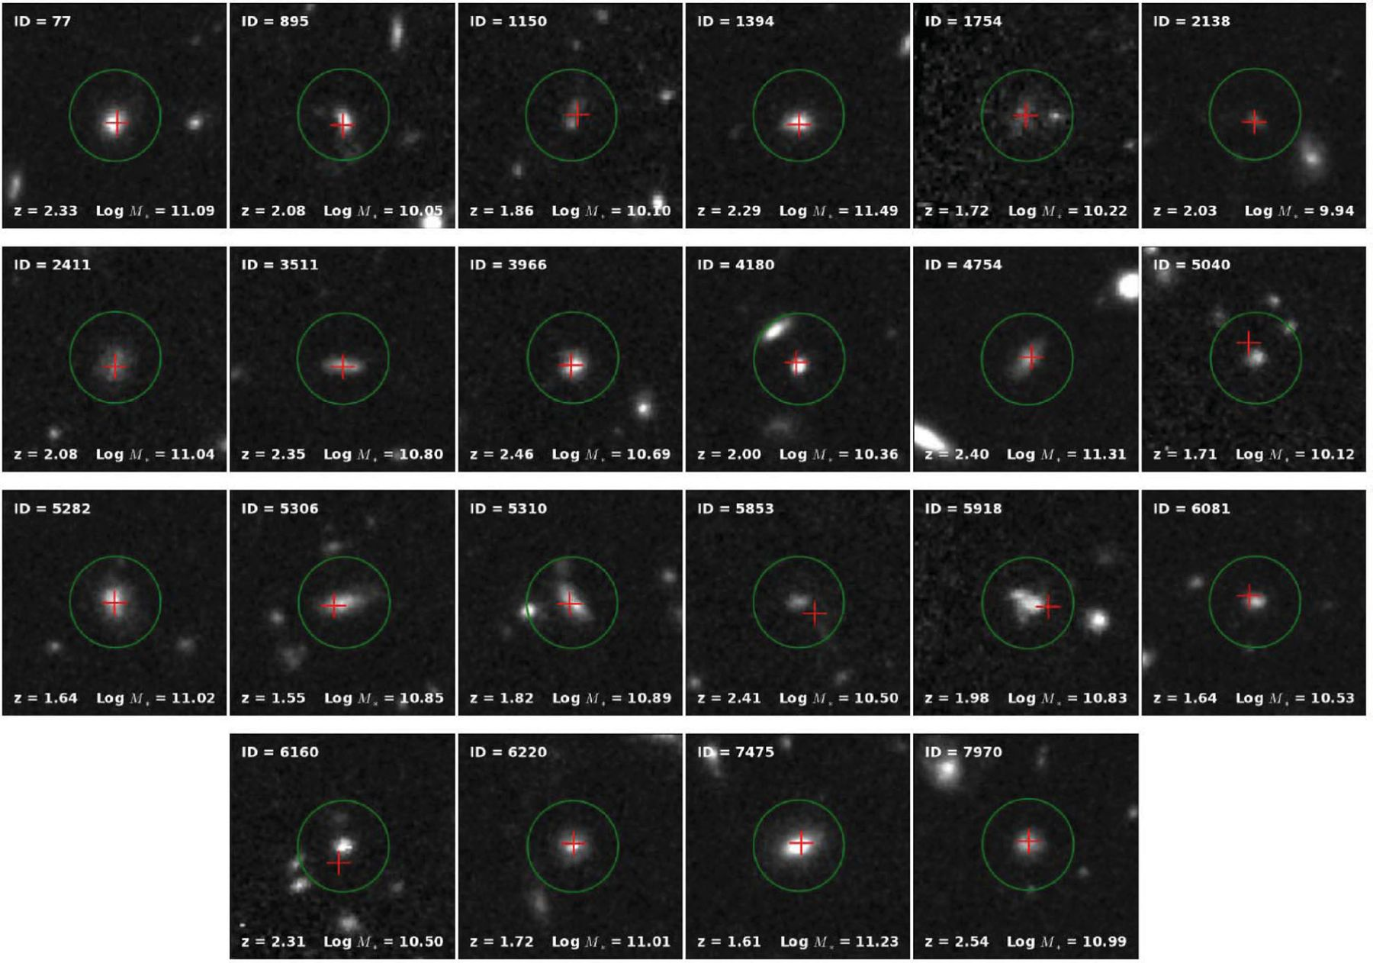
Figure 2. Postage stamp (10 × 10?arcsec²) NICMOS F160W (H band) images of GNS galaxies detected in HerMES ...
Notes:
Figure 2. Postage stamp (10 × 10?arcsec2) NICMOS F160W (H band) images of GNS galaxies detected in HerMES with SNR > 3 at 250?µm. The red cross in each postage stamp marks the position of the corresponding matched object in the HerMES/PEP catalogue, which is extracted using MIPS 24?µm priors. The green circle indicates the 2arcsec matching radius used for cross-matching between the two catalogues.
Unless provided in the caption above, the following copyright applies to the content of this slide: © 2012 The Authors Monthly Notices of the Royal Astronomical Society © 2012 RAS

Slide 3
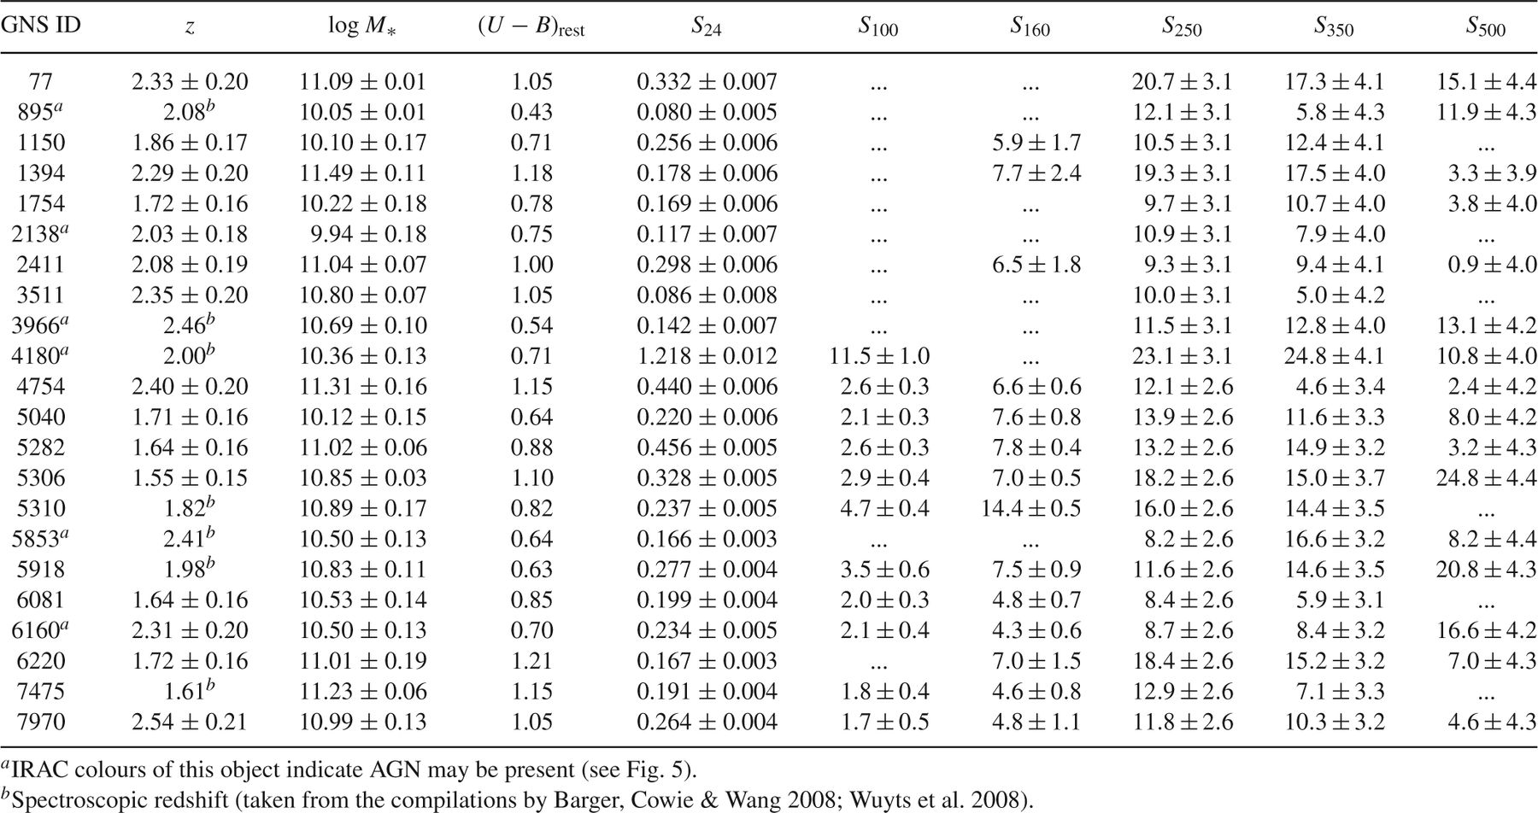
Table 1. Properties of 1.5 < z 3. Flux densities (S?) are ...
Notes:
Table 1. Properties of 1.5 < z 3. Flux densities (S?) are in mJy, and only wavelengths in common between both GOODS-N and GOOD-S are shown. The error bars on photometric redshifts (we do not show error bars on objects with spectroscopic redshifts, marked with superscript b) and stellar mass estimates are statistical only, and the typical uncertainty in (U - B)rest is 0.15?mag (see Conselice et al. , for details)
Unless provided in the caption above, the following copyright applies to the content of this slide: © 2012 The Authors Monthly Notices of the Royal Astronomical Society © 2012 RAS

Slide 4
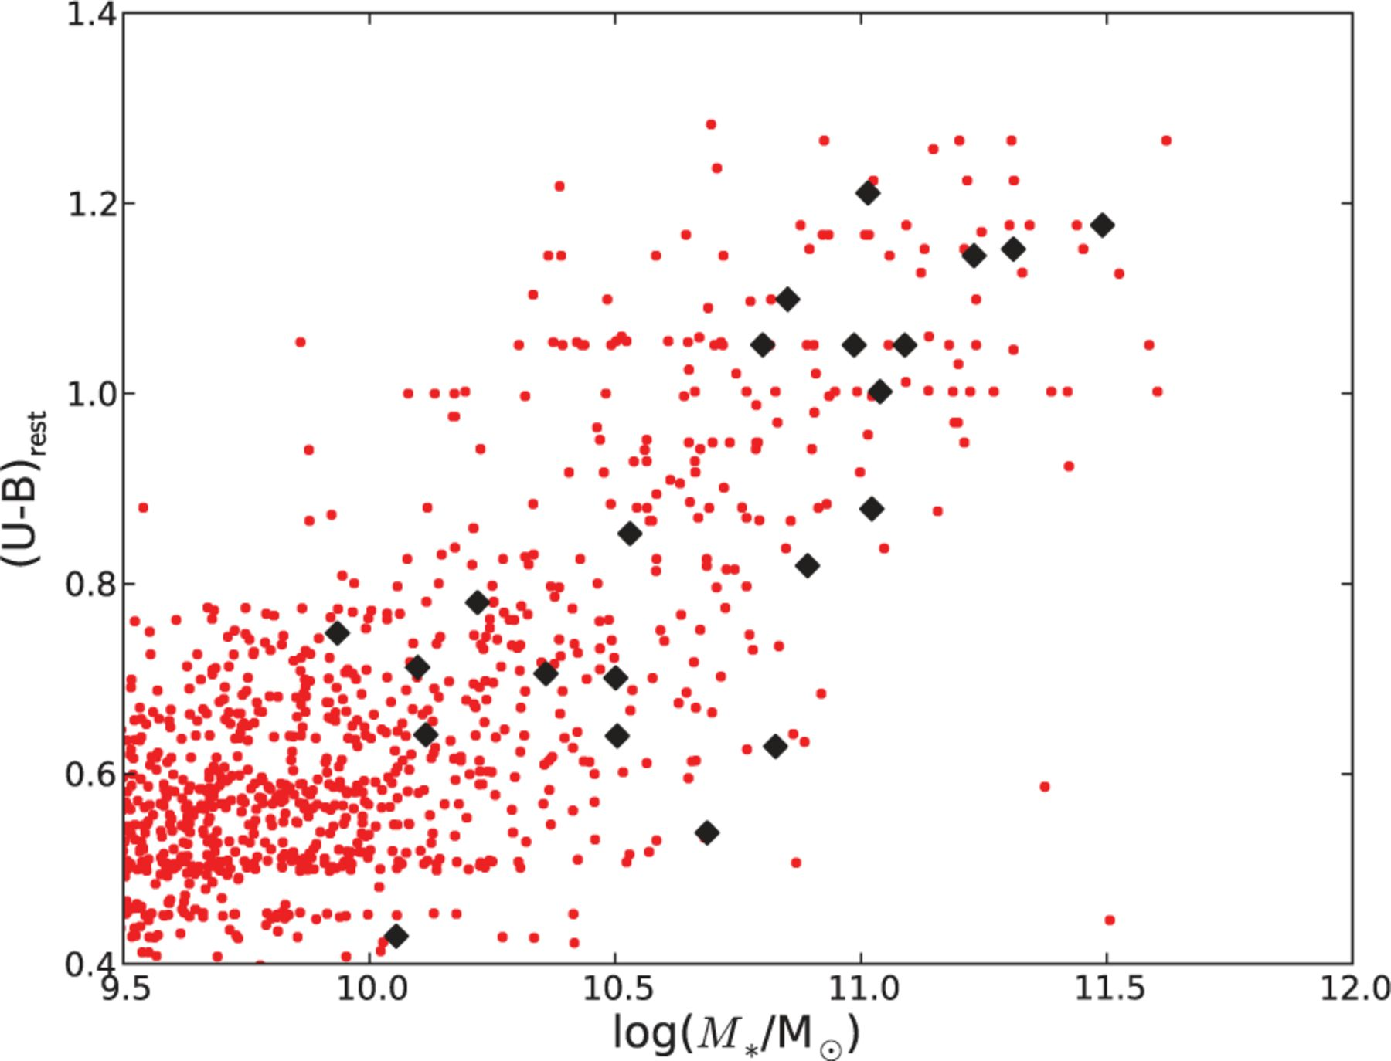
Figure 3. Distribution of 1.5 < z < 3 GNS galaxies with log?(M*/M?) > 9.5 in the (U - ...
Notes:
Figure 3. Distribution of 1.5 < z < 3 GNS galaxies with log?(M*/M?) > 9.5 in the (U - B)rest colour-stellar mass plane (small red dots). The large black diamonds indicate the objects detected at 250?µm in HerMES. The typical uncertainty in the GNS stellar mass estimates is ~0.2?dex, while the typical uncertainty in (U - B)rest is 0.15?mag (see Conselice et al. ).
Unless provided in the caption above, the following copyright applies to the content of this slide: © 2012 The Authors Monthly Notices of the Royal Astronomical Society © 2012 RAS

Slide 5
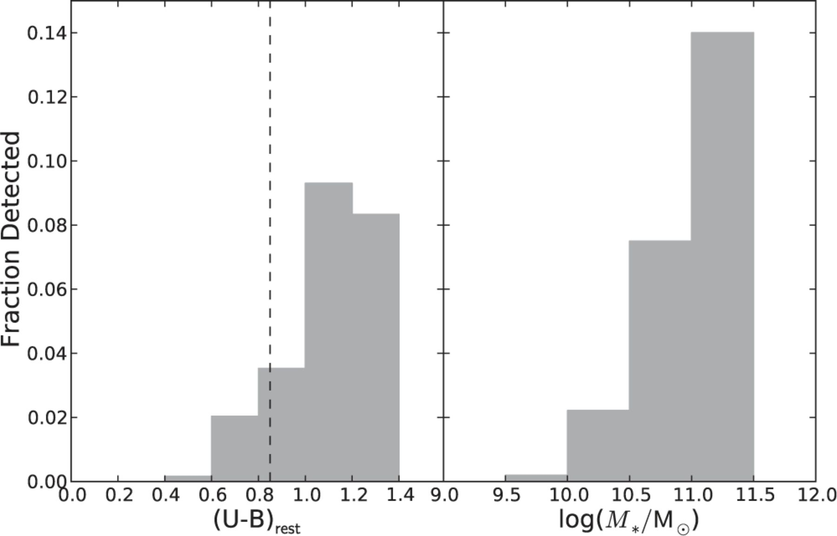
Figure 4 Fraction of GNS galaxies with log (M*/M⊙) > 9.5 and 1.5 < z 3 at 250-m as ...
Notes:
Figure 4 Fraction of GNS galaxies with log (M*/M⊙) > 9.5 and 1.5 < z 3 at 250-m as functions of rest-frame (U - B)rest colour (left) and stellar mass (right). Clearly, massive galaxies with redder colours are preferentially detected. For comparison, the rest-frame colour separation between quiescent and actively star-forming galaxies adopted by Kriek et al. (2009) is at (U - B)rest =0.85 (dashed line).
Unless provided in the caption above, the following copyright applies to the content of this slide: © 2012 The Authors Monthly Notices of the Royal Astronomical Society © 2012 RAS

Slide 6
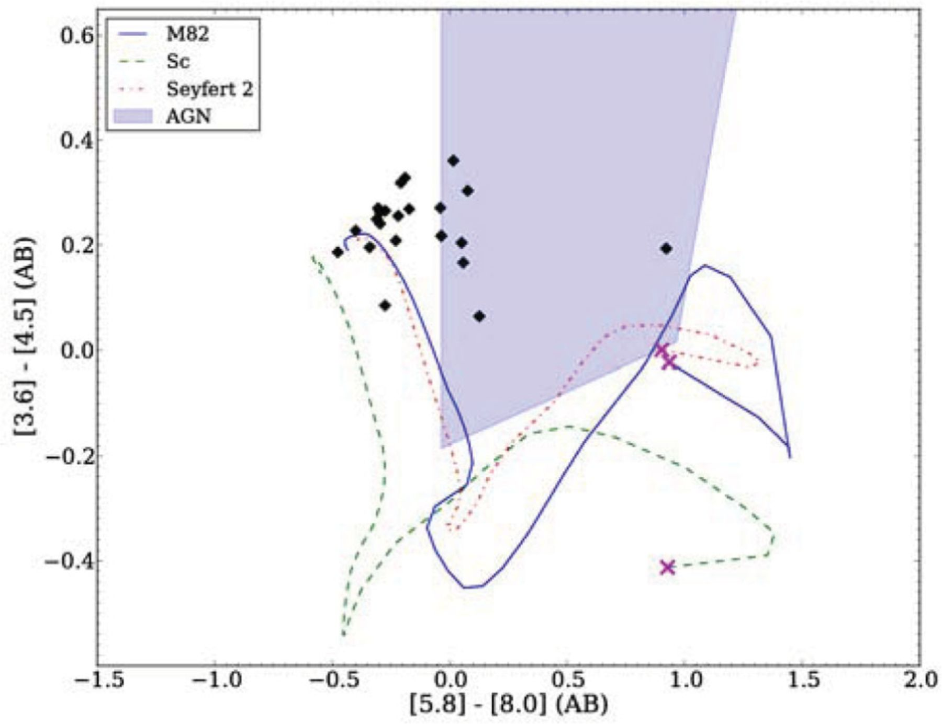
Figure 5 IRAC colourûcolour plot of GNS galaxies detected in HerMES. Overplotted are non-evolving tracks of various ...
Notes:
Figure 5 IRAC colourûcolour plot of GNS galaxies detected in HerMES. Overplotted are non-evolving tracks of various spectral templates as they are redshifted from z = 0 to 2 (see legend; the crosses indicate the z = 0 end of each track), taken from the library of Polletta et al. (2007). The colours of most of the objects are not consistent with those expected of Type I QSOs (shown by the shaded area marked ‘AGN’ in the legend), and are more similar to those expected of star-forming galaxies at this redshift.
Unless provided in the caption above, the following copyright applies to the content of this slide: © 2012 The Authors Monthly Notices of the Royal Astronomical Society © 2012 RAS

Slide 7
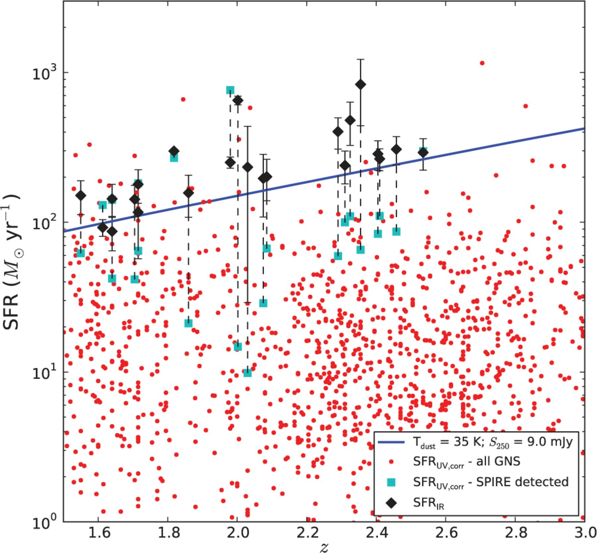
Figure 6 Comparison of SFR_{IR} estimated for GNS galaxies detected at 250µm (black diamonds) with the ...
Notes:
Figure 6 Comparison of SFRIR estimated for GNS galaxies detected at 250µm (black diamonds) with the approximate 3σ flux limit as a function of redshift (blue line, estimated assuming a modified blackbody SED with Tdust = 35 K), and the extinction-corrected UV estimates (SFRUV,corr) for these same galaxies (cyan squares). The SFRUV,corr values of the entire GNS sample are plotted for comparison (small red dots). The dashed lines indicate corresponding SFR estimates for a given galaxy.
Unless provided in the caption above, the following copyright applies to the content of this slide: © 2012 The Authors Monthly Notices of the Royal Astronomical Society © 2012 RAS

Slide 8
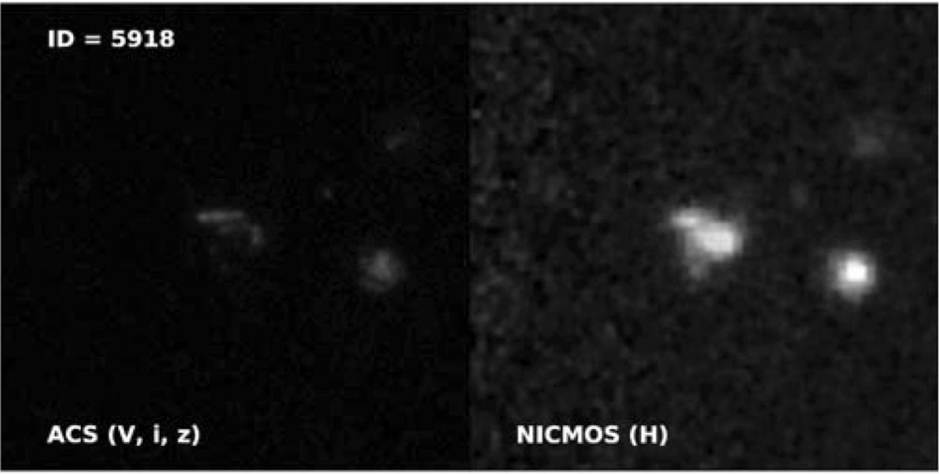
Figure 7 ACS (V, i, z) image (10 × 10 arcsec²) of the multiple component system ID 5918 (left), the only ...
Notes:
Figure 7 ACS (V, i, z) image (10 × 10 arcsec2) of the multiple component system ID 5918 (left), the only galaxy in the sample with significantly larger SFRUV,corr than SFRIR of the GNS galaxies detected at 250 µm (see Fig. 6).
Unless provided in the caption above, the following copyright applies to the content of this slide: © 2012 The Authors Monthly Notices of the Royal Astronomical Society © 2012 RAS

Slide 9
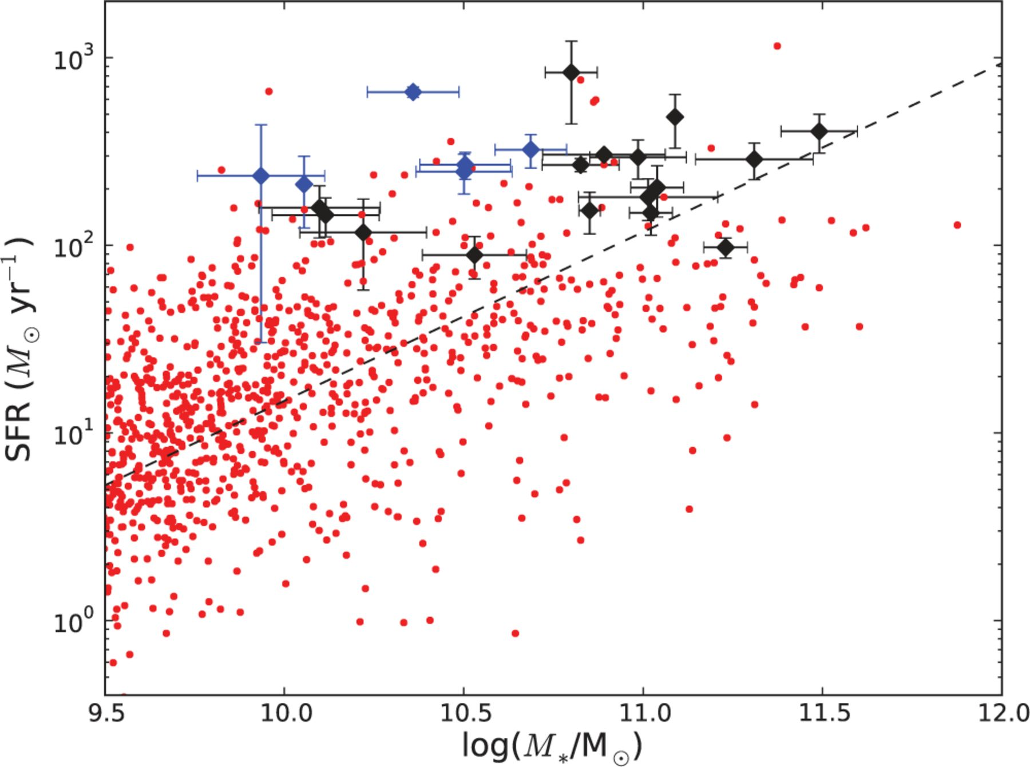
Figure 8 Relation between total SFR and M* for GNS galaxies. The large diamonds represent SPIRE detected ...
Notes:
Figure 8 Relation between total SFR and M* for GNS galaxies. The large diamonds represent SPIRE detected galaxies; those highlighted in blue have IRAC colours consistent with AGN (see Fig. 5). For these galaxies, the total SFR estimate that we use is SFRIR+UV. The small red points represent the wider GNS sample; in this case, the total SFR estimate is SFRUV,corr. The dashed line is the SFRUV,corr-M* relation measured at z ∼ 2 by Daddi et al. (2007). Note that the error bars indicate statistical errors in SFR and M* only.
Unless provided in the caption above, the following copyright applies to the content of this slide: © 2012 The Authors Monthly Notices of the Royal Astronomical Society © 2012 RAS

Slide 10
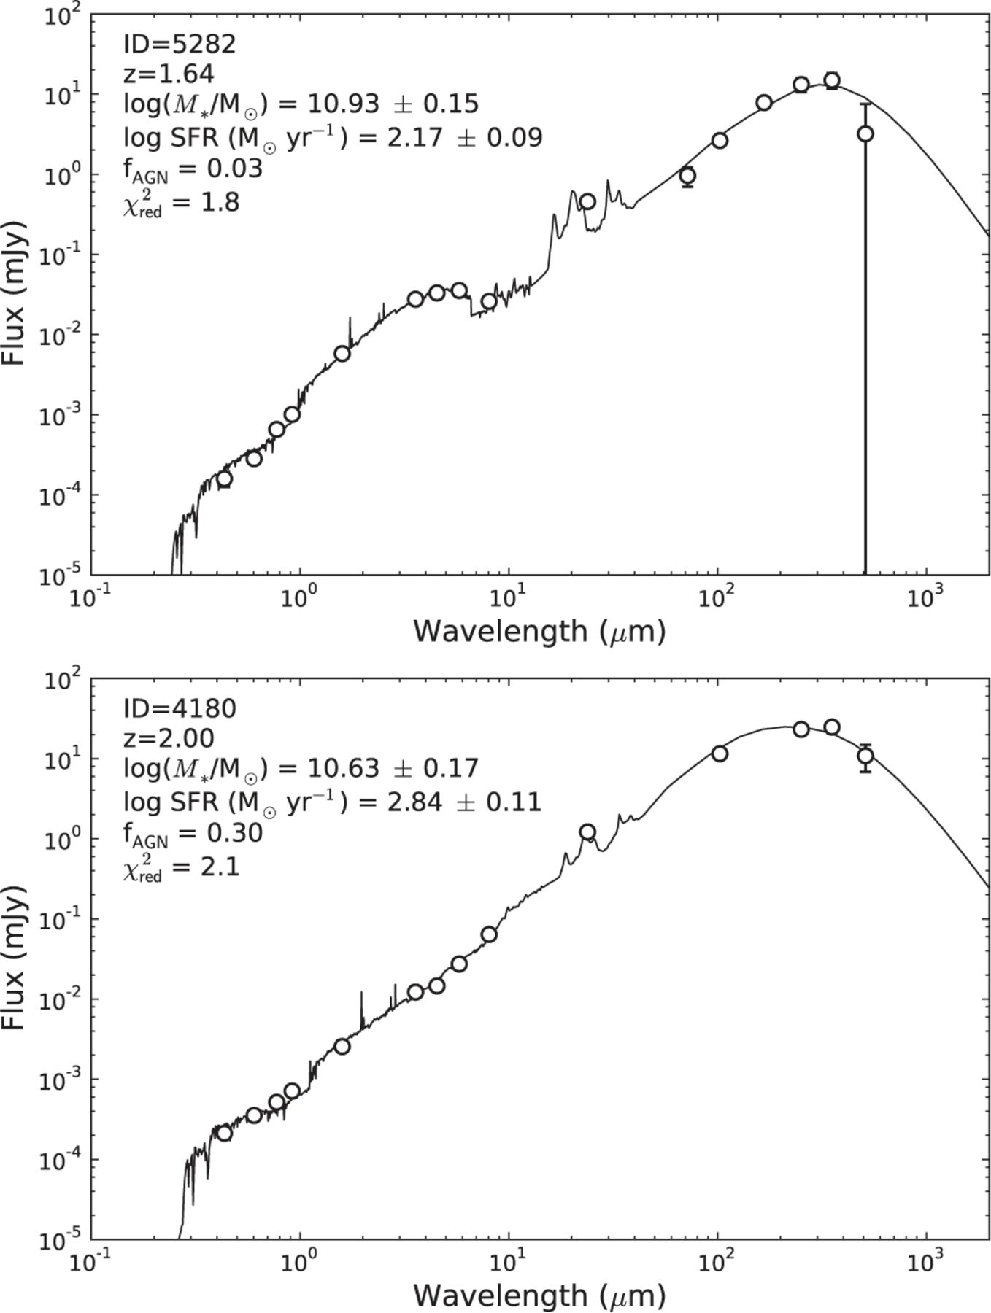
Figure 9 Examples of opticalûIR SEDs fitted with cigale. Note that different underlying assumptions were used with ...
Notes:
Figure 9 Examples of opticalûIR SEDs fitted with cigale. Note that different underlying assumptions were used with cigale compared to the rest of this work, i.e. the Maraston (2005) stellar population models, Kroupa (2001) IMF and Dale & Helou (2002) infrared templates were used. The cigale fit results suggest that the bulk of the IR emission is associated with star formation rather than AGN. Note that the median x2red of the sample is 1.7, so the example fits we show here are representative, although we choose to show ID 4180 in particular because it is the object with the largest inferred AGN contribution to the IR luminosity.
Unless provided in the caption above, the following copyright applies to the content of this slide: © 2012 The Authors Monthly Notices of the Royal Astronomical Society © 2012 RAS

Slide 11
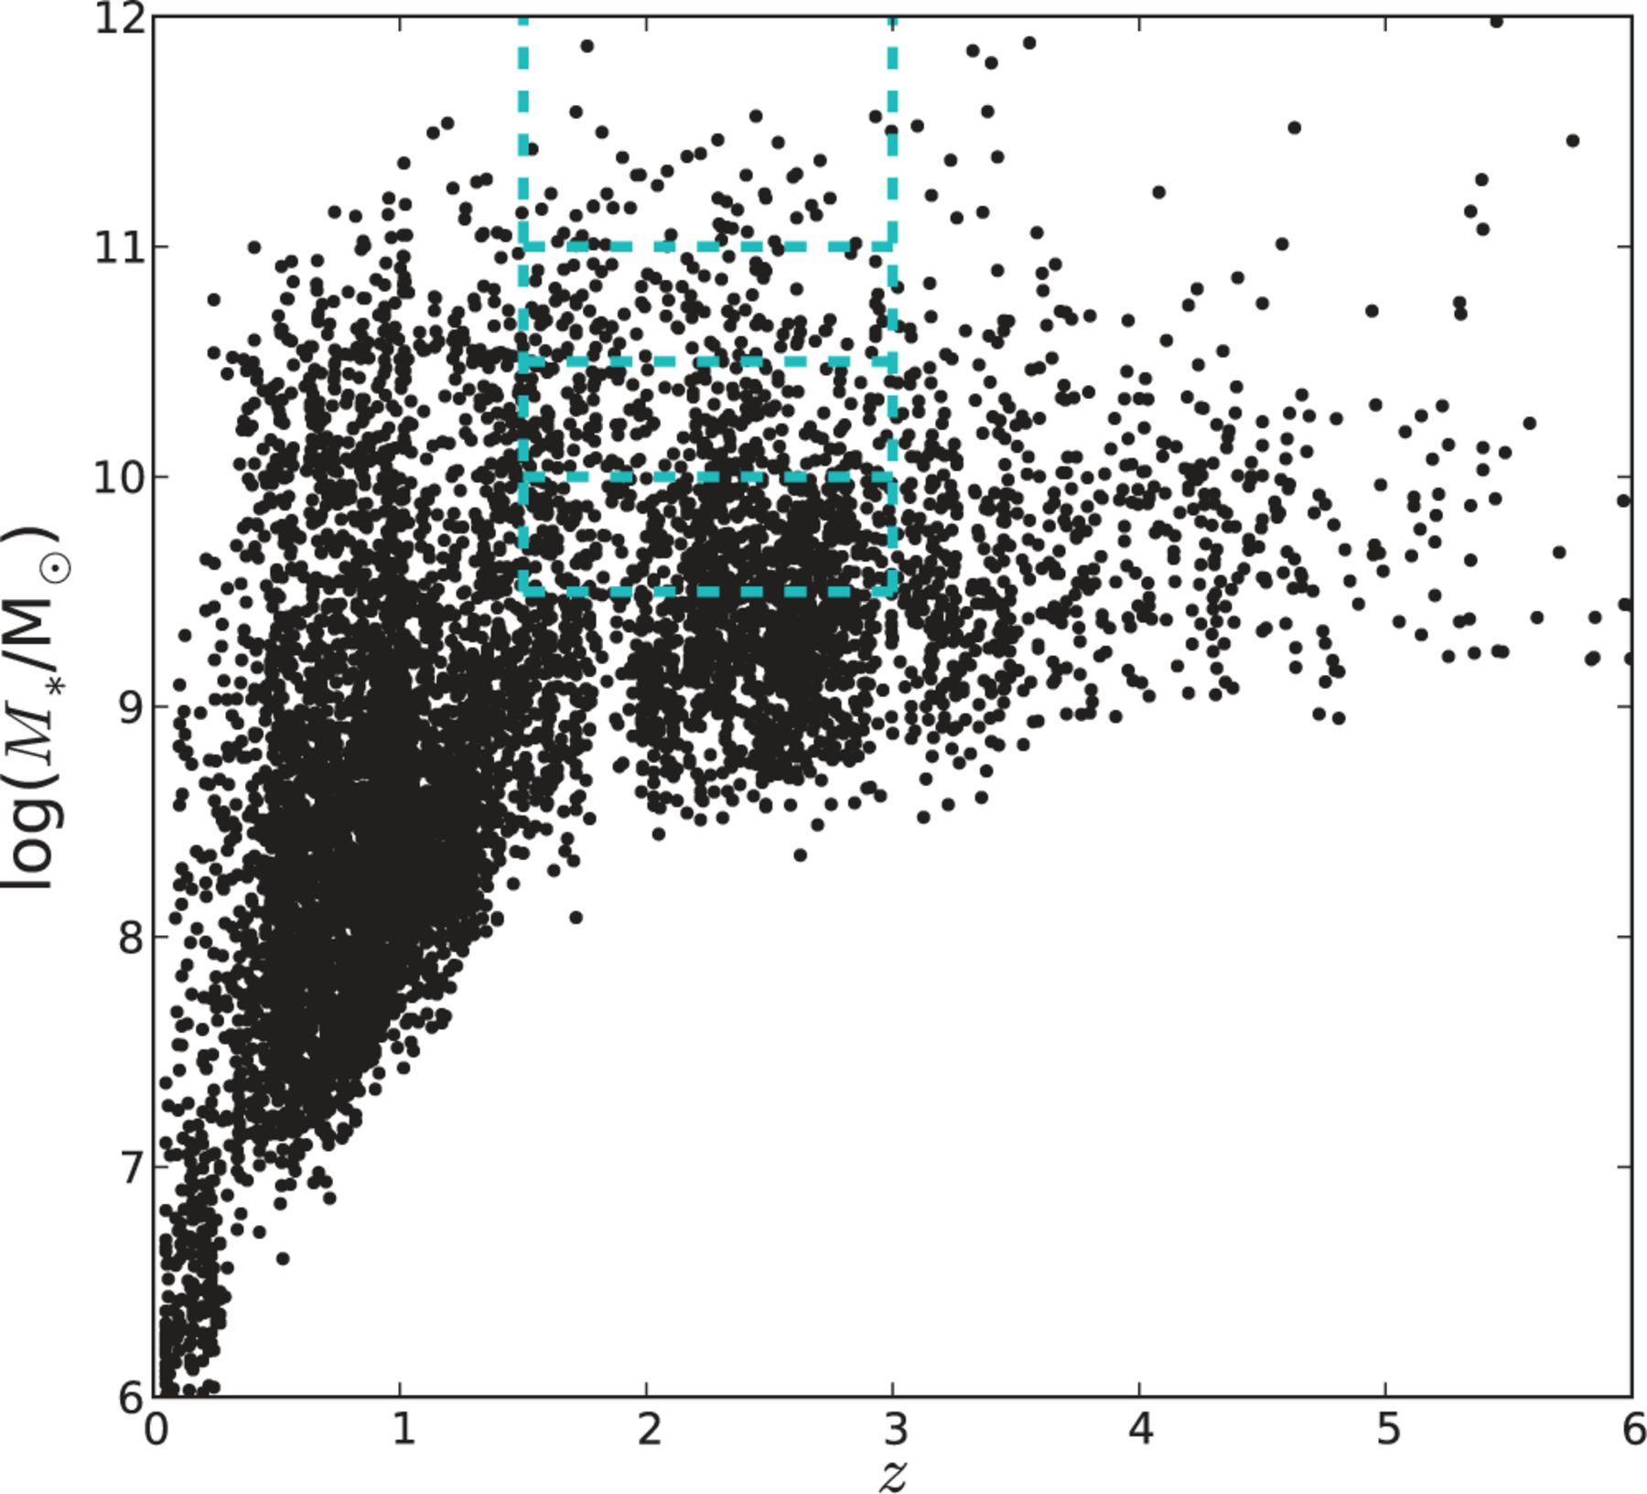
Figure 10 Distribution of stellar masses with redshift for the GNS catalogue in both GOODS fields. The blue dashed ...
Notes:
Figure 10 Distribution of stellar masses with redshift for the GNS catalogue in both GOODS fields. The blue dashed lines indicate the samples used in the stacking analysis presented in this paper.
Unless provided in the caption above, the following copyright applies to the content of this slide: © 2012 The Authors Monthly Notices of the Royal Astronomical Society © 2012 RAS

Slide 12
Table 2 Properties of the mass-limited galaxy samples for GOODS-North, GOODS-South and the combined sample. N ...
Notes:
Table 2 Properties of the mass-limited galaxy samples for GOODS-North, GOODS-South and the combined sample. N indicates the total number of galaxies that were stacked in each sample; Nzspec is the number of these objects with spectroscopic redshifts; 〈z〉 is the median redshift of the sample; NX is the number of objects which are detected in X-rays (these are not included in the stacks and are not counted in N).
Unless provided in the caption above, the following copyright applies to the content of this slide: © 2012 The Authors Monthly Notices of the Royal Astronomical Society © 2012 RAS

Slide 13
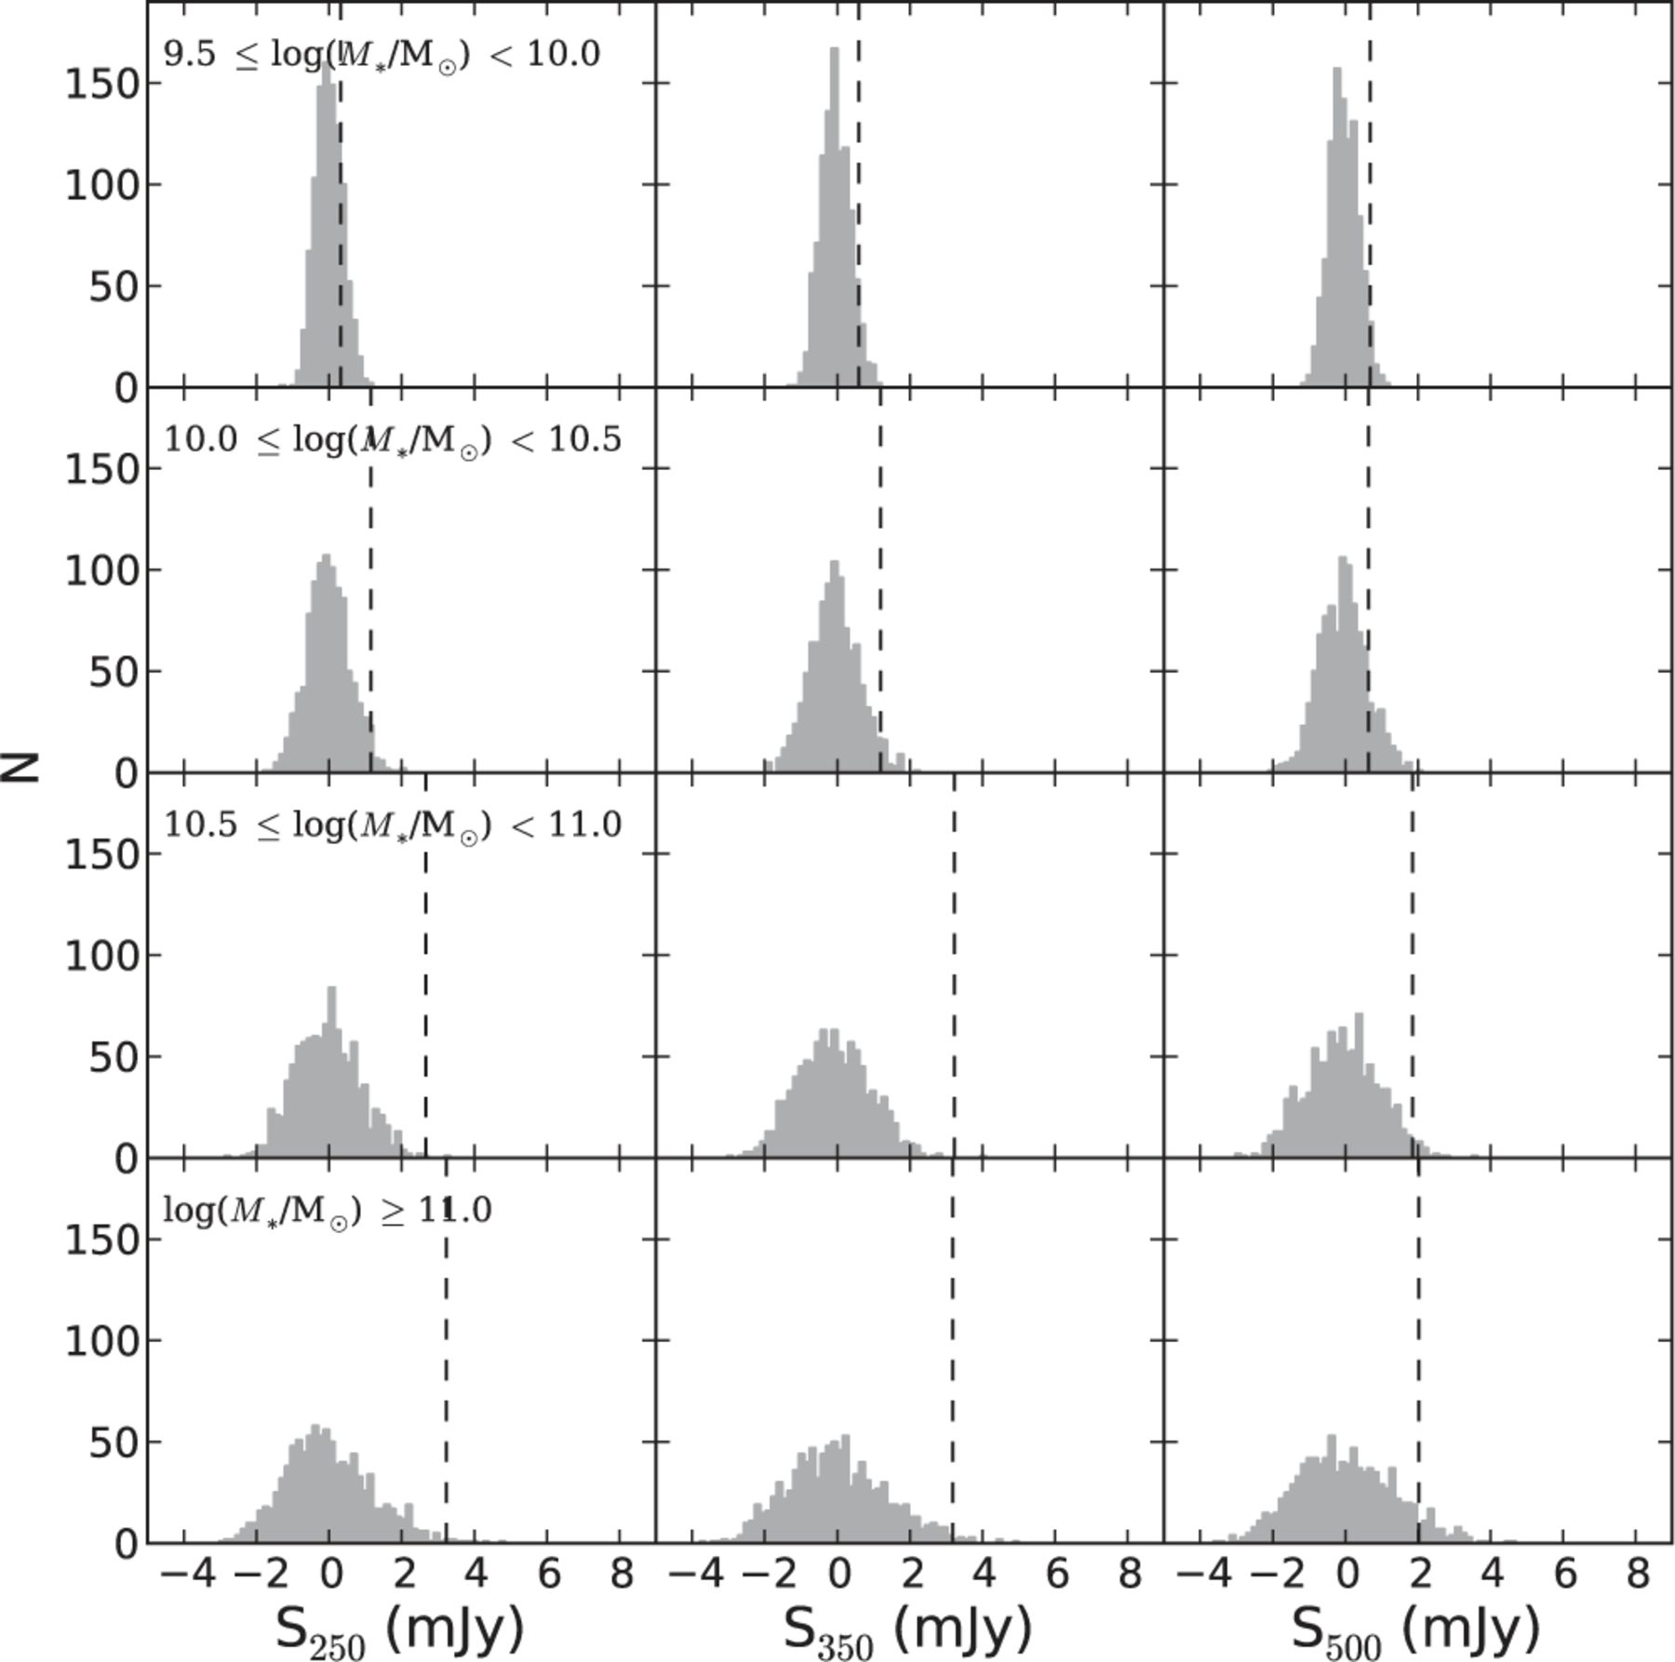
Figure 11 Result of stacking on random positions for each stellar mass bin in the GOODS-N SPIRE maps. The dashed line ...
Notes:
Figure 11 Result of stacking on random positions for each stellar mass bin in the GOODS-N SPIRE maps. The dashed line in each subplot indicates the stacked mean flux recovered when stacking on the real object positions, as listed in Table 3.
Unless provided in the caption above, the following copyright applies to the content of this slide: © 2012 The Authors Monthly Notices of the Royal Astronomical Society © 2012 RAS

Slide 14
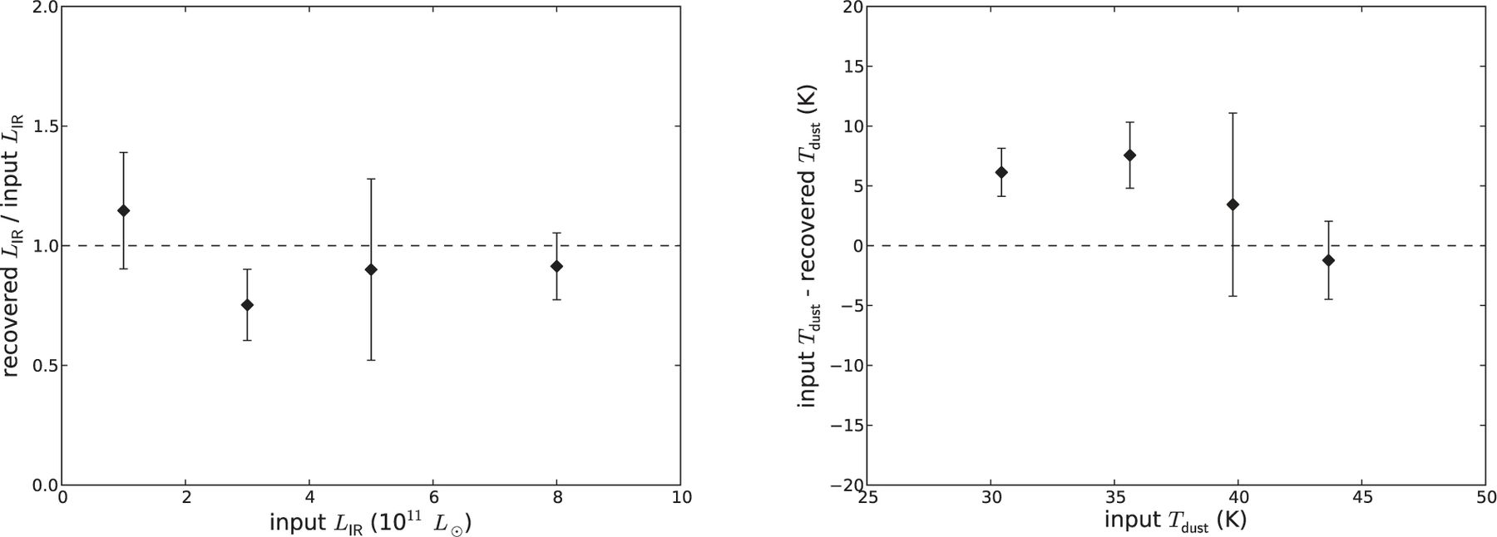
Figure 12 Recovery of L_{IR} and T_{dust} when applying the stacking algorithm and SED fitting on ...
Notes:
Figure 12 Recovery of LIR and Tdust when applying the stacking algorithm and SED fitting on simple simulated maps.
Unless provided in the caption above, the following copyright applies to the content of this slide: © 2012 The Authors Monthly Notices of the Royal Astronomical Society © 2012 RAS

Slide 15
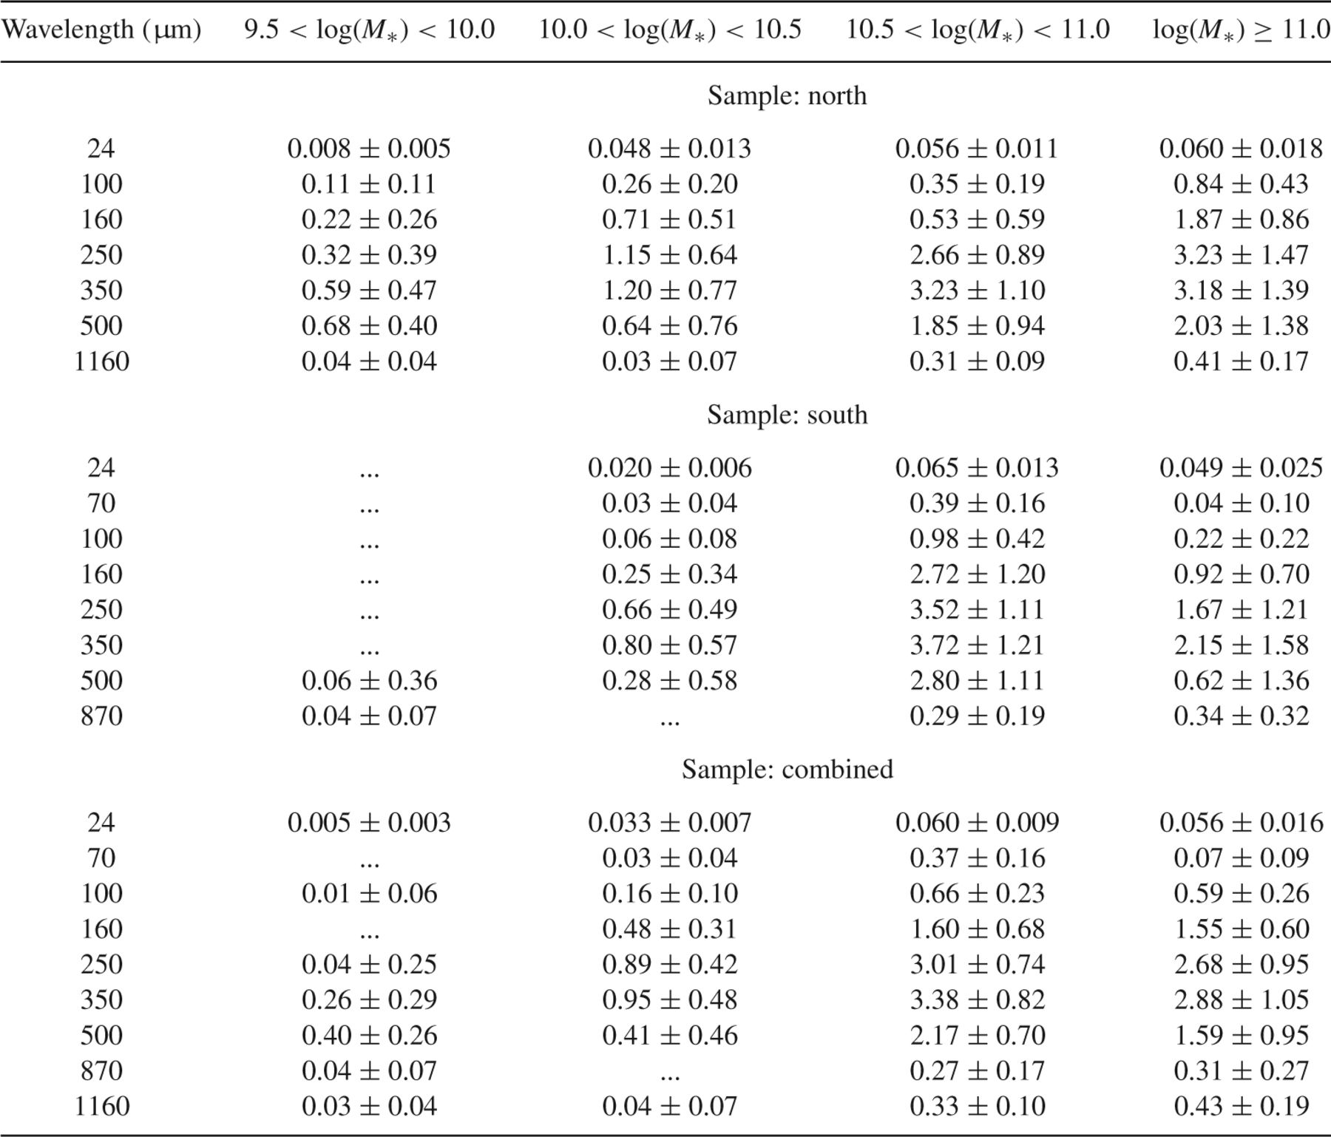
Table 3 Stacked mean fluxes (in mJy) for 1.5 < z < 3 GOODS NICMOS Survey galaxies in stellar mass bins. Ellipses (…) ...
Notes:
Table 3 Stacked mean fluxes (in mJy) for 1.5 < z < 3 GOODS NICMOS Survey galaxies in stellar mass bins. Ellipses (…) indicate where the solution was negative and therefore unphysical.
Unless provided in the caption above, the following copyright applies to the content of this slide: © 2012 The Authors Monthly Notices of the Royal Astronomical Society © 2012 RAS

Slide 16
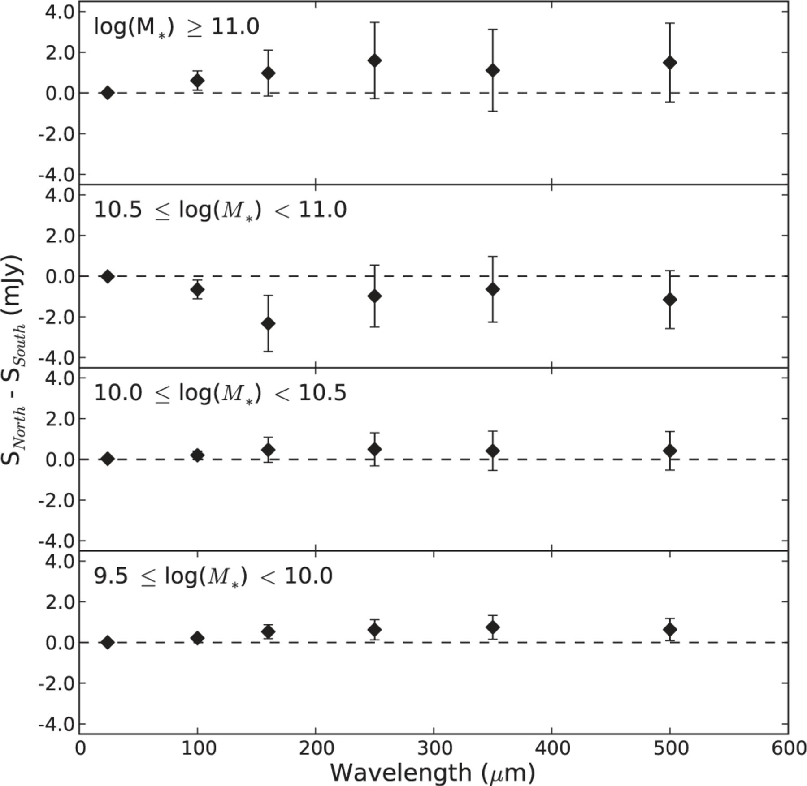
Figure 13 Difference between the stacked flux densities in GOODS-N and GOODS-S for each stellar mass bin. Within the ...
Notes:
Figure 13 Difference between the stacked flux densities in GOODS-N and GOODS-S for each stellar mass bin. Within the large uncertainties there is no significant difference between the two fields, although the stacked flux densities are generally fainter in GOODS-S.
Unless provided in the caption above, the following copyright applies to the content of this slide: © 2012 The Authors Monthly Notices of the Royal Astronomical Society © 2012 RAS

Slide 17
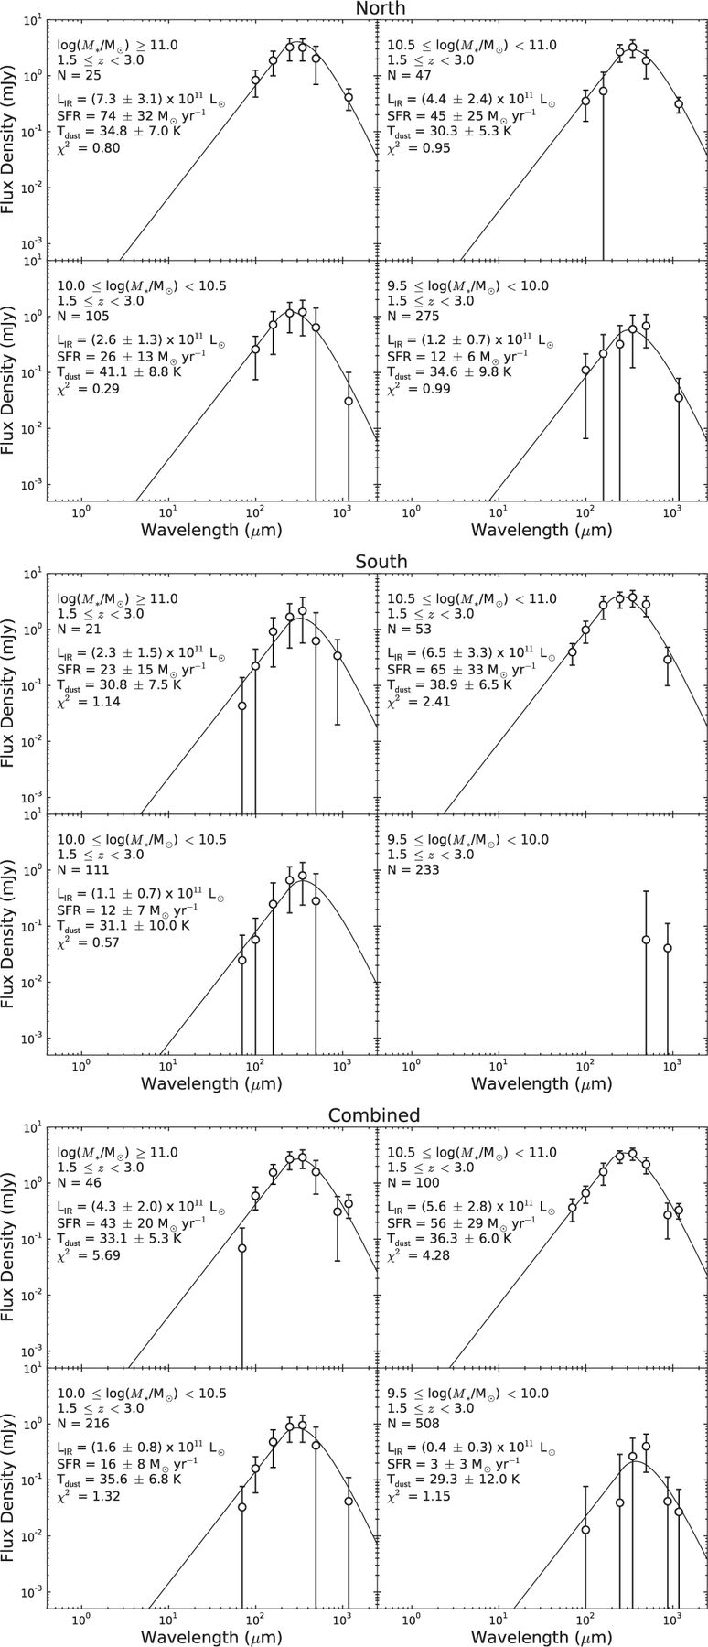
Figure 14 The stacked far-IR/sub-mm SEDs as a function of stellar mass in GOODS-N (top), GOODS-S (middle) and for both ...
Notes:
Figure 14 The stacked far-IR/sub-mm SEDs as a function of stellar mass in GOODS-N (top), GOODS-S (middle) and for both fields combined (bottom). Solid lines indicate the best-fitting modified blackbody model to each SED.
Unless provided in the caption above, the following copyright applies to the content of this slide: © 2012 The Authors Monthly Notices of the Royal Astronomical Society © 2012 RAS

Slide 18
Figure 15 Comparison of mean SFR in each stellar mass bin derived from stacking (SFR_{IR+UV}; this work) with ...
Notes:
Figure 15 Comparison of mean SFR in each stellar mass bin derived from stacking (SFRIR+UV; this work) with the mean SFR derived from the UV-slope extinction-corrected rest-frame UV flux (SFRUV,corr). The latter uses measurements described in Bauer et al. (2011). We calculate the mean SFRUV,corr using the same galaxies as in the stellar mass bins used in the IR stacking analysis, after first scaling the Bauer et al. (2011) values to a Chabrier (2003) IMF. Results are shown for each GOODS field separately, as well as the combined sample.
Unless provided in the caption above, the following copyright applies to the content of this slide: © 2012 The Authors Monthly Notices of the Royal Astronomical Society © 2012 RAS

Slide 19
Figure 16 The relation between SFR_{IR+UV} and M* for galaxies stacked in bins of stellar mass ...
Notes:
Figure 16 The relation between SFRIR+UV and M* for galaxies stacked in bins of stellar mass (black diamonds). The blue line shows a weighted least-squares fit to the relation. The dashed line shows the SFR-M* relation measured by Daddi et al. (2007) at z ∼ 2 for comparison. The small red points show the SFRUV,corr measurements for individual GNS galaxies from Bauer et al. (2011), highlighting the large scatter in this relation. The results are shown for each GOODS field separately, as well as the combined sample.
Unless provided in the caption above, the following copyright applies to the content of this slide: © 2012 The Authors Monthly Notices of the Royal Astronomical Society © 2012 RAS

Slide 20
Figure 17 The ratio of obscured to unobscured star formation (SFR_{IR}/SFR_{UV}) as a function of ...
Notes:
Figure 17 The ratio of obscured to unobscured star formation (SFRIR/SFRUV) as a function of M* for galaxies stacked in bins of stellar mass (where SFRUV is taken from the measurements of Bauer et al. 2011). The blue line shows a weighted least-squares fit to the relation. The dashed line indicates SFRIR/SFRUV = 1. The results are shown for each GOODS field separately, as well as the combined sample.
Unless provided in the caption above, the following copyright applies to the content of this slide: © 2012 The Authors Monthly Notices of the Royal Astronomical Society © 2012 RAS

