Slide 1
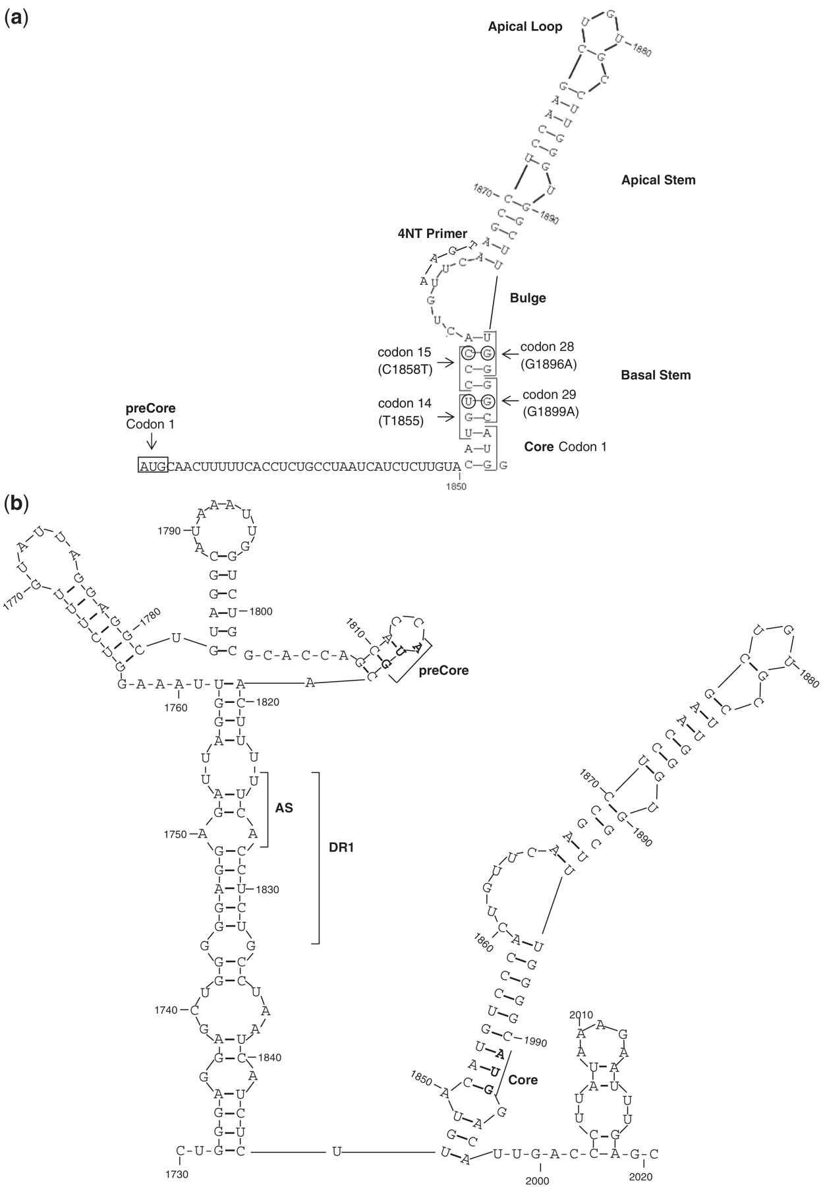
Figure 1. (a) Stem-loop structure of the 5′ HBV pgRNA. Main structural motifs (loops and stems), main codons studied ...
Notes:
Figure 1. (a) Stem-loop structure of the 5′ HBV pgRNA. Main structural motifs (loops and stems), main codons studied (1, 14, 15, 28 and 29 of preCore and 1 of Core genes), and the location of 4-nt primer annealing in the 5′ pgRNA are indicated in the figure. (b) Stem-loop structure of the 3′ HBV pgRNA. The acceptor site (AS), direct repeat region 1 (DR1), and the preCore and Core start codons are indicated in the figure.
Unless provided in the caption above, the following copyright applies to the content of this slide: © The Author(s) 2011. Published by Oxford University Press.This is an Open Access article distributed under the terms of the Creative Commons Attribution Non-Commercial License (http://creativecommons.org/licenses/by-nc/3.0), which permits unrestricted non-commercial use, distribution, and reproduction in any medium, provided the original work is properly cited.

Slide 2
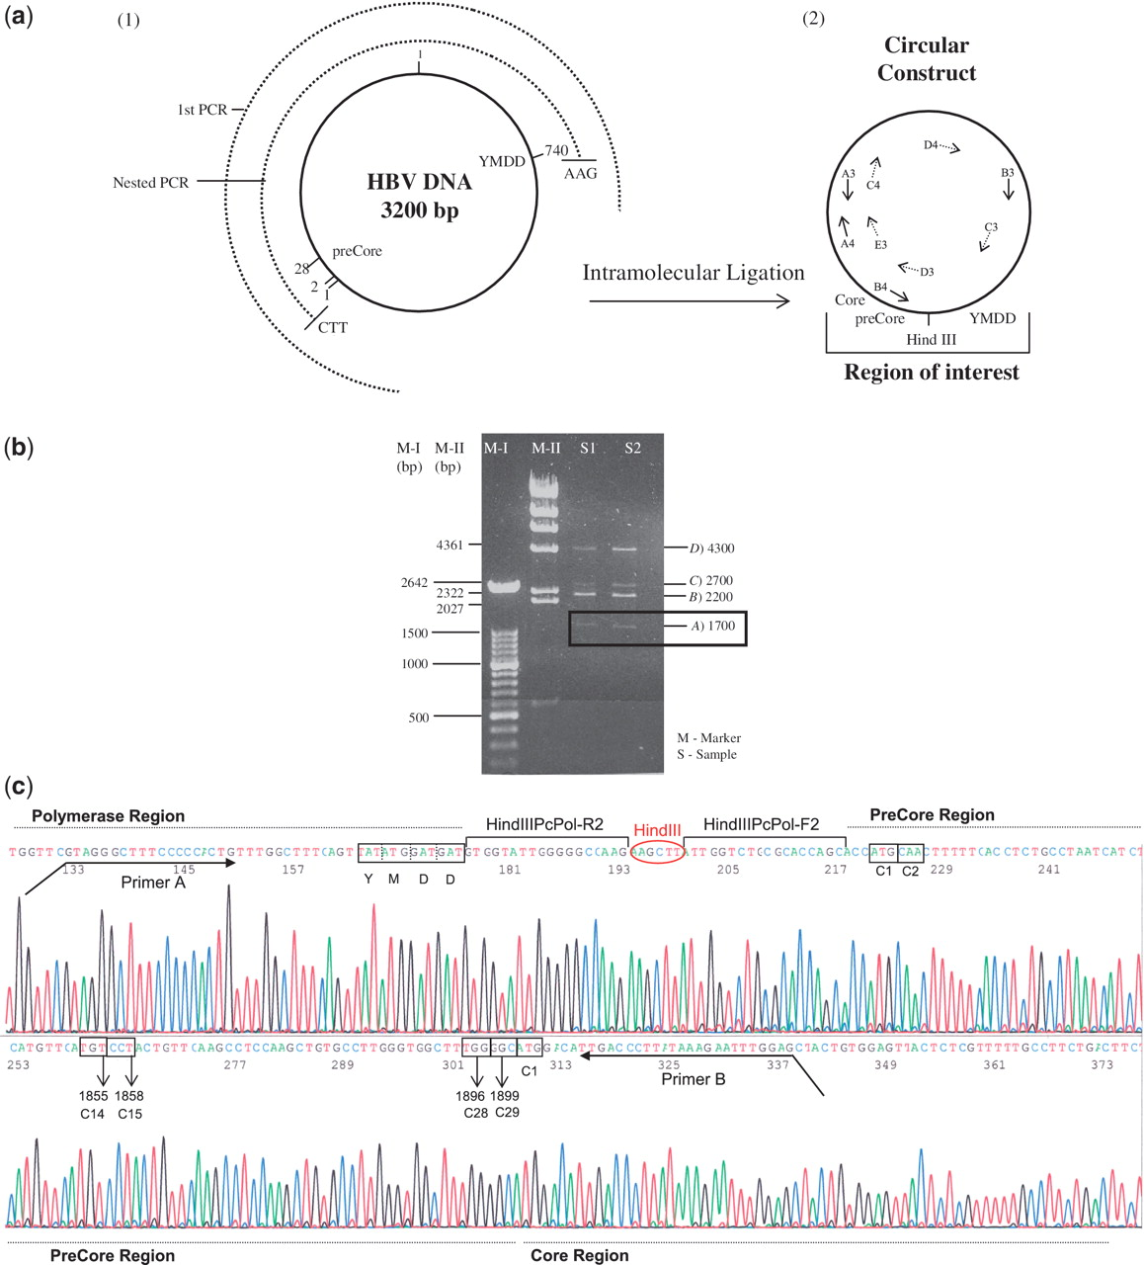
Figure 2. (a) Schematic representation of the intramolecular ligation technique to obtain the preCore and YMDD Pol ...
Notes:
Figure 2. (a) Schematic representation of the intramolecular ligation technique to obtain the preCore and YMDD Pol motif close to each other. (1) The circle in a continuous line represents the complete HBV genome (3200 bp). The semicircles in discontinuous lines represent the first (first PCR, 2700 bp) and the nested (2194 bp for genotype A2 sequences and 2155 bp for genotype D sequences) PCR products. (2) The product obtained after intramolecular ligation and primers used to sequence the circular molecule (Table 2) are indicated in the figure. (b) Agarose gel obtained after intramolecular digestion. Two markers (M-I and M-II) were loaded in the gel; band lengths are shown at the left side of the image. Two samples (S1 and S2) were loaded and four bands were detected; band lengths are indicated at the right side of the image. A band with an apparent size of 1700 bp was the circular molecule, with the preCore and YMDD Pol motif close to each other. Band B was the nested PCR product without ligation, and band D were dimers of nested PCR products without ligation. Band C corresponded to the ligated dimers. B, C and D bands were not used, because the main interest was to analyze regions from the same genome. (c) Sequence of the circular construct including the preCore region, YMDD polymerase motif (in box), and HindIII sequence. PreCore (1, 2, 14, 15, 28 and 29) and Core (1) codons analyzed in the text are also enclosed in boxes.
Unless provided in the caption above, the following copyright applies to the content of this slide: © The Author(s) 2011. Published by Oxford University Press.This is an Open Access article distributed under the terms of the Creative Commons Attribution Non-Commercial License (http://creativecommons.org/licenses/by-nc/3.0), which permits unrestricted non-commercial use, distribution, and reproduction in any medium, provided the original work is properly cited.

Slide 3
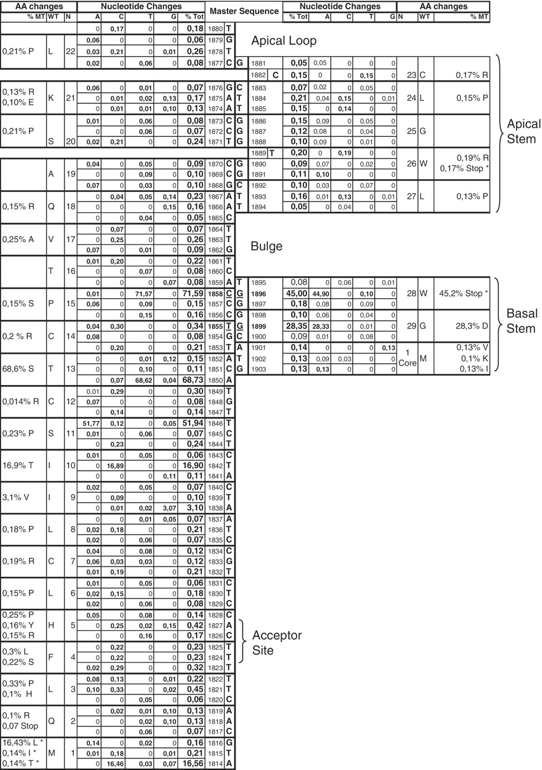
Figure 3. Schematic representation of base pairing between the preCore positions analyzed, which correspond to the ...
Notes:
Figure 3. Schematic representation of base pairing between the preCore positions analyzed, which correspond to the stem–loop structure. The columns in the center indicate the consensus sequence obtained from the laboratory’s entire collection of genotypes A sequences (bold characters). The ‘Nucleotide changes’ column indicates the percentage of each nucleotide change (%A, %C, %T and %C) and the total changes (%Tot) for all positions, attending to the master sequence. The ‘Amino acid (AA) changes’ column indicates the codon representing the position (N), the amino acid coded from the master sequence (WT), and the percentage of sequences that code for a different amino acid (%MT).
Unless provided in the caption above, the following copyright applies to the content of this slide: © The Author(s) 2011. Published by Oxford University Press.This is an Open Access article distributed under the terms of the Creative Commons Attribution Non-Commercial License (http://creativecommons.org/licenses/by-nc/3.0), which permits unrestricted non-commercial use, distribution, and reproduction in any medium, provided the original work is properly cited.

Slide 4
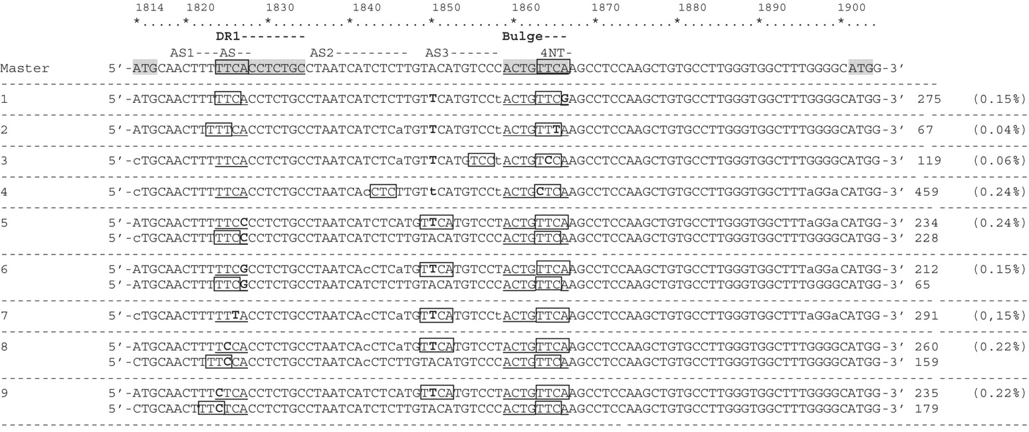
Figure 4. Sequences without correct homology between the 4 nt primer in the bulge (1863–1866) and acceptor site (AS) in ...
Notes:
Figure 4. Sequences without correct homology between the 4 nt primer in the bulge (1863–1866) and acceptor site (AS) in direct repeat region 1 (DR1) (1824–1827). The genotype A2 consensus sequence from our laboratory collection used as the pattern is presented in the first line, and variants are added below. The number of sequences of each variant and the percentage of the total represented is indicated at the end of each line. Bold characters indicate mutations from the master, and lower cases indicate a mixture with the nucletotide of the consensus sequence. Boxes indicate homologous sequences and suggest alternative ASs.
Unless provided in the caption above, the following copyright applies to the content of this slide: © The Author(s) 2011. Published by Oxford University Press.This is an Open Access article distributed under the terms of the Creative Commons Attribution Non-Commercial License (http://creativecommons.org/licenses/by-nc/3.0), which permits unrestricted non-commercial use, distribution, and reproduction in any medium, provided the original work is properly cited.

