Slide 1
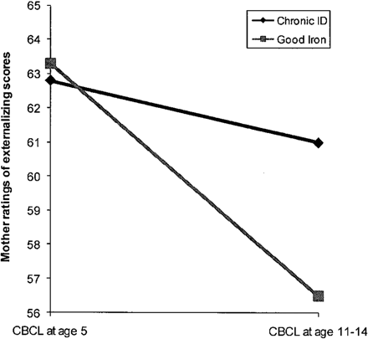
Figure 2. Interaction between iron status and time predicting mother ratings of externalizing problems for infants with ...
Notes:
Figure 2. Interaction between iron status and time predicting mother ratings of externalizing problems for infants with low activity.
Unless provided in the caption above, the following copyright applies to the content of this slide: © The Author 2009. Published by Oxford University Press on behalf of the Society of Pediatric Psychology. All rights reserved. For permissions, please e-mail: journals.permissions@oxfordjournals.org

Slide 2
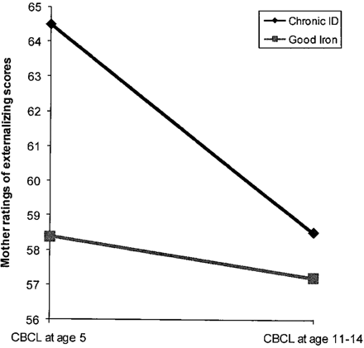
Figure 1. Interaction between iron status and time predicting mother ratings of externalizing problems for infants with ...
Notes:
Figure 1. Interaction between iron status and time predicting mother ratings of externalizing problems for infants with high activity.
Unless provided in the caption above, the following copyright applies to the content of this slide: © The Author 2009. Published by Oxford University Press on behalf of the Society of Pediatric Psychology. All rights reserved. For permissions, please e-mail: journals.permissions@oxfordjournals.org

