Slide 1
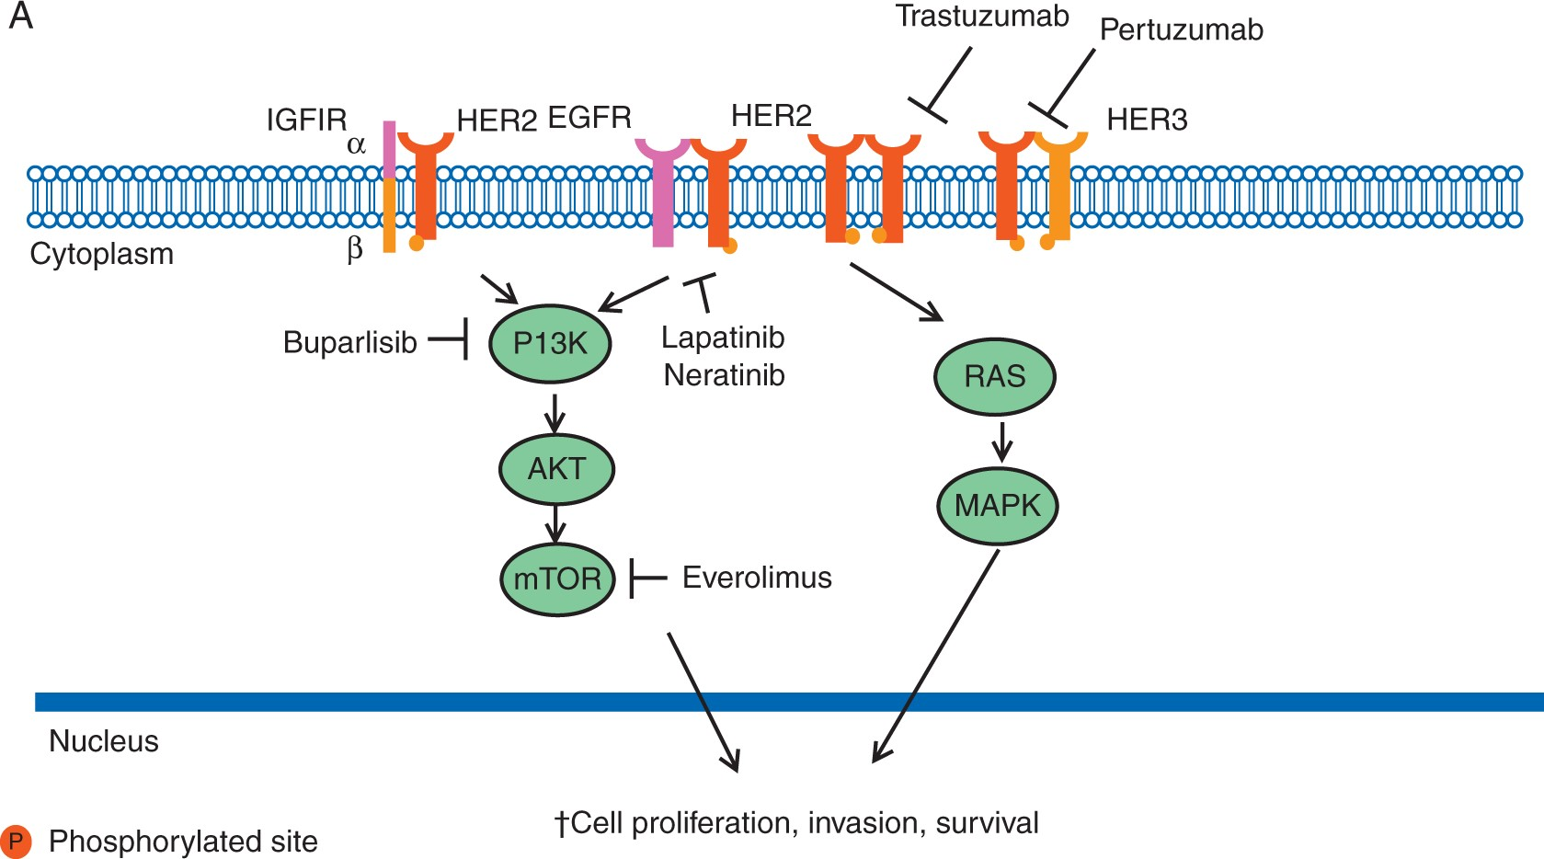
Figure 1 HER2 signal transduction. Activation of the receptor tyrosine kinase occurs by homodimerization or ...
Notes:
Figure 1 HER2 signal transduction. Activation of the receptor tyrosine kinase occurs by homodimerization or heterodimerization with other HER family members; i.e., epidermal growth factor receptor (EGFR) and HER3 and insulin growth factor receptor 1 (IGFIR). Activated HER2 initiates downstream signaling through the PI3K-AKT-mTOR and RAS-MAPK pathways, promoting cell proliferation and survival.
Unless provided in the caption above, the following copyright applies to the content of this slide: © The Author 2016. Published by Oxford University Press on behalf of the European Society for Medical Oncology. All rights reserved. For permissions, please email: journals.permissions@oup.com.

Slide 2
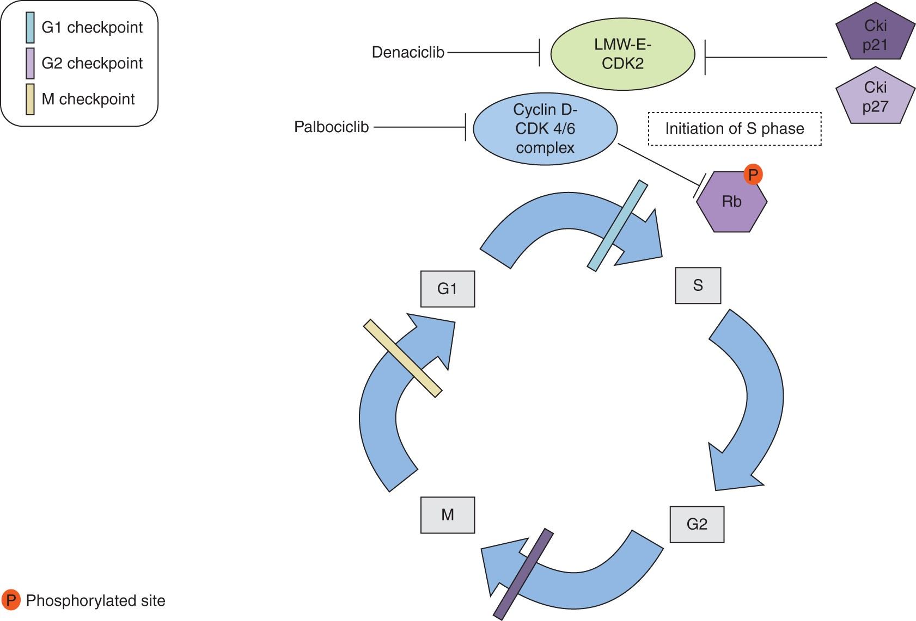
Figure 2 The figure depicts the role of cyclin-dependent kinases 4 and 6 (CDK4/6) in the cell cycle. The normal cell ...
Notes:
Figure 2 The figure depicts the role of cyclin-dependent kinases 4 and 6 (CDK4/6) in the cell cycle. The normal cell replication processes are represented i.e., G1 first growth period to S DNA replication phase G2 second growth period, and M, which is the mitosis period. Cyclin D1-CDK4/6 inactivates retinoblastoma protein (Rb) through phosphorylation. The latter event allows for cell cycle progression from G1 to S phase. Palbociclib targets cyclin-CDK4/6 complex formation ultimately generating cell cycle arrest. Also low molecular weight cyclin E-cycle dependent kinase 2 (LMW-E-CDK2) complex activation is depicted. When active LMW-E-CDK2 complex is resistant to inhibitory effect of cyclin inhibitors p21 and p27 and promote initiation of S phase. Denaciclib targets CDK2 promoting cell cycles arrest.
Unless provided in the caption above, the following copyright applies to the content of this slide: © The Author 2016. Published by Oxford University Press on behalf of the European Society for Medical Oncology. All rights reserved. For permissions, please email: journals.permissions@oup.com.

