Slide 1
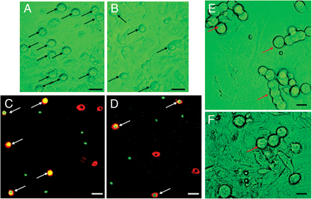
Figure 1 Isolation and culture of FGSCs from ovaries of neonatal and adult mice. (A and B) The morphology of FGSCs ...
Notes:
Figure 1 Isolation and culture of FGSCs from ovaries of neonatal and adult mice. (A and B) The morphology of FGSCs (arrows) from neonatal (A) and adult (B) mice cultured on mitomycin C-treated STO cells for 24 h after isolation by a two-step enzymatic digestion. (C and D) Dual immunofluorescence of BrdU (green) and MVH (red) in FGSCs (arrows) of neonatal (C) and adult (D) mice isolated and cultured for 2 days. (E and F) The FGSCs isolated from neonatal (E) and adult (F) mice expanded and were undergoing mitosis after 3 days of culture. Arrows indicate that the FGSCs are undergoing mitosis or expanded FGSCs. Scale bars, 25 µm (A–D) and 10 µm (E, F).
Unless provided in the caption above, the following copyright applies to the content of this slide: © The Author (2010). Published by Oxford University Press on behalf of Journal of Molecular Cell Biology, IBCB, SIBS, CAS. All rights reserved.

Slide 2
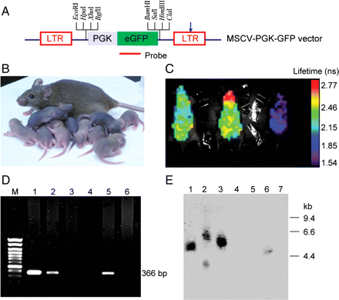
Figure 2 GFP offspring generated from the transplantation of FGSCs. (A) The MSCV-PGK-GFP vector carrying PGK. Arrow, ...
Notes:
Figure 2 GFP offspring generated from the transplantation of FGSCs. (A) The MSCV-PGK-GFP vector carrying PGK. Arrow, self-inactivating mutation; LTR, long terminal repeat. (B) Offspring from a C57BL/6 × CD-1 F1 recipient mouse transplanted with GFP-transfected FGSCs. (C) The offspring were screened by live imaging (The eXplore Optix, GE Company) for the identification of GFP offspring. Left, middle: GFP-positive offspring. Right: GFP-negative offspring. (D) PCR analysis of offspring. Amplification via 32 cycles of PCR was performed using Taq polymerase (Promega) with primer set (5′-CGACGGCAACTACAAGACCCG-3′ and 5′-ACGAACTCCAGCAGGACCATG-3′) specific for the GFP gene. The PCR product was also sequenced for further confirmation of successful gene transgenesis. M, 100-bp DNA ladder; lane 1, positive control (DNA from MSCV-PGK-GFP plasmid); lanes 2, 5, transgenic mice; lanes 3, 4, 6, WT mice. (E) Southern blot analysis of tail DNA with a probe, a 366-bp-long PCR amplified fragment from the MSCV-PGK-GFP plasmid using primers for the GFP gene (Figure 2A). Genomic DNA was digested with EcoRI. Size markers are indicated to the right of the Southern blot. Lanes 1–3, 6, transgenic mice; lanes 4, 5, 7, WT mice.
Unless provided in the caption above, the following copyright applies to the content of this slide: © The Author (2010). Published by Oxford University Press on behalf of Journal of Molecular Cell Biology, IBCB, SIBS, CAS. All rights reserved.

Slide 3
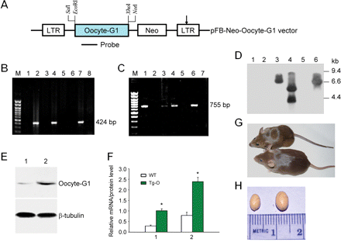
Figure 3 Production of Oocyte-G1 transgenic mice. (A) Diagram of the Oocyte-G1 transgenic strategy. Arrow, ...
Notes:
Figure 3 Production of Oocyte-G1 transgenic mice. (A) Diagram of the Oocyte-G1 transgenic strategy. Arrow, self-inactivating mutation; Neo, the neomycin phosphotransferase gene; Oocyte-G1, targeting gene (see Supplemental online material); LTR, long terminal repeat. (B) PCR analysis of gene transgenesis in offspring. PCR was performed using primer set (5′-GGTGGAGAGGCTATTCGGCTATGA-3′ and 5′-ATCCTGATCGACAAGACCGGCTTC-3′) specific for Neo gene. The PCR product was sequenced for confirmation of the presence of Neo gene. M, 100-bp DNA ladder; lanes 3, 5, 8, transgenic mice; lanes 2, 4, 6, 7, 9, WT mice. (C) PCR analysis of offspring with primer set (5′-GCACTGCCTTTGAAGAGTCC-3′ and 5′-CATCTCGGTGTTTTCCACCTC-3′) specific for Oocyte-G1. The PCR product was also sequenced for further confirmation of successful gene transgenesis. M, 100-bp DNA ladder; lanes 1, 3, 4, 6, transgenic mice; lanes 2, 5, 7, WT mice. (D) Southern blot analysis of offspring with a probe, a 755-bp-long PCR amplified fragment from the pFB-Neo-Oocyte-G1 plasmid using specific primers (5′-GCACTGCCTTTGAAGAGTCC-3′ and 5′-CATCTCGGTGTTTTCCACCTC-3′) for Oocyte-G1 (see Supplemental online material). Tail DNA was digested with EcoRI. Size markers are indicated to the right of the southern blot. Lanes 1, 2, 5, WT mice; lanes 3, 6, transgenic line 1; lane 4, transgenic line 2. (E) Representative western blot analysis of Oocyte-G1 in testicular protein obtained from Tg-O or WT mice. Lane 1, WT; lane 2, Tg-O. (F) Western blots were quantified by densitometry and the data were expressed as a ratio of Oocyte-G1:β-tubulin (mean ± SEM); qRT-PCR analysis of Oocyte-G1 mRNA expression in Tg-O and WT testes. The result showed that Tg-O mice overexpressed Oocyte-G1 in the testes. 1, western blot analysis; 2, qRT-PCR. (G) Tg-O (above) and WT (bottom) mice. (H) Macroscopic appearance of Tg-O (left) and WT (right) testes at 8 weeks of age.
Unless provided in the caption above, the following copyright applies to the content of this slide: © The Author (2010). Published by Oxford University Press on behalf of Journal of Molecular Cell Biology, IBCB, SIBS, CAS. All rights reserved.

Slide 4
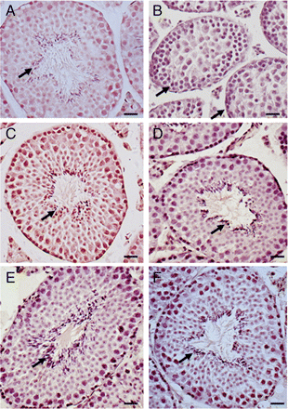
Figure 4 Developmental retardation of the male sex organ (testis) in the Tg-O mice. (A–F) Morphometric analysis of WT ...
Notes:
Figure 4 Developmental retardation of the male sex organ (testis) in the Tg-O mice. (A–F) Morphometric analysis of WT (A, C, E) and Tg-O (B, D, F) testes. (A) Histological section of WT testis at 8 weeks of age. Many sperm were found in seminiferous tubules (arrow). (B) Morphology of Tg-O testis at 8 weeks of age. No sperm was observed in seminiferous tubules (arrows). (C and D) Morphology of WT (C) and Tg-O (D) testes at 12 weeks of age. A number of sperm were found in seminiferous tubules of (C) and (D) (arrows). (E and F) Morphology of WT (E) and Tg-O (F) testes at 16 weeks of age. Many sperm were observed in seminiferous tubules (arrows). Scale bars, 50 µm.
Unless provided in the caption above, the following copyright applies to the content of this slide: © The Author (2010). Published by Oxford University Press on behalf of Journal of Molecular Cell Biology, IBCB, SIBS, CAS. All rights reserved.

Slide 5
Figure 5 Morphological defects in sperm of Tg-D mice. (A) WT sperm. (B) Tg-D sperm bent over in the midpiece (white ...
Notes:
Figure 5 Morphological defects in sperm of Tg-D mice. (A) WT sperm. (B) Tg-D sperm bent over in the midpiece (white arrows) or formed loop (red arrow). (C) Tg-D sperm folded at the proximal midpiece. The sperm head is bent back on the tail (arrow). (D) Tg-D sperm formed loop (arrow). (E) Tg-D sperm head and neck attached to the midpiece (arrow). (F) Percentage of sperm with normal and abnormal morphology. (G) Immunofluorescence of Dnaic2 in WT sperm, showing Dnaic2 protein expressed in the sperm midpiece and membrane of sperm head (arrow). (H) Morphology of WT sperm after fixation with 4% paraformaldehyde and immunofluorescence.
Unless provided in the caption above, the following copyright applies to the content of this slide: © The Author (2010). Published by Oxford University Press on behalf of Journal of Molecular Cell Biology, IBCB, SIBS, CAS. All rights reserved.

Slide 6
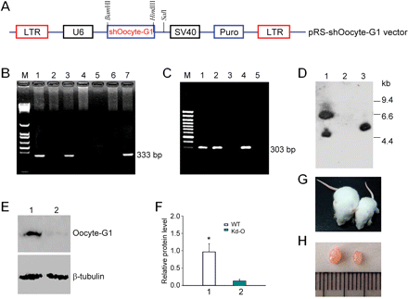
Figure 6 Production of Kd-O mice. (A) Diagram of the Kd-O strategy. U6, U6 promoter; SV40 (Simian Virus), SV40 early ...
Notes:
Figure 6 Production of Kd-O mice. (A) Diagram of the Kd-O strategy. U6, U6 promoter; SV40 (Simian Virus), SV40 early promoter; Puro, puromycin-N-acetyl transferase gene; shOocyte-G1, the shRNA expression cassette consists of a 29-bp target Oocyte-G1 specific sequence (see the section ‘Materials and methods’), a 7-bp loop, and another 29-bp reverse complementary sequence. (B) PCR analysis of Kd-O offspring. PCR was performed using primer set (5′-GAGCGTCGAAGCGGGGGCGGTGTTC-3′ and 5′-CAGGTCGCGCGGTCCTTCGGGCACTC-3′) specific for Puro gene. The PCR product was sequenced for confirmation of the presence of Puro gene. M, 100-bp DNA ladder; lanes 1, 3, 7, Puro-positive mice; lanes 2, 4, 5, 6, WT mice. (C) PCR analysis of offspring with primer set (5′-TCGACCCTGTGGAATGTGT-3′ and 5′-GGGCTTGTACTCGGTCAT-3′) specific for SV40 (Figure 6A) early promoter. The PCR product was also sequenced for confirmation of the presence of SV40 early promoter. M, 100-bp DNA ladder; lane 1, positive control (DNA from pRS shOocyte-G1 plasmid); lanes 2, 4, SV40-positive mice; lane 3, WT mouse, lane 5, negative control. (D) Southern blot analysis of offspring with a probe, a 303-bp-long PCR amplified fragment using primers for SV40 early promoter (see above). Genomic DNA was digested with EcoRI. Size markers are shown on the right of the Southern blot. Lanes 1, 3, SV40-positive mice; lane 2, WT mouse. (E) Representative western blot analysis of Oocyte-G1 in testis, lung and kidney protein obtained from WT mouse (lane 1) or Kd-O (lane 2). (F) Western blots were quantified by densitometry and the data were expressed as a ratio of Oocyte-G1:β-tubulin (mean ± SEM). 1, western blot analysis of WT mouse; 2, western blot analysis of Kd-O. *P < 0.05. (G) Kd-O (right) and WT (left) mice at 18 days of age. (H) Macroscopic appearance of Kd-O (right) and WT (left) testes from 18-day-old mice.
Unless provided in the caption above, the following copyright applies to the content of this slide: © The Author (2010). Published by Oxford University Press on behalf of Journal of Molecular Cell Biology, IBCB, SIBS, CAS. All rights reserved.

Slide 7
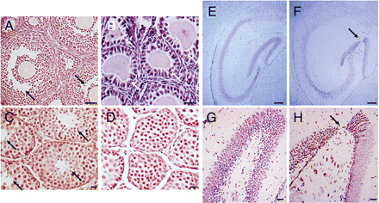
Figure 7 Phenotype of Kd-O mice. (A and B) Representative morphology of ovaries from WT (A) and Kd-O (B) mice at 18 ...
Notes:
Figure 7 Phenotype of Kd-O mice. (A and B) Representative morphology of ovaries from WT (A) and Kd-O (B) mice at 18 days of age, showing that most follicles were atretic (white arrows) and large antral follicles were absent in Kd-O ovaries. Black arrows indicate large antral follicles. (C and D) Representative views of testis sections from WT (C) and Kd-O (D) mice at 18 days of age. There was active spermatogenesis in all seminiferous tubules (arrows) of WT mice. Abnormal spermatogenesis or disorganization in the development of spermatogenesis was observed in all seminiferous tubules of Kd-O mice. (E and F) Representative morphology of the hippocampus from WT (E) and Kd-O (F) mice at 18 days of age. An abnormality in the dentate gyrus of the hippocampus (arrow) was observed in brains of Kd-O mice (F). (G and H) Morphology of the dentate gyrus (higher power) from WT (G) and Kd-O (H) mice. A broken dentate gyrus (arrow) was found in brain of Kd-O mice (H). Scale bars, 50 µm (A, C, D), 25 µm (B, G, H), 200 µm (E, F).
Unless provided in the caption above, the following copyright applies to the content of this slide: © The Author (2010). Published by Oxford University Press on behalf of Journal of Molecular Cell Biology, IBCB, SIBS, CAS. All rights reserved.

