Slide 1
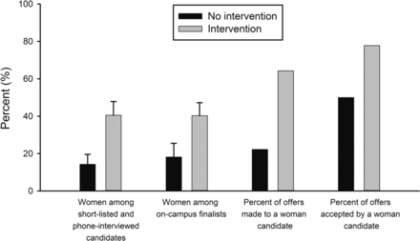
Figure 1. Mean percentages of women interviewed at two points in the science, technology, engineering, and mathematics ...
Notes:
Figure 1. Mean percentages of women interviewed at two points in the science, technology, engineering, and mathematics (STEM) faculty search process and simple percentages of tenure-track job offers extended to and accepted by women, by intervention group. The error bars represent the standard error.
Unless provided in the caption above, the following copyright applies to the content of this slide: © The Author(s) 2015. Published by Oxford University Press on behalf of the American Institute of Biological Sciences.This is an Open Access article distributed under the terms of the Creative Commons Attribution Non-Commercial License (http://creativecommons.org/licenses/by-nc/4.0/), which permits non-commercial re-use, distribution, and reproduction in any medium, provided the original work is properly cited. For commercial re-use, please contact journals.permissions@oup.com.

