Slide 1
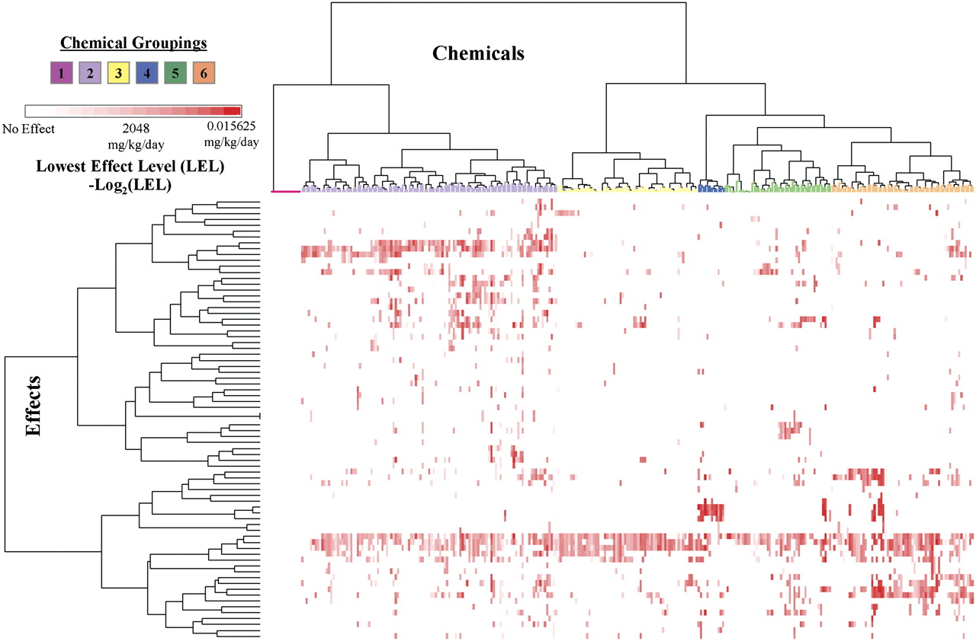
FIG. 1. Two-way hierarchical clustering of 75 treatment-related effects from multigeneration reproduction tests on ...
Notes:
FIG. 1. Two-way hierarchical clustering of 75 treatment-related effects from multigeneration reproduction tests on 316 chemicals in ToxRefDB. Six chemical groups were identified based on their patterns of reproductive toxicity. Each chemical group description is derived from the mostly heavily weighted endpoints (see Results and http://www.epa.gov/ncct/toxrefdb/ for details) and does not mean that every chemical in the group causes the endpoint.
Unless provided in the caption above, the following copyright applies to the content of this slide: Published by Oxford University Press 2009.

Slide 2
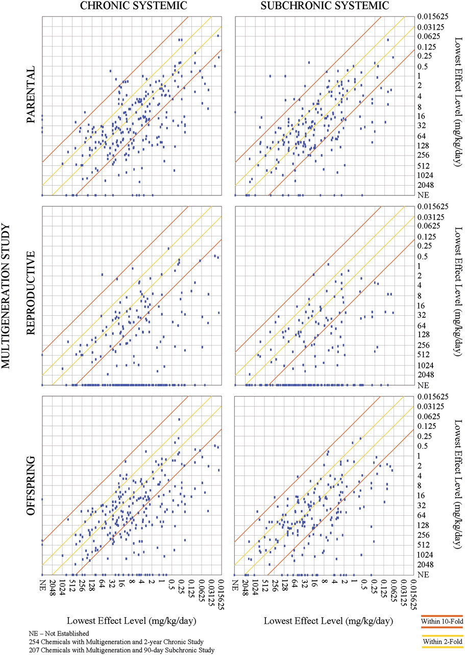
FIG. 2. Parental, reproductive, and offspring LELs (inverse log transformed) from multigeneration rat studies were ...
Notes:
FIG. 2. Parental, reproductive, and offspring LELs (inverse log transformed) from multigeneration rat studies were compared to systemic LEL from chronic/cancer and subchronic rat studies for 254 and 207 chemicals, respectively. Points within gold lines indicate less than twofold difference between multigeneration and chronic studies. Points within orange lines indicate less than 10-fold difference between multigeneration and chronic studies. “NE” stands for not established.
Unless provided in the caption above, the following copyright applies to the content of this slide: Published by Oxford University Press 2009.

Slide 3
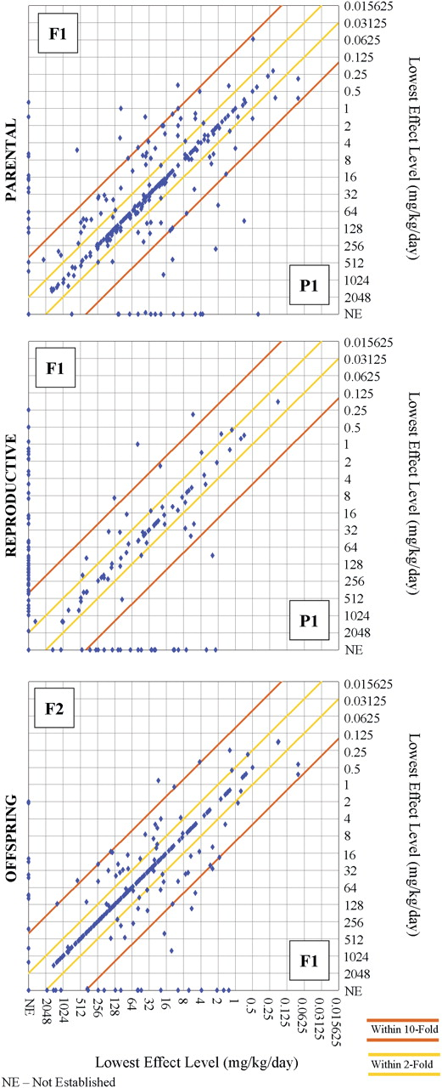
FIG. 3. Comparing LELs across generation and endpoint category. Points within dark orange lines indicate less than ...
Notes:
FIG. 3. Comparing LELs across generation and endpoint category. Points within dark orange lines indicate less than twofold difference between generations. Points within light orange lines indicate less than 10-fold difference between generations. “NE” stands for not established.
Unless provided in the caption above, the following copyright applies to the content of this slide: Published by Oxford University Press 2009.

Slide 4
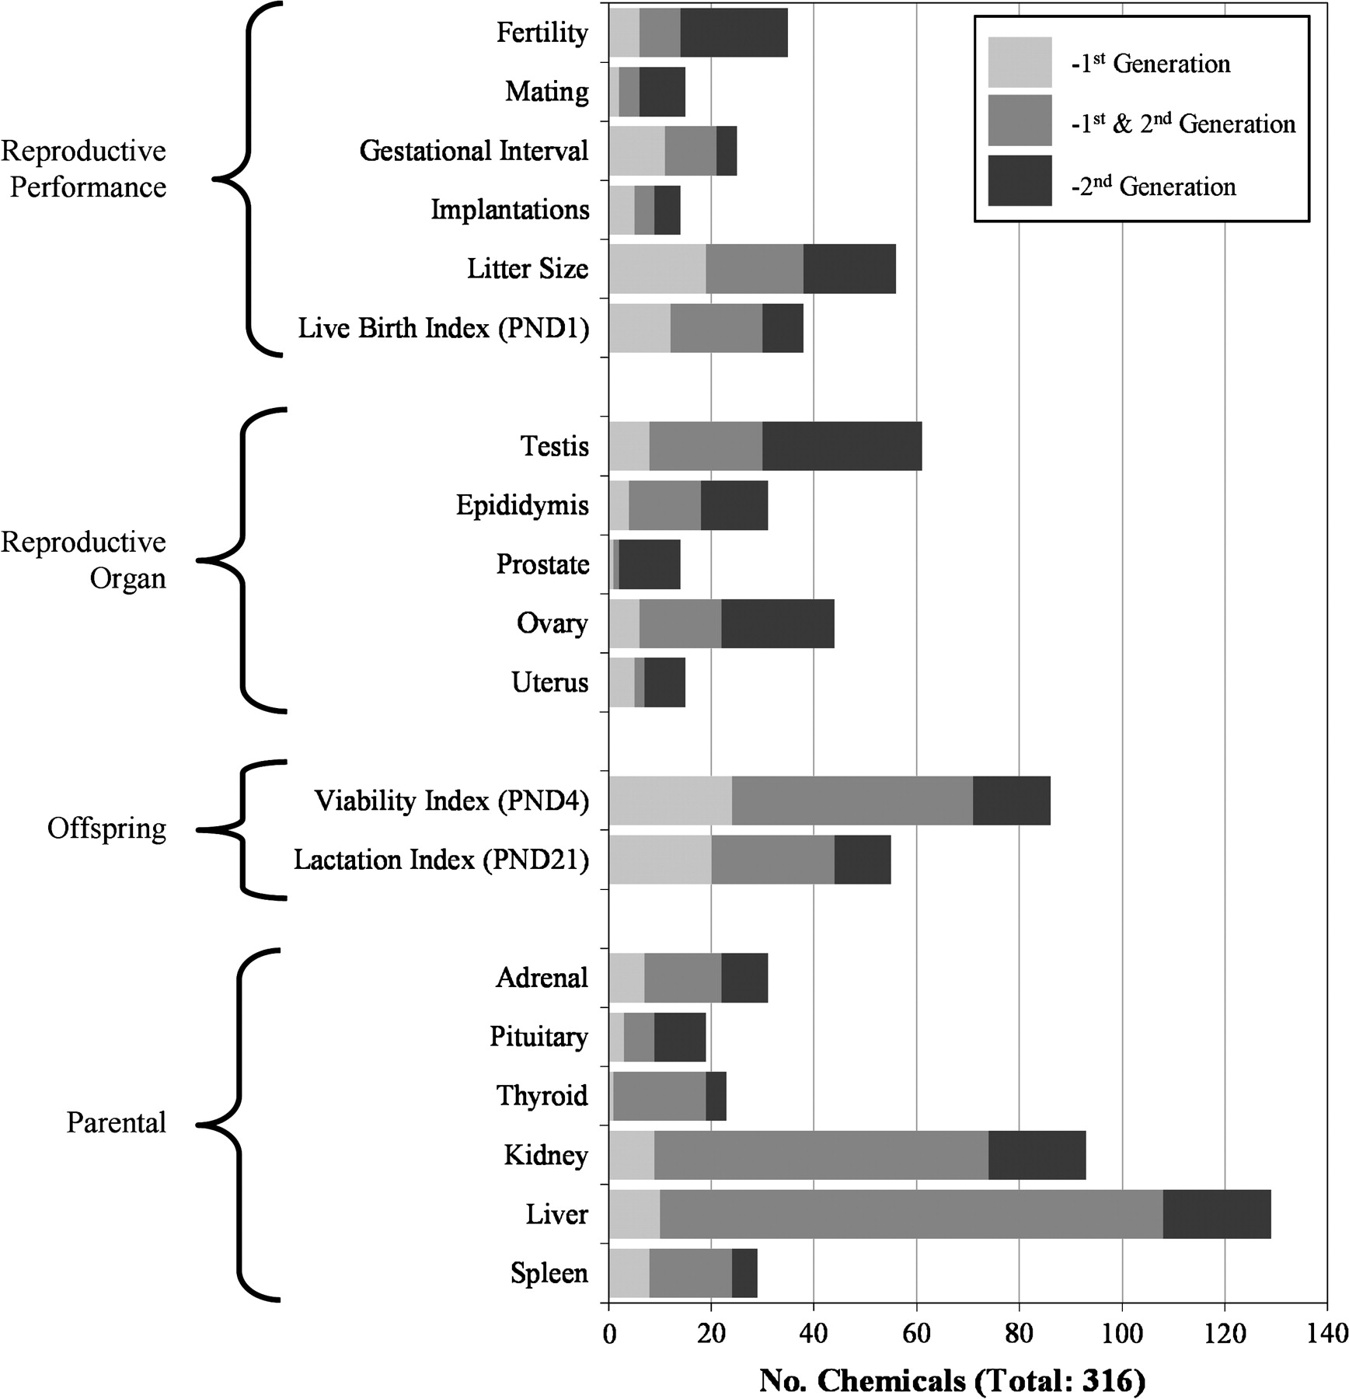
FIG. 4. Incidence and distribution, by generation, of the 19 endpoints selected for predictive modeling, including ...
Notes:
FIG. 4. Incidence and distribution, by generation, of the 19 endpoints selected for predictive modeling, including reproductive, offspring, and systemic toxicity endpoints from the rat multigeneration reproduction study (see Results and http://www.epa.gov/ncct/toxrefdb/ for details). The light gray bar indicates chemicals observing the endpoint only in the first generation, either P1 adult or F1 juvenile. The medium gray bar indicates chemicals observing the endpoint in both first and second generation treatment groups. The dark gray bar indicates chemicals observing the endpoint only in the second generation, either F1 adult or F2 juvenile.
Unless provided in the caption above, the following copyright applies to the content of this slide: Published by Oxford University Press 2009.

