Slide 1
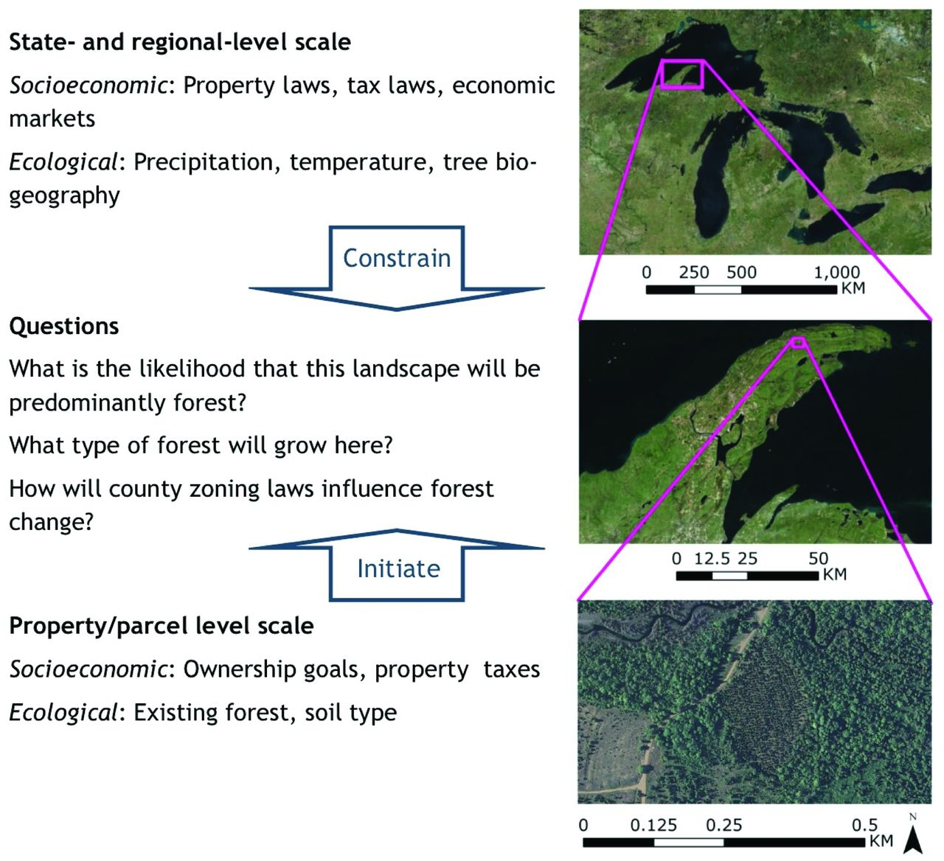
Figure 1. To determine how forest cover changes over time on the Keweenaw Peninsula in northern Michigan, researchers ...
Notes:
Figure 1. To determine how forest cover changes over time on the Keweenaw Peninsula in northern Michigan, researchers must understand fine-scale social, economic, and ecological characteristics at the parcel level (e.g., management goals and decisions of the owner, soil types), as well as the broad-scale constraints at the state or ecoregion level (e.g., state property and tax laws, regional climate). Map data: ESRI, Digital globe, and US Geological Survey (https://lta.cr.usgs.gov/high_res_ortho). Abbreviation: km, kilometers.
Unless provided in the caption above, the following copyright applies to the content of this slide: Published by Oxford University Press on behalf of American Institute of Biological Sciences 2016. This work is written by (a) US Government employee(s) and is in the public domain in the US.

Slide 2
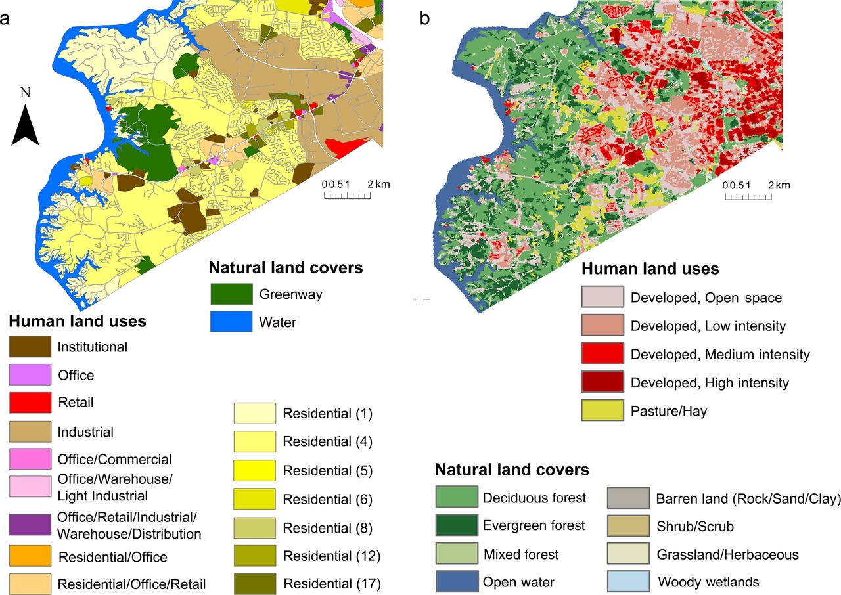
Figure 2. Urban planners and landscape ecologists use different vocabularies to describe land covers and uses. Planners ...
Notes:
Figure 2. Urban planners and landscape ecologists use different vocabularies to describe land covers and uses. Planners have developed detailed classifications of human uses but relatively poor classifications of natural land covers (a). The opposite is true of landscape ecologists (b). In order for the disciplines to collaborate more effectively, a shared terminology must be developed. The data in panel (a) are from the City of Charlotte's (North Carolina) 2013 Adopted Future Land Use map. The residential land uses in (a) are differentiated by the number of dwellings per acre in parentheses. The data in panel (b) are from the United States Geological Survey's 2006 National Land Cover Database.
Unless provided in the caption above, the following copyright applies to the content of this slide: Published by Oxford University Press on behalf of American Institute of Biological Sciences 2016. This work is written by (a) US Government employee(s) and is in the public domain in the US.

