Slide 1
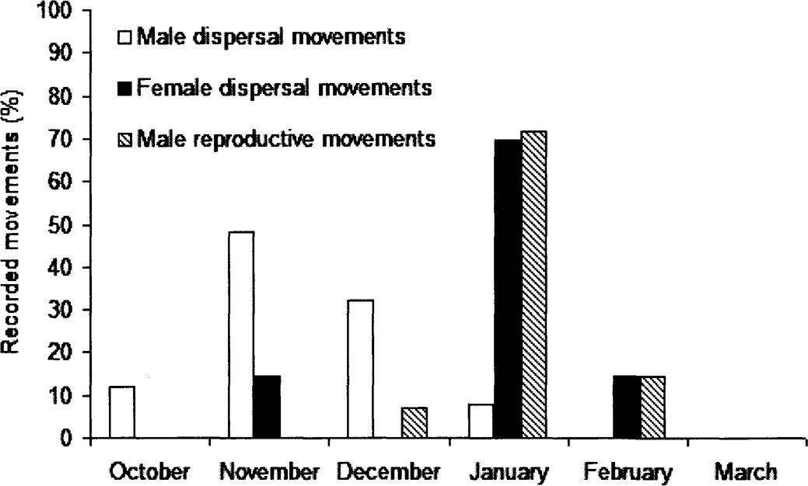
Fig. 3 The percentage of all recorded male (n = 25 movements, 8 individuals) and female (n = 7 movements, 4 ...
Notes:
Fig. 3 The percentage of all recorded male (n = 25 movements, 8 individuals) and female (n = 7 movements, 4 individuals) dispersal and reproductive movements (n = 14 movements, 9 individuals) of red foxes (Vulpes vulpes) detected at monthly intervals during October to March.
Unless provided in the caption above, the following copyright applies to the content of this slide: © 2011 American Society of Mammalogists

Slide 2
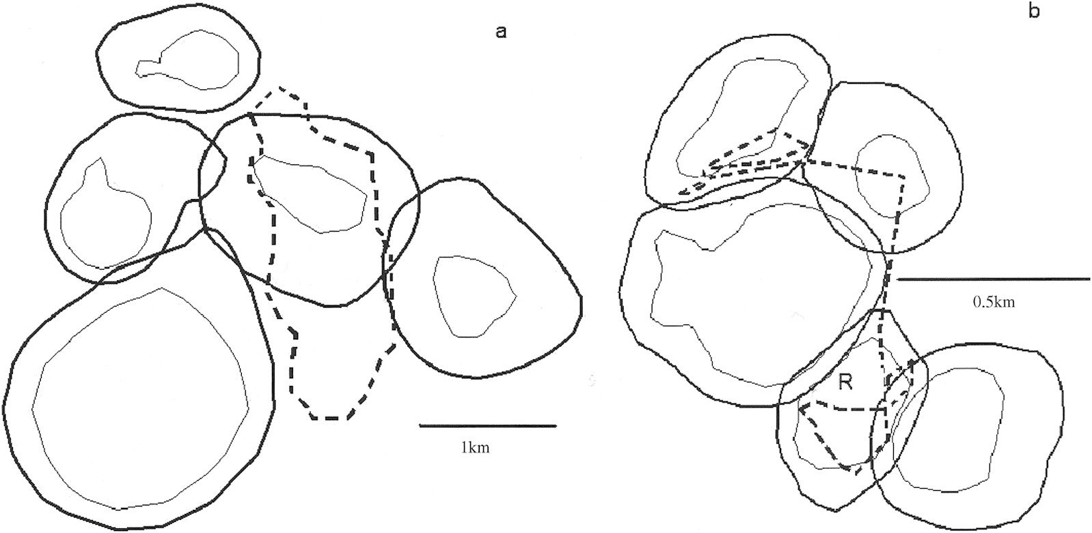
Fig. 2 Examples of a) a single exploratory movement of a dispersing red fox (Vulpes vulpes) from a temporary range ...
Notes:
Fig. 2 Examples of a) a single exploratory movement of a dispersing red fox (Vulpes vulpes) from a temporary range (start and end point marked by a diamond), and b) a male reproductive movement (both denoted by dashed lines) in a matrix of resident home territories denoted by 95% (thick line) and 60% (thin line) harmonic mean isopleths. The home territory of the male making the reproductive movement is indicated with R. For clarity, the spatial coverage of all resident home territories is not shown.
Unless provided in the caption above, the following copyright applies to the content of this slide: © 2011 American Society of Mammalogists

Slide 3
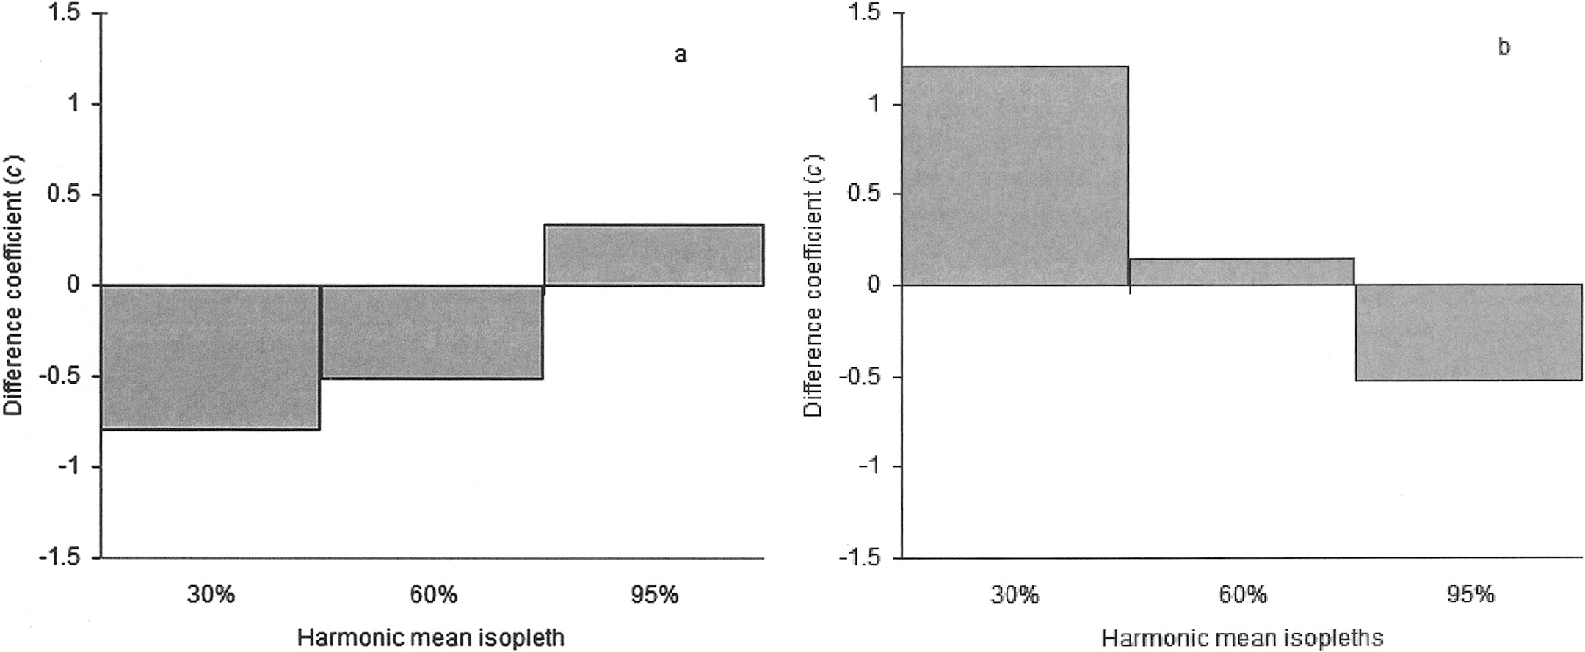
Fig. 1 Differences between frequencies of real versus random movements of red foxes (Vulpes vulpes) for a) dispersal ...
Notes:
Fig. 1 Differences between frequencies of real versus random movements of red foxes (Vulpes vulpes) for a) dispersal and b) reproductive movements within 95%, 60%, and 30% harmonic mean isopleths of adults. Differences are expressed as the coefficient, c (for details, see text). A positive difference indicates a higher frequency than expected and a negative difference a lower frequency than expected.
Unless provided in the caption above, the following copyright applies to the content of this slide: © 2011 American Society of Mammalogists

