Slide 1
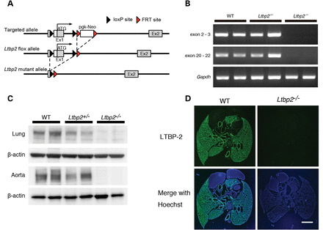
Figure 1. Generation of Ltbp2 null mice. (A) Schematic representation of the strategy to target the Ltbp2 gene. The ...
Notes:
Figure 1. Generation of Ltbp2 null mice. (A) Schematic representation of the strategy to target the Ltbp2 gene. The pgk-Neo cassette flanked by FRT sites was removed by crossing with flippase-expressing mice. Subsequently, the exon 1 flanked by loxP sites was removed by crossing with mice expressing Cre-recombinase in the germline. (B) RT–PCR analysis showing complete loss of Ltbp2 mRNA in Ltbp2–/– mice. Total RNA from lungs of 10-week-old mice was extracted and reverse-transcribed to cDNA, followed by PCR. Although only exon 1 of the Ltbp2 gene was deleted, primers designed to amplify exon 2–3 or exon 20–22 did not produce PCR product in Ltbp2–/– samples, indicating that the Ltbp2 mRNA was disrupted by nonsense-mediated decay. The expression level of Gapdh was used as an internal control (Bottom). (C) Western blot analysis of lung and aorta extract from 10-week-old wild-type and Ltbp2–/– mice, using an anti-LTBP-2 antibody. β-actin was used as an internal control. (D) Immunofluorescent staining of thoracic tissues of P5 wild-type and Ltbp2–/– mice using an anti-LTBP-2 antibody. LTBP-2 was specifically expressed in lungs and vessels of wild-type mice. Lower panels are superimposition of upper panels with Hoechst 33258 staining. Scale bar, 1 mm.
Unless provided in the caption above, the following copyright applies to the content of this slide: © The Author 2014. Published by Oxford University Press. All rights reserved. For Permissions, please email: journals.permissions@oup.com

Slide 2
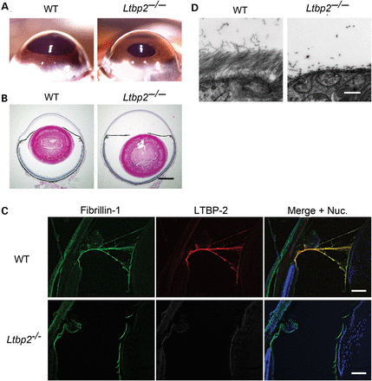
Figure 2. Ltbp2 deficiency causes ciliary zonule fragmentation. (A) Pictures of eyes of wild-type and ...
Notes:
Figure 2. Ltbp2 deficiency causes ciliary zonule fragmentation. (A) Pictures of eyes of wild-type and Ltbp2–/– mouse at 12 months. The irises of wild-type mouse eyes were convex as they were pushed by lenses, whereas the irises of Ltbp2–/– mouse eyes appeared flat. (B) HE-stained histological sections of mouse eyes. The lens of Ltbp2–/– mouse eye was dislocated posteriorly. Scale bar, 1 mm. (C) Immunofluorescent staining of 8-week-old Ltbp2–/– and wild-type mouse eyes using anti-fibrillin-1 and anti-LTBP-2 antibodies. The right images were produced by superimposition of the left and middle images, together with Hoechst 33258 nuclear staining. Scale bars, 100 µm. Nuc., nuclei. (D) TEM of ciliary zonules of 10-week-old wild-type and Ltbp2–/– mouse eyes. Ciliary zonules of wild-type eye were composed of thick bundles of microfibrils, but those of Ltbp2–/– eye were fragmented. Scale bar, 500 nm.
Unless provided in the caption above, the following copyright applies to the content of this slide: © The Author 2014. Published by Oxford University Press. All rights reserved. For Permissions, please email: journals.permissions@oup.com

Slide 3
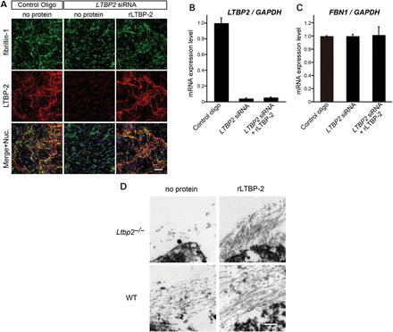
Figure 3. LTBP-2 induced microfibril assembly in cell culture (A–C) and in organ culture (D). (A) Human non-pigmented ...
Notes:
Figure 3. LTBP-2 induced microfibril assembly in cell culture (A–C) and in organ culture (D). (A) Human non-pigmented ciliary epithelial cells (HNPCEC) were transfected with siRNA as indicated and cultured in 4% serum containing medium with or without recombinant LTBP-2 (rLTBP-2), 15 µg/ml for 7 days. Cells were stained with anti-fibrillin-1 (upper panels) and anti-LTBP-2 antibodies (middle panels). Superimpositions of the upper and middle panels together with Hoechst nuclear staining (lower panels) showed co-localization of LTBP-2 and fibrillin-1. LTBP2 knockdown abrogated fibrillin microfibril meshwork formation, and supplementation of rLTBP-2 rescued the knockdown effect in HNPCEC. Scale bar, 100 µm. (B) LTBP2 knockdown efficiency in HNPCEC. Total RNA from siRNA-transfected HNPCEC was extracted 7 days after transfection. LTBP2 and GAPDH mRNA levels were measured with quantitative real-time PCR. (C) LTBP2 knockdown or rLTBP-2 supplementation did not affect the expression of fibrillin-1. FBN1 mRNA levels were measured as in (B), using GAPDH mRNA levels as internal controls. Data are presented as mean ± SEM of five independent experiments, each performed in triplicate. (D) Eye explants of P5 wild-type and Ltbp2–/– mice were cultured with or without rLTBP-2. After 7 days culture, ciliary zonules were evaluated by TEM. Ltbp2–/– mouse eye cultured without rLTBP-2 (upper-left), with rLTBP-2, 15 µg/ml (upper-right), wild-type eye cultured without rLTBP-2 (lower-left), with rLTBP-2, 15 µg/ml (lower-right). rLTBP-2 not only rescued the formation of ciliary zonules in Ltbp2–/– mouse eyes but also increased microfibril bundles in the ciliary zonules of wild-type mouse eyes. Scale bar, 500 nm.
Unless provided in the caption above, the following copyright applies to the content of this slide: © The Author 2014. Published by Oxford University Press. All rights reserved. For Permissions, please email: journals.permissions@oup.com

Slide 4
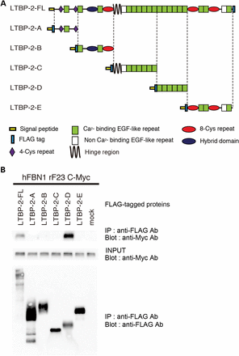
Figure 4. In vitro binding assay showing interaction of LTBP-2 with fibrillin-1. (A) Domain structure of the human ...
Notes:
Figure 4. In vitro binding assay showing interaction of LTBP-2 with fibrillin-1. (A) Domain structure of the human full-length LTBP-2 and the LTBP-2 fragments. The full-length LTBP2 was expressed as a C-terminal FLAG-tagged protein, and LTBP-2 fragments were expressed as N-terminal FLAG-tagged proteins flanked by the preprotrypsin signal sequence in HEK293T cells. (B) Specific interaction of fibrillin-1 with LTBP-2-D fragment. An N-terminal fragment of human fibrillin-1 (rF23) was independently expressed as a C-terminal Myc-tagged protein. Mixture of conditioned media and cell lysates from cells transfected with the LTBP-2 constructs and with the fibrillin-1 construct were incubated and immunoprecipitated with anti-FLAG antibody, followed by western blot analysis with anti-Myc antibody and anti-FLAG antibody.
Unless provided in the caption above, the following copyright applies to the content of this slide: © The Author 2014. Published by Oxford University Press. All rights reserved. For Permissions, please email: journals.permissions@oup.com

Slide 5
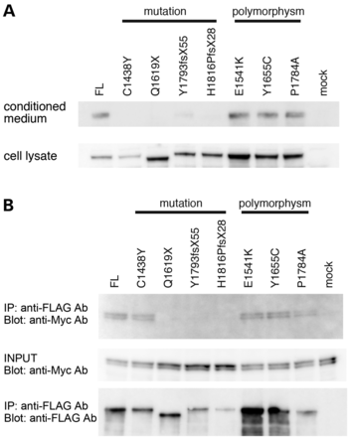
Figure 5. Human LTBP2 mutations cause loss of secretion and lack of fibrillin-1 binding activity. (A) HEK293T cells ...
Notes:
Figure 5. Human LTBP2 mutations cause loss of secretion and lack of fibrillin-1 binding activity. (A) HEK293T cells were transiently transfected with FLAG-tagged human LTBP-2 cDNAs with point mutations reported in ocular diseases or with known polymorphisms. Transfected cells were cultured in serum-free medium for 48 h, and the cell lysates and the conditioned media were harvested and analyzed by western blot with anti-FLAG antibody. (B) In vitro binding assay showing interaction of LTBP-2 mutants and variants with fibrillin-1. Mixtures of the media and cell lysates of HEK293T cells transfected with FLAG-tagged LTBP-2 mutants or variants were incubated with independently expressed Myc-tagged N-terminal fragment of fibrillin-1. The reactants were subjected to immunoprecipitation with anti-FLAG antibody, followed by western blot analysis with anti-Myc antibody or anti-FLAG antibody.
Unless provided in the caption above, the following copyright applies to the content of this slide: © The Author 2014. Published by Oxford University Press. All rights reserved. For Permissions, please email: journals.permissions@oup.com

