Slide 1
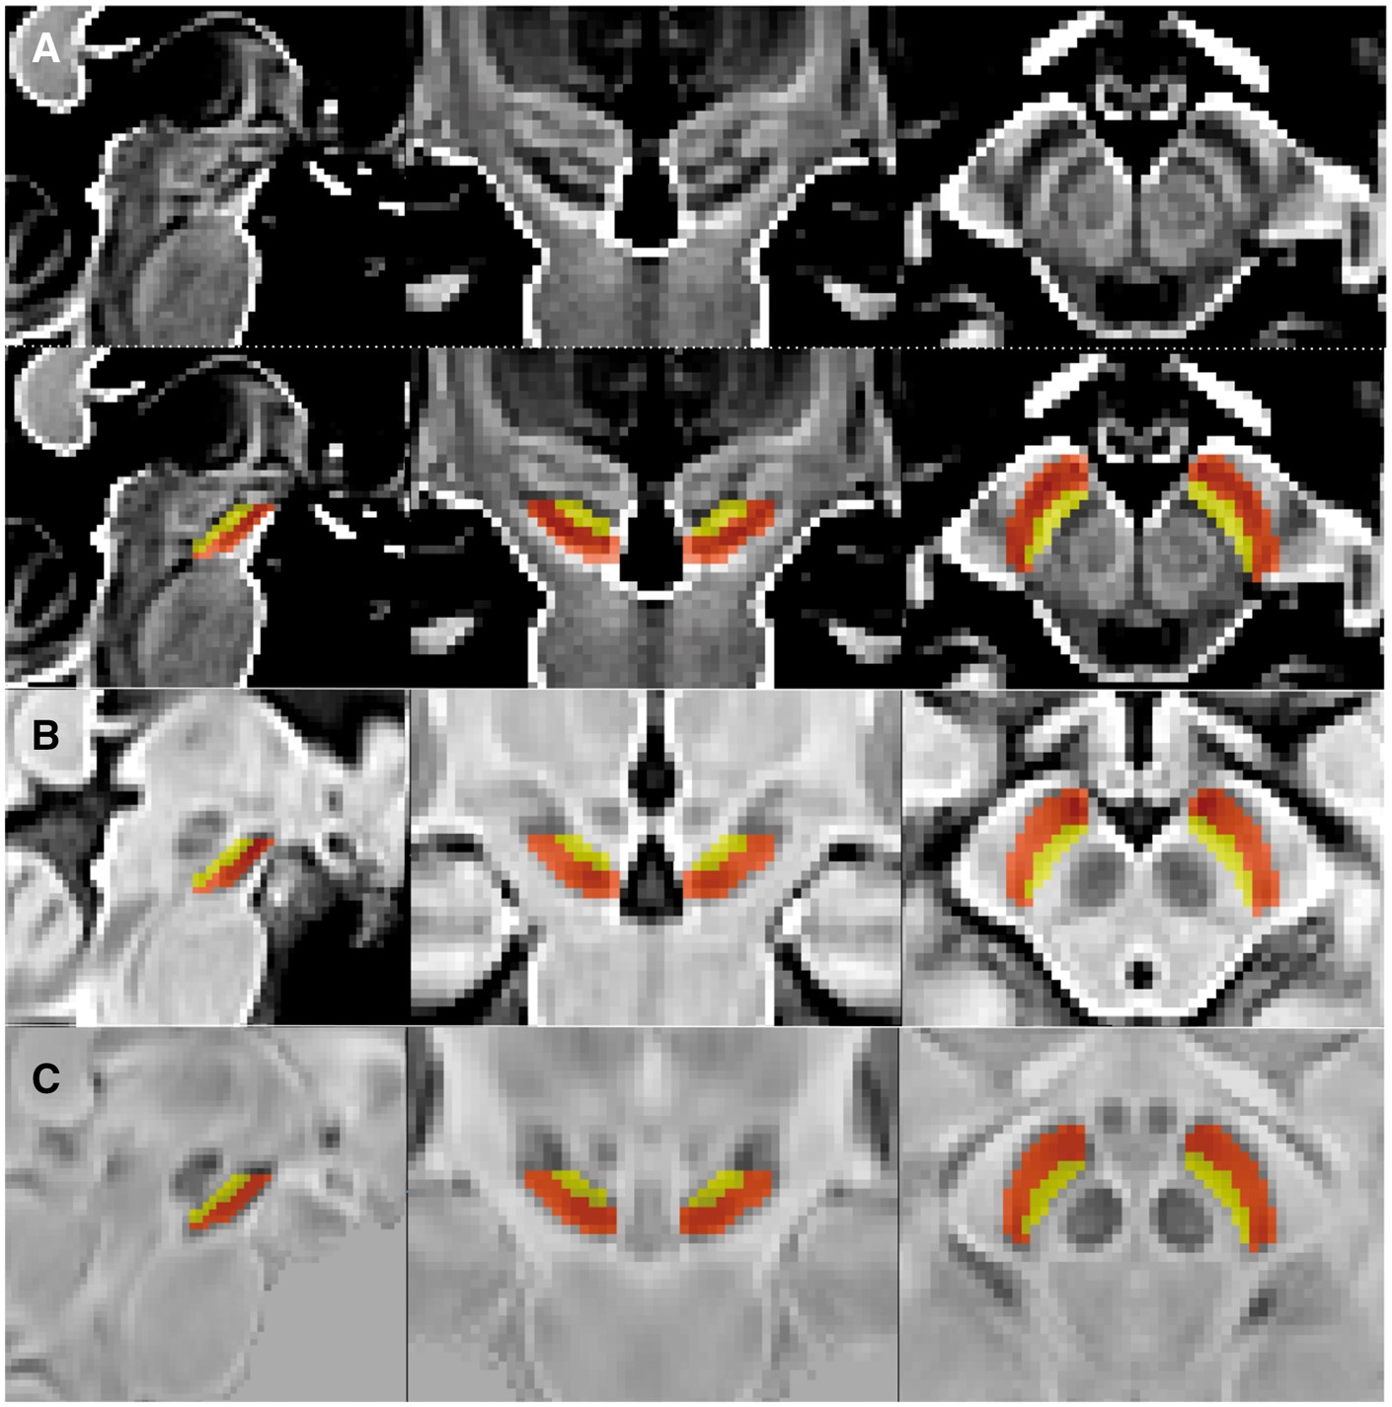
Figure 1 Manual substantia nigra subdivision. Representative sagittal, coronal and axial views of the midbrain region ...
Notes:
Figure 1 Manual substantia nigra subdivision. Representative sagittal, coronal and axial views of the midbrain region for the (A, top) T1-weighted average template, and for nigral subregions overlaid onto (A, bottom) T1-weighted, (B) T2*-weighted and (C) QSM templates. Dorsal and ventral tiers are denoted by yellow and orange overlays, respectively.
Unless provided in the caption above, the following copyright applies to the content of this slide: © The Author (2016). Published by Oxford University Press on behalf of the Guarantors of Brain. All rights reserved. For Permissions, please email: journals.permissions@oup.com

Slide 2
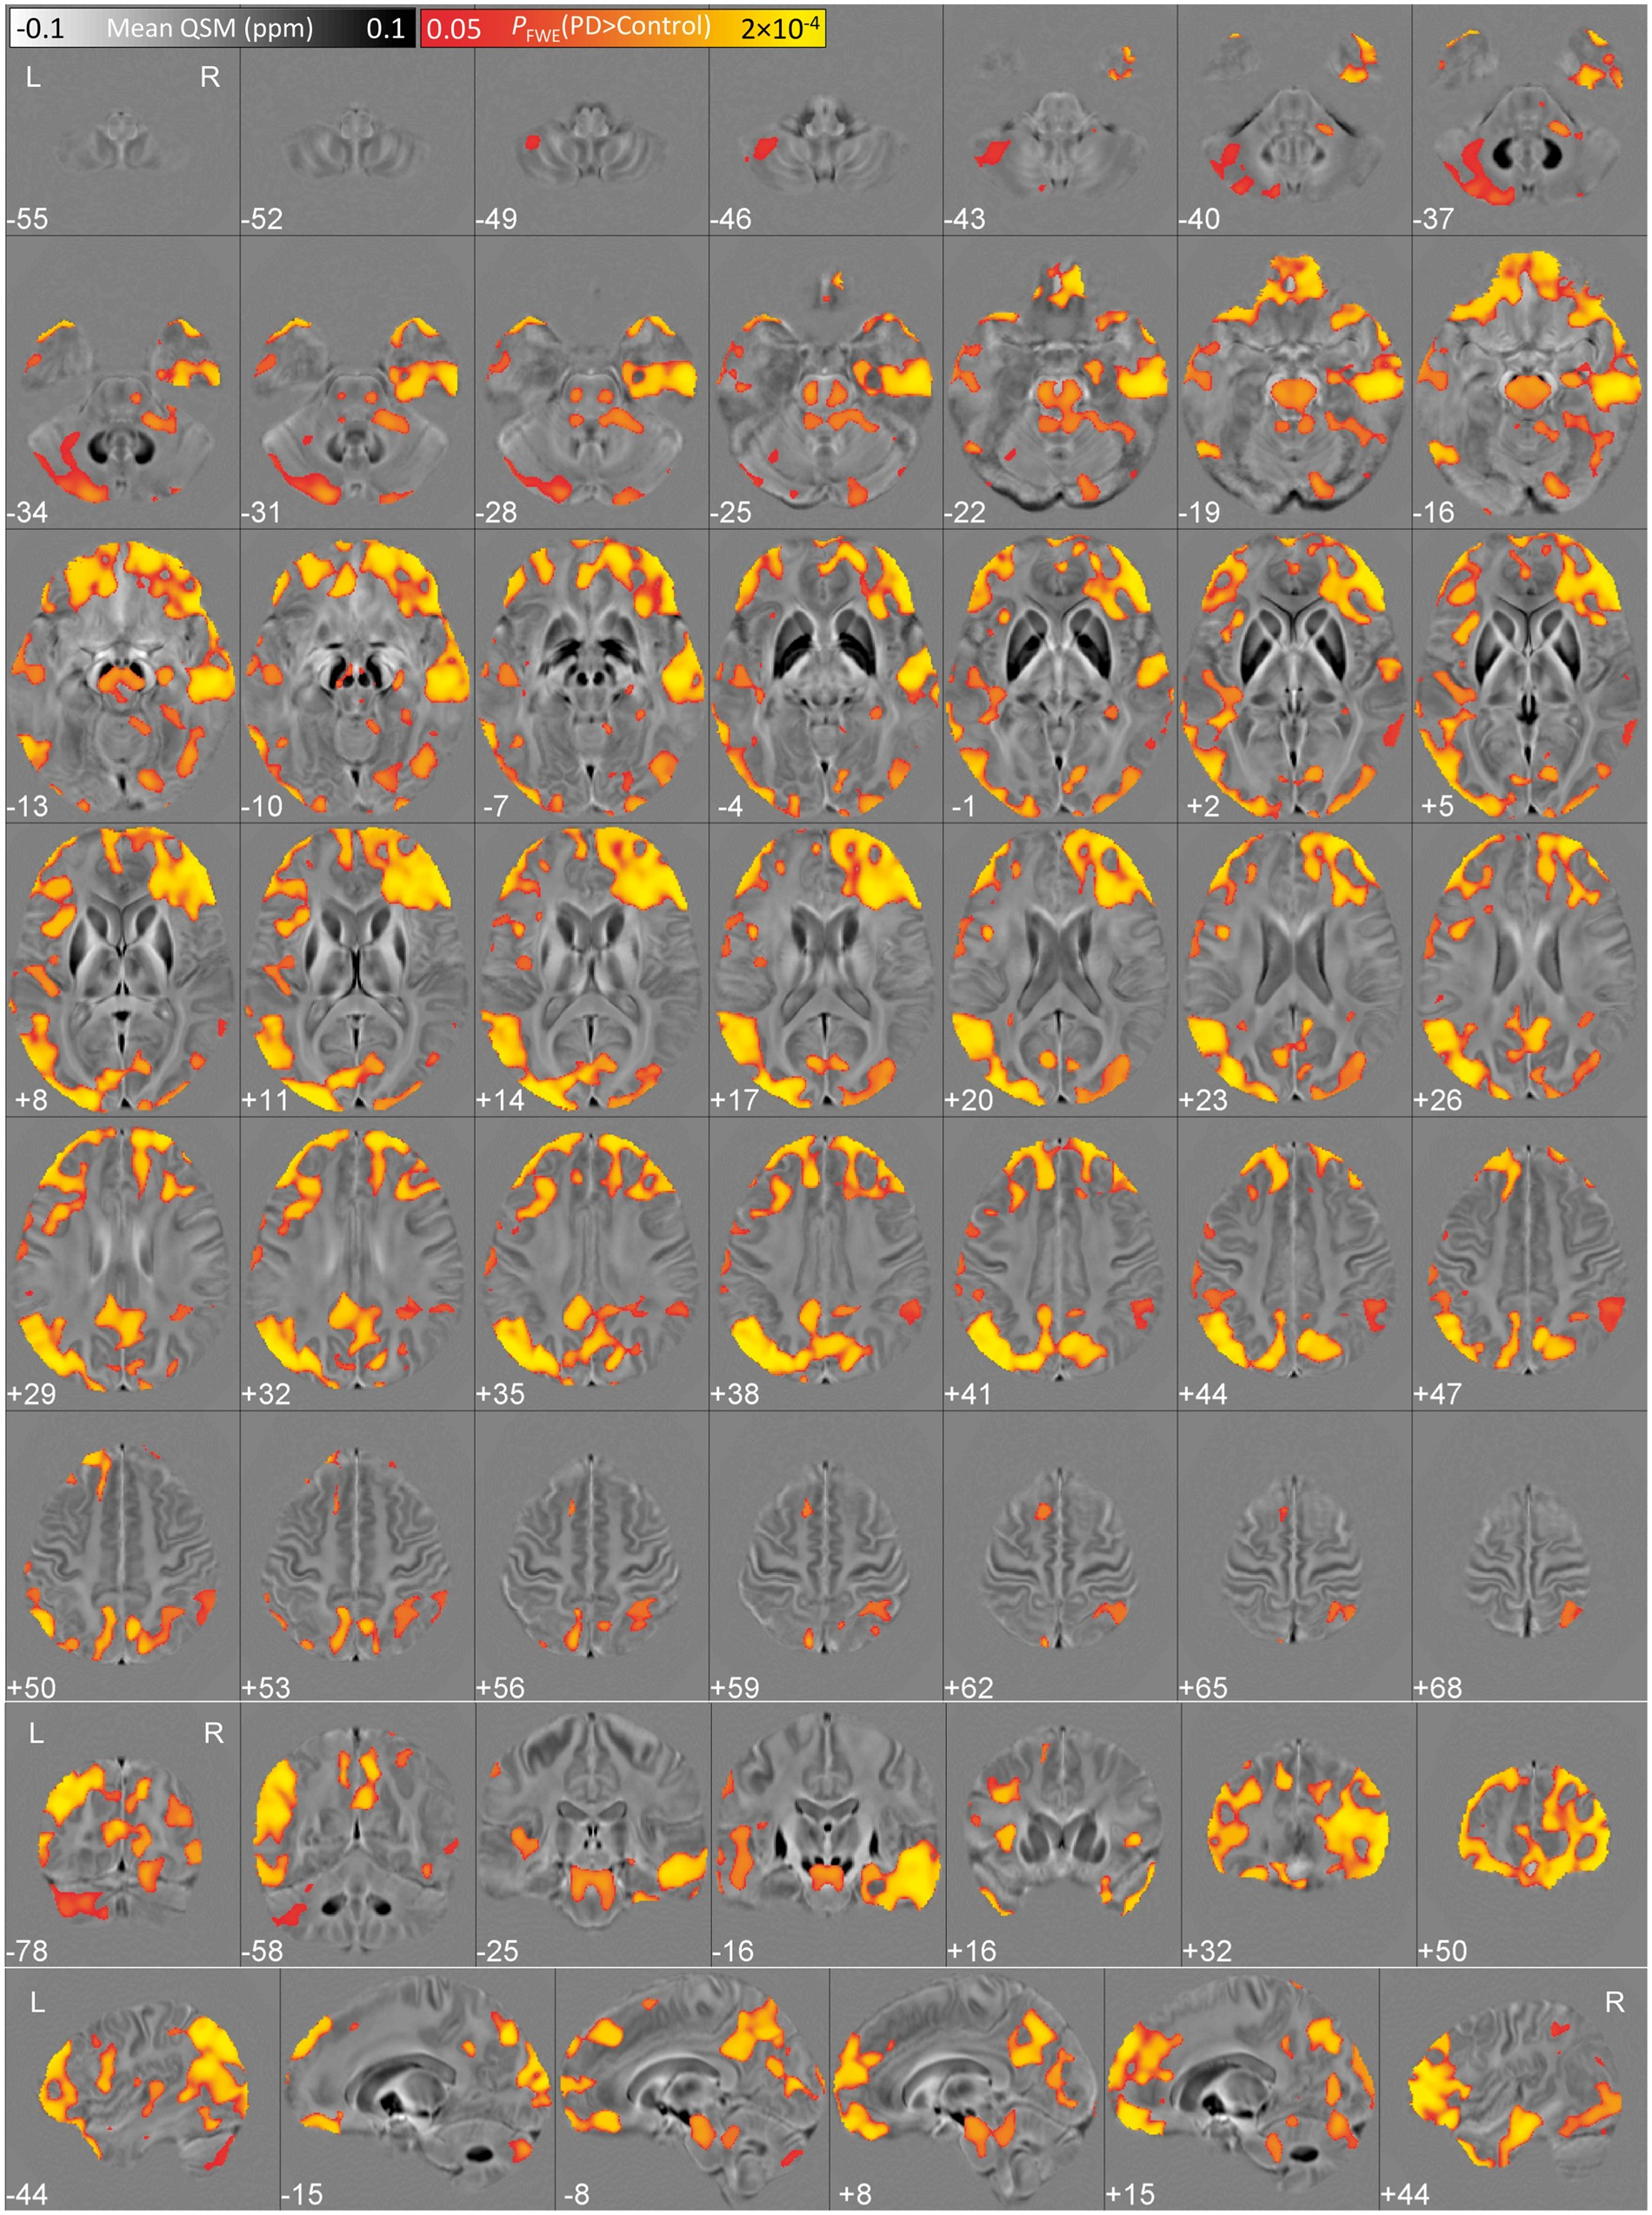
Figure 2 Cluster-based QSM group statistics (n = 25 Parkinson’s disease patients versus n = 50 elderly controls) for ...
Notes:
Figure 2 Cluster-based QSM group statistics (n = 25 Parkinson’s disease patients versus n = 50 elderly controls) for the contrast age-corrected QSM greater in Parkinson’s disease than in controls. Results were overlaid onto the study-wise QSM template in the MNI coordinate system. Red/yellow clusters represent statistical differences at PFWE < 0.05.
Unless provided in the caption above, the following copyright applies to the content of this slide: © The Author (2016). Published by Oxford University Press on behalf of the Guarantors of Brain. All rights reserved. For Permissions, please email: journals.permissions@oup.com

Slide 3
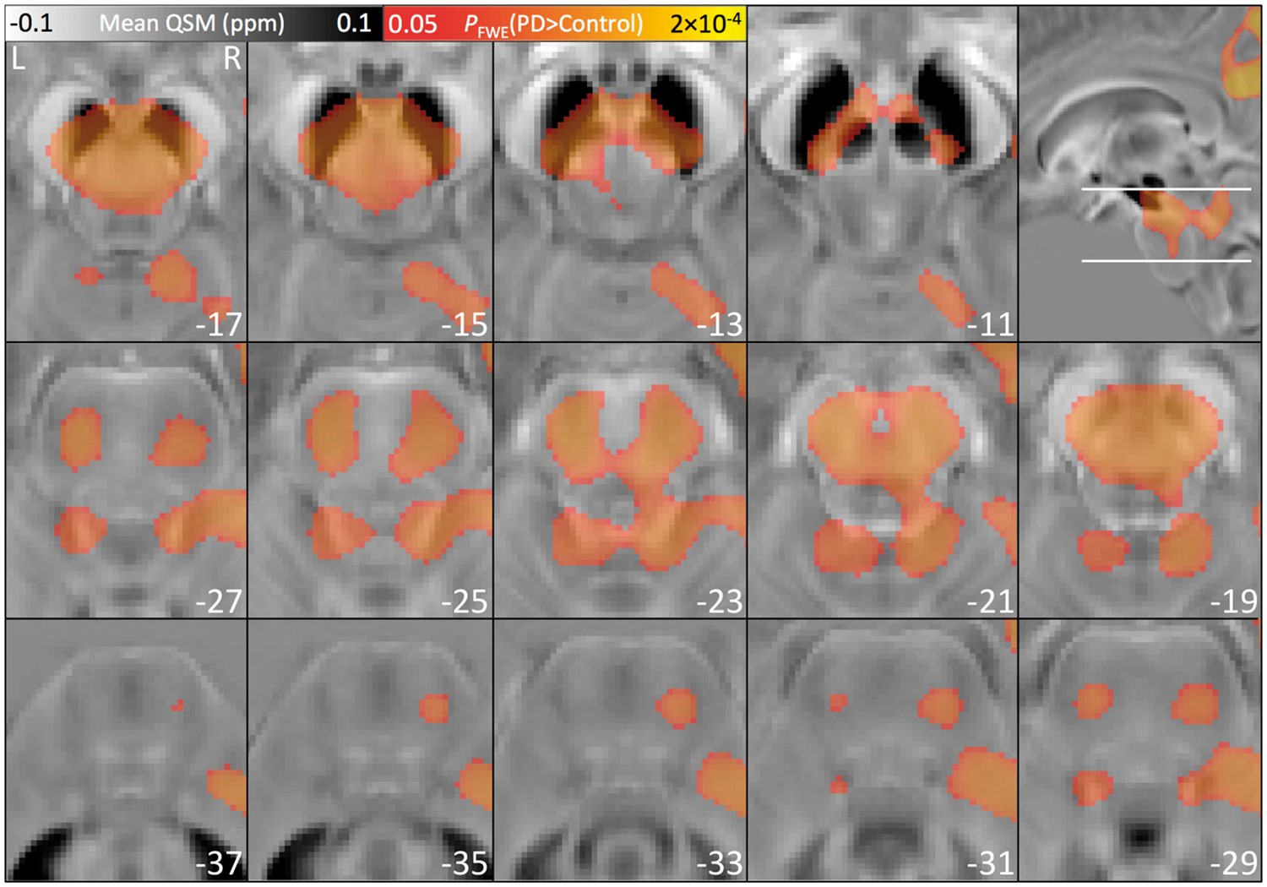
Figure 3 QSM group results with focus on rostral pons and caudal mesencephalic areas. Results were overlaid onto the ...
Notes:
Figure 3 QSM group results with focus on rostral pons and caudal mesencephalic areas. Results were overlaid onto the QSM template in MNI space. Semi-transparent blobs represent statistical differences at PFWE < 0.05.
Unless provided in the caption above, the following copyright applies to the content of this slide: © The Author (2016). Published by Oxford University Press on behalf of the Guarantors of Brain. All rights reserved. For Permissions, please email: journals.permissions@oup.com

Slide 4
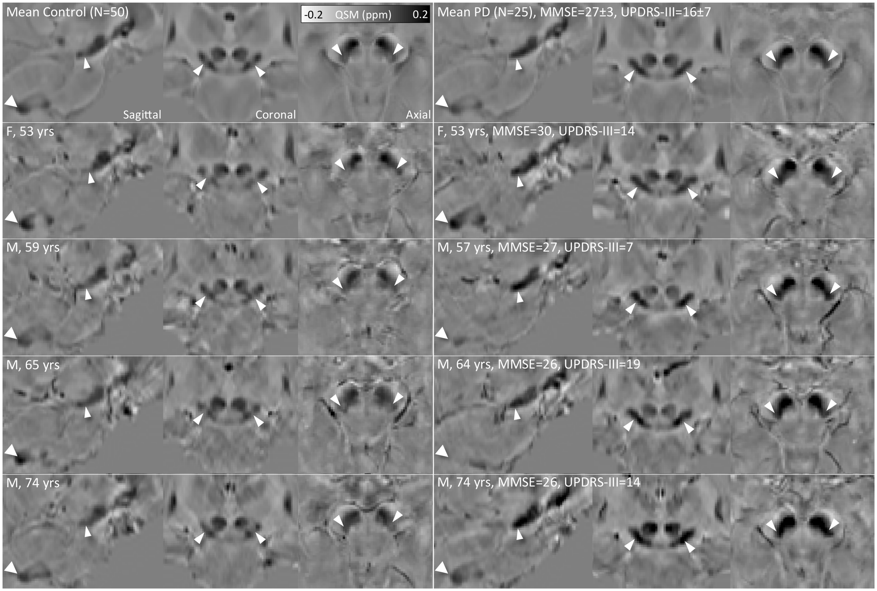
Figure 4 Magnified views of brainstem and cerebellar nuclei for QSM group-average and individual Parkinson’s ...
Notes:
Figure 4 Magnified views of brainstem and cerebellar nuclei for QSM group-average and individual Parkinson’s disease/paired-control subjects. Arrowheads denote nigrosome-1 in dorsal substantia nigra (thin arrows, increased QSM in Parkinson’s disease) and dentate nucleus (thick arrows, decreased QSM in Parkinson’s disease).
Unless provided in the caption above, the following copyright applies to the content of this slide: © The Author (2016). Published by Oxford University Press on behalf of the Guarantors of Brain. All rights reserved. For Permissions, please email: journals.permissions@oup.com

Slide 5
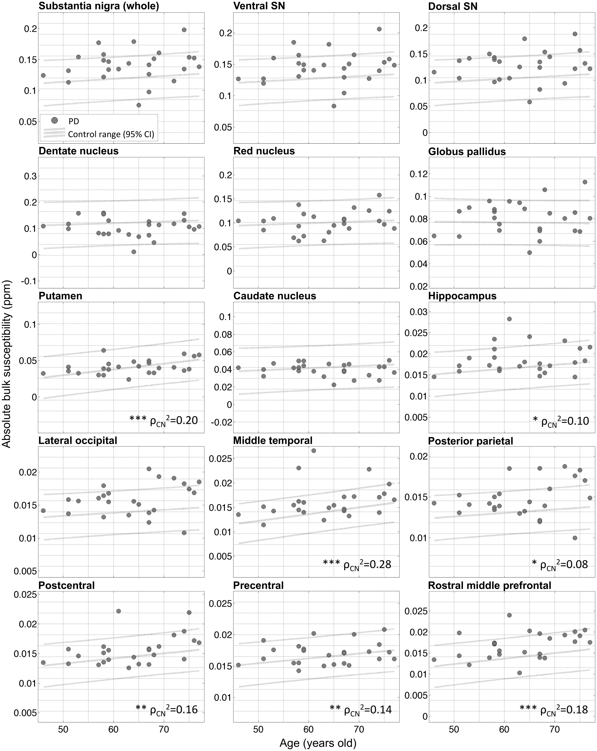
Figure 5 Regional QSM as a function of age. Median QSM values in Parkinson’s disease plotted in relation to their ...
Notes:
Figure 5 Regional QSM as a function of age. Median QSM values in Parkinson’s disease plotted in relation to their matched-control range. Asterisks signify the strength of the age-correlation in the control group (***PBonferroni < 0.05; **P < 0.01; *P < 0.05). To aid comparability, y-axes were clipped at 6 SD around the global control mean.
Unless provided in the caption above, the following copyright applies to the content of this slide: © The Author (2016). Published by Oxford University Press on behalf of the Guarantors of Brain. All rights reserved. For Permissions, please email: journals.permissions@oup.com

Slide 6
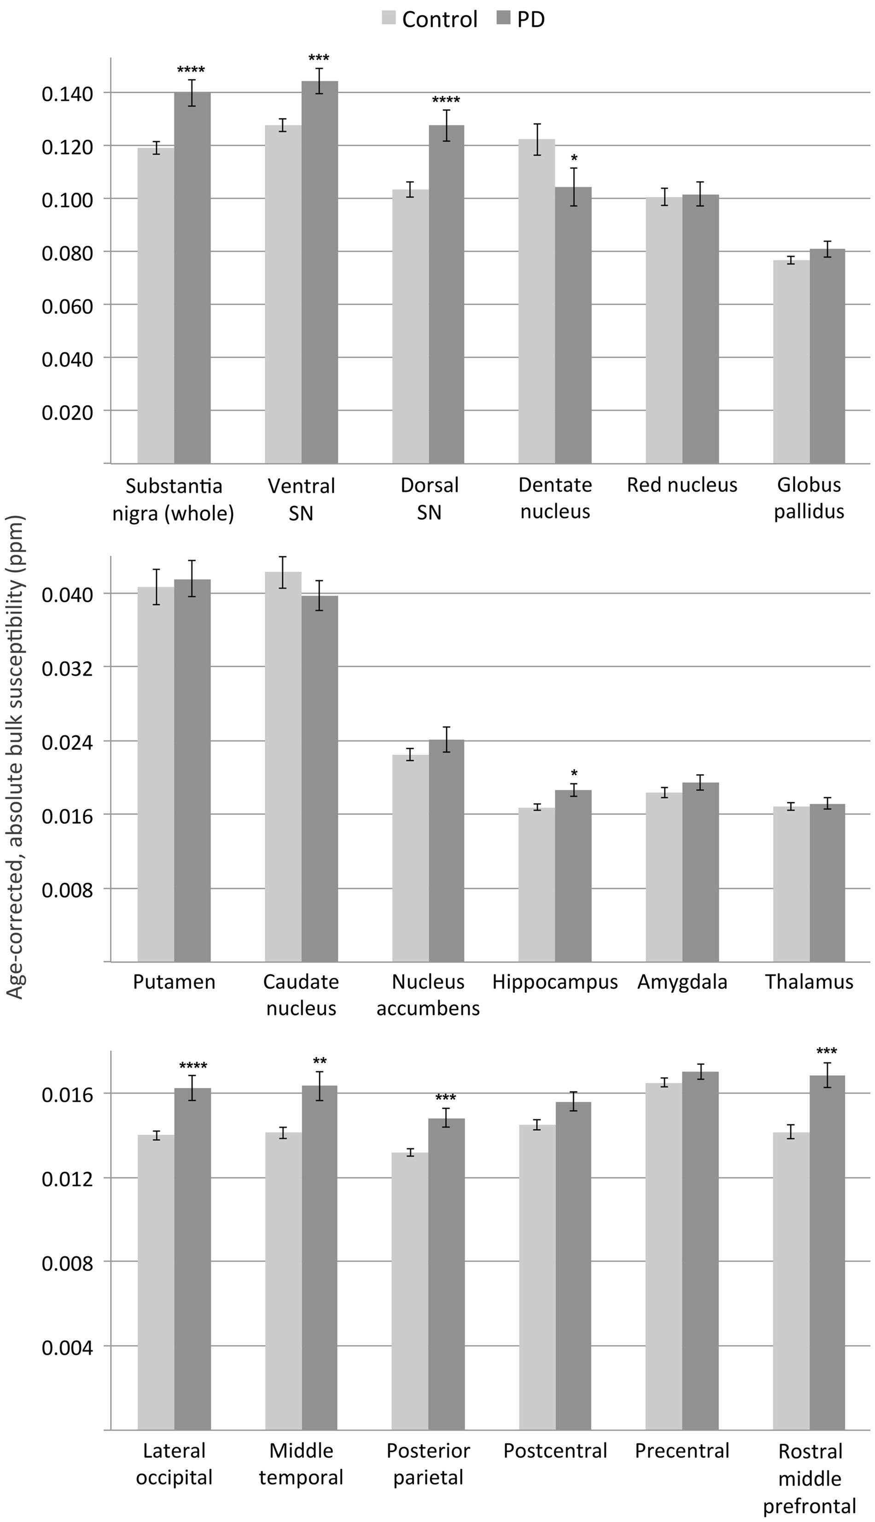
Figure 6 Summary of age-corrected QSM statistics (mean ± standard error of the mean). Asterisks signify the strength ...
Notes:
Figure 6 Summary of age-corrected QSM statistics (mean ± standard error of the mean). Asterisks signify the strength of the group difference (****PBonferroni < 0.01; ***PBonferroni < 0.05; **P < 0.01; *P < 0.05). PD = Parkinson’s disease.
Unless provided in the caption above, the following copyright applies to the content of this slide: © The Author (2016). Published by Oxford University Press on behalf of the Guarantors of Brain. All rights reserved. For Permissions, please email: journals.permissions@oup.com

