Slide 1
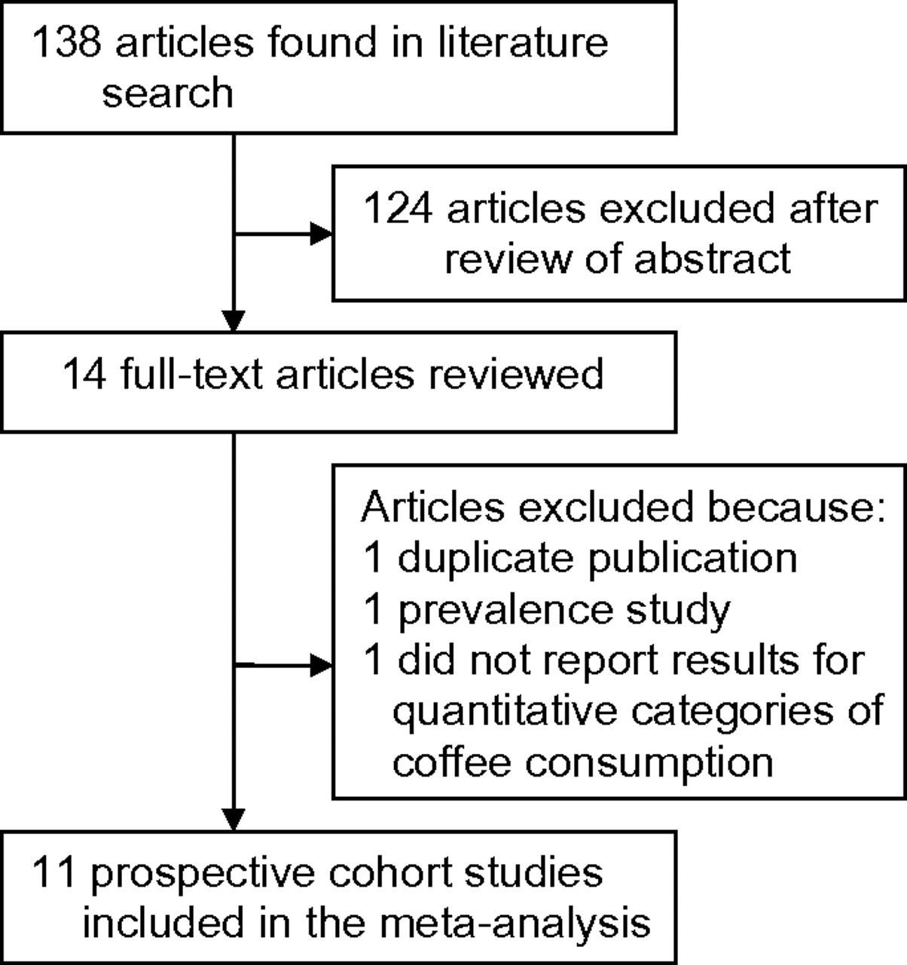
Figure 1. Selection of studies for inclusion in a meta-analysis of coffee consumption and stroke risk, 1966–2011.
Notes:
Figure 1. Selection of studies for inclusion in a meta-analysis of coffee consumption and stroke risk, 1966–2011.
Unless provided in the caption above, the following copyright applies to the content of this slide: American Journal of Epidemiology © The Author 2011. Published by Oxford University Press on behalf of the Johns Hopkins Bloomberg School of Public Health. All rights reserved. For permissions, please e-mail: journals.permissions@oup.com.

Slide 2
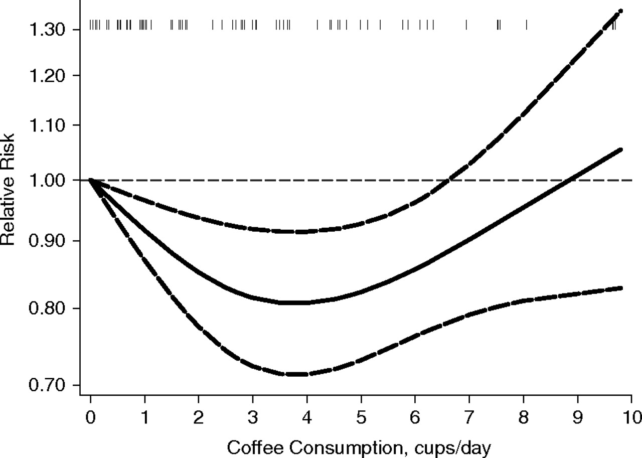
Figure 2. Adjusted relative risk of stroke associated with coffee consumption in a meta-analysis of published studies, ...
Notes:
Figure 2. Adjusted relative risk of stroke associated with coffee consumption in a meta-analysis of published studies, 1966–2011. Coffee consumption was modeled with restricted cubic splines in a multivariate random-effects dose-response model. The lowest value of zero was used to estimate all relative risks. Tick marks above the curve represent the positions of the published relative risks. The vertical axis is on a log scale.
Unless provided in the caption above, the following copyright applies to the content of this slide: American Journal of Epidemiology © The Author 2011. Published by Oxford University Press on behalf of the Johns Hopkins Bloomberg School of Public Health. All rights reserved. For permissions, please e-mail: journals.permissions@oup.com.

