Slide 1
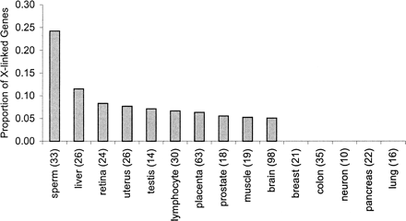
Fig. 1. The proportions of human X-linked, tissue-specific genes for various tissues. The number of genes sampled for ...
Notes:
Fig. 1. The proportions of human X-linked, tissue-specific genes for various tissues. The number of genes sampled for each tissue is in brackets. A high abundance of sperm-specific genes are found on the X chromosome (eight out of 33), consistent with previous findings by Wang et al. 2001. The proportion of X-linked sperm genes is higher than that found in any other tissue-specific genes, including the testes, supporting the idea that the mammalian X chromosome has specialized in sperm function
Unless provided in the caption above, the following copyright applies to the content of this slide: Society for Molecular Biology and Evolution

Slide 2
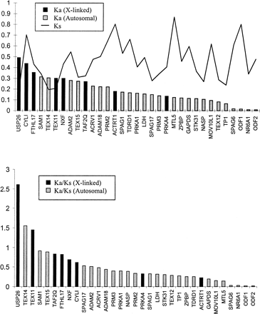
Fig. 2. Measures of K_{a} and K_{s} (above) and K_{a}/K_{s} (below) for ...
Notes:
Fig. 2. Measures of Ka and Ks (above) and Ka/Ks (below) for sperm-specific proteins in mammals. Ka and Ks were calculated using the method of Li (1993). Sperm-specific genes on the X chromosome (in black) show a tendency towards higher values of Ka and on average have a significantly higher Ka than sperm-specific genes found on the autosomes (P < 0.001). However, values of Ks are more scattered and on average show no significant differences between X-linked and autosomal sperm proteins (P = 0.90)
Unless provided in the caption above, the following copyright applies to the content of this slide: Society for Molecular Biology and Evolution

