Slide 1
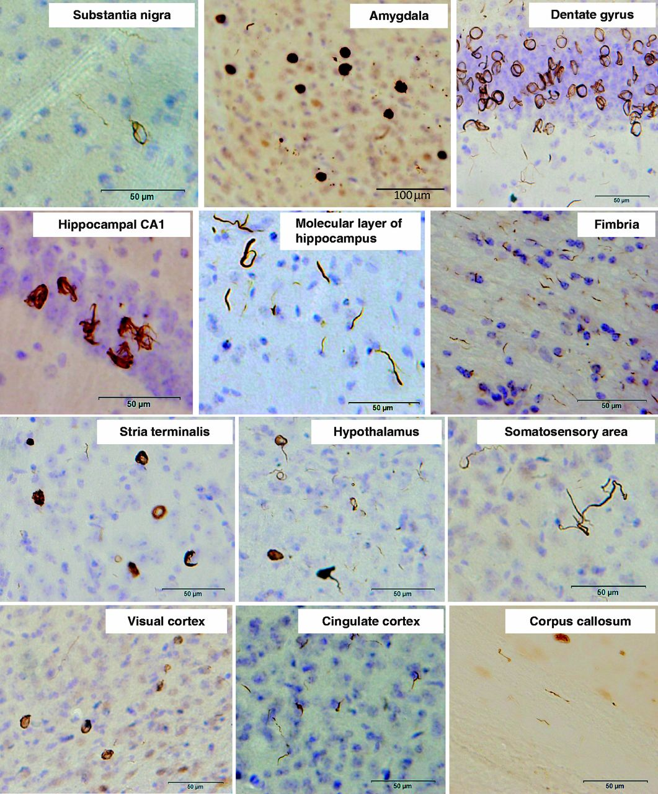
Figure 1 Induction of phosphorylated α-synuclein pathology in wild-type mouse brain injected with human α-synuclein ...
Notes:
Figure 1 Induction of phosphorylated α-synuclein pathology in wild-type mouse brain injected with human α-synuclein fibrils, observed at 15 months after injection. Sections were immunostained with anti-phosphorylated α-synuclein antibody, 1175. The shapes of phosphorylated α-synuclein-positive structures differed among brain areas. Ring-like and Lewy neurite-like structures were observed in substantia nigra, hippocampus, hypothalamus, somatosensory area, visual cortex, cingulate cortex and corpus callosum, whereas Lewy body- and Lewy neurite-like structures were observed in amygdala and stria terminalis.
Unless provided in the caption above, the following copyright applies to the content of this slide: © The Author (2013). Published by Oxford University Press on behalf of the Guarantors of Brain.This is an Open Access article distributed under the terms of the Creative Commons Attribution Non-Commercial License (http://creativecommons.org/licenses/by-nc/3.0/), which permits unrestricted non-commercial use, distribution, and reproduction in any medium, provided the original work is properly cited.

Slide 2
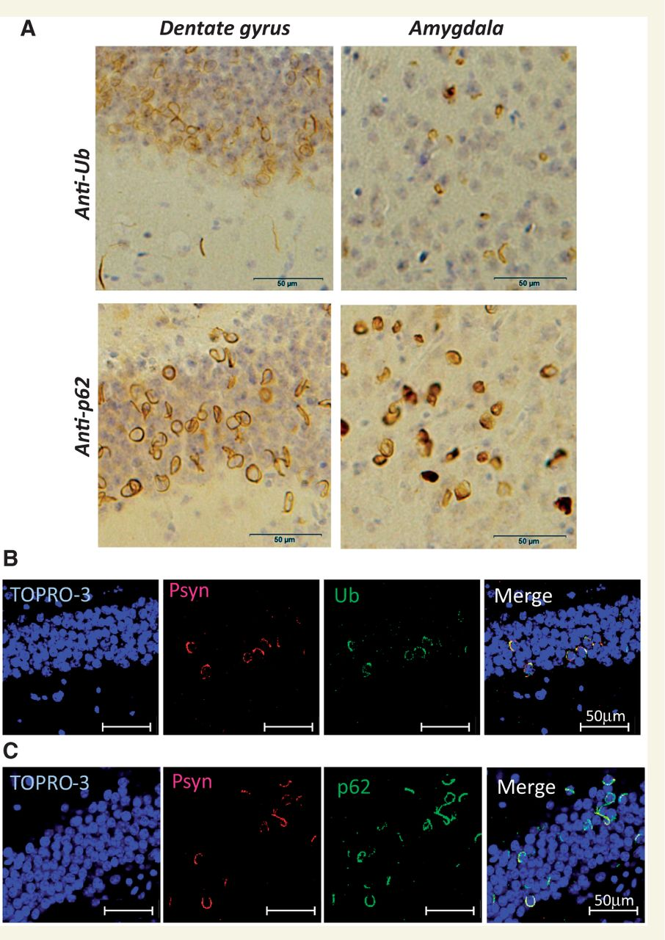
Figure 2 α-Synuclein pathology in fibril-injected mice brain was immunoreactive for ubiquitin (Ub) and p62. (A) ...
Notes:
Figure 2 α-Synuclein pathology in fibril-injected mice brain was immunoreactive for ubiquitin (Ub) and p62. (A) Staining of dentate gyrus and amygdala of fibril-injected mice at 15 months after injection, using anti-ubiquitin (upper) and p62 (lower) antibodies. Abundant ubiquitin- and p62-positive pathology can be seen. (B and C) Double-labelled immunofluorescence of dentate gyrus for phosphorylated α-synuclein (Psyn) and ubiquitin (B) or p62 (C). Phosphorylated α-synuclein-positive structures were co-localized with ubiquitin and p62.
Unless provided in the caption above, the following copyright applies to the content of this slide: © The Author (2013). Published by Oxford University Press on behalf of the Guarantors of Brain.This is an Open Access article distributed under the terms of the Creative Commons Attribution Non-Commercial License (http://creativecommons.org/licenses/by-nc/3.0/), which permits unrestricted non-commercial use, distribution, and reproduction in any medium, provided the original work is properly cited.

Slide 3
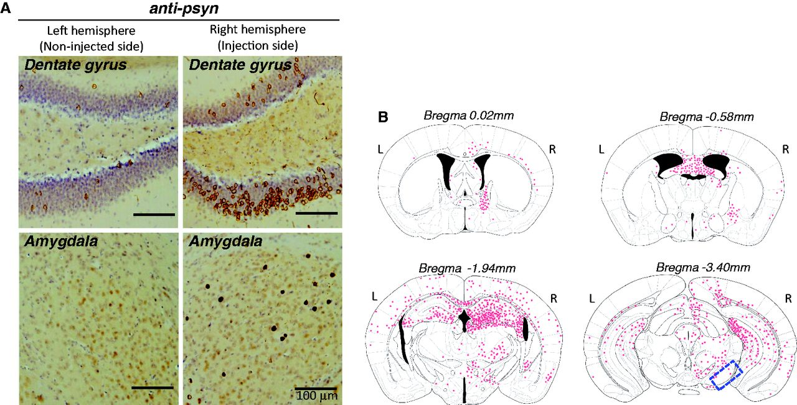
Figure 3 (A) Spreading of phosphorylated α-synuclein pathology on the contralateral side of mouse brain injected with ...
Notes:
Figure 3 (A) Spreading of phosphorylated α-synuclein pathology on the contralateral side of mouse brain injected with α-synuclein fibrils. Staining of dentate gyrus and amygdala in the right hemisphere (injection side) and in the left hemisphere (non-injected side) with anti-phosphorylated α-synuclein (psyn) antibody, 1175, at 15 months after injection. (B) Distribution of phosphorylated α-synuclein pathology in human α-synuclein fibril-injected mouse brain at 15 months after injection (n = 24). Four coronal sections were stained with phosphorylated α-synuclein antibody, 1175. Red dots indicates Lewy bodies- and Lewy neurites-like pathology. Near the injection level (bregma -3.40 mm), abundant phosphorylated α-synuclein pathology was present in substantia nigra, hippocampus, external capsule, and entorhinal cortex in right hemisphere, whereas in the left hemisphere, sparser pathology was detected in hippocampus and external capsule. At the level of -1.94 mm from bregma, severe phosphorylated α-synuclein pathology was present in hippocampus, amygdala, corpus callosum, hypothalamus and motor, visual, somatosensory, auditory and piriform cortex in the right hemisphere, whereas moderate phosphorylated α-synuclein pathology was observed in corpus callosum, hippocampus, external capsule and motor, somasosensory and auditory cortex in the left hemisphere. At the level of -0.58 mm from bregma, phosphorylated α-synuclein pathology was detected in amygdala, corpus callosum, fimbria, fornix, hypothalamus, striatum and somatosensory and piriform cortex in the right hemisphere, whereas in the left hemisphere, the pathology was present in corpus callosum, fimbria, fornix, hypothalamus and striatum. At the level of 0.02 mm from bregma, phosphorylated α-synuclein pathology was concentrated in stria terminalis, septal nucleus and cingulate, motor and somatosensory cortex in the right hemisphere. In the left hemisphere, phosphorylated α-synuclein pathology was detected only in septal nucleus. Dashed box indicates substantia nigra (injection site). L = left hemisphere of brain; R = right hemisphere.
Unless provided in the caption above, the following copyright applies to the content of this slide: © The Author (2013). Published by Oxford University Press on behalf of the Guarantors of Brain.This is an Open Access article distributed under the terms of the Creative Commons Attribution Non-Commercial License (http://creativecommons.org/licenses/by-nc/3.0/), which permits unrestricted non-commercial use, distribution, and reproduction in any medium, provided the original work is properly cited.

Slide 4
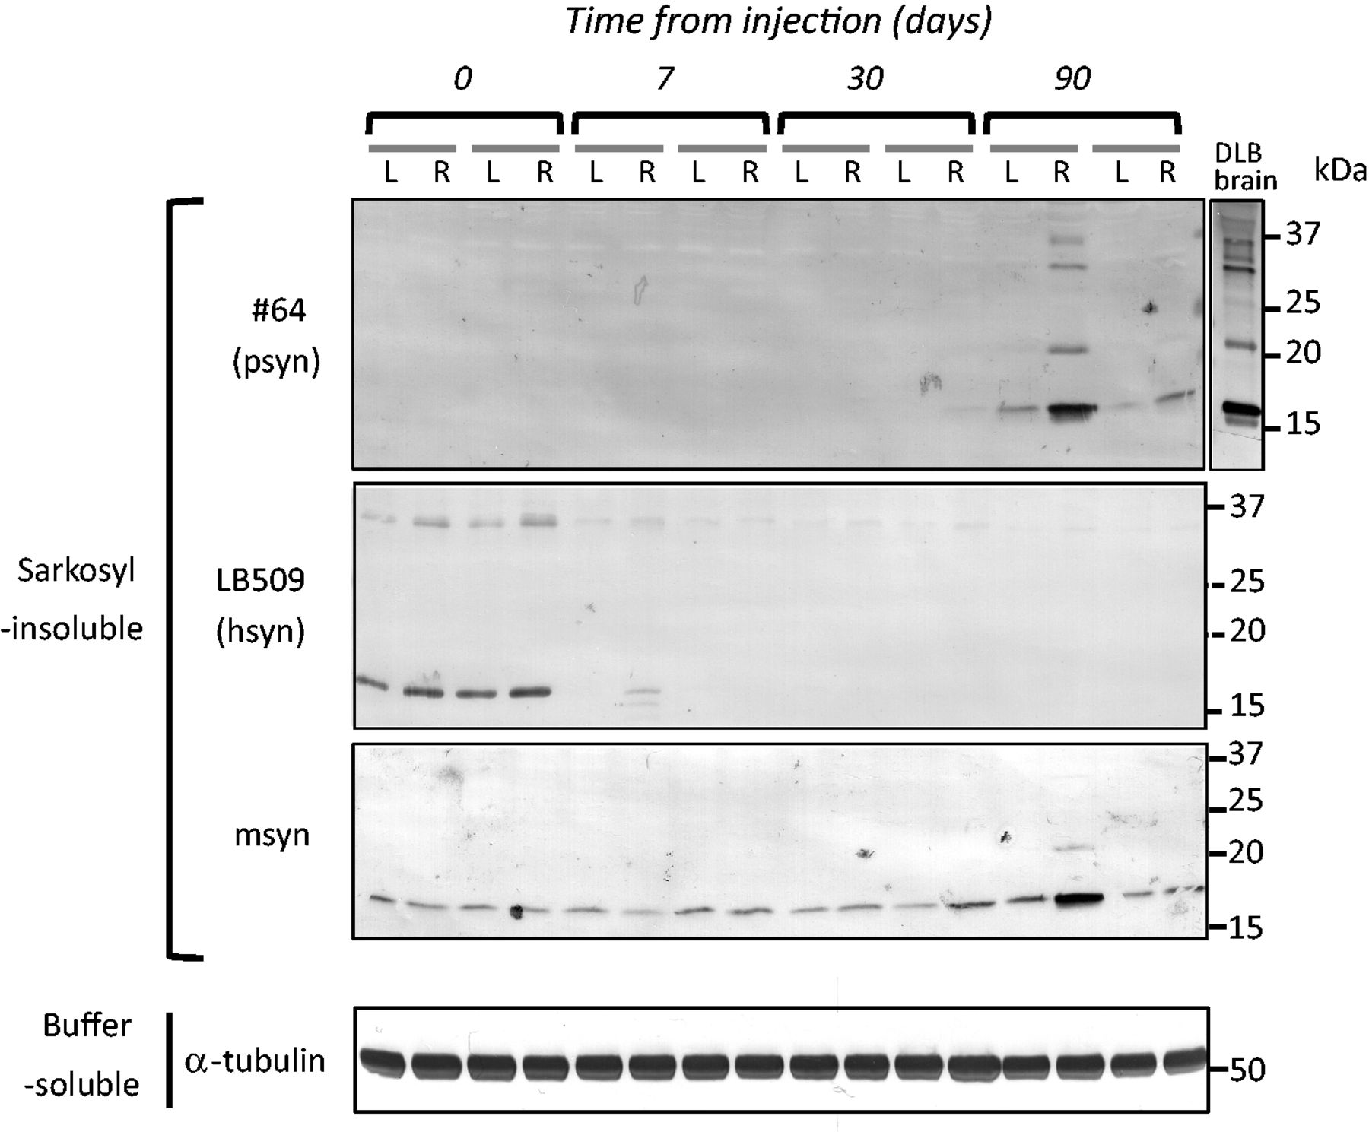
Figure 4 Endogenous mouse α-synuclein was aggregated in wild-type mouse brain injected with human α-synuclein (hsyn) ...
Notes:
Figure 4 Endogenous mouse α-synuclein was aggregated in wild-type mouse brain injected with human α-synuclein (hsyn) fibrils. The brain was divided into two parts at the longitudinal fissure of the cerebrum. Sarkosyl-insoluble fractions were obtained from the right and left hemispheres, and analysed by immunoblotting with #64, LB509 or anti-mouse α-synuclein (msyn) antibodies. Representative images are shown (n = 14). Sarkosyl-insoluble phosphorylated α-synuclein (psyn) started to accumulate, predominantly in the right hemisphere, at 90 days after injection. It was composed of endogenous mouse α-synuclein, not exogenous human α-synuclein.
Unless provided in the caption above, the following copyright applies to the content of this slide: © The Author (2013). Published by Oxford University Press on behalf of the Guarantors of Brain.This is an Open Access article distributed under the terms of the Creative Commons Attribution Non-Commercial License (http://creativecommons.org/licenses/by-nc/3.0/), which permits unrestricted non-commercial use, distribution, and reproduction in any medium, provided the original work is properly cited.

Slide 5
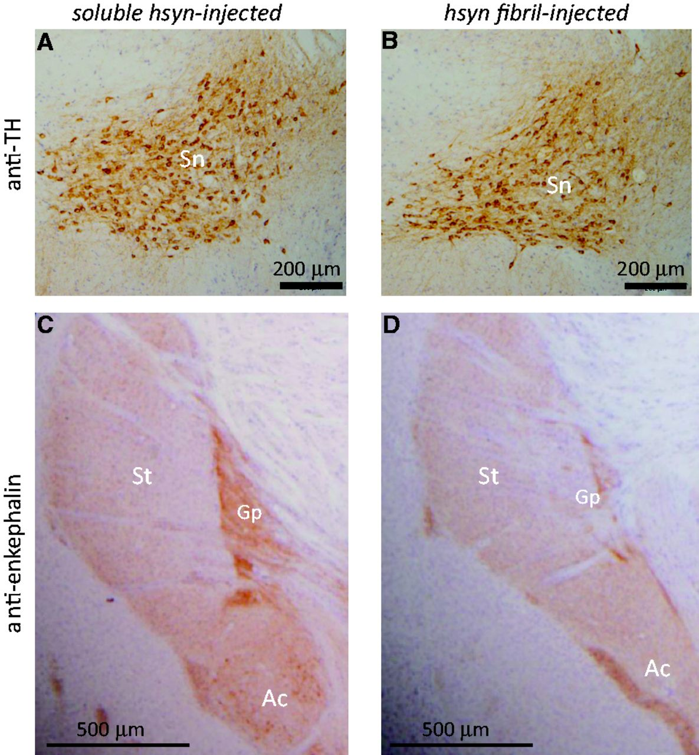
Figure 5 Fibril-injected mice show apparent reduction of a neurotransmitter enkephalin in amygdala central nucleus and ...
Notes:
Figure 5 Fibril-injected mice show apparent reduction of a neurotransmitter enkephalin in amygdala central nucleus and globus pallidus at 15 months after injection. Brain sections were stained with anti-tyrosine hydroxylase (TH) (A and B) and anti-enkephalin (C and D) antibodies. Ac = amygdala central nucleus; Gp = globus pallidus; Sn = substantia nigra; St = striatum.
Unless provided in the caption above, the following copyright applies to the content of this slide: © The Author (2013). Published by Oxford University Press on behalf of the Guarantors of Brain.This is an Open Access article distributed under the terms of the Creative Commons Attribution Non-Commercial License (http://creativecommons.org/licenses/by-nc/3.0/), which permits unrestricted non-commercial use, distribution, and reproduction in any medium, provided the original work is properly cited.

Slide 6
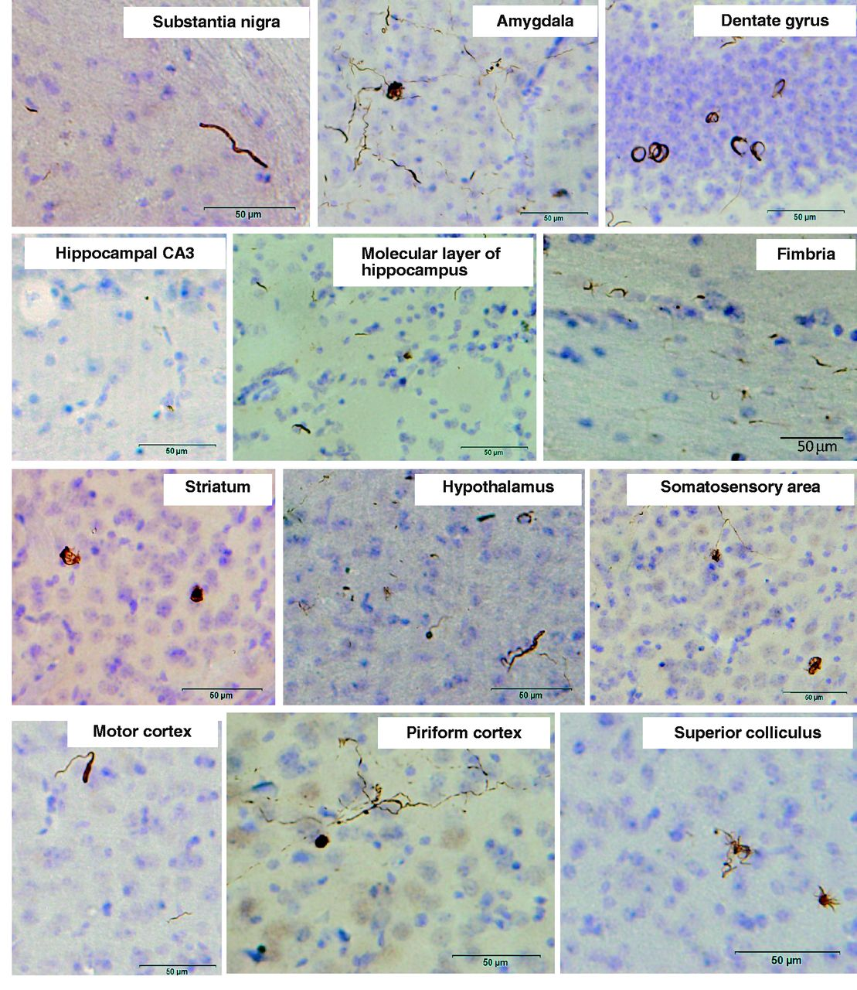
Figure 6 α-Synuclein pathology in wild-type mice brain injected with dementia with Lewy bodies-insoluble fraction ...
Notes:
Figure 6 α-Synuclein pathology in wild-type mice brain injected with dementia with Lewy bodies-insoluble fraction observed at 15 months after injection. Sections were immunostained with anti-phosphorylated α-synuclein antibody, 1175.
Unless provided in the caption above, the following copyright applies to the content of this slide: © The Author (2013). Published by Oxford University Press on behalf of the Guarantors of Brain.This is an Open Access article distributed under the terms of the Creative Commons Attribution Non-Commercial License (http://creativecommons.org/licenses/by-nc/3.0/), which permits unrestricted non-commercial use, distribution, and reproduction in any medium, provided the original work is properly cited.

