Slide 1
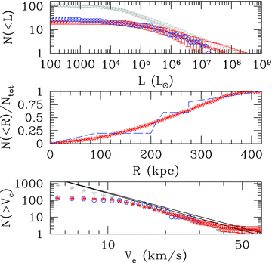
Figure 1 Top panel: luminosity function of satellite galaxies, corrected to match the SDSS DR5 selection. Upper grey ...
Notes:
Figure 1 Top panel: luminosity function of satellite galaxies, corrected to match the SDSS DR5 selection. Upper grey curve with error bars: full sample of simulated galaxies surviving tidal stripping. Lower red curve with error bars: galaxies with baryon fraction >7.5 × 10−3. Blue circles: observed luminosity function of Milky Way satellites. Middle panel: cumulative radial distribution of our simulated satellite population (dashed line: from Tollerud et al. 2008, fig. 5. ‘DR5’ distribution). Bottom panel: cumulative velocity distribution of our simulated satellite population compared to the fit derived for satellites in Via Lactea I (lower line, Diemand et al. 2007) and Aquarius (upper line, Springel et al. 2008). Circles: observed dSph satellites of the Milky Way. Error bars are 1σ Poissonian errors.
Unless provided in the caption above, the following copyright applies to the content of this slide: © 2010 The Authors. Journal compilation © 2010 RAS

Slide 2
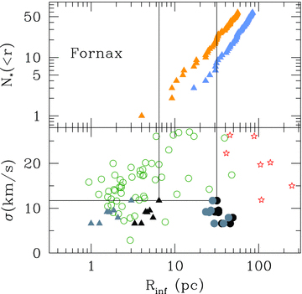
Figure 3 Top panel: number of stars within a given projected radius in Fornax. Lower curve: all Fornax member stars ...
Notes:
Figure 3 Top panel: number of stars within a given projected radius in Fornax. Lower curve: all Fornax member stars for which velocities are currently available in the published kinematic samples of Walker et al. (2009a). Upper curve: all Fornax target candidates, including unobserved stars, that are sufficiently bright (V≲ 21.5) for velocity measurements with existing 6–10-m telescopes. Bottom panel: relationship between velocity dispersion (σ) and radius of the sphere of influence of MBHs – defined as the sphere that encompasses 2 ×MBH– for 10 halo realizations. Stars: ‘massive seeds’. Circles: ‘peak3.5’. Black triangles: Milky Way satellites: we assume that the MBH sits on the MBH–σ relationship, and the density profile is cored. Grey triangles: as above, but for an NFW profile. Black dots: we assume a fixed MBH mass, 105 M⊙ and a cored profile. Grey dots: as above, but for an NFW profile.
Unless provided in the caption above, the following copyright applies to the content of this slide: © 2010 The Authors. Journal compilation © 2010 RAS

Slide 3
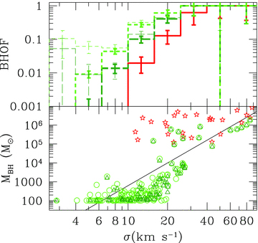
Figure 2 Top: fraction of galaxies, at a given velocity dispersion, which host a central MBH (occupation fraction, ...
Notes:
Figure 2 Top: fraction of galaxies, at a given velocity dispersion, which host a central MBH (occupation fraction, BHOF). Long-dashed green histogram: ‘peak3.5’ case. Short-dashed green histogram: ‘peak3’ case. Thick lines: all satellites. Thin lines: luminous satellites. Solid red histogram: ‘massive seeds’. Bottom: the MBH–velocity dispersion (σ) relationship for MBHs in satellites. We here show the results of a suite of 10 realizations. Stars: ‘massive seeds’. Circles: ‘peak3.5’. Triangles: ‘peak3’.
Unless provided in the caption above, the following copyright applies to the content of this slide: © 2010 The Authors. Journal compilation © 2010 RAS

