Slide 1
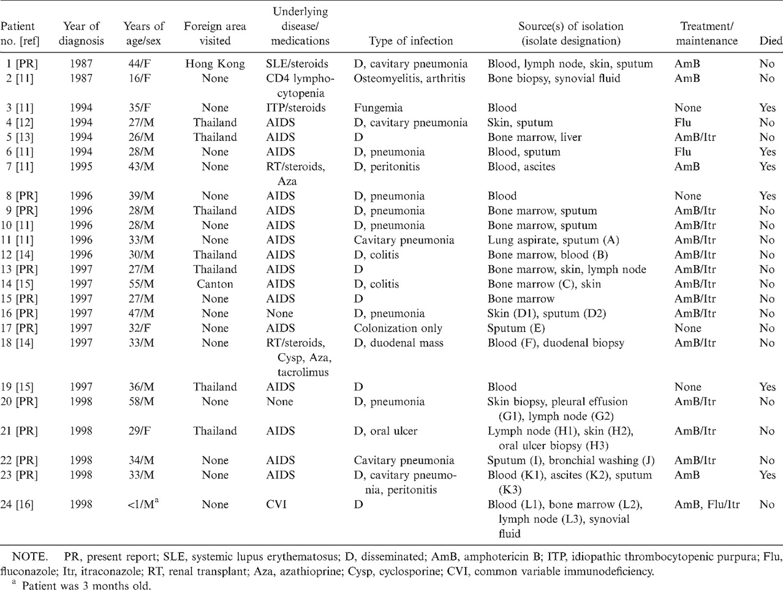
Table 1 Summary of clinical characteristics of 24 patients with Penicillium marneffei infection or colonization in ...
Notes:
Table 1 Summary of clinical characteristics of 24 patients with Penicillium marneffei infection or colonization in Taiwan from January 1987 through December 1998.
Unless provided in the caption above, the following copyright applies to the content of this slide: © 2000 by the Infectious Diseases Society of America

Slide 2
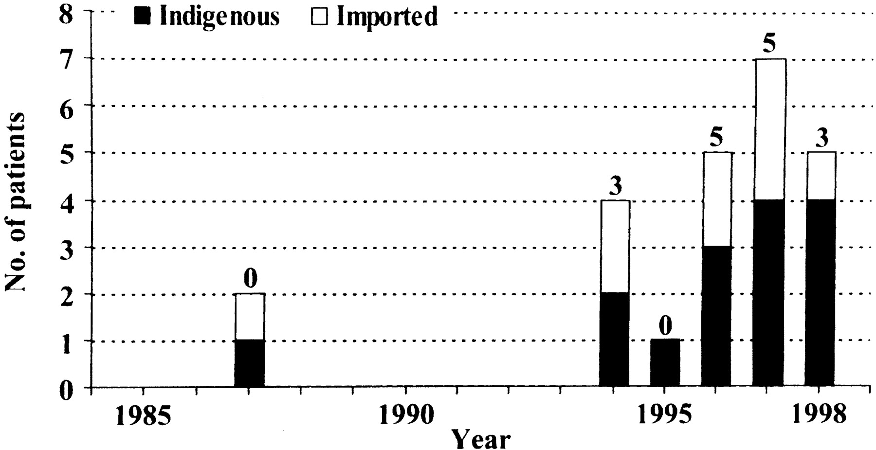
Figure 1 No. of patients with Penicillium marneffei infection or colonization in Taiwan and the year of diagnosis. No. ...
Notes:
Figure 1 No. of patients with Penicillium marneffei infection or colonization in Taiwan and the year of diagnosis. No. above each bar indicates no. of patients with AIDS.
Unless provided in the caption above, the following copyright applies to the content of this slide: © 2000 by the Infectious Diseases Society of America

Slide 3
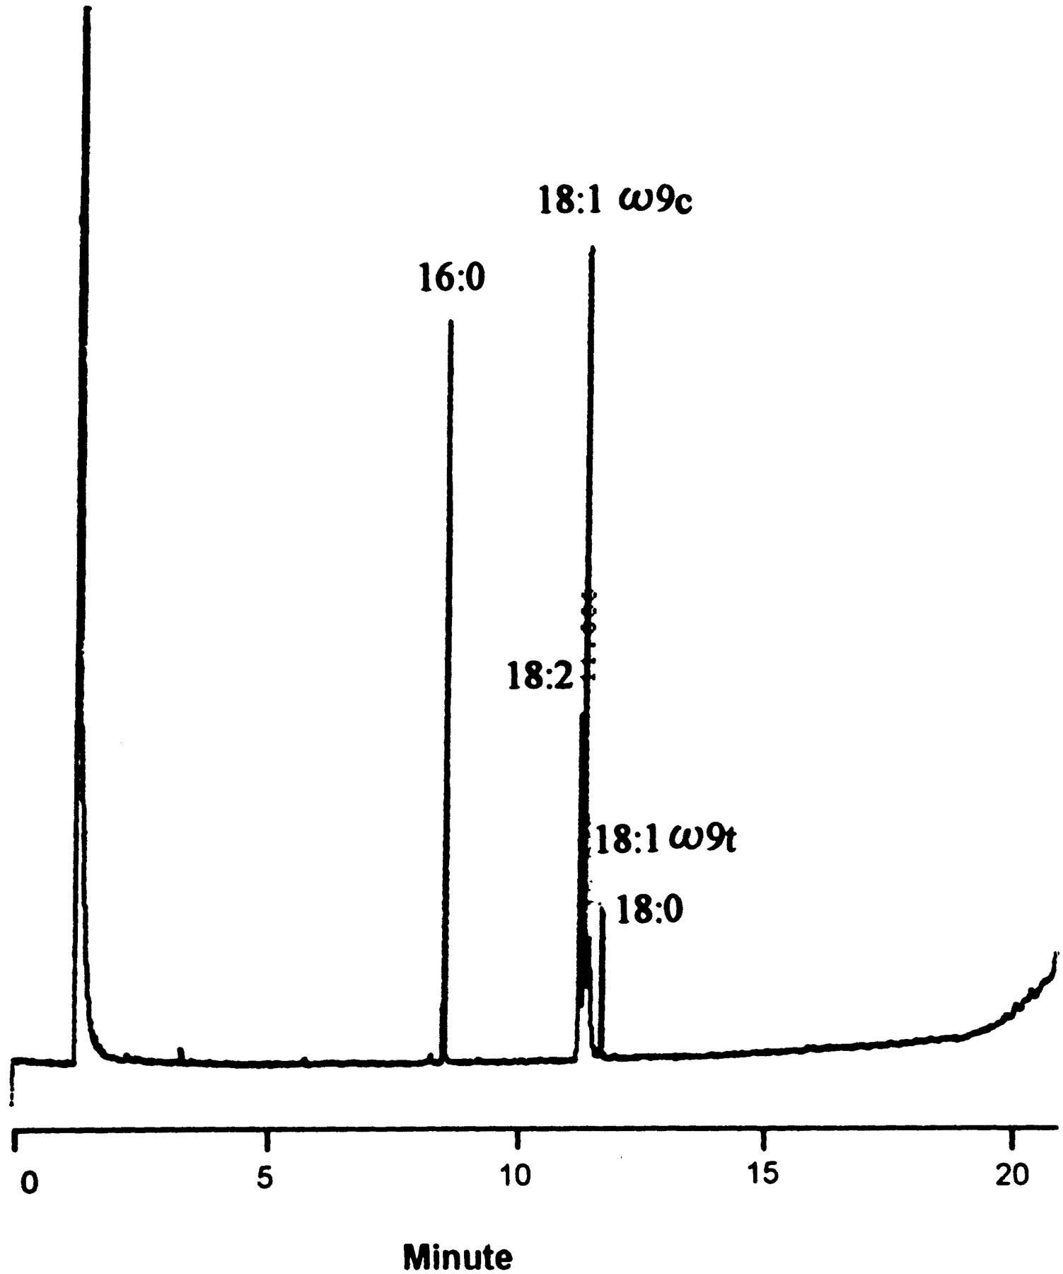
Figure 2 Gas chromatogram of fatty acid methyl esters (FAMEs) of Penicillium marneffei. All 20 isolates of P. ...
Notes:
Figure 2 Gas chromatogram of fatty acid methyl esters (FAMEs) of Penicillium marneffei. All 20 isolates of P. marneffei had similar FAME profiles. ω9c, cis-9-octadecanoic acid; ω9t, trans-9-octadecanoic acid.
Unless provided in the caption above, the following copyright applies to the content of this slide: © 2000 by the Infectious Diseases Society of America

Slide 4
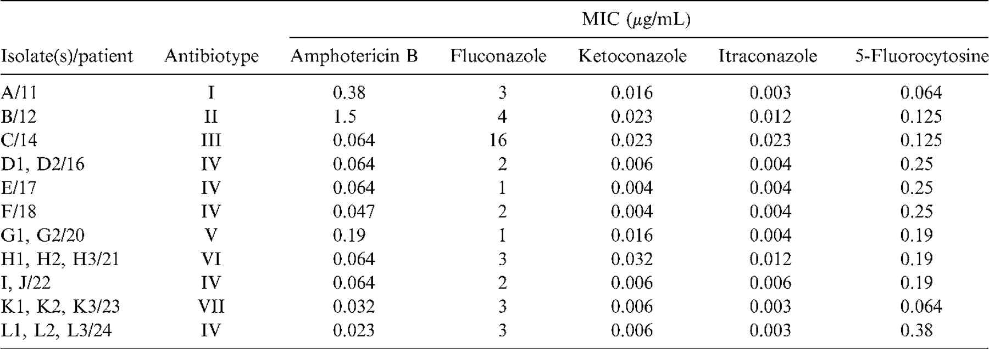
Table 2 In vitro susceptibility data and antibiotypes by the E-test of the 20 isolates of Penicillium marneffei ...
Notes:
Table 2 In vitro susceptibility data and antibiotypes by the E-test of the 20 isolates of Penicillium marneffei recovered from 11 patients.
Unless provided in the caption above, the following copyright applies to the content of this slide: © 2000 by the Infectious Diseases Society of America

Slide 5
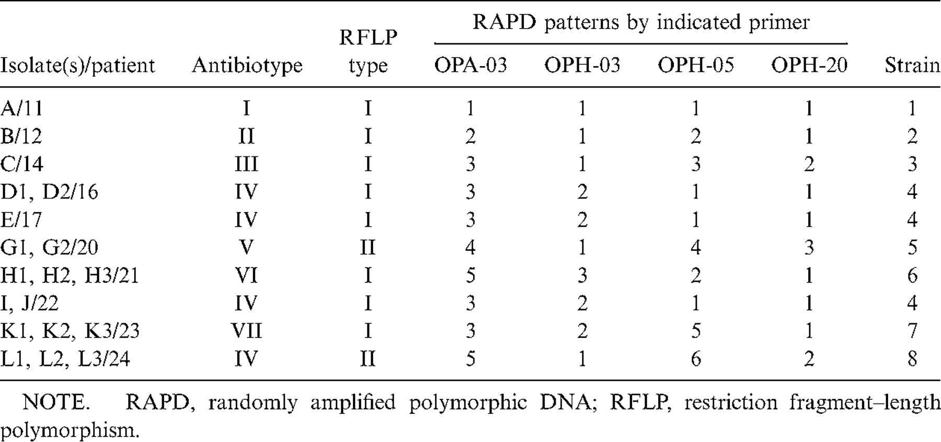
Table 3 Phenotypic and genotypic characteristics of the 20 isolates of Penicillium marneffei.
Notes:
Table 3 Phenotypic and genotypic characteristics of the 20 isolates of Penicillium marneffei.
Unless provided in the caption above, the following copyright applies to the content of this slide: © 2000 by the Infectious Diseases Society of America

Slide 6
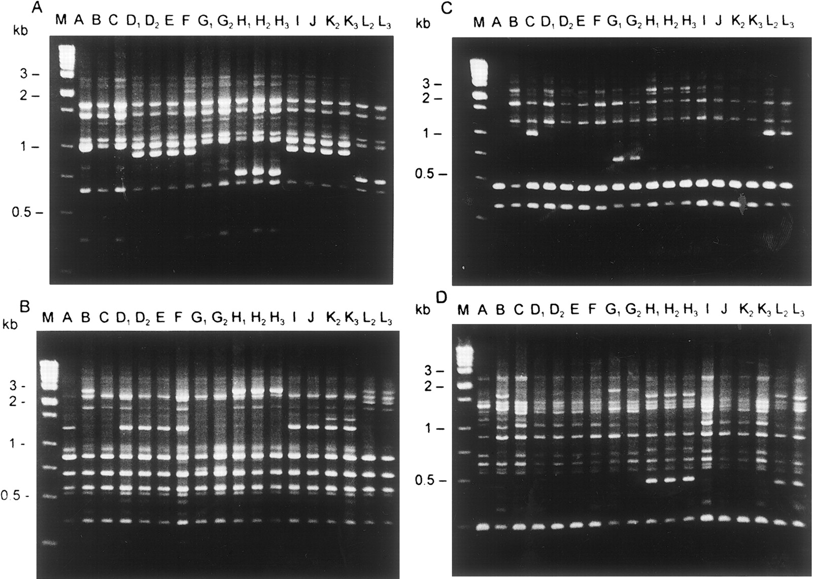
Figure 3 Randomly amplified polymorphic DNA (RAPD) patterns of 18 isolates of Penicillium marneffei. RAPD patterns ...
Notes:
Figure 3 Randomly amplified polymorphic DNA (RAPD) patterns of 18 isolates of Penicillium marneffei. RAPD patterns were generated by arbitrarily primed polymerase chain reaction (APPCR) using 4 primers: OPH-03 (A), OPH-05 (B), OPH-20 (C), and OPA-03 (D). Lane M, Molecular size marker; lanes A-L3, the isolates designated in table 1.
Unless provided in the caption above, the following copyright applies to the content of this slide: © 2000 by the Infectious Diseases Society of America

