Slide 1
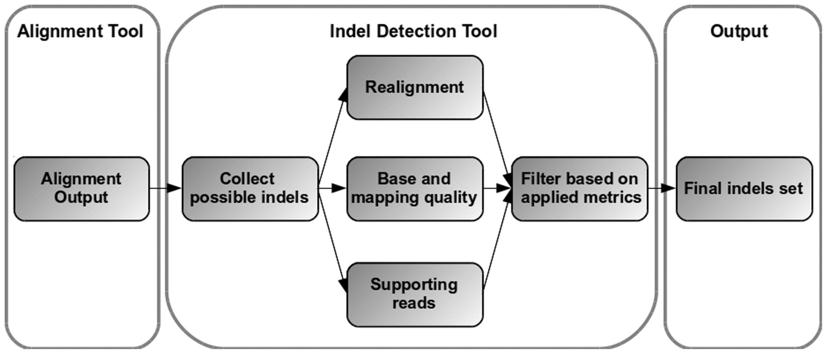
Figure 1: Basic indel calling workflow. The initial step is alignment against a reference genome in which all possible ...
Notes:
Figure 1: Basic indel calling workflow. The initial step is alignment against a reference genome in which all possible indels are detected. The following step, performed by the indel calling tools, is the collection of these possible indels, calculating various metrics, depending on the specific tool, that either support or oppose the presence of each indel. An optimal combination of both alignment and indel calling tools should result in an accurate set of confidently called indels.
Unless provided in the caption above, the following copyright applies to the content of this slide: © The Author 2012. Published by Oxford University Press. For Permissions, please email: journals.permissions@oup.com

Slide 2
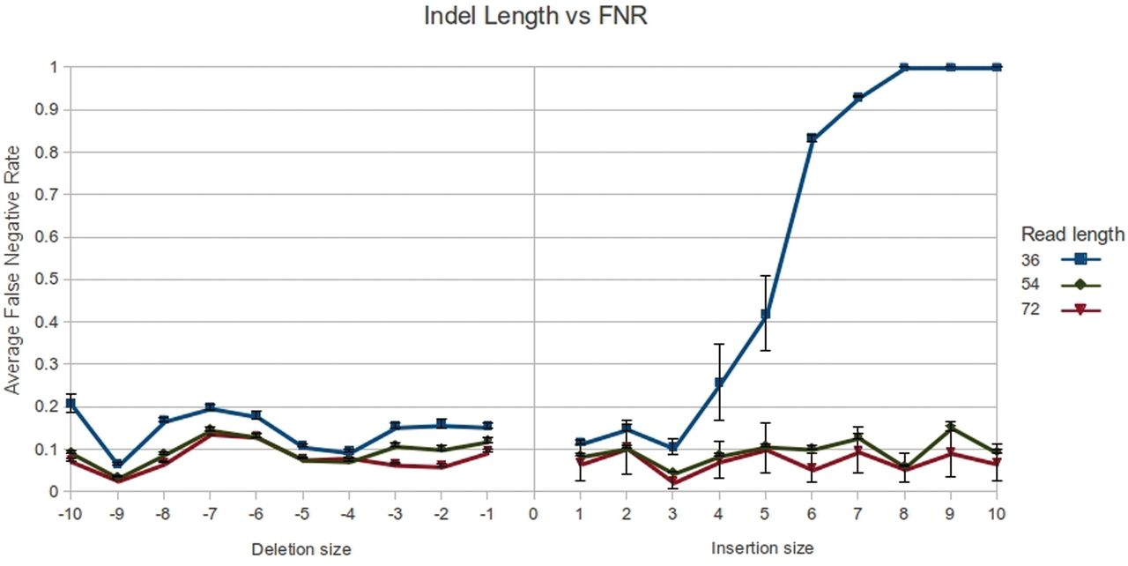
Figure 2: Indel length versus false negative rate (FNR), describing the average FNR across all software as indel length ...
Notes:
Figure 2: Indel length versus false negative rate (FNR), describing the average FNR across all software as indel length increases. It is noticeable that insertions and deletions are detected in a similar rate across lengths, with the exception of increased rate of missed insertions of >3 nt long, when read length is 36 nt.
Unless provided in the caption above, the following copyright applies to the content of this slide: © The Author 2012. Published by Oxford University Press. For Permissions, please email: journals.permissions@oup.com

Slide 3
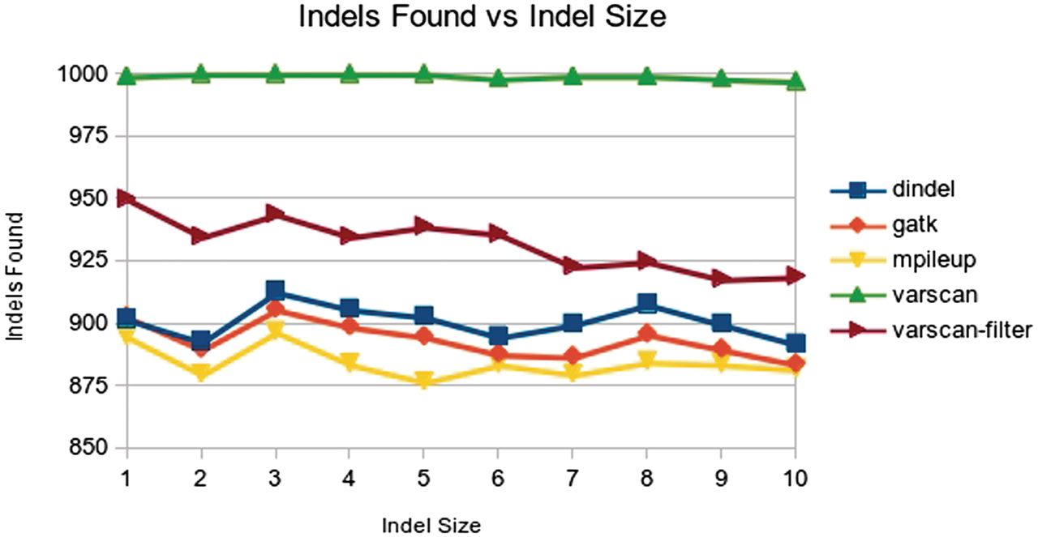
Figure 3: Indels found versus indel size shows the similar sensitivity of GATK, mpileup and Dindel and the higher ...
Notes:
Figure 3: Indels found versus indel size shows the similar sensitivity of GATK, mpileup and Dindel and the higher sensitivity of VarScan and filtered VarScan across all indel sizes. Only filtered VarScan demonstrated a significant decrease in sensitivity as indel size increases.
Unless provided in the caption above, the following copyright applies to the content of this slide: © The Author 2012. Published by Oxford University Press. For Permissions, please email: journals.permissions@oup.com

Slide 4
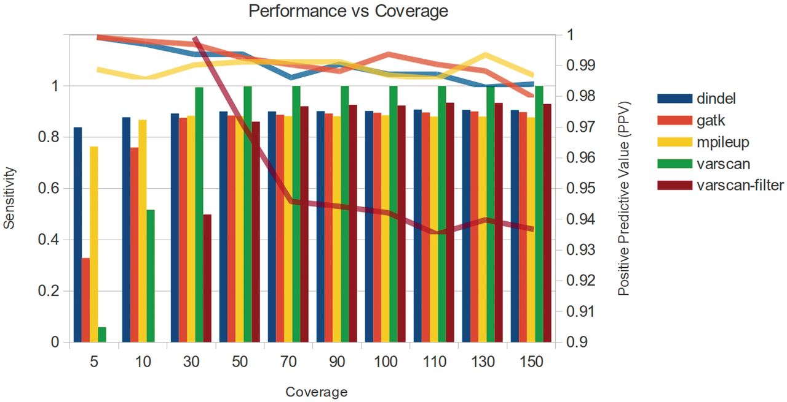
Figure 4: Performance versus coverage, both detected indels (bars) and PPV (lines) against coverage. Our set parameters ...
Notes:
Figure 4: Performance versus coverage, both detected indels (bars) and PPV (lines) against coverage. Our set parameters for the filtered VarScan do not permit indel calling with coverage <20×, so it did not detect any indels in coverage ≤10×. The figure depicts the combined increase in detected indels and decrease in PPV as coverage increases. Unfiltered VarScan’s PPV is not presented in this figure since it is much lower (0.77–0.41) than the rest of the software.
Unless provided in the caption above, the following copyright applies to the content of this slide: © The Author 2012. Published by Oxford University Press. For Permissions, please email: journals.permissions@oup.com

Slide 5
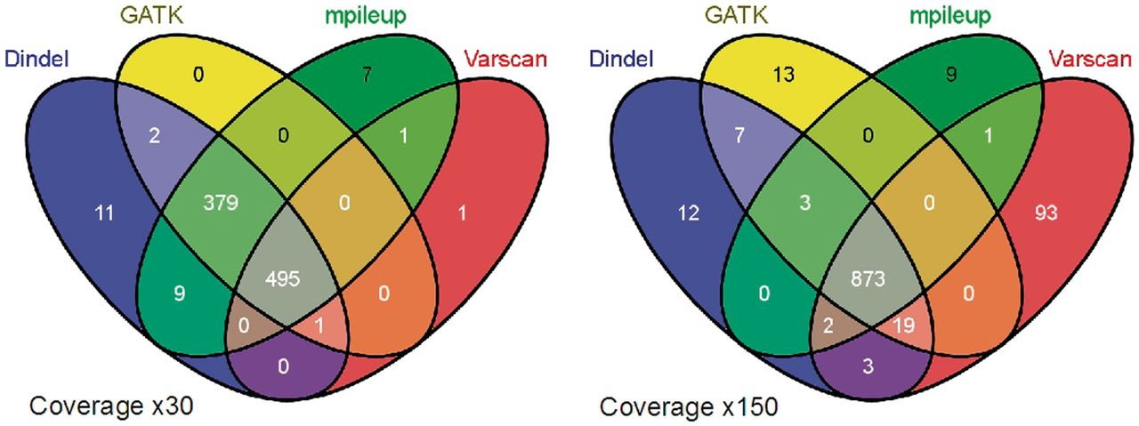
Figure 5: Venn diagram depicting the number of indels found for each software with 30× and 150× coverage and read ...
Notes:
Figure 5: Venn diagram depicting the number of indels found for each software with 30× and 150× coverage and read length 72. Inclusion of indels called in any of the software results in a decrease in PPV with only a mild sensitivity improvement. Inclusion of indels supported by at least two software results in a sensitivity improvement for some of the software and a significant increase in PPV, crucial in high coverage data.
Unless provided in the caption above, the following copyright applies to the content of this slide: © The Author 2012. Published by Oxford University Press. For Permissions, please email: journals.permissions@oup.com

