Slide 1
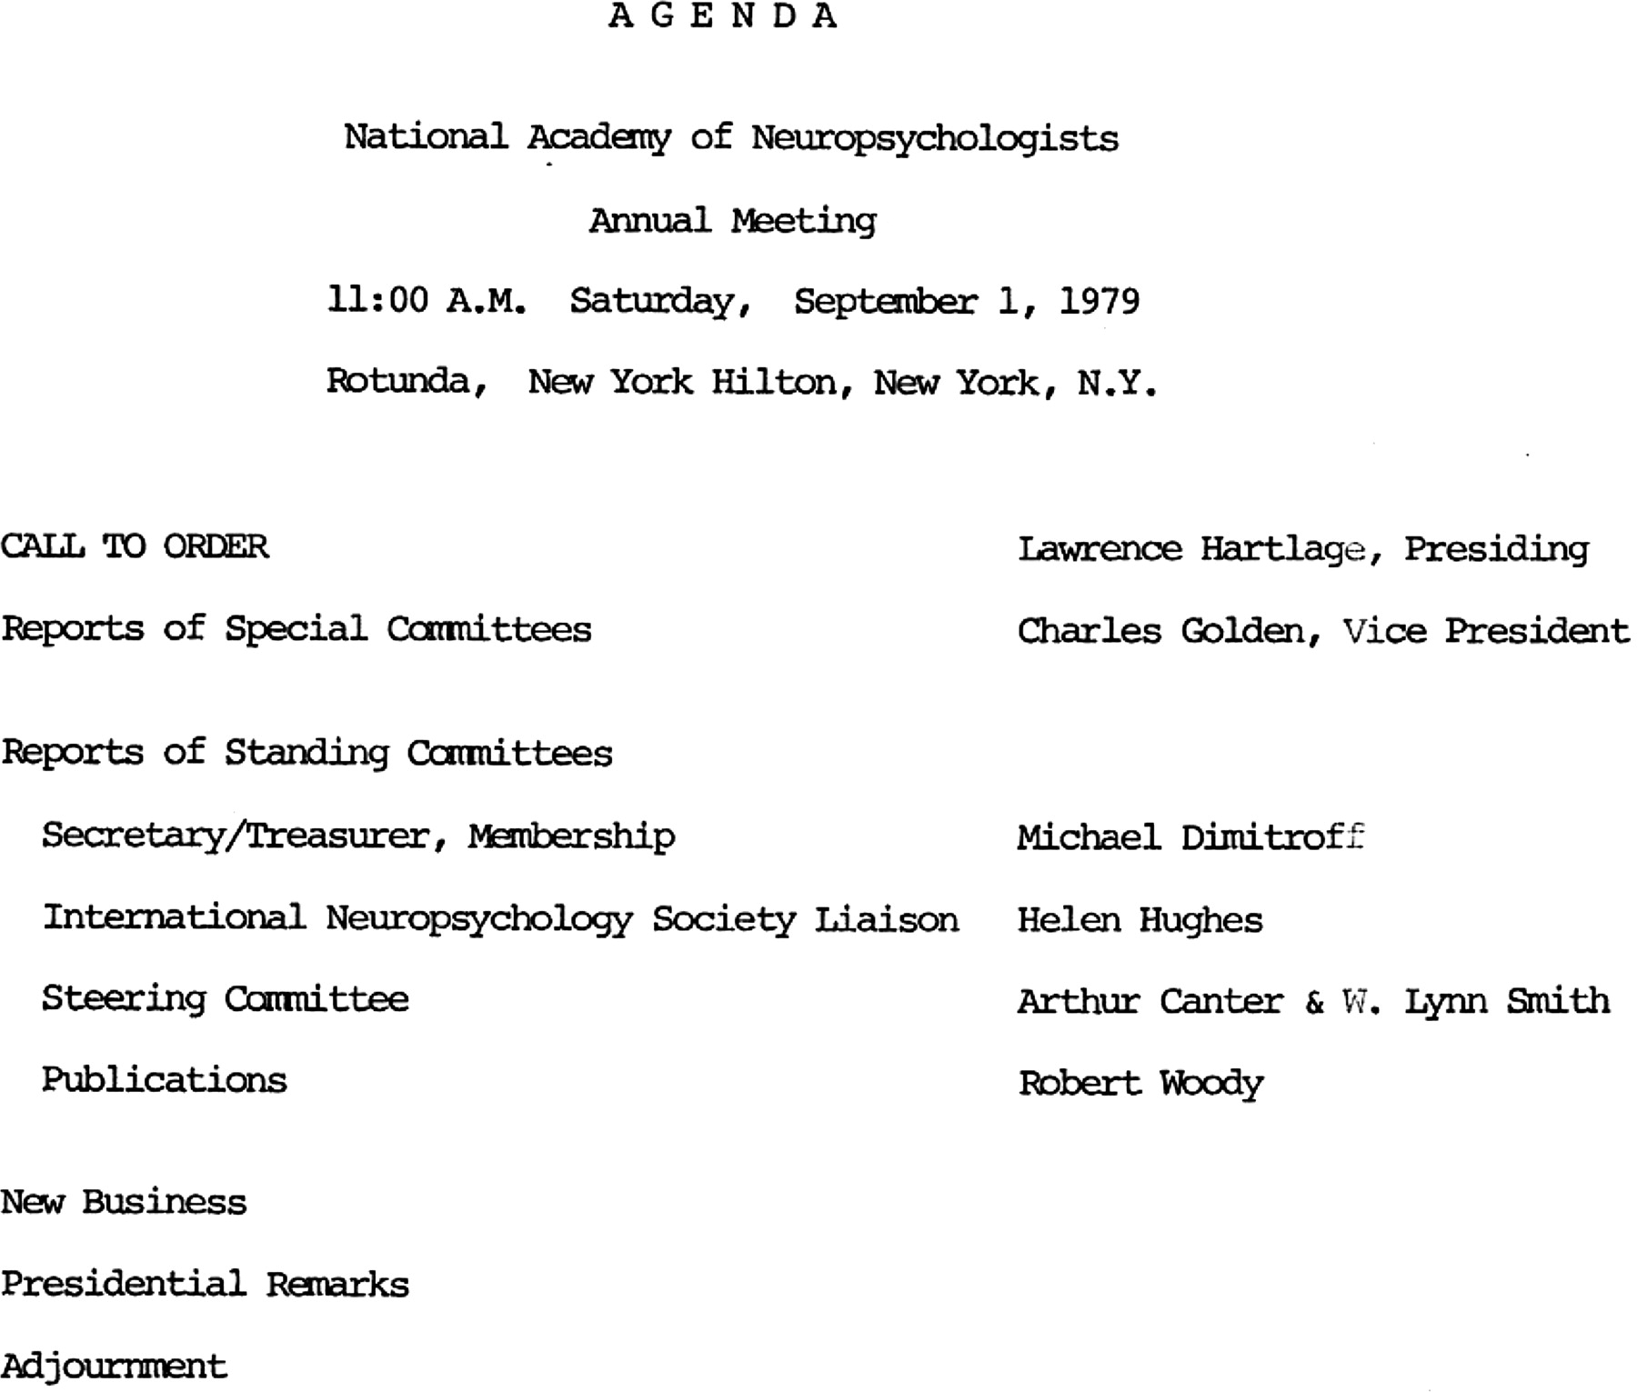
Fig. 1. Agenda, Annual Meeting of NAN, 1979. Provided by Lawrence C. Hartlage, PhD.
Notes:
Fig. 1. Agenda, Annual Meeting of NAN, 1979. Provided by Lawrence C. Hartlage, PhD.
Unless provided in the caption above, the following copyright applies to the content of this slide: © The Author 2011. Published by Oxford University Press. All rights reserved. For permissions, please e-mail: journals.permissions@oup.com.

Slide 2
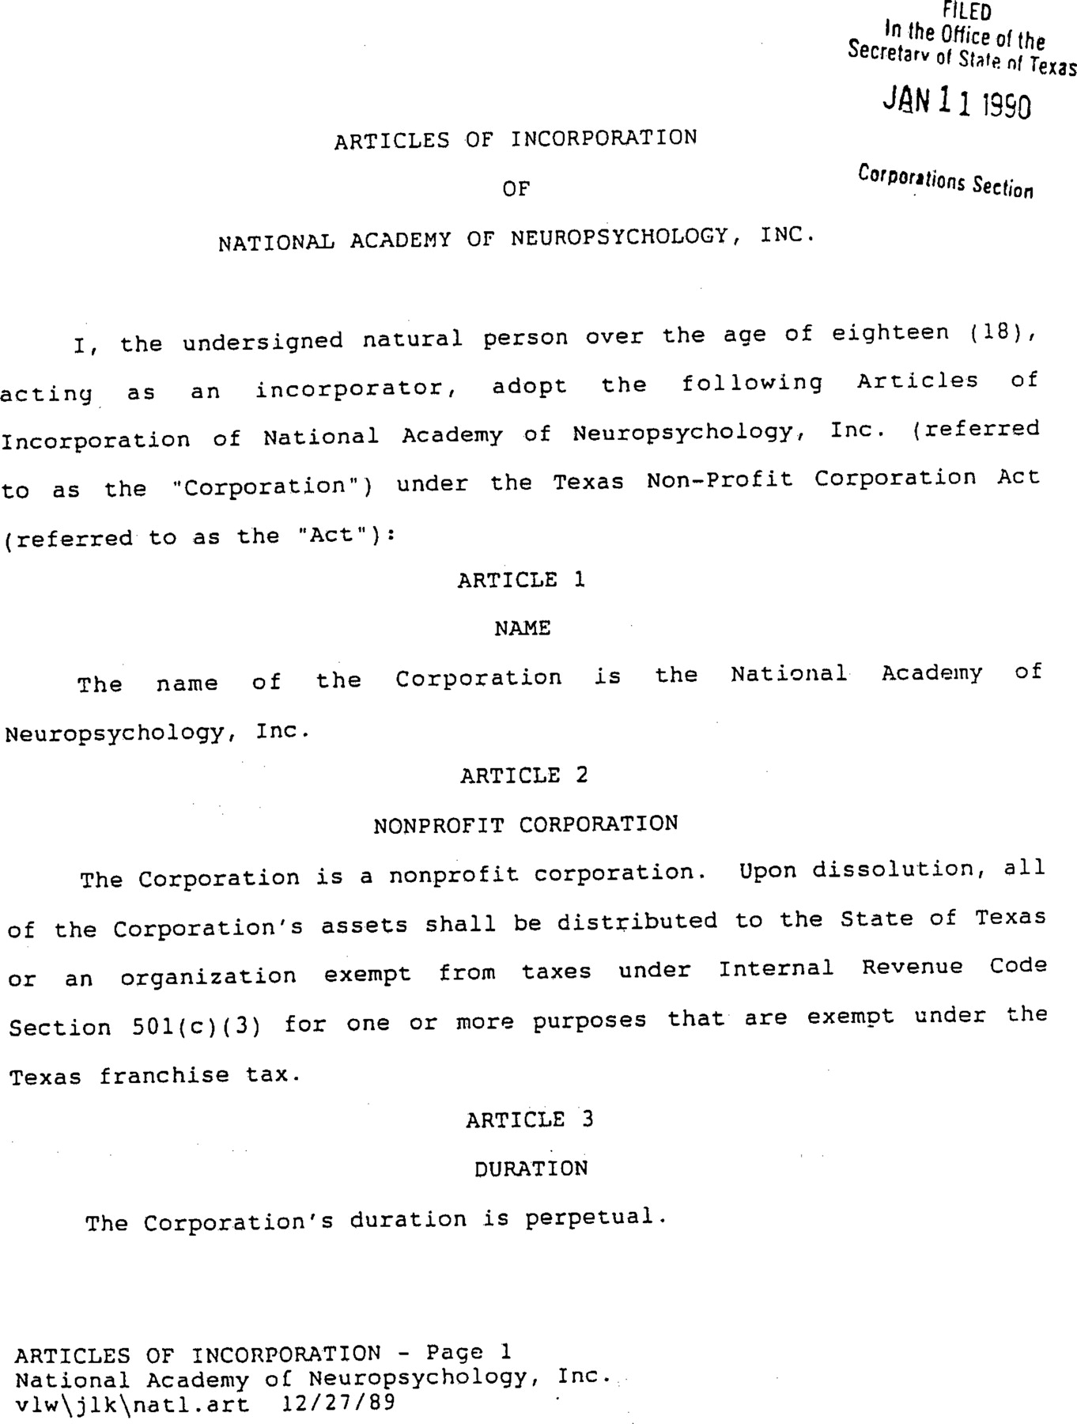
Fig. 2. Articles of incorporation. Provided by Lawrence C. Hartlage, PhD.
Notes:
Fig. 2. Articles of incorporation. Provided by Lawrence C. Hartlage, PhD.
Unless provided in the caption above, the following copyright applies to the content of this slide: © The Author 2011. Published by Oxford University Press. All rights reserved. For permissions, please e-mail: journals.permissions@oup.com.

