Slide 1
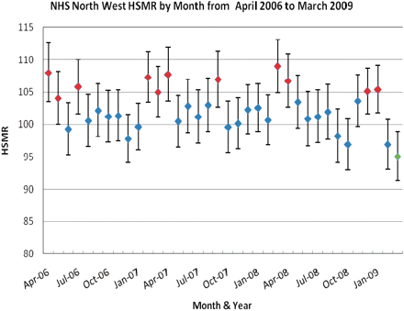
Figure 1. North West SHA HSMR by month from April 2006 to March 2009.
Notes:
Figure 1. North West SHA HSMR by month from April 2006 to March 2009.
Unless provided in the caption above, the following copyright applies to the content of this slide: © The Author(s) 2010. Published by Oxford University Press.This is an Open Access article distributed under the terms of the Creative Commons Attribution Non-Commercial License (http://creativecommons.org/licenses/by-nc/2.5), which permits unrestricted non-commercial use, distribution, and reproduction in any medium, provided the original work is properly cited.

Slide 2
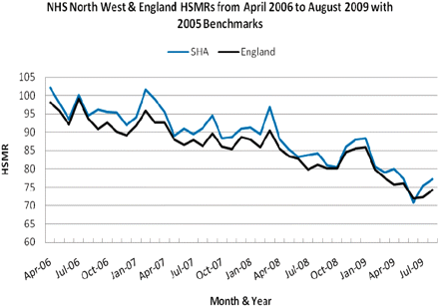
Figure 2. North West SHA & England HSMR by month from April 2006 to March 2009 with 2005 benchmarks.
Notes:
Figure 2. North West SHA & England HSMR by month from April 2006 to March 2009 with 2005 benchmarks.
Unless provided in the caption above, the following copyright applies to the content of this slide: © The Author(s) 2010. Published by Oxford University Press.This is an Open Access article distributed under the terms of the Creative Commons Attribution Non-Commercial License (http://creativecommons.org/licenses/by-nc/2.5), which permits unrestricted non-commercial use, distribution, and reproduction in any medium, provided the original work is properly cited.

Slide 3
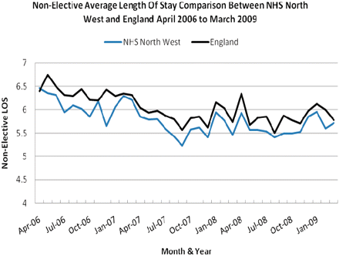
Figure 3. North West SHA & England Non-Elective ALOS by month from April 2006 to March 2009.
Notes:
Figure 3. North West SHA & England Non-Elective ALOS by month from April 2006 to March 2009.
Unless provided in the caption above, the following copyright applies to the content of this slide: © The Author(s) 2010. Published by Oxford University Press.This is an Open Access article distributed under the terms of the Creative Commons Attribution Non-Commercial License (http://creativecommons.org/licenses/by-nc/2.5), which permits unrestricted non-commercial use, distribution, and reproduction in any medium, provided the original work is properly cited.

Slide 4
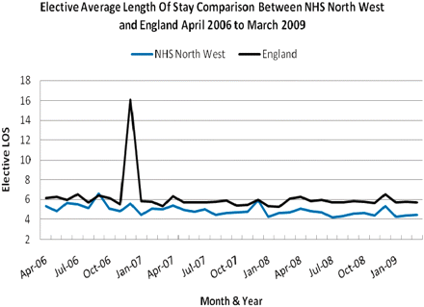
Figure 4. North West SHA & England Elective ALOS by month from April 2006 to March 2009.
Notes:
Figure 4. North West SHA & England Elective ALOS by month from April 2006 to March 2009.
Unless provided in the caption above, the following copyright applies to the content of this slide: © The Author(s) 2010. Published by Oxford University Press.This is an Open Access article distributed under the terms of the Creative Commons Attribution Non-Commercial License (http://creativecommons.org/licenses/by-nc/2.5), which permits unrestricted non-commercial use, distribution, and reproduction in any medium, provided the original work is properly cited.

Slide 5
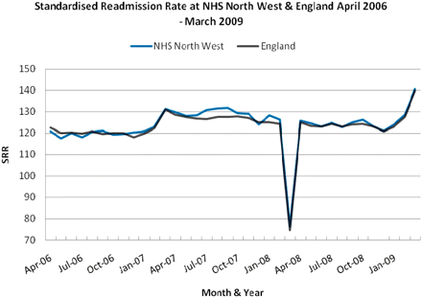
Figure 5. North West SHA & England SRR by month from April 2006 to March 2009.
Notes:
Figure 5. North West SHA & England SRR by month from April 2006 to March 2009.
Unless provided in the caption above, the following copyright applies to the content of this slide: © The Author(s) 2010. Published by Oxford University Press.This is an Open Access article distributed under the terms of the Creative Commons Attribution Non-Commercial License (http://creativecommons.org/licenses/by-nc/2.5), which permits unrestricted non-commercial use, distribution, and reproduction in any medium, provided the original work is properly cited.

