Slide 1
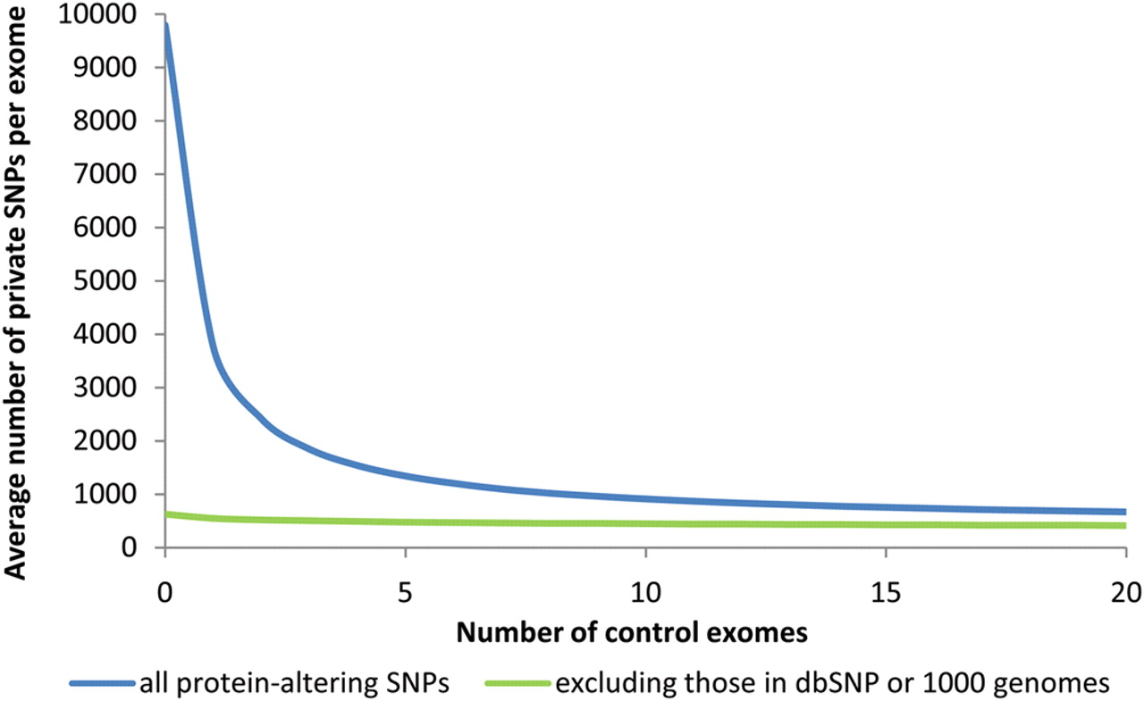
Figure 1. Effect of increasing number of control exomes on private variants observed in a single exome, with and ...
Notes:
Figure 1. Effect of increasing number of control exomes on private variants observed in a single exome, with and without the use of dbSNP and 1000 genomes data. The number of private mutations observed in an individual from sequential addition of control exomes was averaged from 10 000 permutations of 21 published exomes of non-African ancestry (9,13,16).
Unless provided in the caption above, the following copyright applies to the content of this slide: © The Author 2010. Published by Oxford University Press. All rights reserved. For Permissions, please email: journals.permissions@oxfordjournals.org

