Slide 1
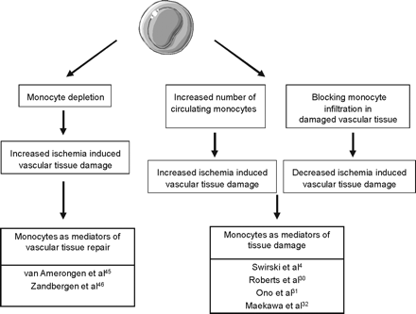
Figure 1 The role of monocytes either as mediators of vascular tissue injury or as mediators of vascular tissue ...
Notes:
Figure 1 The role of monocytes either as mediators of vascular tissue injury or as mediators of vascular tissue repair.
Unless provided in the caption above, the following copyright applies to the content of this slide: Published on behalf of the European Society of Cardiology. All rights reserved. © The Author 2009. For permissions please email: journals.permissions@oxfordjournals.org.

Slide 2
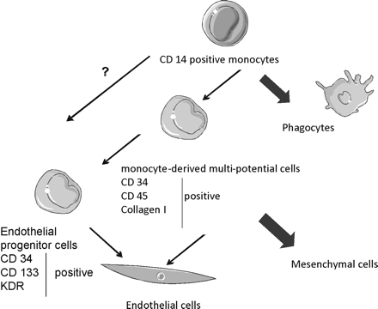
Figure 2 Potential pathways linking monocytes or their bone marrow progenitors to endothelial cells.
Notes:
Figure 2 Potential pathways linking monocytes or their bone marrow progenitors to endothelial cells.
Unless provided in the caption above, the following copyright applies to the content of this slide: Published on behalf of the European Society of Cardiology. All rights reserved. © The Author 2009. For permissions please email: journals.permissions@oxfordjournals.org.

Slide 3
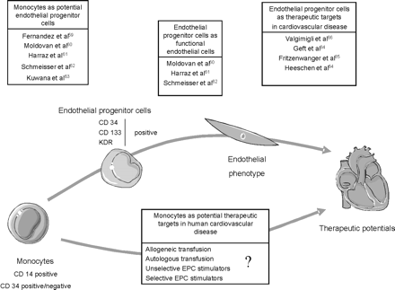
Figure 3 Representative bibliographic data suggesting the role of monocytes in vascular tissue repair.
Notes:
Figure 3 Representative bibliographic data suggesting the role of monocytes in vascular tissue repair.
Unless provided in the caption above, the following copyright applies to the content of this slide: Published on behalf of the European Society of Cardiology. All rights reserved. © The Author 2009. For permissions please email: journals.permissions@oxfordjournals.org.

