Slide 1
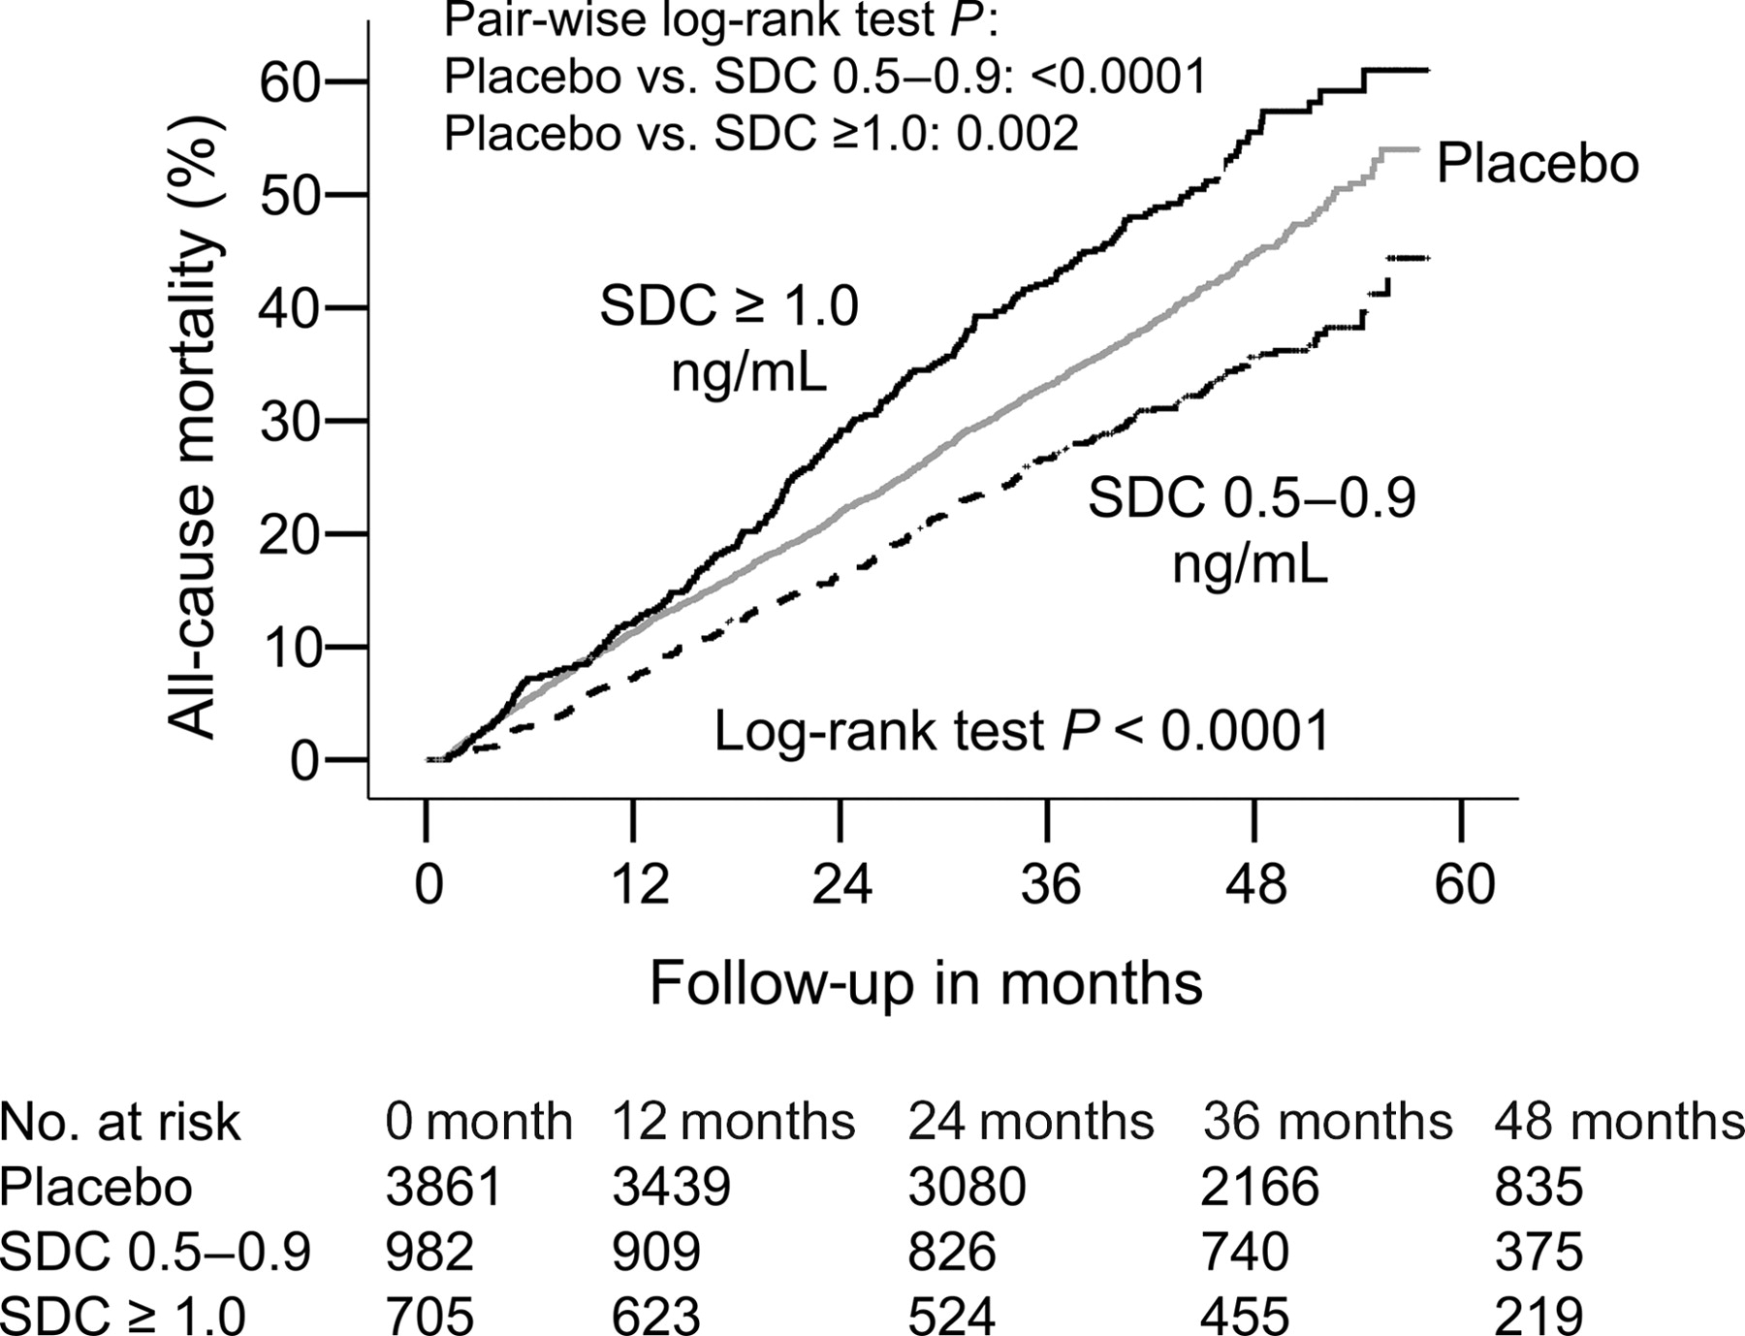
Figure 1 Kaplan–Meier plots for cumulative risk of death due to all causes by SDC.
Notes:
Figure 1 Kaplan–Meier plots for cumulative risk of death due to all causes by SDC.
Unless provided in the caption above, the following copyright applies to the content of this slide: © The European Society of Cardiology 2005. All rights reserved. For Permissions, please e-mail: journals.permissions@oxfordjournals.org

Slide 2
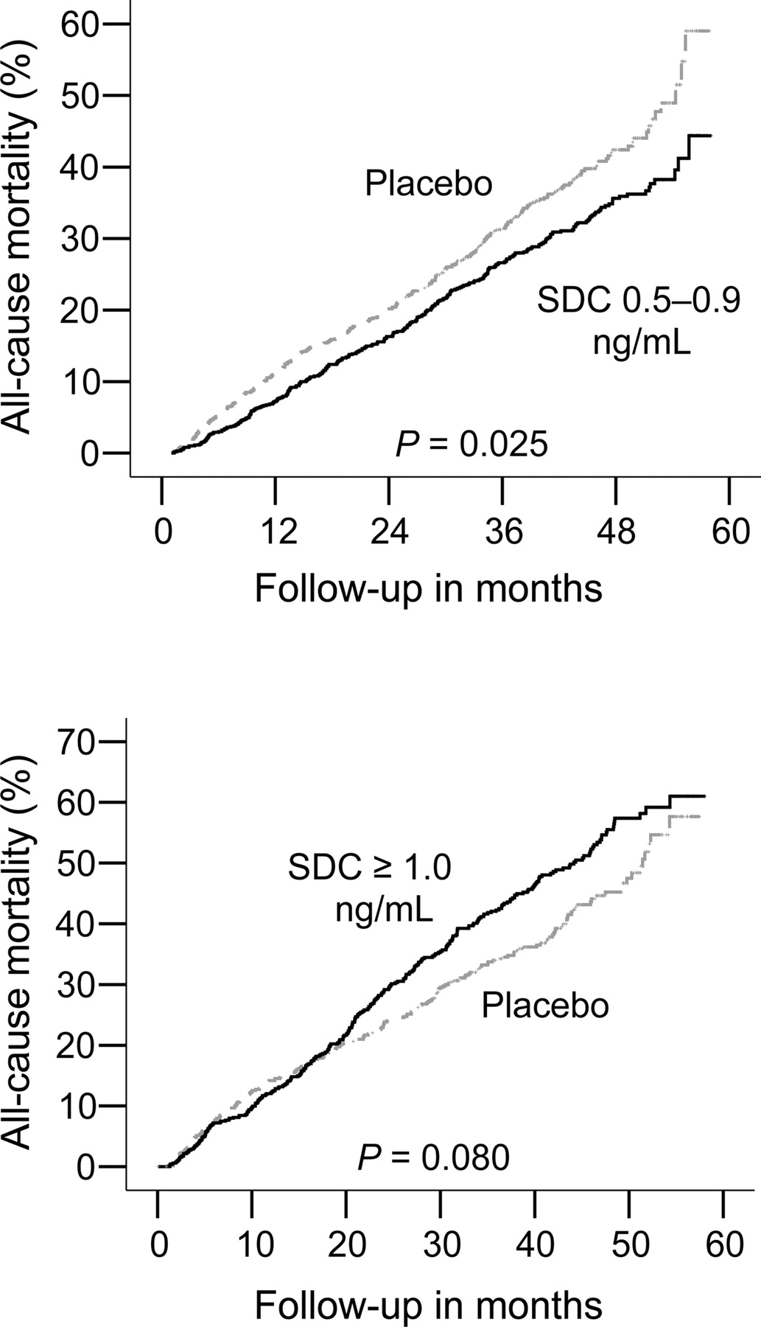
Figure 2 Kaplan–Meier plots for cumulative risk of all-cause death among patients matched by propensity to ...
Notes:
Figure 2 Kaplan–Meier plots for cumulative risk of all-cause death among patients matched by propensity to develop SDCs 0.5–0.9 (upper panel) and ≥1.0 ng/mL (lower panel).
Unless provided in the caption above, the following copyright applies to the content of this slide: © The European Society of Cardiology 2005. All rights reserved. For Permissions, please e-mail: journals.permissions@oxfordjournals.org

Slide 3
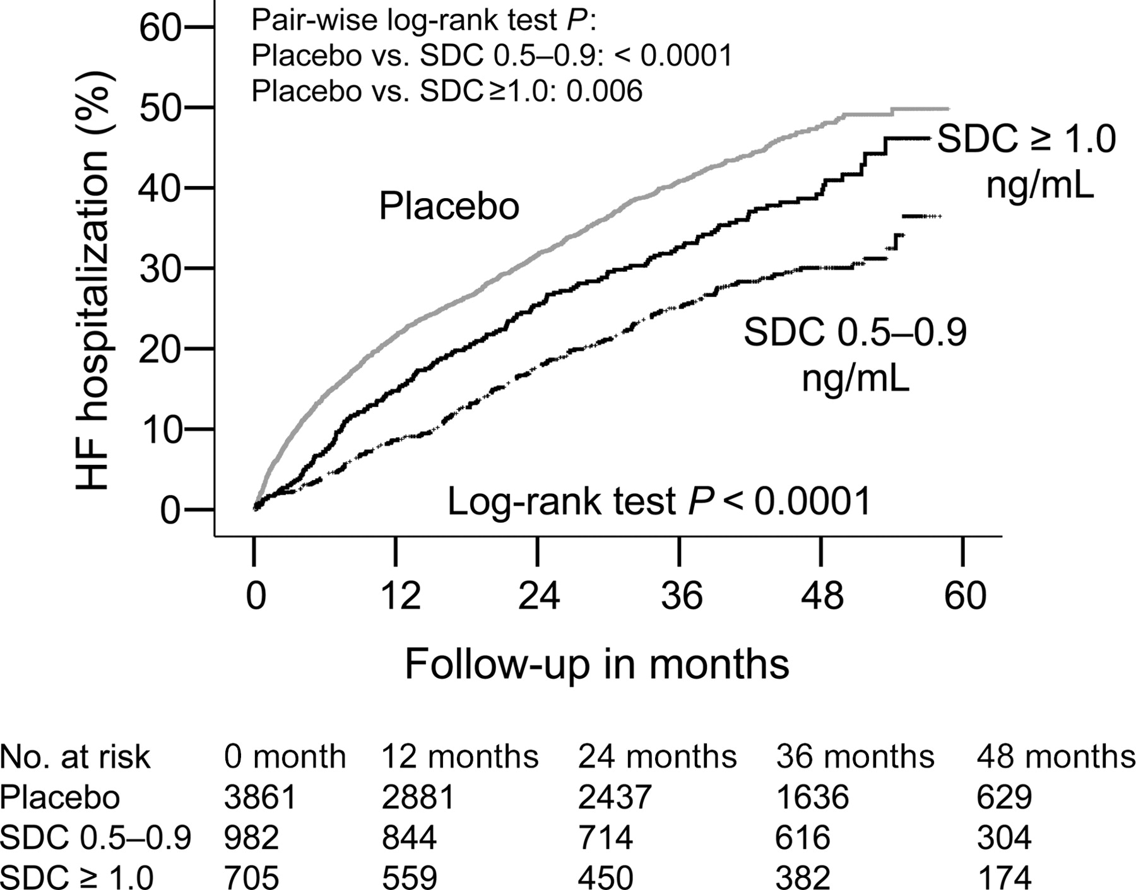
Figure 3 Kaplan–Meier plots for cumulative risk of hospitalization due to worsening HF by SDC.
Notes:
Figure 3 Kaplan–Meier plots for cumulative risk of hospitalization due to worsening HF by SDC.
Unless provided in the caption above, the following copyright applies to the content of this slide: © The European Society of Cardiology 2005. All rights reserved. For Permissions, please e-mail: journals.permissions@oxfordjournals.org

Slide 4
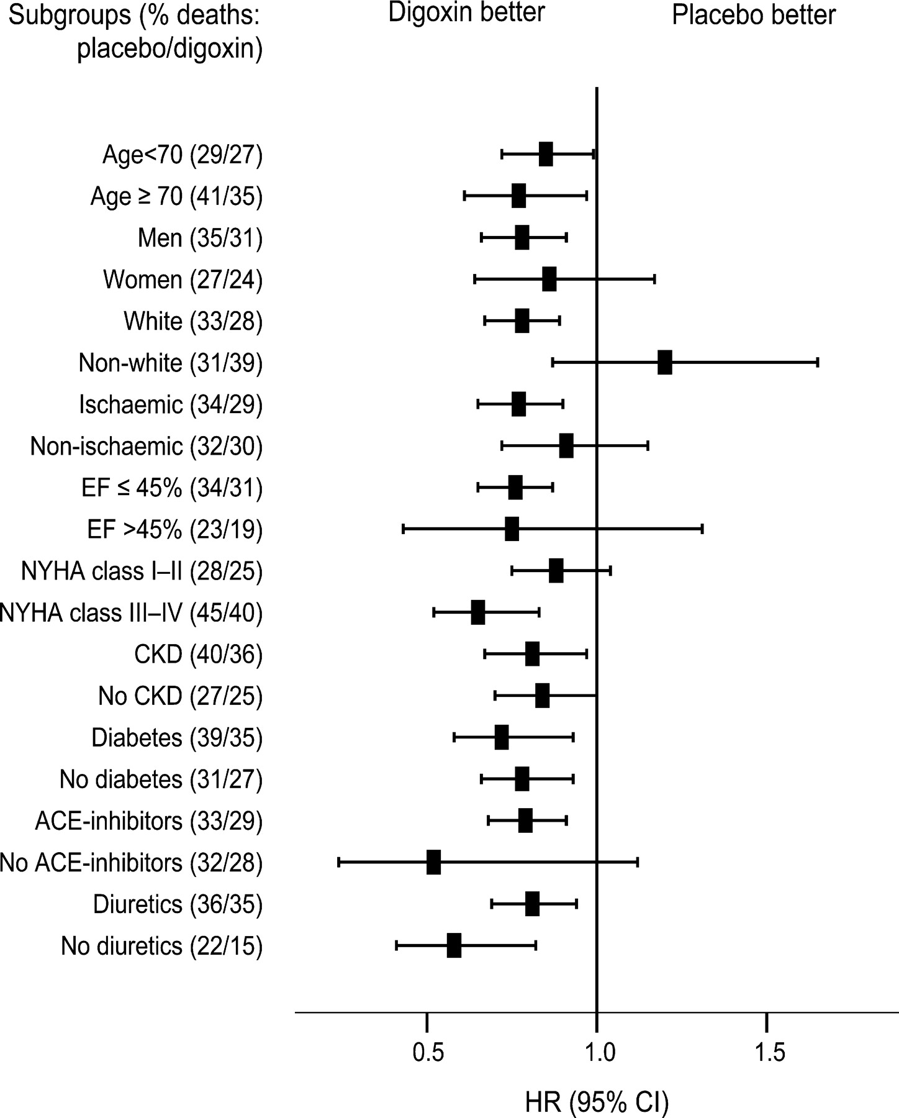
Figure 4 HR (95% CI) for all-cause mortality in subgroups of patients with HF with SDC 0.5–0.9 ng/dL and ...
Notes:
Figure 4 HR (95% CI) for all-cause mortality in subgroups of patients with HF with SDC 0.5–0.9 ng/dL and placebo.
Unless provided in the caption above, the following copyright applies to the content of this slide: © The European Society of Cardiology 2005. All rights reserved. For Permissions, please e-mail: journals.permissions@oxfordjournals.org

