Slide 1
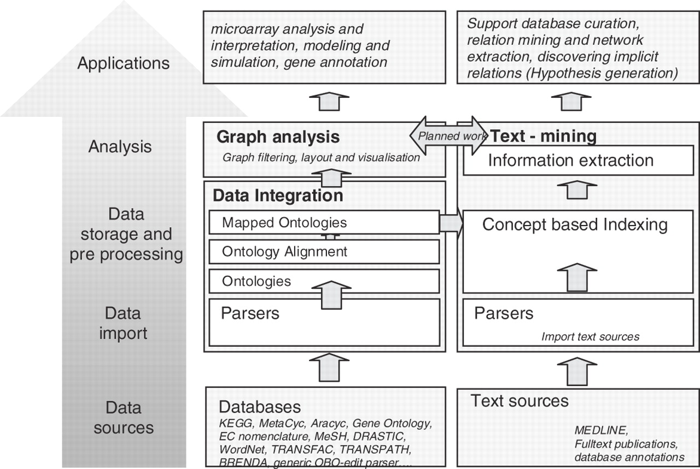
Fig. 1 Overview of the ONDEX architecture and its components.
Notes:
Fig. 1 Overview of the ONDEX architecture and its components.
Unless provided in the caption above, the following copyright applies to the content of this slide: © The Author 2006. Published by Oxford University Press. All rights reserved. For Permissions, please email: journals.permissions@oxfordjournals.org

Slide 2
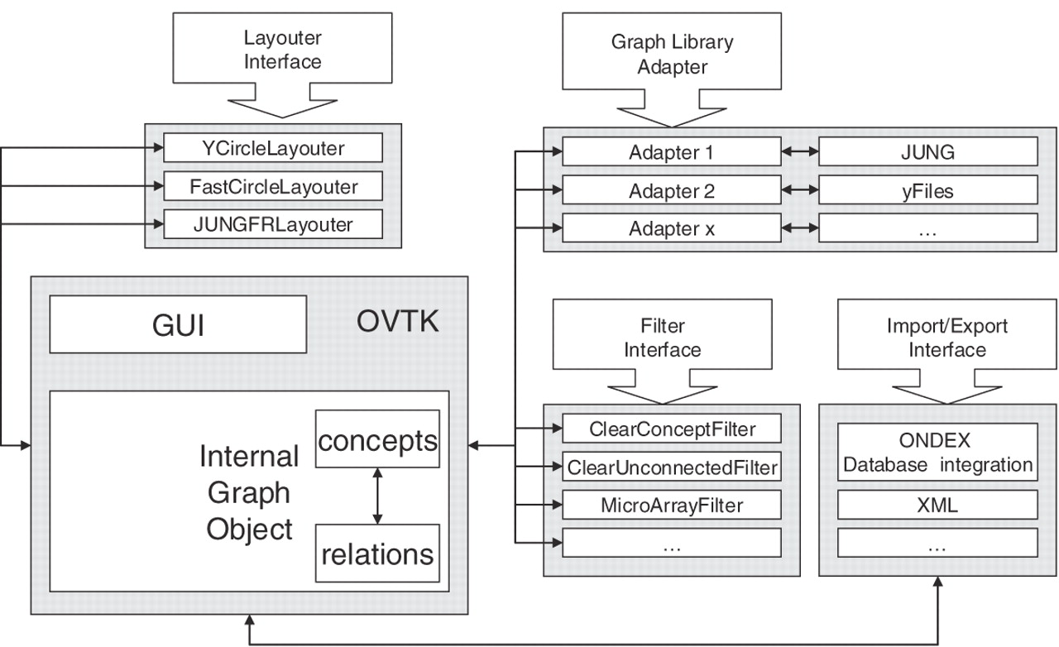
Fig. 2 System architecture of the graph analysis and visualization components of ONDEX.
Notes:
Fig. 2 System architecture of the graph analysis and visualization components of ONDEX.
Unless provided in the caption above, the following copyright applies to the content of this slide: © The Author 2006. Published by Oxford University Press. All rights reserved. For Permissions, please email: journals.permissions@oxfordjournals.org

Slide 3
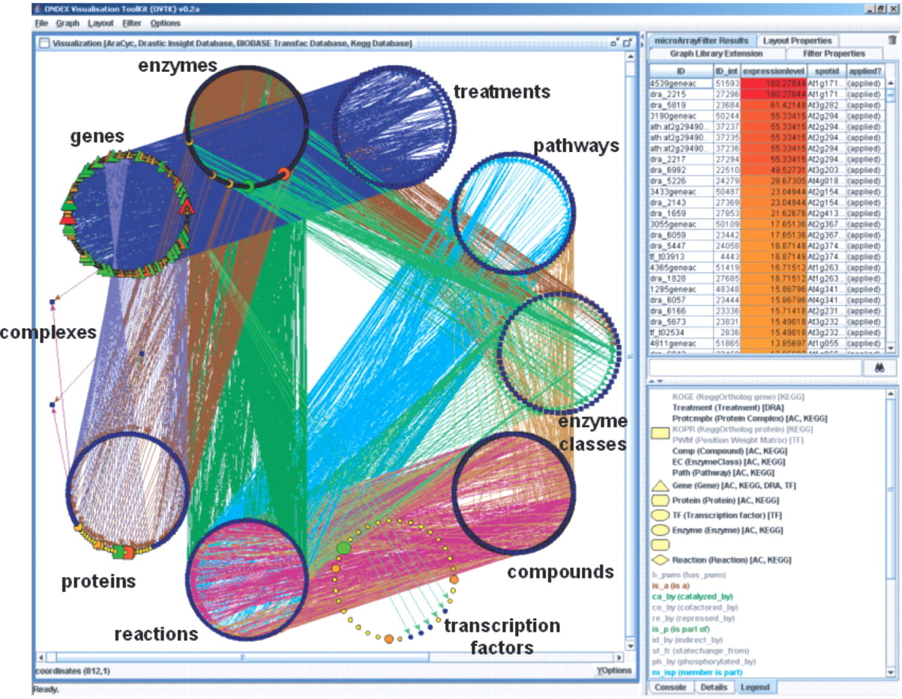
Fig. 3 The ONDEX front-end can visualize, filter and analyze microarray results in the context of hundreds of ...
Notes:
Fig. 3 The ONDEX front-end can visualize, filter and analyze microarray results in the context of hundreds of thousands of concepts integrated from several heterogeneous databases (AraCyc, KEGG, Transfac, Transpath and DRASTIC). Concepts from several concept classes (transcription factors proteins and genes) are highlighted according to their expression level in the microarray experiment. The layout was generated using the FastCircularLayout algorithm (see Section 3.4). This layout is especially useful to give a first overview of the quantity and nature of the data. To extract more meaning from the data displayed in this screenshot, users can apply further filters and analysis methods.
Unless provided in the caption above, the following copyright applies to the content of this slide: © The Author 2006. Published by Oxford University Press. All rights reserved. For Permissions, please email: journals.permissions@oxfordjournals.org

Slide 4
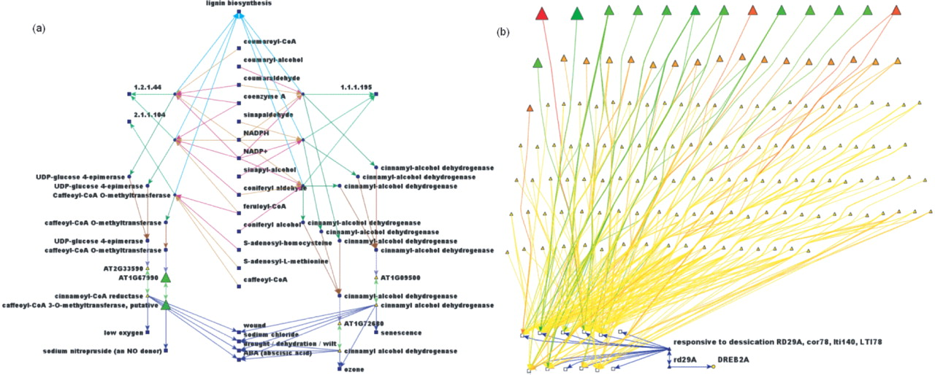
Fig. 4 (a) The lignin pathway displayed in the graph analysis component showing only elements where the genes are ...
Notes:
Fig. 4 (a) The lignin pathway displayed in the graph analysis component showing only elements where the genes are up- or down-regulated. This figure shows that the four genes At1g67990, At1g09500, At1g72680 and At2g33590 are differentially expressed. They encode several proteins and enzymes which participate in the lignin biosynthesis pathway and fall into three enzyme classes (2.1.1.104, 1.1.1.195 and 1.2.1.44). Data from the DRASTIC database show that these genes respond to different types of stress (ABA, sodium chloride, drought and wound). (b) Even though it was not differentially expressed on the microarray chip, according to the TRANSFAC database, rd29A (At5g52310) is known to be regulated by a transcription factor which was also differentially expressed in the microarray experiment. This gene is further annotated with 12 different stress types in the DRASTIC database (bottom left, blue rectangular boxes). These 12 stress types are also known to affect the expression of 120 other genes that were also differentially expressed in the analyzed microarray experiment.
Unless provided in the caption above, the following copyright applies to the content of this slide: © The Author 2006. Published by Oxford University Press. All rights reserved. For Permissions, please email: journals.permissions@oxfordjournals.org

