Slide 1
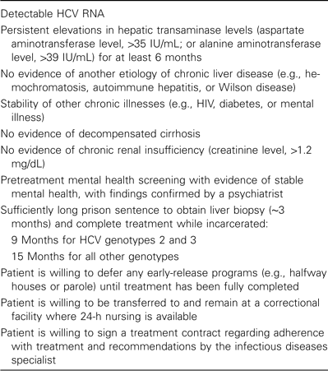
Table 1 Eligibility criteria for treatment of hepatitis C virus (HCV) infection in the Connecticut Department of ...
Notes:
Table 1 Eligibility criteria for treatment of hepatitis C virus (HCV) infection in the Connecticut Department of Correction.
Unless provided in the caption above, the following copyright applies to the content of this slide: © 2008 by the Infectious Diseases Society of America

Slide 2
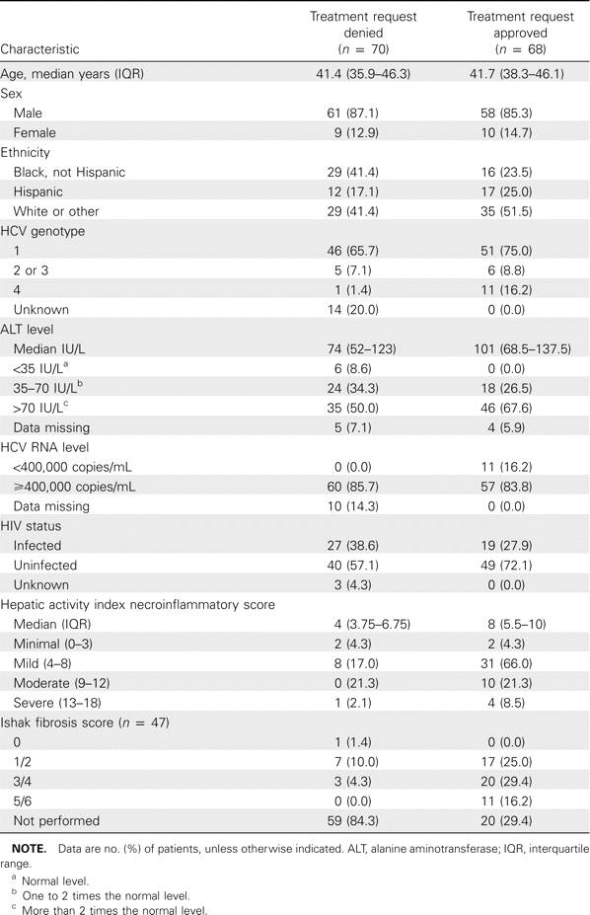
Table 2 Characteristics of 138 patients referred for treatment of hepatitis C virus (HCV) infection.
Notes:
Table 2 Characteristics of 138 patients referred for treatment of hepatitis C virus (HCV) infection.
Unless provided in the caption above, the following copyright applies to the content of this slide: © 2008 by the Infectious Diseases Society of America

Slide 3
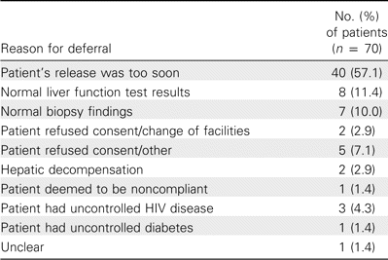
Table 3 Reasons for deferral of hepatitis C therapy.
Notes:
Table 3 Reasons for deferral of hepatitis C therapy.
Unless provided in the caption above, the following copyright applies to the content of this slide: © 2008 by the Infectious Diseases Society of America

Slide 4
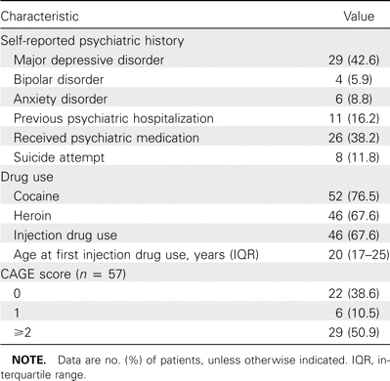
Table 4 Psychiatric comorbidities among 68 patients who were approved for hepatitis C therapy.
Notes:
Table 4 Psychiatric comorbidities among 68 patients who were approved for hepatitis C therapy.
Unless provided in the caption above, the following copyright applies to the content of this slide: © 2008 by the Infectious Diseases Society of America

Slide 5
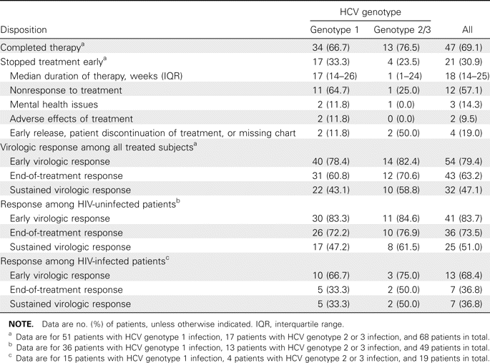
Table 5 Treatment disposition and outcomes, by hepatitis C virus (HCV) genotype.
Notes:
Table 5 Treatment disposition and outcomes, by hepatitis C virus (HCV) genotype.
Unless provided in the caption above, the following copyright applies to the content of this slide: © 2008 by the Infectious Diseases Society of America

Slide 6
Table 6 Multiple regression analysis of correlates of failure to achieve a sustained virologic response (n = 68).
Notes:
Table 6 Multiple regression analysis of correlates of failure to achieve a sustained virologic response (n = 68).
Unless provided in the caption above, the following copyright applies to the content of this slide: © 2008 by the Infectious Diseases Society of America

Slide 7
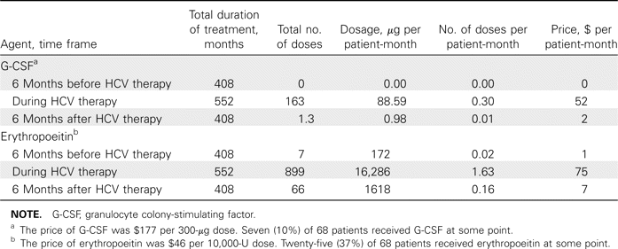
Table 7 Use of hematopoeitic growth factors during hepatitis C treatment.
Notes:
Table 7 Use of hematopoeitic growth factors during hepatitis C treatment.
Unless provided in the caption above, the following copyright applies to the content of this slide: © 2008 by the Infectious Diseases Society of America

Slide 8
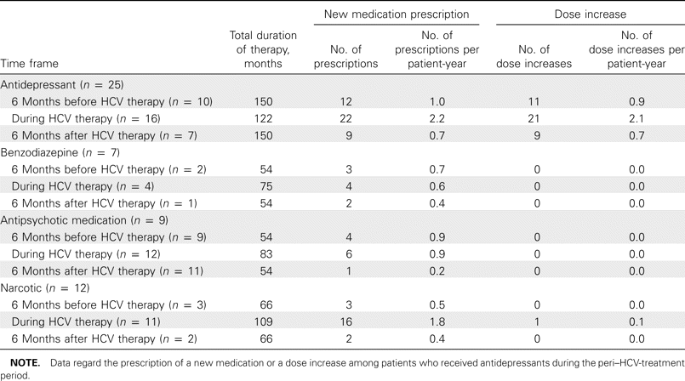
Table 8 Use of psychiatric medication during hepatitis C treatment.
Notes:
Table 8 Use of psychiatric medication during hepatitis C treatment.
Unless provided in the caption above, the following copyright applies to the content of this slide: © 2008 by the Infectious Diseases Society of America

