Slide 1
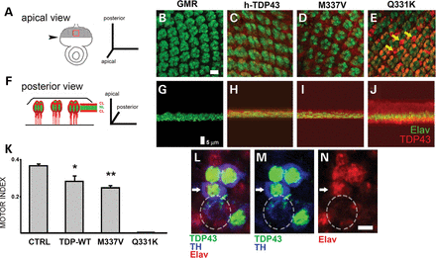
Figure 1. The Q331K mutation of human TDP-43 undergoes cytoplasmic localization and confers toxicity in transgenic ...
Notes:
Figure 1. The Q331K mutation of human TDP-43 undergoes cytoplasmic localization and confers toxicity in transgenic Drosophila. (A) Schematic of conventional apical view of the third instar larval eye imaginal disc. Expression of transgenes using GMR-GAL4 commences posterior to the morphogenetic furrow (hatched area). The red square corresponds to the approximate fields viewed in (B)–(D). Arrowhead, morphogenetic furrow. (B–D) Apical views posterior to the furrow corresponding to GMR-GAL4 driver alone (A) or co expressed with either WT (B), M337V (C) or Q331K UAS-TDP-43 transgenes (E). Green, neuronal nuclear protein Elav (which occupies most of the cytoplasm of developing photoreceptors in this view); red, TDP-43. The TDP-43 signal is diffuse for WT (C) and M337 V (D) but somewhat punctate for Q331K TDP-43 (yellow arrows, E). (F) Schematic of the anterior view of the eye disc corresponding to the view in (A) rotated 90° into the plane of the page in order to distinguish nuclear from cytoplasmic layers. Elav staining (G) identifies the nuclei of developing photoreceptors, which overlaps the TDP-43 signal for WT (H) and M337V (I) TDP-43. For Q331K, however, the TDP-43 signal is displaced from the nuclei, and the eye disc appears thickened. (K) Negative geotaxis assessed automatically using the Drosophila activity monitor system (DAMS). Male flies with pan-neural expression of TDP-43 were reared at 18°C throughout development and then after eclosion transferred to an incubator with 12 h light–dark cycles at 25°C for behavioral testing. WT (*P < 0.05) and M337V TDP-43 flies (**P < 0.01) showed impaired climbing performance when compared with driver alone (Student's t-test). Pan-neural Q331K was lethal even at 18°C. (L–M) Views of dopaminergic neurons in the adult brain (protocerebral posteriolateral cluster 1 (PPL1) at 10 days expressing UAS-TDP-43Q331K under control of TH-GAL4. Green, TDP-43; blue, tyrosine hydroxylase (TH); red, Elav. Most neurons (e.g. white arrow) show nuclear TDP-43 staining that overlaps the Elav signal; however, in a sick neuron (hatched circle) that has begun to lose its nuclear Elav staining, TDP-43 is displaced from the nucleus, with traces left in the cytoplasm in the vicinity of the TH signal. Scale bars, 5 µm (B–E and G–J); 7 µm (L–N). Genotypes: (B and G): w1118; GMR-GAL4/+. (C and H): w1118; GMR-GAL4/+;UAS-TDP-43WT/+. (D and I): w1118; GMR-GAL4/+; UAS-TDP-43M337V/+. (E and J): w1118; GMR-GAL4/+; UAS-TDP-43Q331K/+. K: ‘CTRL’, elav-GAL4/Y. ‘TDP-WT’, elav-GAL4/Y; +; UAS-TDP-43WT/+. ‘M337V’, elav-GAL4/Y; +; UAS-TDP-43M337V/+. ‘Q331K’, elav-GAL4/Y; +; UAS-TDP-43Q331K/+. (E and J): w1118; GMR-GAL4/+; UAS-TDP-43Q331K/+.
Unless provided in the caption above, the following copyright applies to the content of this slide: © The Author 2013. Published by Oxford University Press. All rights reserved. For Permissions, please email: journals.permissions@oup.com

Slide 2
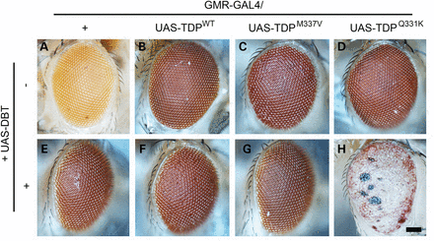
Figure 2. Coexpression of DBT, a fly homolog of CKIε, markedly enhances the phenotype of the Q331K TDP-43 mutant. ...
Notes:
Figure 2. Coexpression of DBT, a fly homolog of CKIε, markedly enhances the phenotype of the Q331K TDP-43 mutant. Stocks stably expressing both GMR-GAL4 and the indicated forms of UAS-TDP-43 were crossed to UAS-dbt. Vials containing progeny embryos were incubated at 18°C throughout development. Shown are photomicrographs of progeny eyes taken within 24–48 h post-eclosion. (A) Driver alone. (B) WT TDP-43. (C) M337V. (D) Q331K. At this temperature, external phenotypes are normal and indistinguishable from one another. (E) Overexpression of DBT does not produce an abnormal phenotype. Neither WT (F) nor M337V TDP-43 (G) produces any abnormal phenotype when coexpressed with DBT; Q331K, however, is partially lethal when coexpressed with DBT, and emerging adults show markedly enhanced rough eye phenotypes with widespread depigmentation and necrotic (or hypermelanized) patches (H). Scale bar, 50 μm. Genotypes: (A) w1118; GMR-GAL4/+. (B) w1118; GMR-GAL4/+;UAS-TDP-43WT/+. (C) w1118; GMR-GAL4/+; UAS-TDP-43M337V/+. (D) w1118; GMR-GAL4/+; UAS-TDP-43Q331K/+. (E) w1118; GMR-GAL4/+; UAS-dbt. (F), w1118; GMR-GAL4/+;UAS-TDP-43WT/UAS-dbt. (C) w1118; GMR-GAL4/+; UAS-TDP-43M337V/UAS-dbt. (D) w1118; GMR-GAL4/+; UAS-TDP-43Q331K/UAS-dbt.
Unless provided in the caption above, the following copyright applies to the content of this slide: © The Author 2013. Published by Oxford University Press. All rights reserved. For Permissions, please email: journals.permissions@oup.com

Slide 3
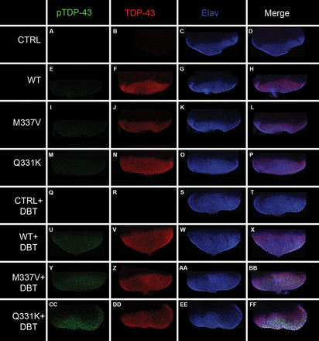
Figure 3. DBT phosphorylates wild-type human TDP43 and its ALS-associated mutant variants, TDP-43^{M337V} and ...
Notes:
Figure 3. DBT phosphorylates wild-type human TDP43 and its ALS-associated mutant variants, TDP-43M337V and TDP-43Q331Kin vivo. (A–FF) Confocal images of third instar larval eye discs stained with antibodies against phosphorylated TDP43 (green), total TDP43 (red) and Elav (Blue). (D), (H), (L), (P), (T), (X), (BB) and (FF) are merged confocal images showing the staining pattern of the three antibodies, phospho-TDP43, total TDP43 and Elav. There is no background staining for pSer409/410 TDP-43 in the absence of the DBT transgene or when DBT is expressed without TDP-43 (A–T). Phospho-TDP signal is modest when DBT is coexpressed with WT or M337V TDP (U–BB), whereas DBT promotes formation of punctae containing phosphorylated TDP-43 in the presence of the Q331K mutant protein (CC–FF), particularly in the posterior portions of the disc. Scale bar, 200 µm. (A–D) w1118; GMR-GAL4/+. (E–H) w1118; GMR-GAL4/+;UAS-TDP-43WT/+. (I–L), w1118; GMR-GAL4/+; UAS-TDP-43M337V/+. (M–P), w1118; GMR-GAL4/+; UAS-TDP-43Q331K/+. (Q–T), w1118; GMR-GAL4/+; UAS-dbt. (U–X) w1118; GMR-GAL4/+;UAS-TDP-43WT/UAS-dbt. Y-BB, w1118; GMR-GAL4/+; UAS-TDP-43M337V/UAS-dbt. CC-FF, w1118; GMR-GAL4/+; UAS-TDP-43Q331K/UAS-dbt.
Unless provided in the caption above, the following copyright applies to the content of this slide: © The Author 2013. Published by Oxford University Press. All rights reserved. For Permissions, please email: journals.permissions@oup.com

Slide 4
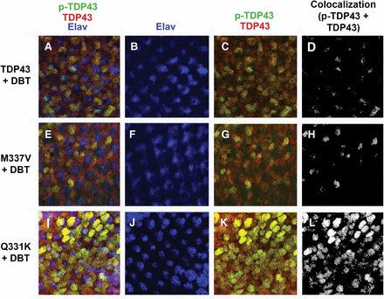
Figure 4. DBT promotes the formation of aggregates containing phosphorylated TDP-43^{Q331K}. (A–L) confocal ...
Notes:
Figure 4. DBT promotes the formation of aggregates containing phosphorylated TDP-43Q331K. (A–L) confocal images of third instar larval eye discs stained with antibodies against phospho-TDP43 (green), total TDP43 (red) and Elav (blue). (D, H and L) Images representing the colocalized pixels of phospho- and total TDP43. Many phosphorylated aggregates immunoreactive for both total and phospho-TDP in eye discs coexpressing TDP-43Q331K and DBT (I, K and L) are seen as yellow in merged images (I and K; see L for coregistered pixels) that largely fail to overlap with the nuclear stain (blue channel in I and J) . Scale bar, 5 µm. (A–D) w1118; GMR-GAL4/+;UAS-TDP-43WT/UAS-dbt. (E–H) w1118; GMR-GAL4/+; UAS-TDP-43M337V/UAS-dbt. (I–L) w1118; GMR-GAL4/+; UAS-TDP-43Q331K/UAS-dbt.
Unless provided in the caption above, the following copyright applies to the content of this slide: © The Author 2013. Published by Oxford University Press. All rights reserved. For Permissions, please email: journals.permissions@oup.com

Slide 5
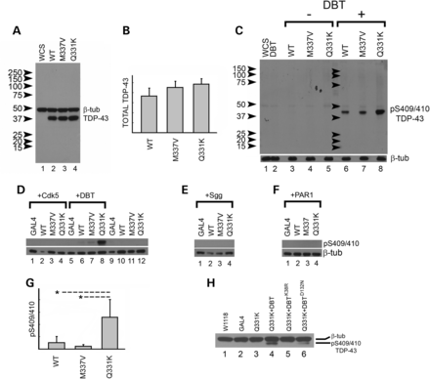
Figure 5. DBT is a robust and specific TDP-43 kinase in vivo. (A) Comparison showing comparable total TDP-43 expression ...
Notes:
Figure 5. DBT is a robust and specific TDP-43 kinase in vivo. (A) Comparison showing comparable total TDP-43 expression levels using retinal expression of WT, M337V and Q331K forms of human TDP-43. (B) Quantitation using a separate set of immunoblots; expression levels of the three constructs are indistinguishable (ANOVA; n = 3 sets of biological replicates for each genotype). (C) Background phosphorylation at the disease-associated S409/410 epitope is undetectable in the absence of DBT, whereas robust phosphorylation is detected in dual DBT/TDP-43 transgenics, with the most robust phosphorylation occurring in the Q331K mutant. (D–F) Phosphorylation is specific for DBT but is not observed using any of three validated tau kinases, Cdk5 + p25 (D), Sgg/GSK-3b (E) or PAR1/MARK2 (F). (G) Quantitation of pS410/410 signal derived from blots performed in parallel with those in (D–F); phosphorylation of Q331K was significantly greater than for WT or M337V TDP-43 (ANOVA with Bonferroni's comparison; n = 3 sets of biological replicates for each genotype). (H) TDP phosphorylation at S409/410 requires kinase activity of DBT, as it is not observed using a transgene encoding a mutation of the active site (compare lane 5 to lane 4) and largely abolished using a transgene encoding a mutation in the ATP-binding domain (lane 6). Images were cleaned up in Photoshop to eliminate stray pen marks indicating molecular weight markers, but bands were not spliced or otherwise manipulated.
Unless provided in the caption above, the following copyright applies to the content of this slide: © The Author 2013. Published by Oxford University Press. All rights reserved. For Permissions, please email: journals.permissions@oup.com

Slide 6
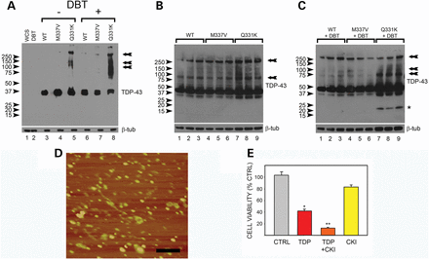
Figure 6. TDP phosphorylation by DBT promotes oligomerization and toxicity. Analysis under low detergent conditions ...
Notes:
Figure 6. TDP phosphorylation by DBT promotes oligomerization and toxicity. Analysis under low detergent conditions shows high-molecular-weight species (arrows) of TDP-43Q331K in addition to monomer, which are increased with DBT coexpression (A). Higher exposure (B and C) shows abundant high-molecular species for all genotypes. At this exposure, modest signal for cleavage products corresponding to the 25 kDa fragment is observed using extracts from dual DBT/TDP-43 transgenics (all forms). (D) AFM analysis of recombinant human TDP-43WT stirred overnight confirms the presence of abundant oligomers. (E) Recombinant oligomeric TDP-43 is toxic to SY5Y human neuroblastoma cells as assessed using a dye reduction assay (P < 0.05, ANOVA with Bonferroni's comparison; n = 4 biological replicates each. Pre-treatment of oligomeric TDP-43 with recombinant rat CKI approximately doubles its toxicity (P < 0.01 versus control), whereas CKI alone has no effect on SY5Y cells.
Unless provided in the caption above, the following copyright applies to the content of this slide: © The Author 2013. Published by Oxford University Press. All rights reserved. For Permissions, please email: journals.permissions@oup.com

